Slide 1
Welcome
Urban Risk Reduction
CDMP’s Strategy
Tuesday| May 06, 2014
Comprehensive Disaster Management Programme (CDMP II)
Ministry of Disaster Management & Relief

Slide 2
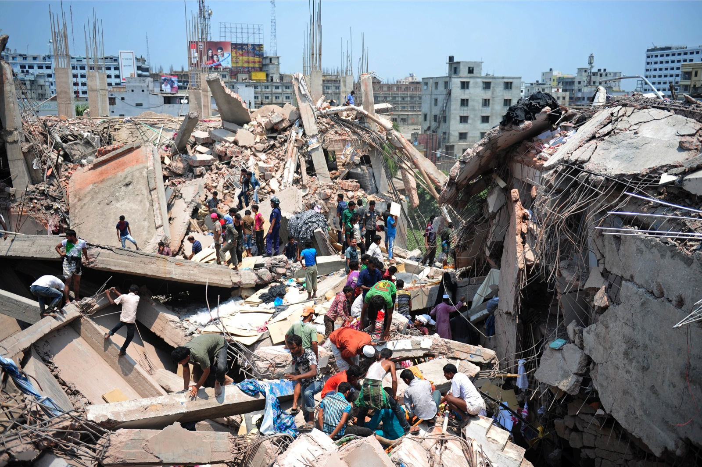
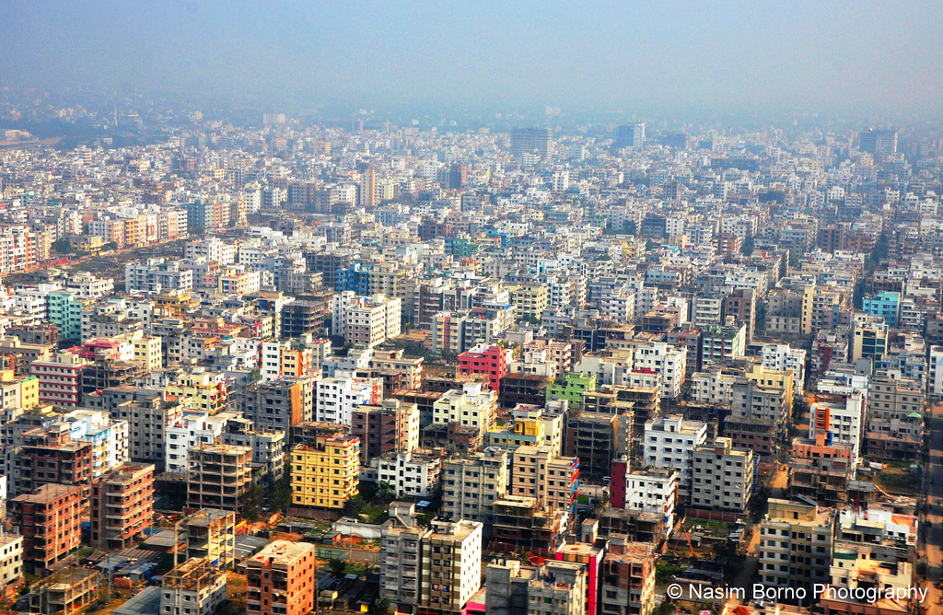
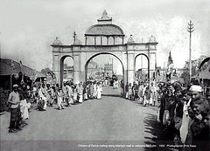
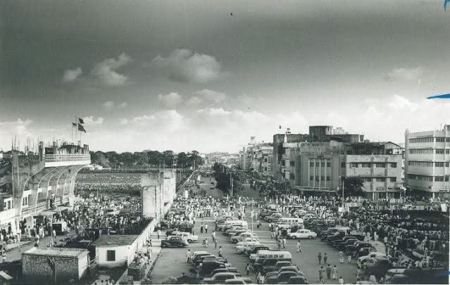
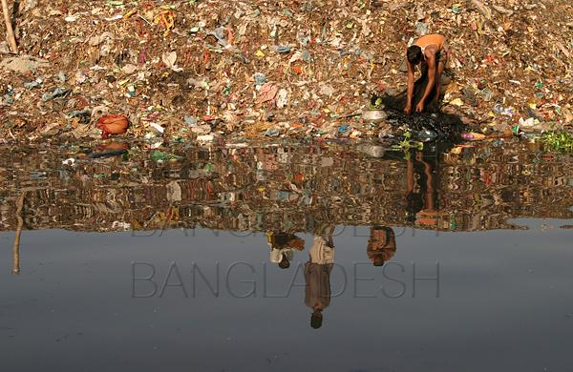
Cities Have always been our engines for growth
With urbanisation, migration, modernisation, they grow into megacities
But unplanned, uncontrolled unsafe……
They become deathtraps…….

Slide 3
CDMP’s
THREE-PRONGED
URBAN RISK REDUCTION
APPROACH
Seismic
Assessment
Capacity
building
Urban Risk
Assessment

Slide 4
Seismic Assessment
Micro zonation Mapping for cities:
CDMP conducted seismic micro zonation mapping for Dhaka, Chittagong and Sylhet during Phase I.
CDMP II is now scaling up this micro zonation mapping in Dinajpur, Rangpur, Rajshahi,Tangail & Mymensingh.
This maps will determine the vulnerability factor for all infrastructure, building, communication networks, life line, gas, electricity and water supply etc
Comprehensive Disaster Management Programme (CDMP II)
Ministry of Disaster Management & Relief

Slide 5
B. Risk Integrated Development Plan
CDMP II is developing a risk integrated development plan for Mymensingh district through Urban Development Directorate (UDD) .
This plan will cover the structural plan, urban/rural area plan, Action area plans and Disaster management plans.
Mymensingh district was selected as a pilot basis since the major fault line of the country crosses this district.
Comprehensive Disaster Management Programme (CDMP II)
Ministry of Disaster Management & Relief

Slide 6
C. Earthquake Contingency Plan
Three tier (Agency, City and National level) earthquake contingency plan developed to:
Identify the key resources to respond to the emergencies
Build and train emergency response team
Restore urban services for meeting the immediate needs.
Agencies covered:
Department of Disaster Management (DDM)
Directorate of Fire Service and Civil Defense (FSCD)
Armed Forces Division
Directorate General of Health service (DGHS)
Dhaka Power Distribution Company (DPDC)
Water Supply & Sewerage Authority (WASA)
Titas Gas Transmission and Distribution Company Limited (TGTDCL)
Bangladesh Telecommunication Company Limited (BTCL)
Comprehensive Disaster Management Programme (CDMP II)
Ministry of Disaster Management & Relief

Slide 7
National Earthquake Contingency Plan has been developed figuring:
Nine operations clusters focusing the command and coordination operations
Search, rescue and evacuation operations
Health services
Relief services
Shelter, water supply, sanitation and hygiene
Restoration of urban services
Transport
Security and welfare services.
Comprehensive Disaster Management Programme (CDMP II)
Ministry of Disaster Management & Relief

Slide 8
D. Sub Soil Investigation and Structural Assessment for Developing Retrofitting design
CDMP II conducted sub soil investigation and as built structural/foundation as well as architectural drawing towards seismic risk assessment and developing retrofitting design of 3 major buildings in Dhaka.
These buildings include Dhaka Medical College Hospital, Secretariat building 4 ( MoDMR) and Secretariat building 1 (Prime Minister’s Office)
The Assessment is in the final stage which will eventually be handed over to the Public Works Department and other relevant stakeholders
Comprehensive Disaster Management Programme (CDMP II)
Ministry of Disaster Management & Relief

Slide 9
Capacity Building
Urban & Community Volunteers
To further strengthen the emergency response in the country CDMP trained more than 26000 urban community volunteers on search and rescue operations
Trained 59 community based volunteers for disseminating landslide early warning messages
Trained 430 secondary and 1500 primary School teachers on earthquake safety.
Comprehensive Disaster Management Programme (CDMP II)
Ministry of Disaster Management & Relief

Slide 10
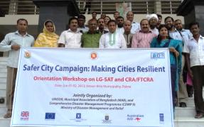
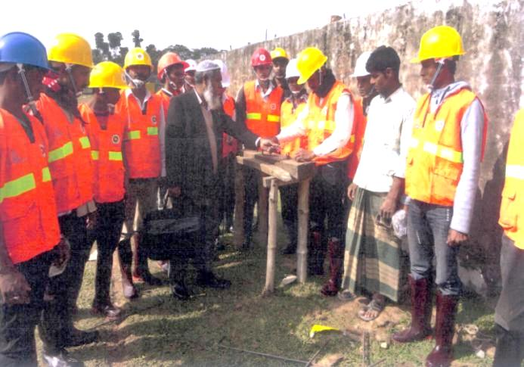
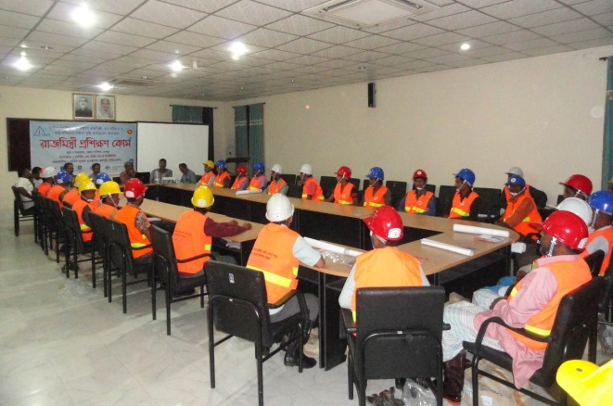
Capacity Building
B. Training of Mayors:
110 Municipal Mayors completed 4th Batch of training on Local Government –Self Assessment Tools (LG-SAT)
C. Training of Skilled workers
CDMP have trained 1,940 of targeted 2,000 construction(masons, bar binders and local contractors) workers trained on safety construction
D. Training of Imams
During Phase II, CDMP will train 600 imams on earthquake risk reduction
Comprehensive Disaster Management Programme (CDMP II)
Ministry of Disaster Management & Relief

Slide 11
Equipment support to reduce Urban Risk
Heavy equipment (viz crane, pilot transporter, bull dozer, excavator, forklift, emergency light, light equipment such as camera, airlifting bags, rescue jack, two wheeler water mist system etc worth BDT 18 crore) have been handed over to FSCD through DDM
Comprehensive Disaster Management Programme (CDMP II)
Ministry of Disaster Management & Relief

Slide 12
School Earthquake Safety Drills
CDMP Conducted earthquake drills in 12,000 secondary and 30,000 primary schools all over the country .
This earthquake drills are a continuous process and conducted twice a year especially in the Earthquake Prone cities of the country.
The initiative is implemented jointly with the ministry of primary and mass education
CDMP also procured drill items for 1168 schools
Advocacy is going on to include drills in the school curriculum.
Comprehensive Disaster Management Programme (CDMP II)
Ministry of Disaster Management & Relief

Slide 13
Urban Risk Assessment
CDMP II have facilitated Urban Risk Assessment (URA) in 3 wards of Dhaka North City Corporation and also developed Risk Reduction Action Plan (RRAP)in collaboration with Actionaid Bangladesh.
Have developed a Facilitators guidebook on conduction of URA
Is in the process of Scaling up to conduct this URA in 22 more wards of 12 City Corporations/Municipalities in 11 Major District
Comprehensive Disaster Management Programme (CDMP II)
Ministry of Disaster Management & Relief

Slide 14
Name of Municipality | Interventions | Cummulative Progress
Gopalgonj Municipality (P-I) | Implementation of Disaster Resilient Resettlement Housing Complex at Madartola (100 unit DRH) | 100% (project complete)
Chittagong City Corporation (2) - Mahesh Khal | Reduce urban disaster risks from water logging through the construction of RCC Retaining Walls and Re-excavation of Mohesh Khal from Police Line Boundary Wall to CDA Road No. 9 near Bangabandhu Bridge | 56%
Chittagong City Corporation (1) - Bahaddarhat | Consturction of U-Channel, Box-Culvert, Guard Wall, Footpath, Catchpit & Re-Excavation of Khal at Chemon ara Bridge to Bahaddarhat khal Parallel to CDA Avenue as per Drainage Master plan under Chittagong City Corporation, Chittagong; Package no. 01, 02, 03, 04 & 05. | 88%
Mymensingh Municipality | Reduce urban disaster risks from water logging through the construction of drainage in Ward 15 & 19. | 98%
Gopalgonj Municipality (Phase II) | Implementation of Disaster Resilient Resettlement Housing Complex at Madartola (160 unit DRH) | 20%
Chalna Municipality | New RCC drain beside Tohsil Office (Ward 3) at Chalna Municipality | 20%
CoxsBazar Municipality | Facility Improvement for community people beside temple on top of Zadipahar | 30%
Sylhet City Corporation | Reduce urban disaster risks of flooding through RCC U Drain and Re-excavation of Khals/Choras namely as Holdi Chora, Malni Chora, Guali Chora and Dhupa Chora under Sylhet City Corporation | 40%
Swandip Pouroshova | Construction of 1300m. U-Type open Drain from Enam Nahar to Saner hat under Sandwip Pourashava | Signing money issued
Alamdanga Pouroshova | Canal re-excavation of canal and side road for walkway | Signing money issued
Comprehensive Disaster Management Programme (CDMP II)
Ministry of Disaster Management & Relief

Slide 15
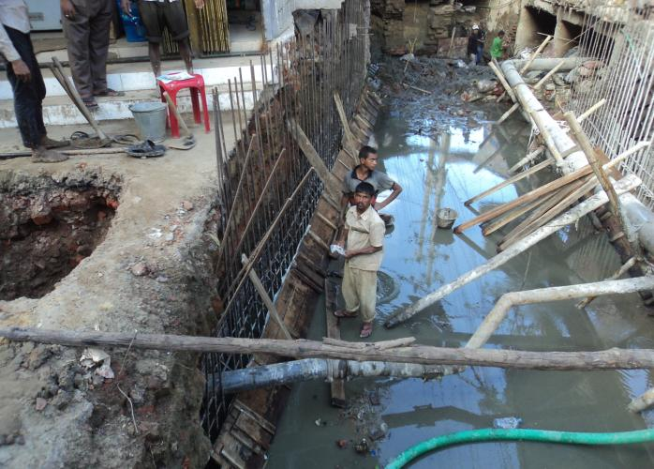
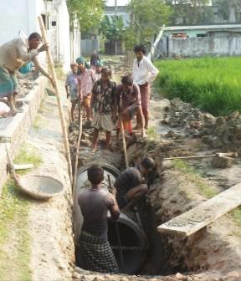
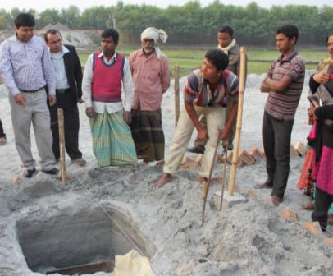
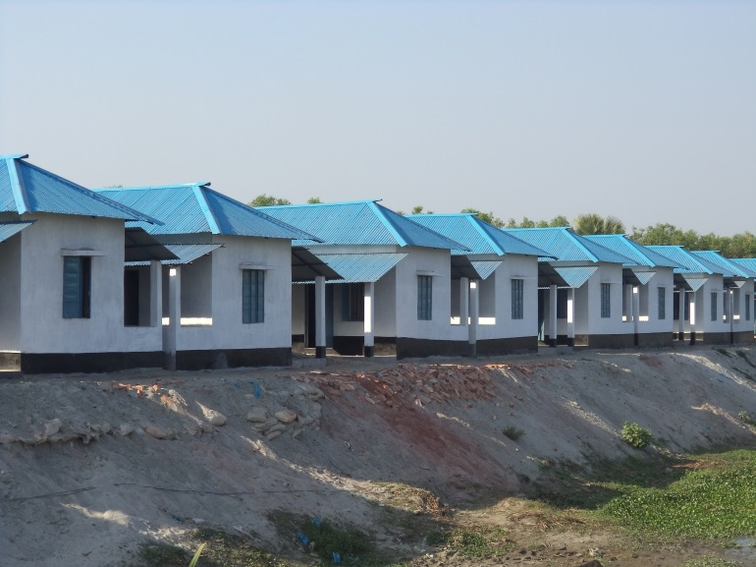
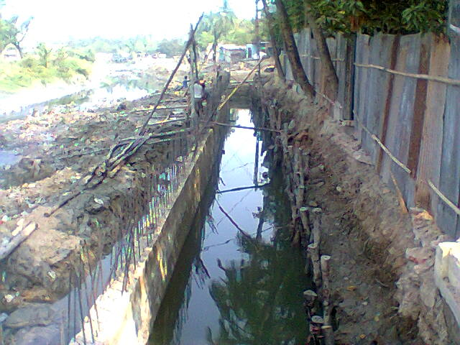
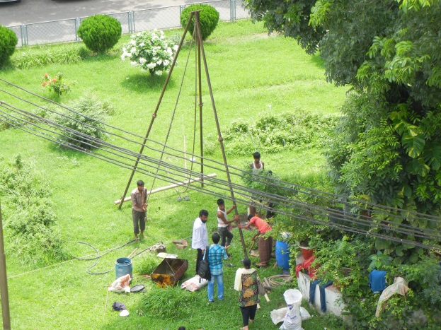
Comprehensive Disaster Management Programme (CDMP II)
Ministry of Disaster Management & Relief

Slide 16
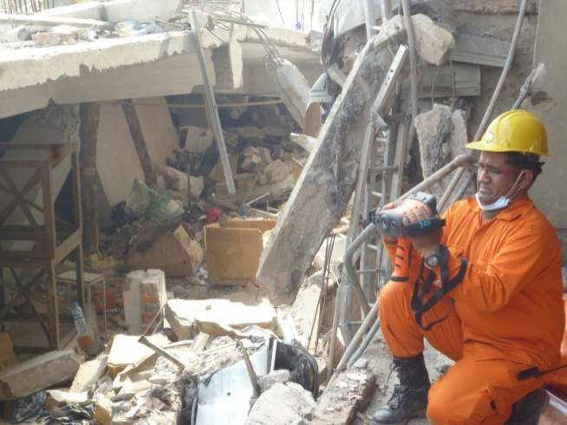
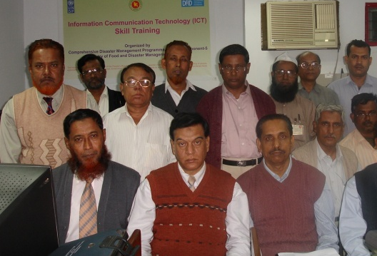
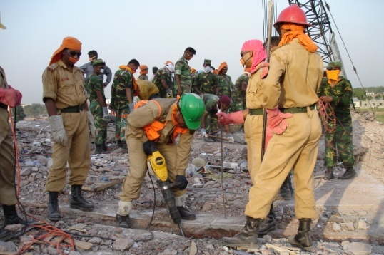
REAFFAIRMING CDMP URBAN RISK REDUCTION PRIORITIES - in light of recent urban disasters
Comprehensive Disaster Management Programme (CDMP II)
Ministry of Disaster Management & Relief

Slide 17
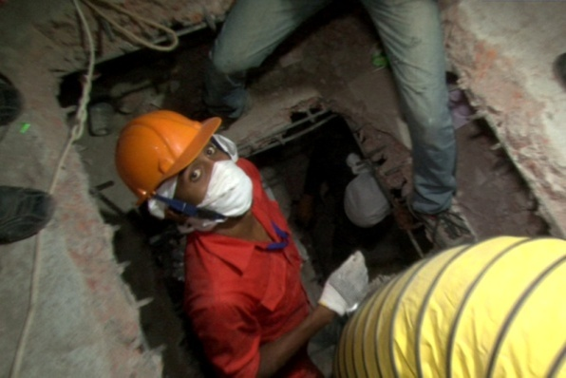
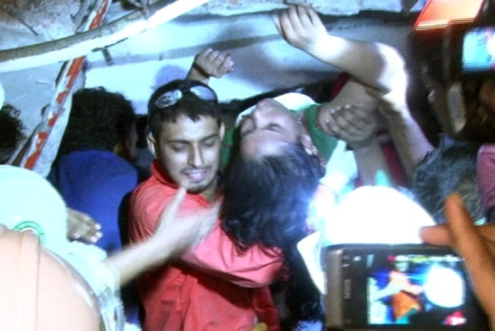
RANA PLAZA: THE LESSONS
CDMP investment payoff:
Deployment and coordination of trained rescuers from FSCD and allied professionals
Trained urban volunteers (around 600)
Use of equipment
Appropriate search-and-rescue
methodologies
Policy and awareness imperatives:
Implementation of Building Code
Retrofitting capacity improvement
Fire and building safety awareness
Comprehensive Disaster Management Programme (CDMP II)
Ministry of Disaster Management & Relief

Slide 18
Thank you
For more information contact: Comprehensive Disaster Management Programme (CDMP II) United Nations Development Programme (UNDP) Department of Disaster Management Bhaban (6th Floor) 92-93 Mohakhali C/A, Dhaka-1212, Bangladesh, Tel: (+88 02) 989 0937, 882 1255
Photo: Otin Dewan/CDMP
Comprehensive Disaster Management Programme (CDMP II)
Ministry of Disaster Management & Relief

