Slide 1

Engineering Geological Survey and Related Others Work in Rural Parts of MSDP Project Area
Environmental & Geospatial Solution (EGS)
Presented by
Fansab Mustahid
Coordinator
Environmental & Geospatial Solution (EGS)

Slide 2
Purpose of the Geological Work
Determine subsurface soil condition of the project area. For example soft, dense or stiff soil.
Identify Subsurface layer up to depth 30m.
Seismic Hazards Assessment.

Slide 3
Methodology
Seismic wave
Geophysical
Down-hole Seismic Test (PS Logging)
Multi-channel Analysis of Surface Wave (MASW)
Geotechnical
Standard Penetration Test (SPT)
Microtremor Survey

Slide 4
Geophysical & Geotechnical Data Acquisition in Field
SL No. | Survey/ Test Name | Numbers of Test
1 | Down-hole Seismic test (PS Logging) | 15
2 | Multi-Channel Analysis of Surface Wave (MASW) | 25
3 | Single Microtremor Survey | 40
4 | Microtremor Array | 4
5 | Standard Penetration Test (SPT) | 70

Slide 5
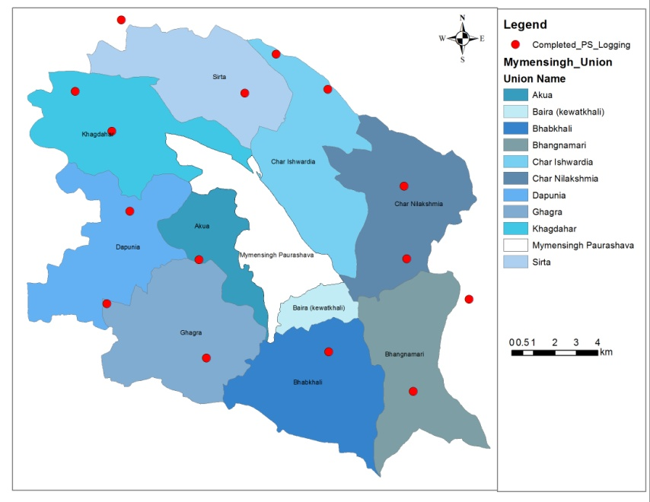
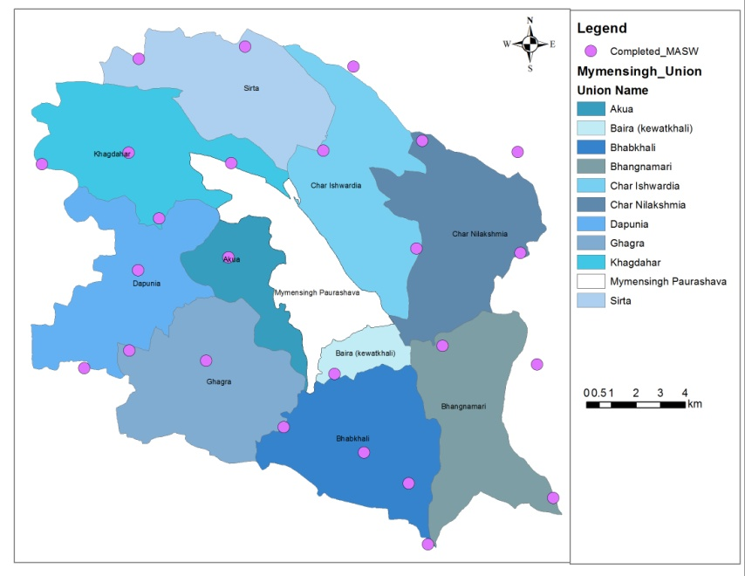

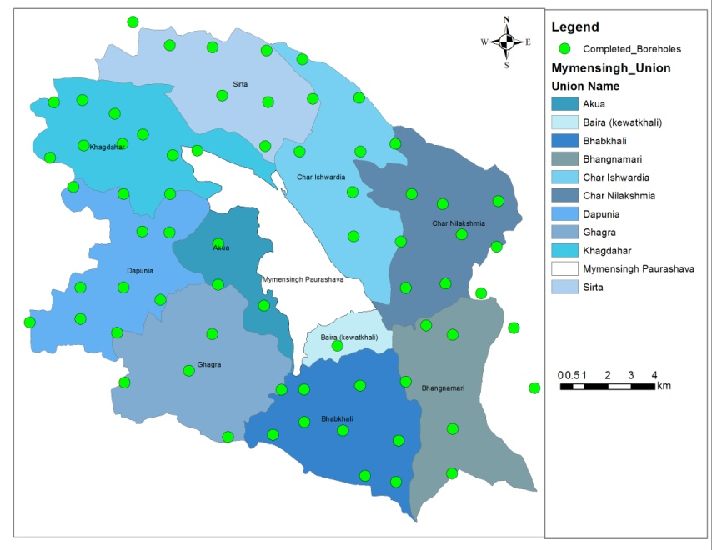
PS Logging Test
MASW
Microtremor Test
Standard Penetration Test

Slide 6

All Test Locations

Slide 7
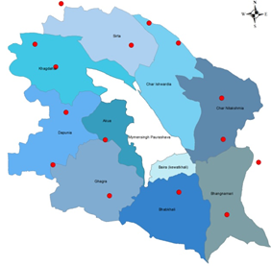
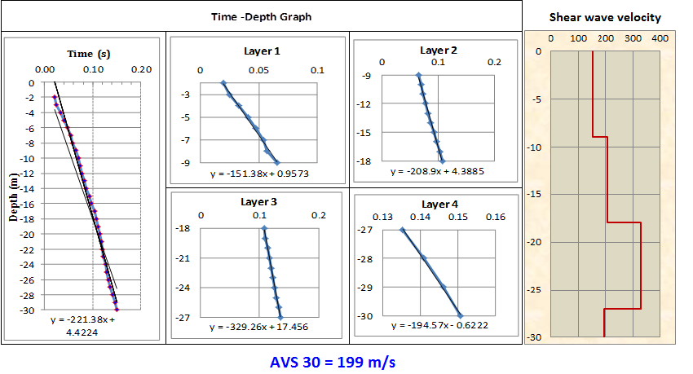
PS Logging Test Result
Test ID : PS-Akua-09
Location : Modhobarra, Akua
Lat- 24°43'32.006"N
Long- 90°22'56.175"E
AVS 30 199 m/s

Slide 8
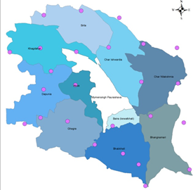
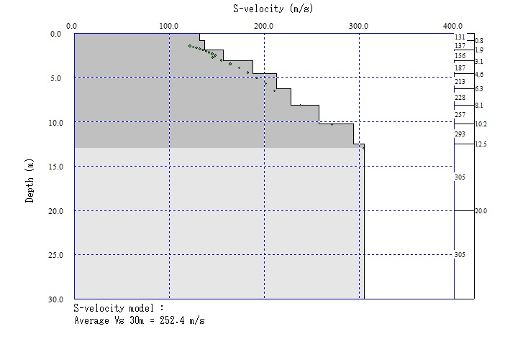
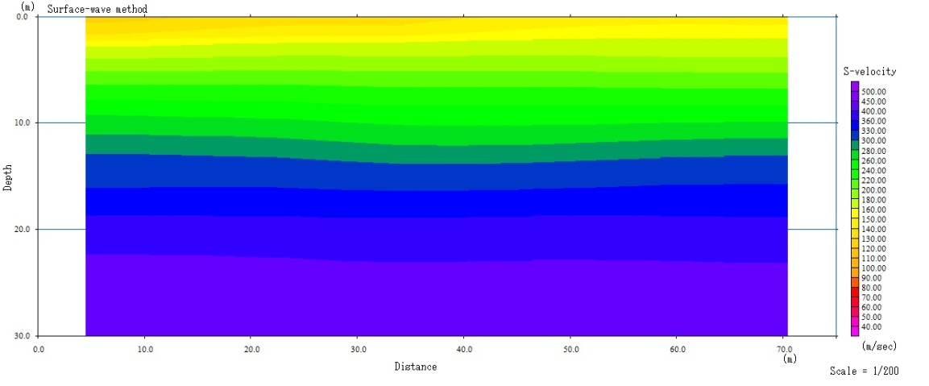
MASW Survey Result
AVS 30 252.4 m/s

Slide 9
Single Microtremor Survey Result
Survey Id : MT 18
Location : Morolpara, Akua
Lat- 24°44'37.3"N
Long- 90°23‘38.3"E
Result:
Peak Amplitude: 1.88
Peak Period: 0.79 sec

Slide 10
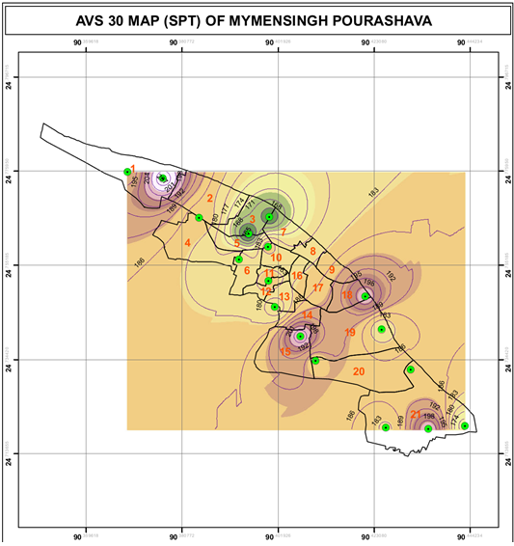
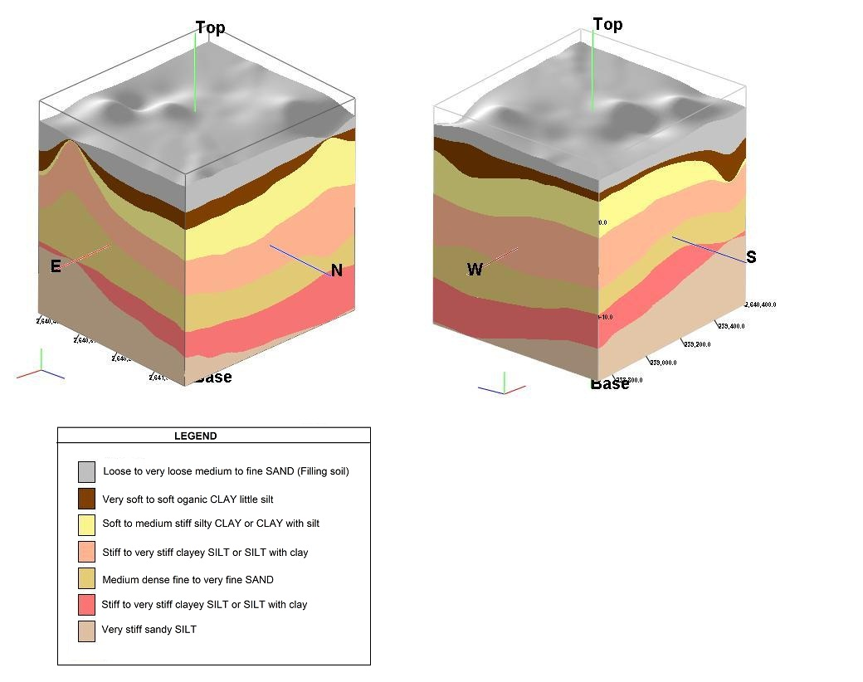

Output: Engineering Geological Map Base on AVS 30

Slide 11
Preparing Hazard Map
MSDP Project Area

Slide 12
Necessary Data for preparing Hazard Map
Previous Earthquake History ( Last 100 years).
Fault Mechanism and identifying earthquake source zone.
Source to site distance.
Description of the local site conditions

Slide 13
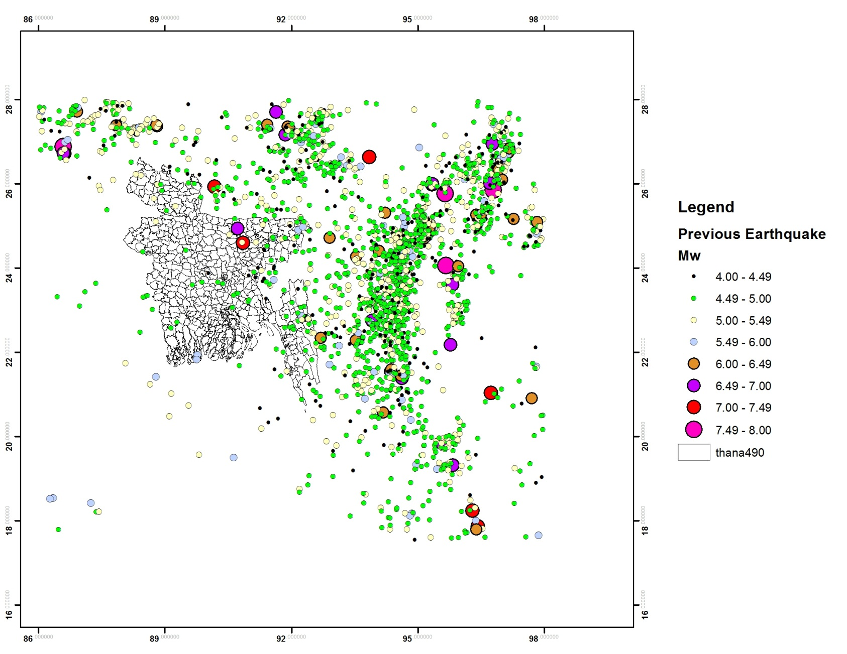
Previous Earthquake History ( Last 100 years).
Fault Mechanism and identifying earthquake source zone.
Source to site distance.
Description of the local site conditions
Source:
US Geological Survey(USGS)
International seismological Centre (ISC)
Bangladesh Meteorological Dept. (BMD)

Slide 14
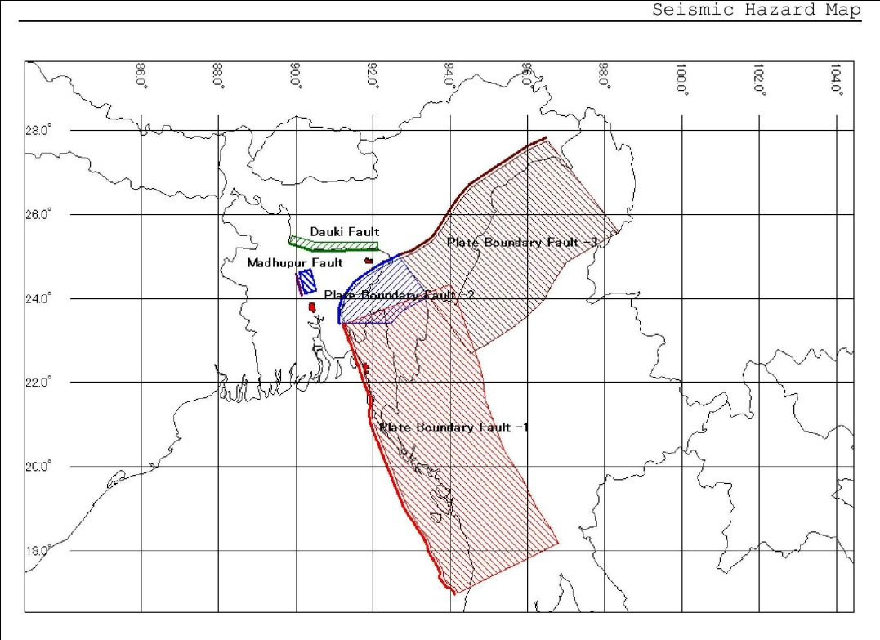
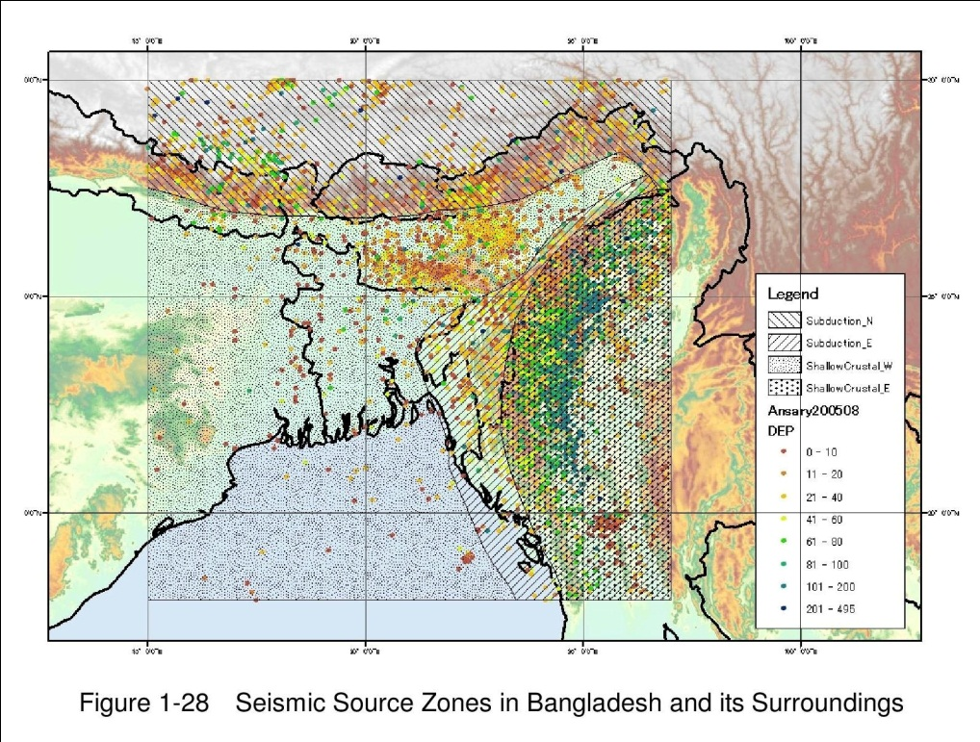
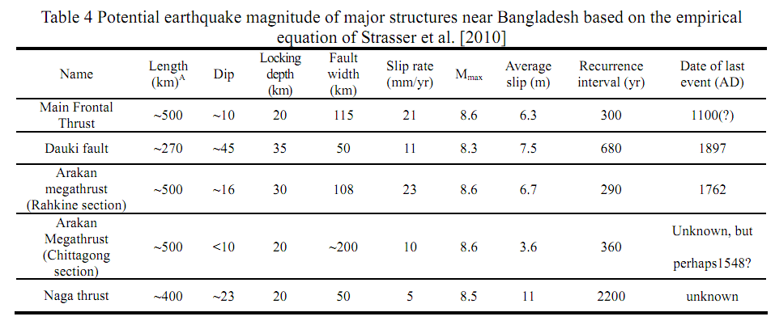
Previous Earthquake History ( Last 100 years).
Fault Mechanism and identifying earthquake source zone.
Source to site distance.
Description of the local site conditions
Source:
CDMP report Seismic Hazard Assessment of Dhk, Chg, Syl.2009.
CDMP report Active tectonic features, 2012

Slide 15
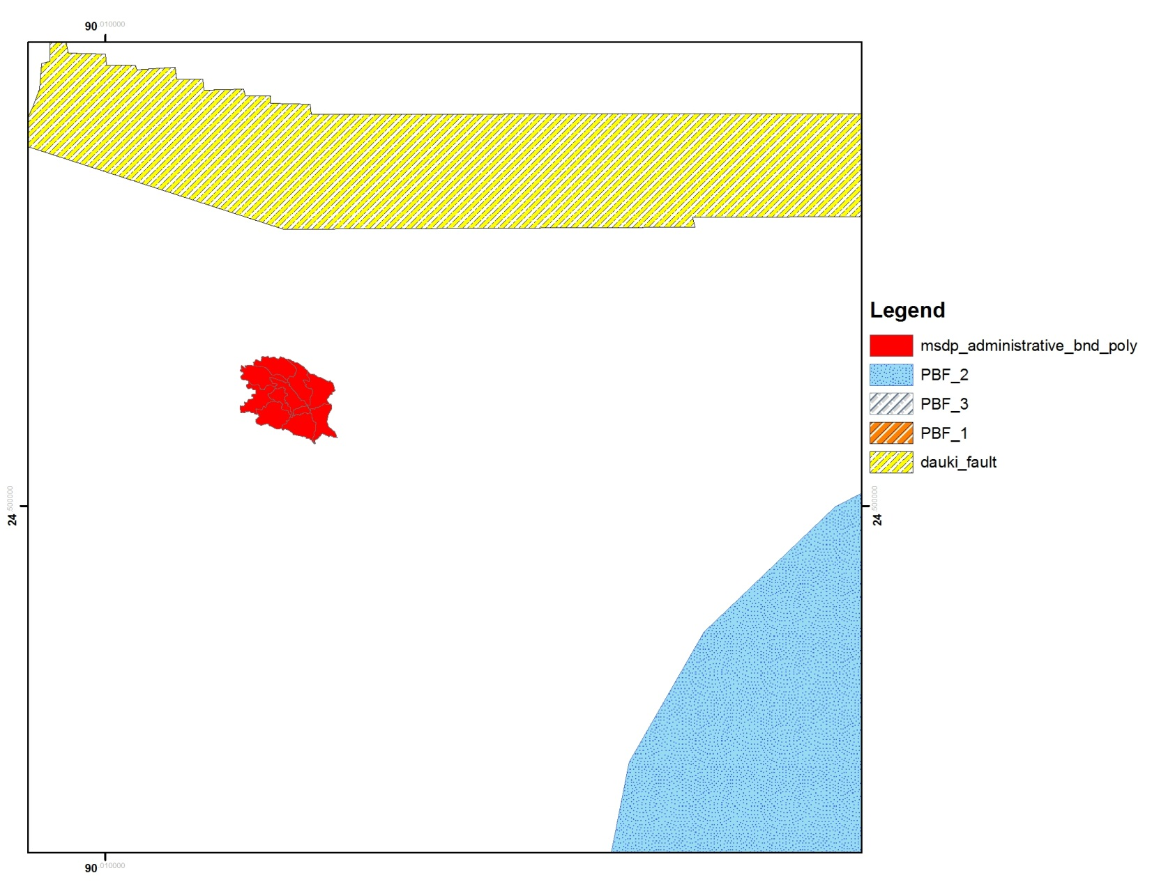
Previous Earthquake History ( Last 100 years).
Fault Mechanism and identifying earthquake source zone.
Source to site distance.
Description of the local site conditions
Dauki Fault
35km
95km (Appx.)
PBF-2

Slide 16
Previous Earthquake History ( Last 100 years).
Fault Mechanism and identifying earthquake source zone.
Source to site distance.
Description of the local site conditions

Slide 17
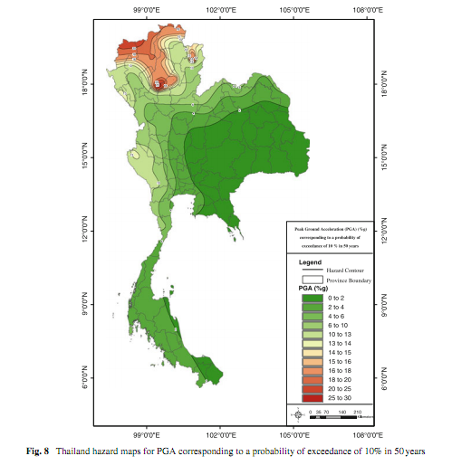
Finally Integrated all those Primary and secondary Data by using GIS , Rockwork and Crisis 2007 Software, we will get seismic hazard map of the project area.
Example:

Slide 18
Thank You All

