Slide 1
Knowledge taping between Government and academia Interfacing between Architecture and Planning through Urban design studio
Department of Architecture
Ahsanullah University of Science and Technology
www.aust.edu

Slide 2
Schedule
Meeting with UDD about detail area plan of Mymensingh city, 15.10.2014
Students initial presentation about different issues of Mymensingh city, Date 14.10.2014 & 16.10.2014
Presentation of UDD at AUST, Date 18.10.2014
Site survey and interactive sessions, Date 20.10.2014 to 24.10.2014
Students presentation, Date 28.10.2014
Presentation for Mayor, Date 29.10.2014
Students presentation, Date 01.11.2014
Students presentation, Date 08.11.2014

Slide 4
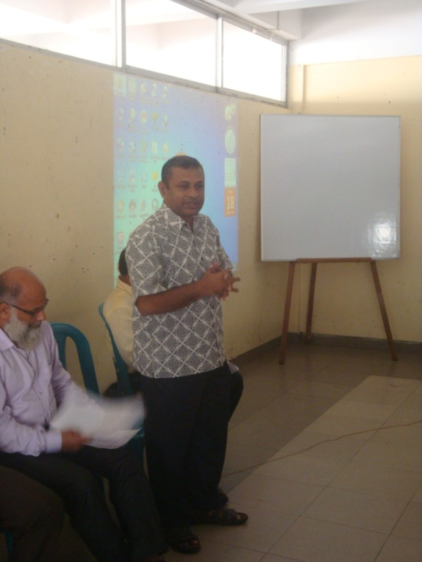
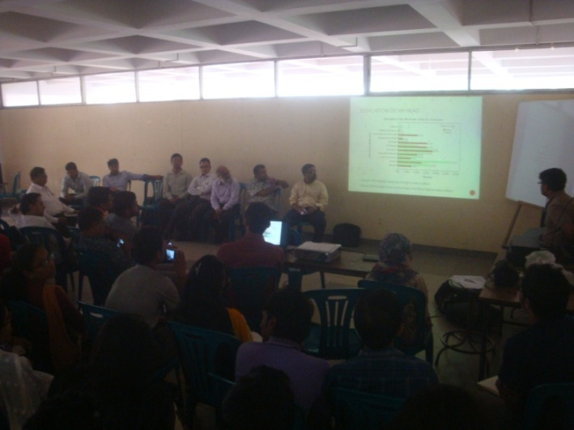
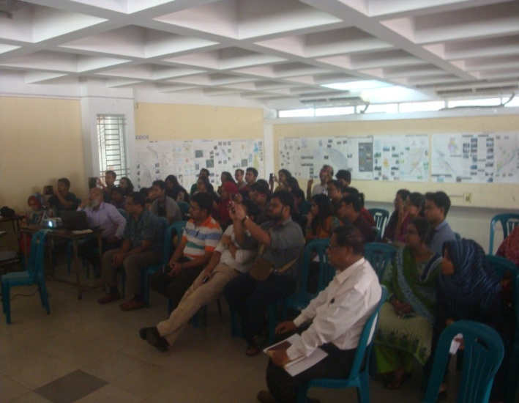
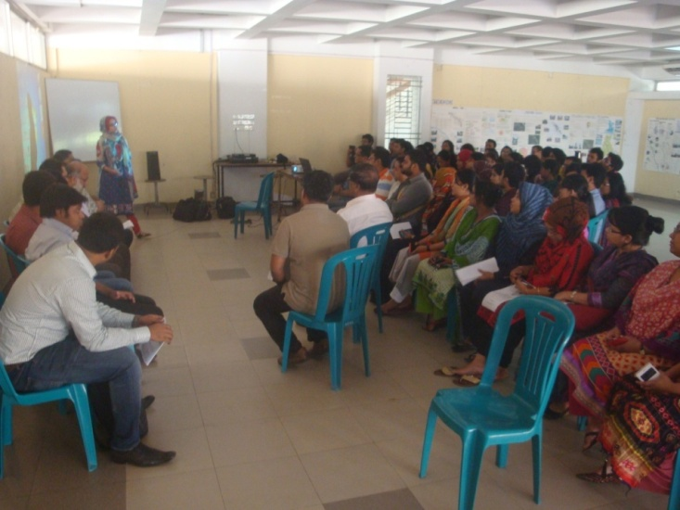
Presentation of UDD at AUST, Date 18.10.2014
Dr. M A Muktadir, head, Department of Architecture, AUST, sharing his views with UDD members
UDD Project Director Dr. Taufique presenting his lectures

Slide 5
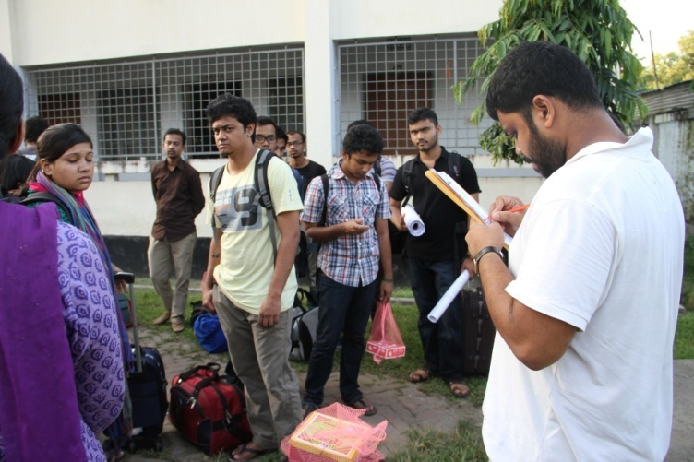
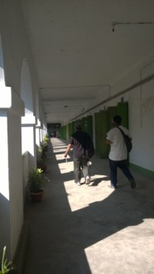
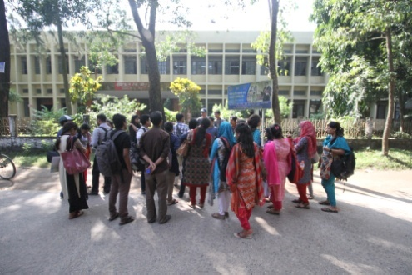
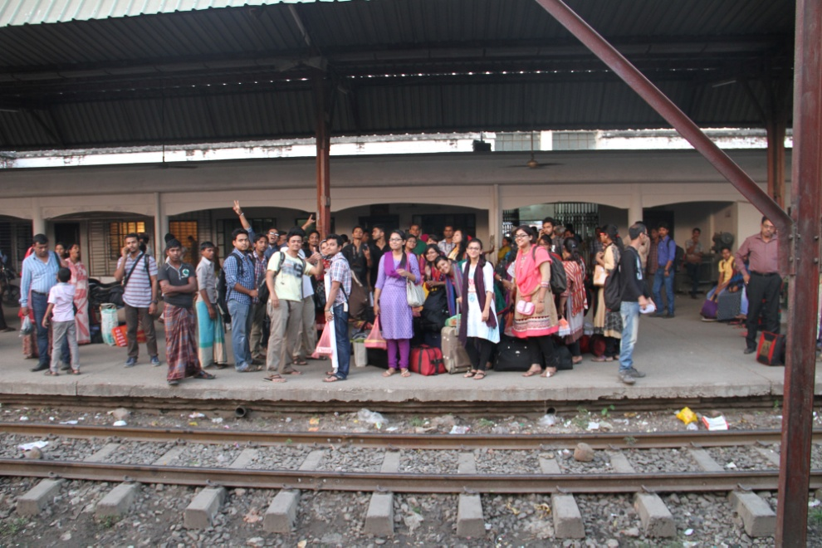
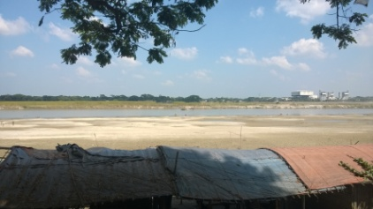
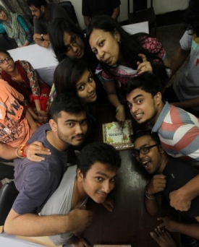
Site survey and interactive sessions, Date 20.10.2014 to 24.10.2014

Slide 6
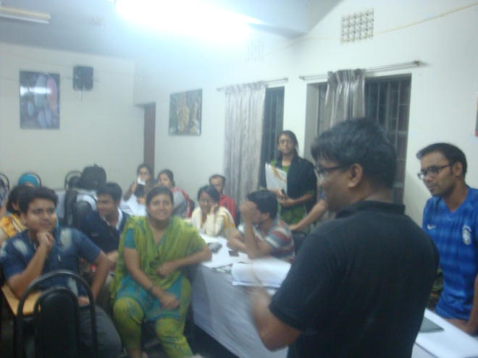
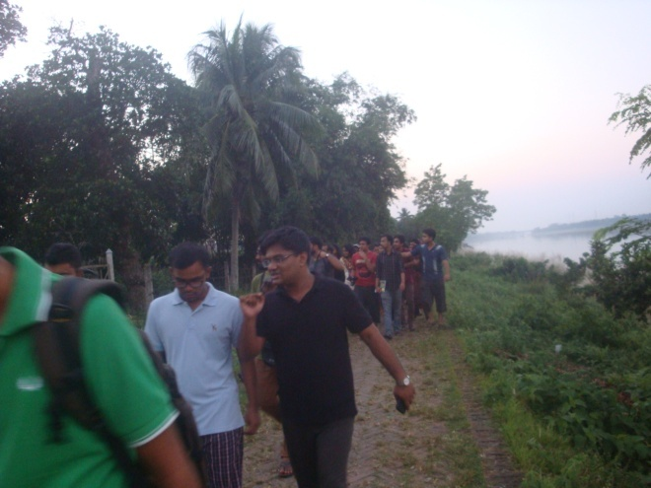
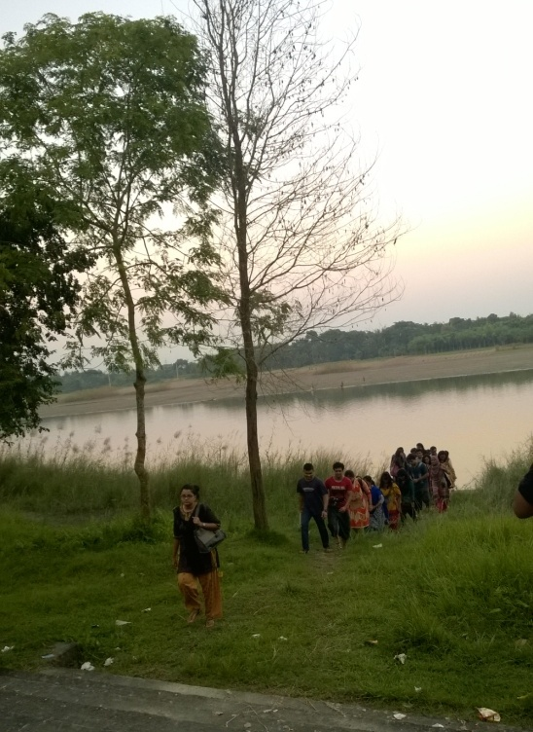
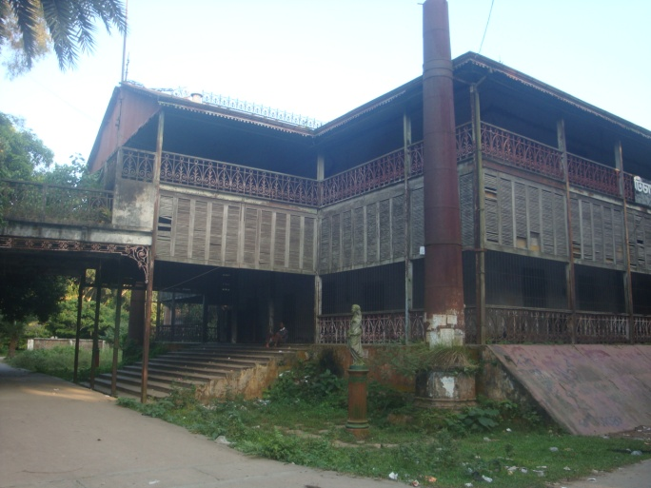
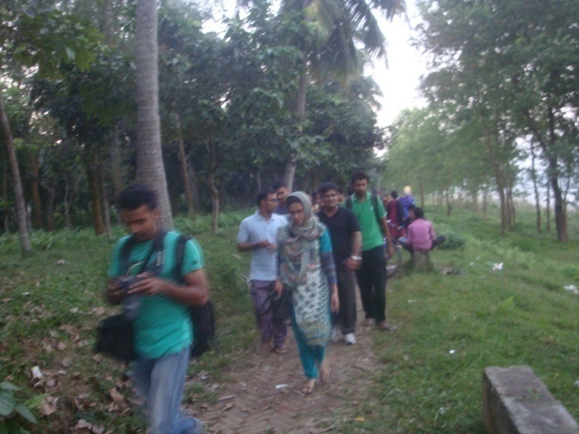
Site survey and interactive sessions, Date 20.10.2014 to 24.10.2014

Slide 7
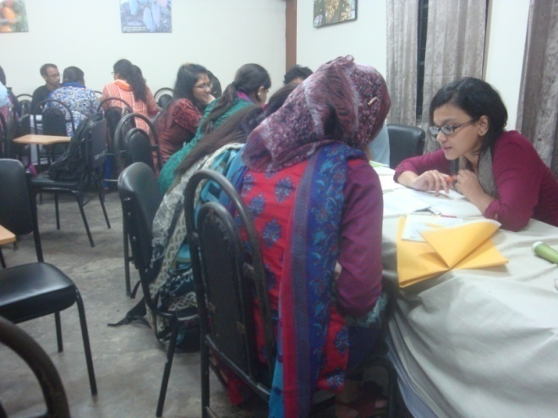
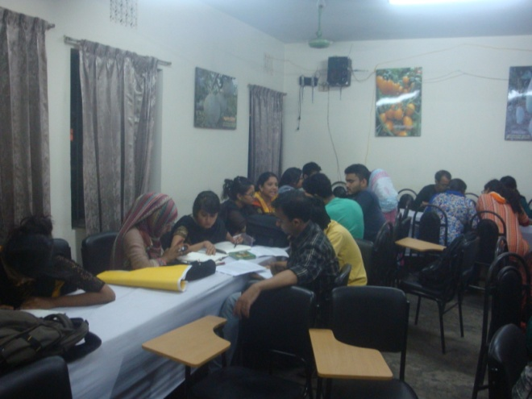
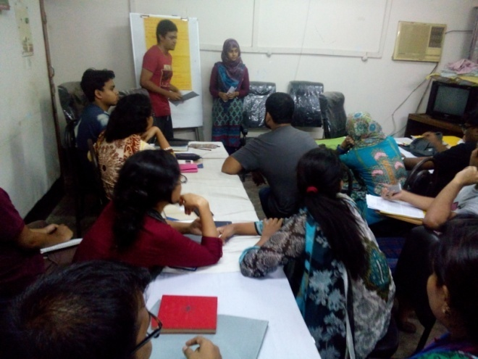
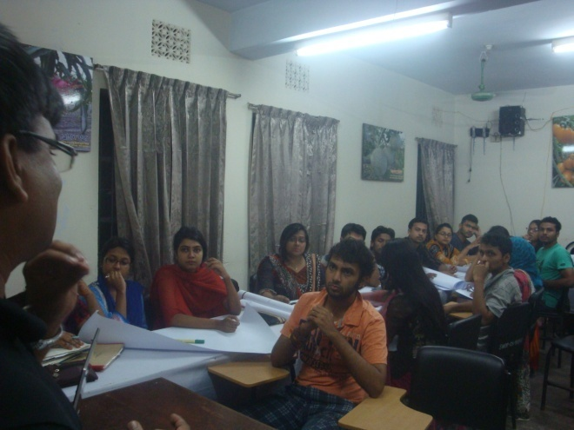
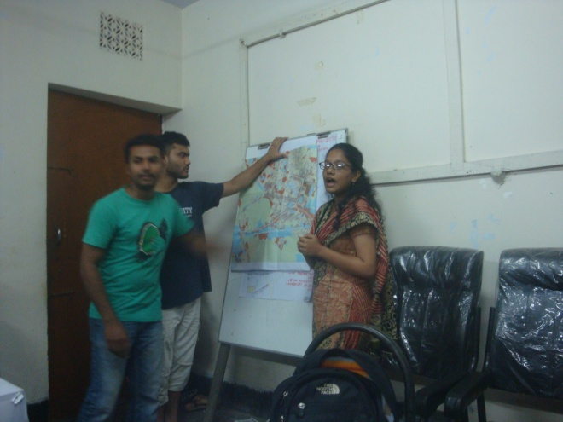
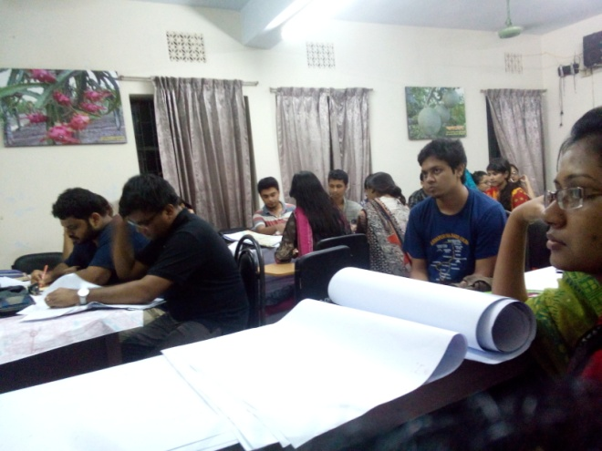
Site survey and interactive sessions, Date 20.10.2014 to 24.10.2014

Slide 8
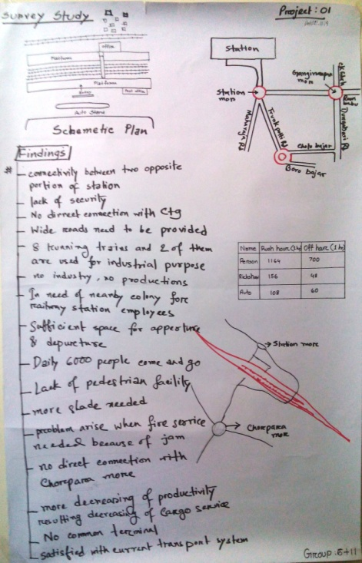
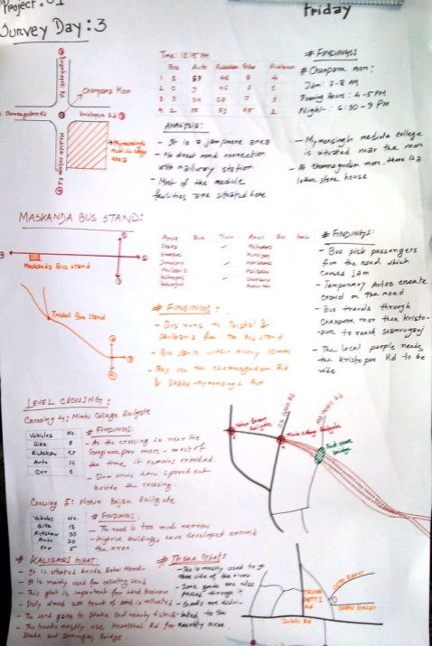
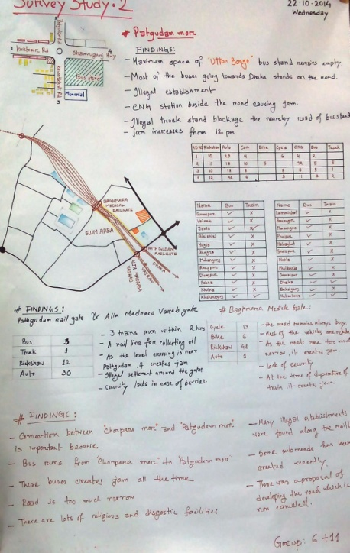
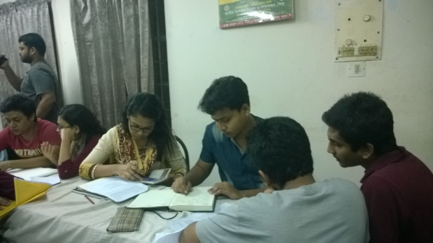
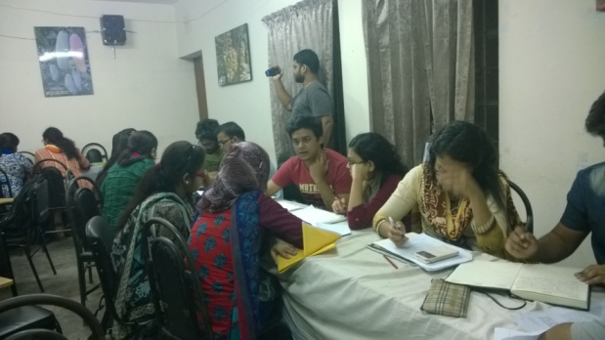
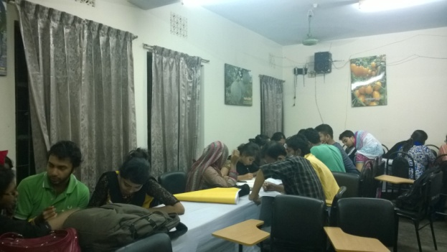
Some output of survey interactive sessions

Slide 9
Project 01
Redesign of Mymensingh central railway station area as a multimodal transportation hub

Slide 10
Project 01 Redesign of Mymensingh Central Railway Station Area as a Multimodal Transportation Hub
In last few decades, specially since 1980s the city of Mymensingh has faced rapid urbanization. The railway station which was once built in the outskirt is now located at the middle of the city and it divides the city into two segments. There are several level crossings throughout the city that hampers the smooth connectivity through road network. This station has a great potential to work as multimodal transport hub. The project is perceived to transform the railway station as a well-designed, carefully integrated into the urban fabric of the city, and sensitively connected into the transport systems of the city and region and thus make it playa major role as a multimodal transport hub that could become critical asset in spurring on the revitalization of Mymensingh.
This project is carried out by studying the surrounding area of the railway station in terms of land use, transportation network, infrastructure and urban services, demographic information etc. in order to understand the setting of the station. Then problems and conflicts are identified and feasible solutions are searched. Solutions are considered to address the present problems and have a vision of 20 years ahead. This project is envisaged to perform as a well-functioning integrated transport system that supports a growing economy and improve accessibility and efficiency of the city's resources and opportunities for all.

Slide 11
Project 1: Redesign of Mymensingh Central Railway Station Area as a Multimodal Transportation Hub
Contextual study
Land use
Conflict analysis
Land use conflict
Intervention scope policy formulation
Physical planning proposal
Detail design
Efficiency
Infrastructure
Urban services
Transportation
Recreational
Religious, education, health facilities
Time-space
Earthquake
Demography
Need/availability of infrastructure and services
Stakeholders' interest
Rules, regulations
Residents desire
Social/cultural
Social/economical
Urban structure
Ethnic conflict
Policy environment, politics
Rules, regulation
Resource constraints
Extent of modification
Urban functionality
Implementation strategy
Feasibility
Residents’ acceptance
Transportation mode, validation
Traffic management
Sustainability
Transportation network, coverage, comfort, cost
Environmental sensitiveness
Revenue generation
Population density
Legal and policyy framework
Playsical planning
Rules and regulation
Earthquake
Building information
Heritage structures

Slide 12
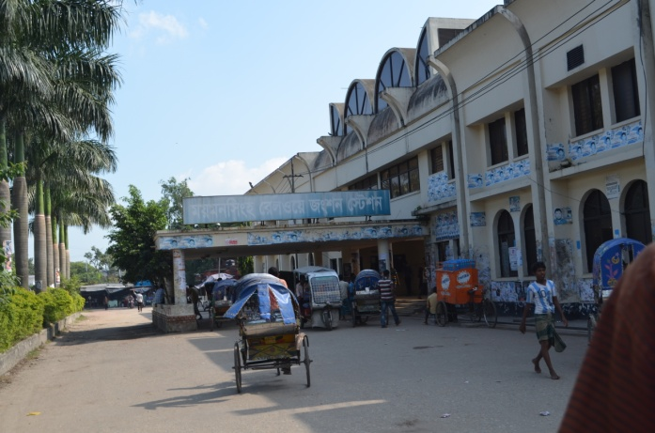
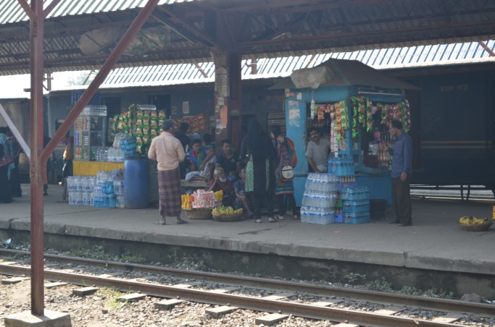
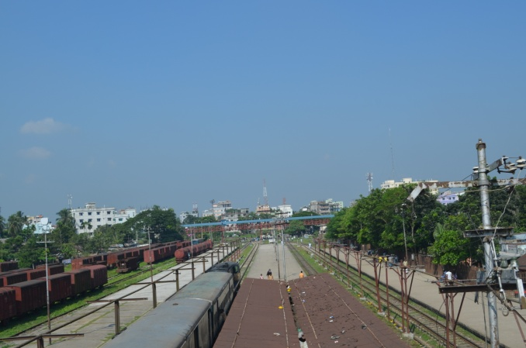
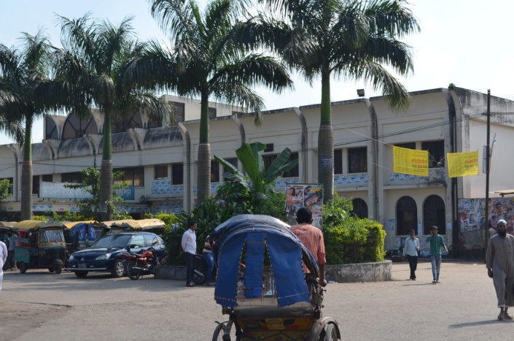
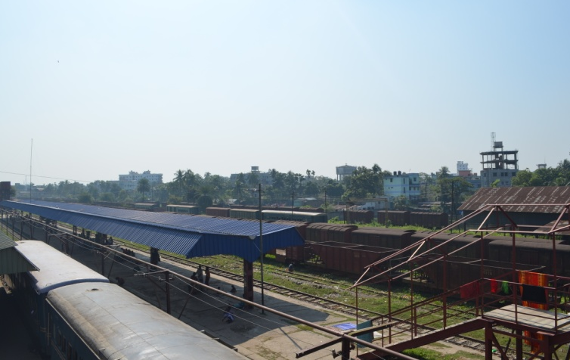
Project 01: Redesign of Mymensingh Central Railway Station area as a multimodal transportation hub.
Survey
Railway station and its surroundings

Slide 13
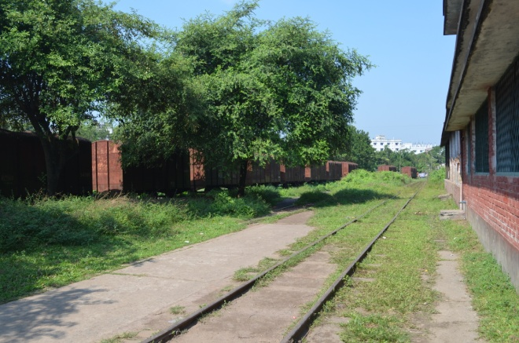
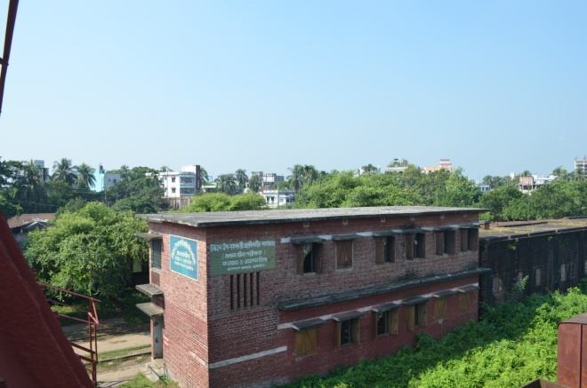
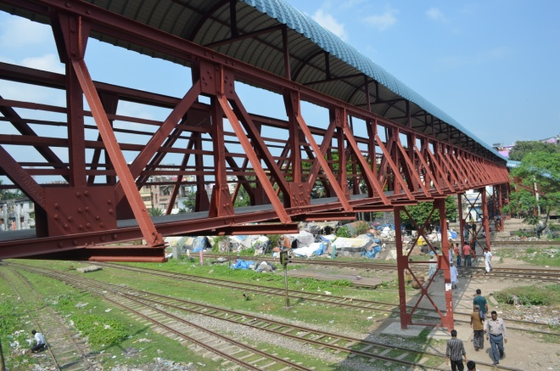
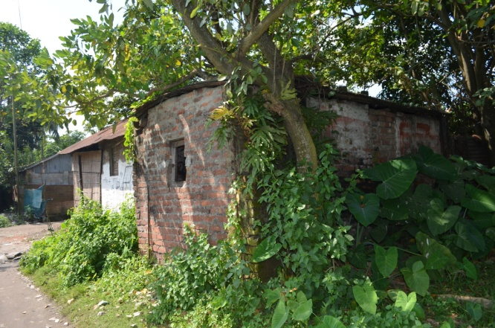
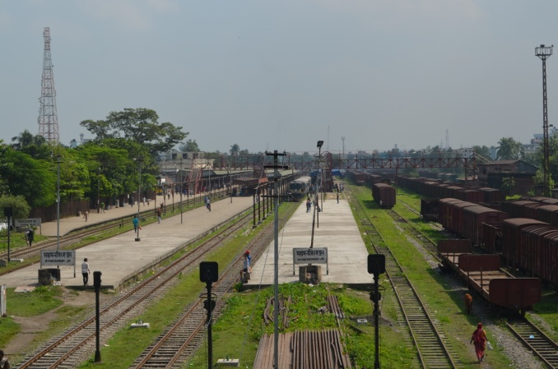
Project 01: Redesign of Mymensingh Central Railway Station area as a multimodal transportation hub.
Railway station and its surroundings

Slide 14
Survey findings presentation (Date 01.11.2014)

Slide 15
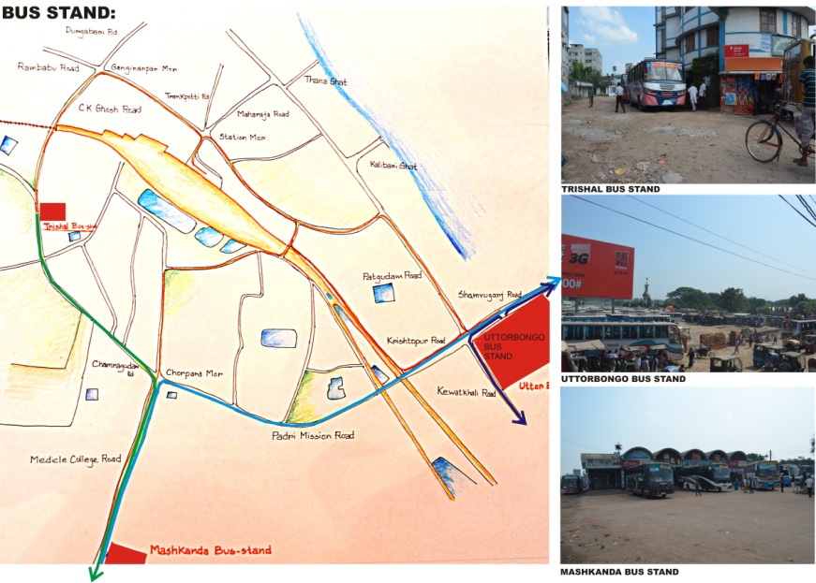
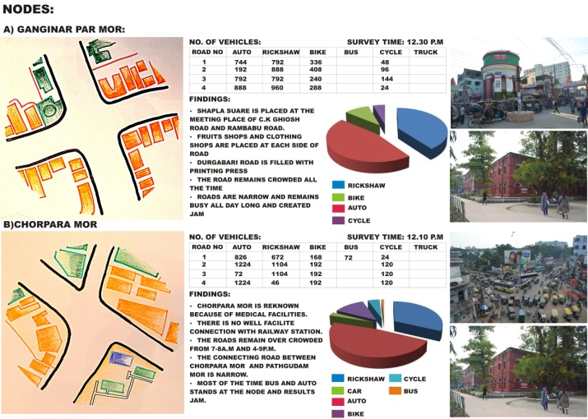
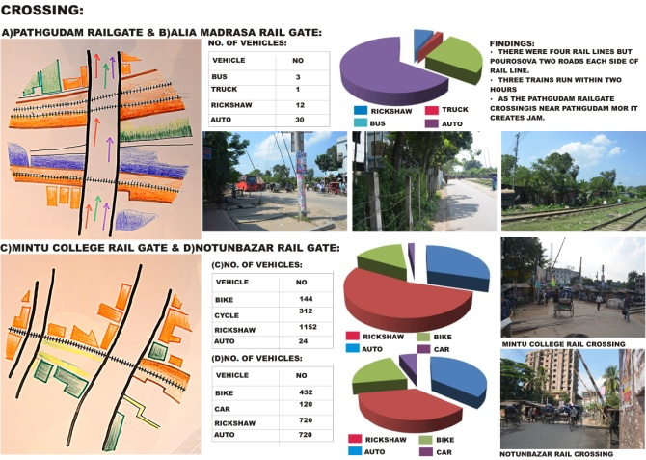
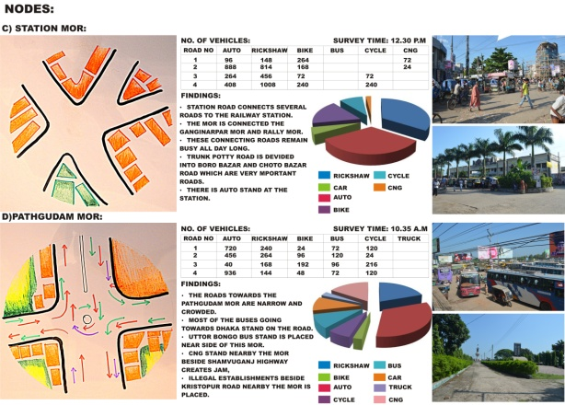
Survey findings presentation (Date 01.11.2014)

Slide 16
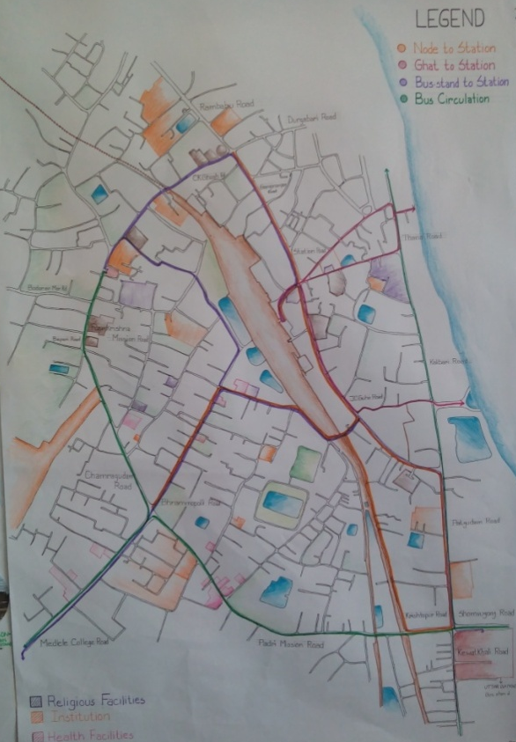
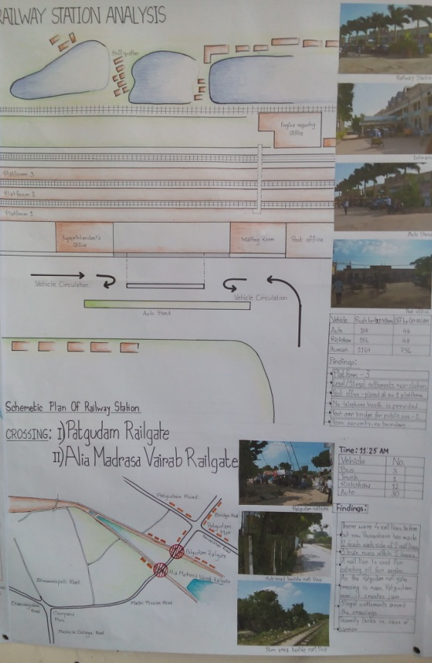
Survey findings

Slide 19
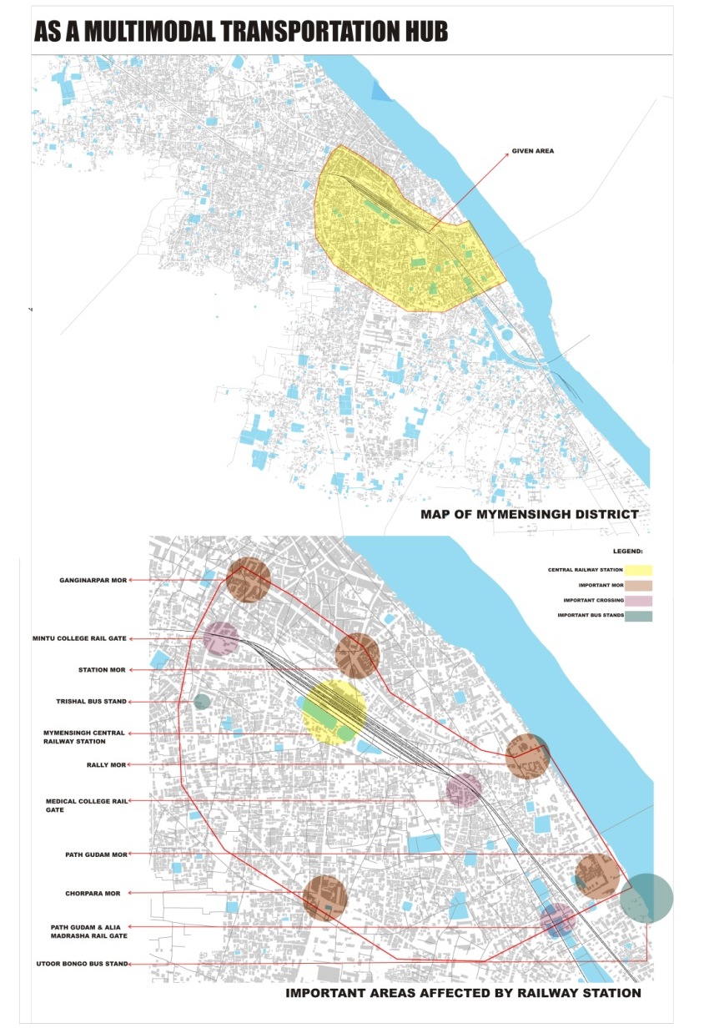
Survey findings presentation (Date 08.11.2014)

Slide 20
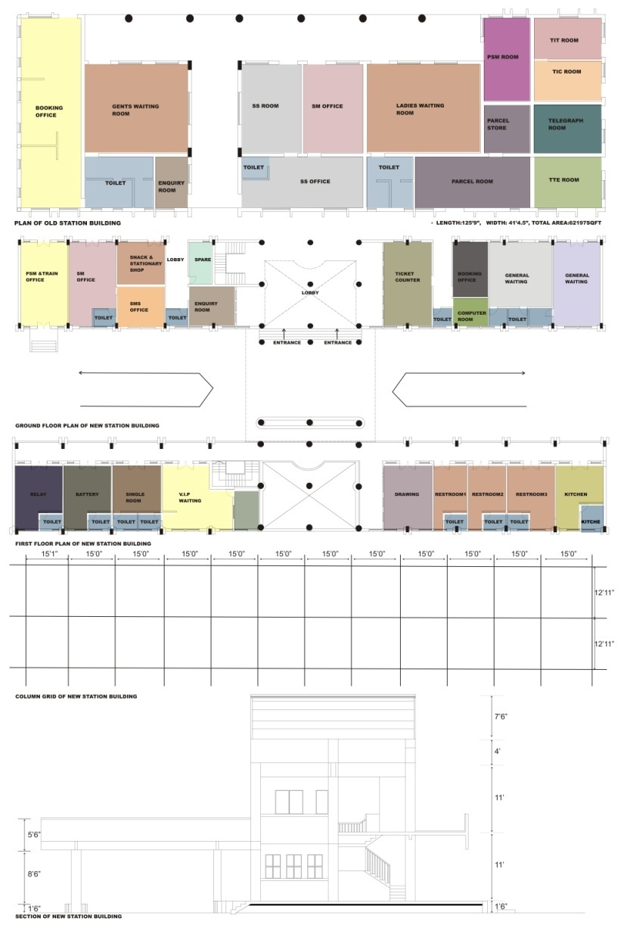
Survey findings presentation (Date 08.11.2014)

Slide 21
Survey findings presentation (Date 08.11.2014)

Slide 22
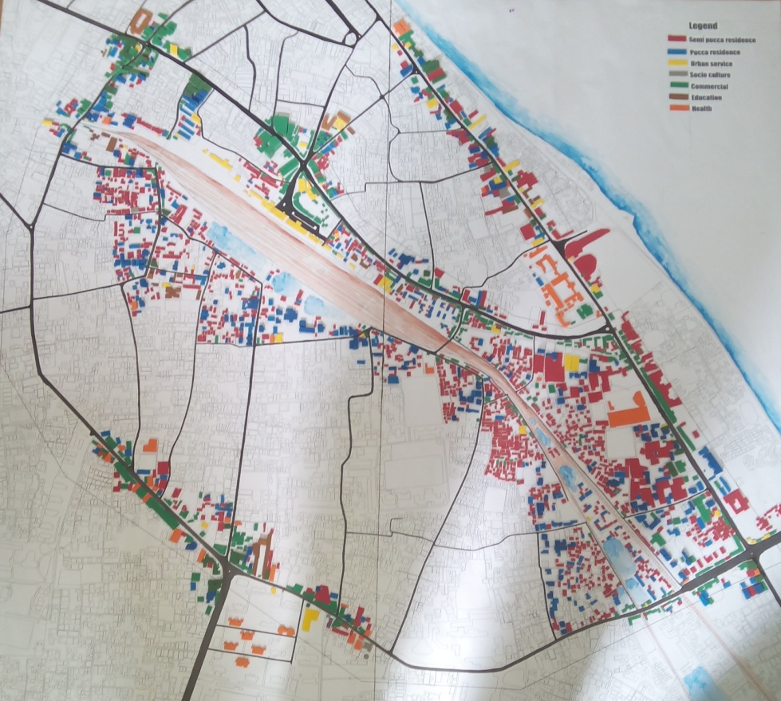
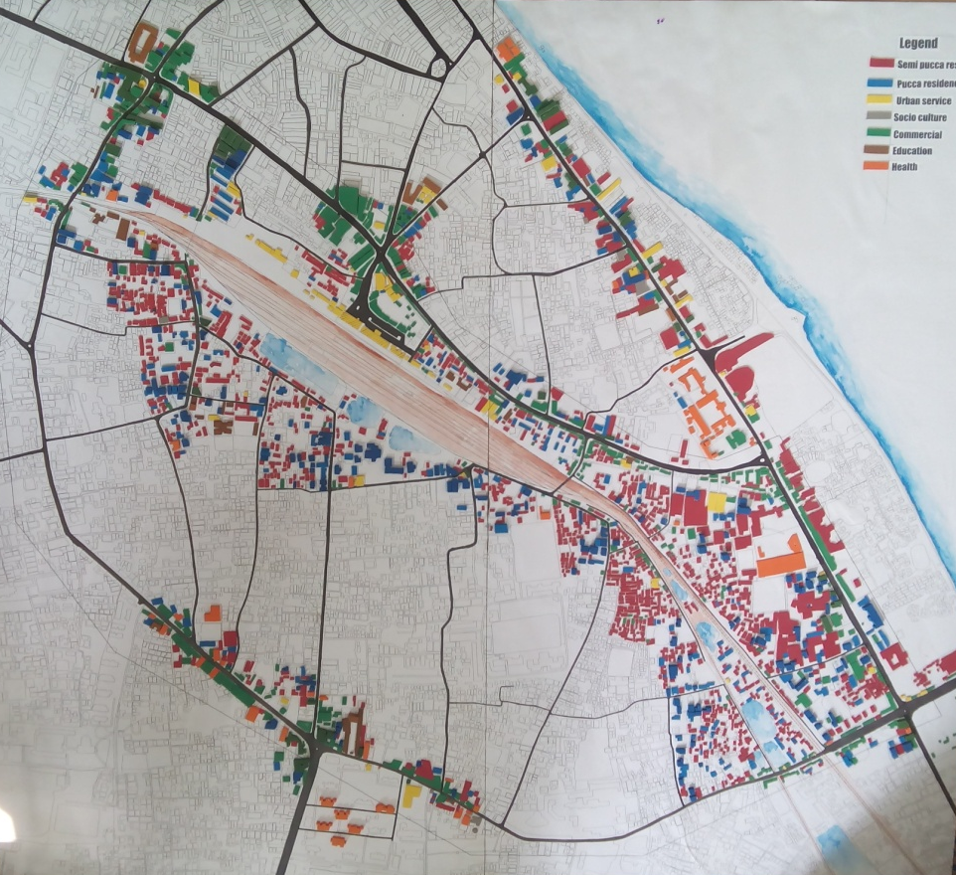
Survey findings presentation (existing model)

Slide 23
BRAHMAPUTRA NOD RIVERFRONT DEVELOPMENT “DREAM PLACE OF SHILPACHARYA JAINUL ABEDIN”

Slide 24
PROJECT 02 'Brahmaputra Nod*' Riverfront Development as A Dream Place of Shilpacharya Jainul Abedin (*Nod is a bangalee word of the River)
In our riverine country rivers are integral part of our lifestyle and obviously of our settlement spaces. Rivers are the major transportation route beside the source of water for various purposes. Monsoon fed rivers are also utilized for farming in the dry season. Beside purely practical purpose rivers also offer opportunity for regional social and recreational activities. It is not uncommon that intensive use of river tend to deteriorate the quality of the riverbank and the river itself. Informal activities, squatter settlements, industrial and other types of pollution, extensive economic activities on the river bank, sand and stone extraction from river bed, hydrological projects that lack environmental concern rampant encroachment, and perpetual lack of attention to the river have taken their toll on the river. And gradually the use and abuse of river have made the river neglected and the city has turned its back towards the river. This studio exercise is intended to tackle such a situation in Mymensingh.
This project considers the riverfront development of Brahmaputra Nod. Eminent Artist, Jainul Abedin grew up amidst a placid surrounding dominated by the river Brahmaputra. Later the Brahmaputra was framed in many of Zainul Abedin works and a source of inspiration all the way through his career. The project aims to develop the riverfront to provide, in an organised way, areas for recreation, civic, economic, and transport facilities for the whole city with the articulation as Shilpachaya Jainul Abedin's dream place.
This project studies the area along the river in detail. Then conflicts are identified and following this proposals are made which ensures Mymensingh with a meaningful riverfront environment along the banks of the 'Brahmaputra Nod' and to redefine an identity of Mymensingh around the river. The project looks to reconnect the city with the river and positively transform the neglected aspects of the riverfront with consideration for environmental improvement, social enhancement and sustainable development.

Slide 25
Project 2: Brahmaputra Nod Riverfront Development as A Dream Place of Shilpacharya Jainul Abedin
Contextual study
Land use along the bank
Conflict analysis
River bank land ownership
Intervention scope policy formulation
Locational sutability
Detail design
Environmental concern
Activity pattern
Life and livelihood on river
Reclaimed land
Flooding events
Transportation, rive rand city
Connectivity of both shores
Social, recreational facilities
Social, recreational facilities
Citizen’s attitude and perception
Riverfront abuse
Earthquake
Public access to river
Rehabilitation of river erosion victims
Environmental concern
Agricultural activities
Legal and policyy framework
Stakeholders‘ interests
Feasibility of physical development
Environmental cnceren
Sustainability
Cost and revenue potential
Peoples acceptance
Development, business and social concern
Implementation strategy
Security concern
Sustainable design
Public acceptance
Public access
Public participation
Security concern
Revenue generation
Legal and policyy framework
Playsical planning
Rules and regulation
Earthquake

Slide 26
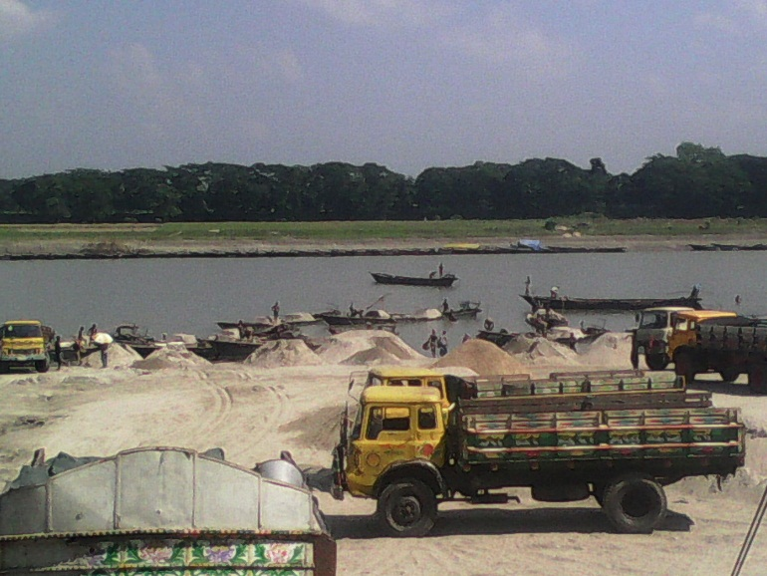
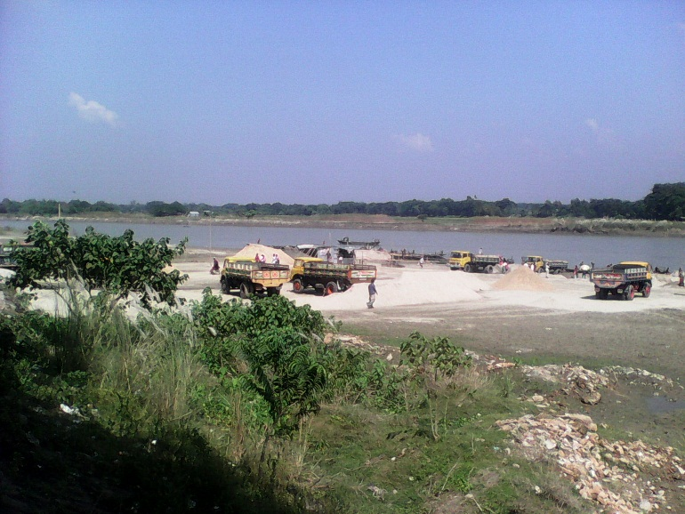
Field Survey
Activity along Brahmaputra River

Slide 27
Field survey
Activity along Brahmaputra River

Slide 28
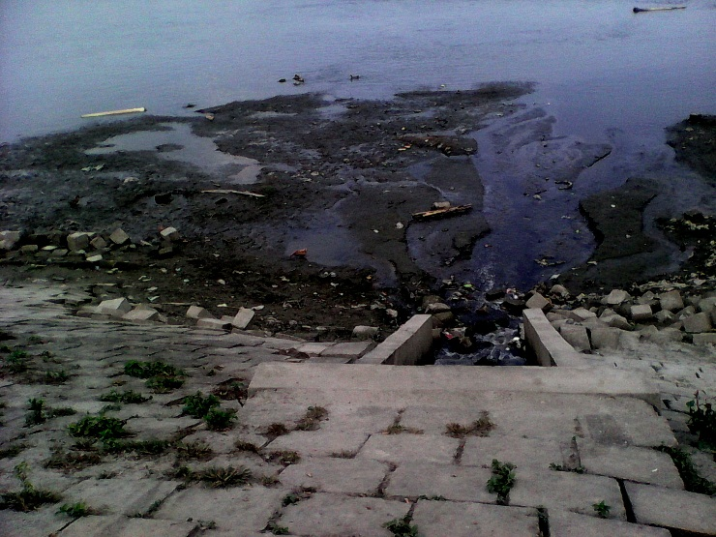
Field survey
Activity along Brahmaputra River

Slide 29
Survey findings presentation

Slide 30
Analysis

Slide 31
LANDUSE & ZONING
KHAGDOHOR GHAT
JAILKHANA GHAT
KATAKHALI GHAT
PARK GHAT
KACHARI GHAT
JUBILEE GHAT
THANA GHAT
KALIBARI GHAT
GUDARA GHAT
SHOSHAN GHAT
RAILWAY STAFF
QUARTER GHAT
BOISHAKHI
MONCHO GHAT
BOTANICAL
GARDEN GHAT
TEKERPAR GHAT

Slide 32
JAINUL ABEDIN’S DREAM
RECREATION
WORKING METHOD
ECONOMIC
RELIGIOUS
TRANSPORTATION
ACTIVITY PATTERN

Slide 33
Site Model

Slide 34
Project 03
Understanding The Dynamics of Shambhuganj Bazaar Area and Its Revitalization

Slide 35
PROJECT 03 Understanding the Dynamics of Shambhuganj Bazar Area and Its Revitalization
This studio exercise is considered to revitalize Shambhuganj area with a view to establish the area as a growth center with enhancement of the Shambhuganj Bazar. This project considers sharing of the benefit of economic agglomeration in the bazar and establishment of the bazar area as a growth center. Growth center can support a balanced rural and urban development for the city. If rural-urban migration flow- share contained in the domicile regions via growth center promotion, the prospects for integrating the urban and rural economies are promising. These prospects can be enhanced by a focus on agricultural processing industries and by investing in an intra-regional road system to encourage agricultural marketing, commuting, and other urban-rural linkages. Since the growth centers will be directly linked with the primate city and other major cities as well as with the smaller urban centers, including market centers, within the region, they form the critical nodes for diffusion of development and social change and for national spatial integration. Shambhuganj as a growth center for the region is expected to ensure job opportunities, especially in the service sector, high-order urban and public services, social adaptation, a decline in fertility, and, through demand effects, a stimulus to the commercialization of agriculture.

Slide 36
Project 3: Understanding the Dynamics of Shambhuganj Bazar Area and its Revitalization
Contextual study
Conflict analysis
Intervention scope policy formulation
Detail design
Environmental concern
Sustainable design
Public acceptance
Public participation
Security concern
Revenue generation
Legal and policyy framework
Playsical planning provision
Rules and regulation
Earthquake
Land use
Infrastructure and
Transportation, connectivity
Recreational
Time-space
Heritage structures
Demography
Earthquake
Urban services
Building information
Bazar activities
Trade details and linkage
Stakeholders role
Land use conflict
Need/availability of infrastructure and services
Rules, regulations
Residents desire
Social/cultural
Social/economical
Percieved business problems
Religious, education, health facilities
Stakeholders‘ interests
Informal economy
Revenue generation and expenditure
Locational sutability
Feasibility of physical development
Environmental cnceren
Sustainability
Cost and revenue potential
Peoples acceptance
Security concern
Community involvement
Income generation
Quality of life
Implementation strategy

Slide 37
Project 03: Understanding The Dynamics of Shambhuganj Bazaar Area and Its Revitalization
Survey
Shambhuganj bazaar area and its surroundings

Slide 38
Survey
Tannery area

Slide 39
Survey findings

Slide 40
Survey findings

Slide 41
Survey findings presentation (Date 01.11.2014)
Shambuganj Bazar is one of the most important bazar amongst all the bazar of Bangladesh. It is economically a bright place for bazar its position in the node point of Three district- Mymensingh,Kishorgonj & Netrokona.
Every year govt get a good Amount of
revenue from the Bazar.Many
important featureas Make the bazar
area as a growth center of this region.
MYMENSHING
MAIN BAZAR AREA
HALUAGHAT
KISHORGONJ
Figure:Location Map of Shambhuganj Bazar
NETROKONA

Slide 42
FEATURES OF SHAMBHUGANJ BAZAR
MAIN FEATURE OF THE BAZAR IS LENEAR
BAZAR AREA
PURBA BAZAR
(MAIN BAZAR)
MADDHA BAZAR
POSHCHIM BAZAR
MAIN FEATURES
FISH SHOP
MEAT SHOP
LEATHER SHOP
RICE SHOP
VEGETABLE
PLASTIC SHOP
PERMANENT SHOP 261
TEMPORARY SHOP 320
MAIN FEATURES
RICE WHOLE SALE SHOP
POTATO WHOLE SALE
JEWELARY SHOP
PHONE FAX
STATIONARY
PARMANENT SHOP 146
TEMPORARY SHOP 103
MAIN FEATURES
RISE MILL
OIL MILL
BAG SHOP
LEATHER MARKET
COSMETICS
CLOTH SHOP
PERMANENT SHOP 152
TEMPORARY SHOP 92
BUILDING TYPE
HAT DAY
SUN DAY
(CHOTO BAZAR)
THURS DAY
(BORO BAZAR)
PACCA
SEMI PACCA
TIN SHADDED

Slide 43
LANDUSE PLAN
LEGENDS
RESIDENTIAL
AREA
VACANT
COMMERCIAL
AREA
ROAD
GRASS LAND
WATER
MAIN BAZAR ROAD
POSHCHIM BAZAR
FISH MARKET
RICE MILL
1ST NODE(TIN RASTAR MOR)
TANNERY MARKET
RESIDENTIAL AREA
BUFFER GUDAM
UNION PARISHAD
2ND NODE(SHOPNOER MOR)

Slide 44
FINDINGS
NARROW ROAD ( WIDTH-15 FEET)
MISUSE OF PEDISTERIAN
NO DRAINAGE SYSTEM
NO PUBLIC TOILET
NO SLAUGHTER HOUSE
NO PROPER LOADIND AND
UNLOADING AREA
NOT ENOUGH SHADE FOR LATHER MARKER
STREAT AR FLOODED IN RAINY SEASON
NO SPACE FOR TRADITIONAL FAIR
PROPER ZONING MISSING
SCARCITY OF SHADED SPACE IN THE HAT
LACK OF GARBAGE MANAGEMENT
CONFLICT ANALYSIS
DIFFERENT BUSINESS MAN DEMEND SAME PLACE IN
THE BAZAR
SYNDICATORS CONFLICT WITH ONE ANOTHER
CONFLICT BETWEEN GOVERNMENT & BUSINESSMEN
RETAIL SALER DO NOT GET PROPER SPACE
SYNDICATORS BLAME THE RETAIL SALER FOR
PRESENT CONDITION
RETAIL SALER ALSO BLAME THE SYNDICATORS FOR
PRESENT MISERABLE CONDITION

Slide 45
1ST NODE(TIN RASTER MOR)
LEGENDS
RESIDENTIAL
AREA
COMMERCIAL
AREA
VACANT
ROAD
WATER
TIME-11:00
DURATION:1HOUR
TIME-02:30
DURATION:1HOUR
VEHICLE | ROAD-1 | ROAD-2 | ROAD-3
BUS | 144 | 48 | 24
TRUCK | 246 | 72 | 84
AUTO | 1032 | 480 | 240
VAN | 216 | 216 | 144
BIKE | 408 | 264 | 261
PEOPLE | 960 | 648 | 480
VEHICLE | ROAD-1 | ROAD-2 | ROAD-3
BUS | 168 | 120 | 144
TRUCK | 504 | 264 | 240
AUTO | 1200 | 816 | 960
VAN | 216 | 144 | 168
BIKE | 720 | 360 | 480
PEOPLE | 2160 | 960 | 1200

Slide 46
2ND NODE(SHOPNOER MOR)
LEGENDS
RESIDENTIAL
AREA
COMMERCIAL
AREA
GRASS
LAND
VACANT
ROAD
WATER
GREEN
TIME-11:45
DURATION:1HOUR
TIME-03:00
DURATION:1HOUR
VEHICLE | ROAD-1 | ROAD-2 | ROAD-3
BUS | 144 | 24 | 24
TRUCK | 48 | 24 | 96
AUTO | 504 | 192 | 120
VAN | 168 | 264 | 48
BIKE | 168 | 144 | 168
PEOPLE | 504 | 384 | 360
VEHICLE | ROAD-1 | ROAD-2 | ROAD-3
BUS | 312 | 504 | 408
TRUCK | 240 | 168 | 120
AUTO | 720 | 480 | 552
VAN | 336 | 264 | 321
BIKE | 360 | 384 | 264
PEOPLE | 1200 | 1104 | 744

Slide 47
Existing study model

Slide 48
Project 04
Preservation of historic structure of Mymensingh city & design a heritage walk route to historic old core & sustainable tourism based on existing heritage & religious structure

Slide 49
PROJECT 04 Preservation (Revitalization I Conservation) of Historic Structures of Mymensingh City and Design a Heritage Walk Route to the Historic Old Core. Integrated and Sustainable Tourism Based on Existing Heritage and Religious Structures
Mymensingh is one of the 16 old districts of Bangladesh which was constituted by the British East India Company. Being more than 400 years old, Mymensingh has a rich cultural and political history and has a very significant position in History of Bangladesh. It was known as the city of Zamindar [land-lord]. The city was moulded by twelve renowned Zamindars around 1887. The twelve of them allied and formed their territory by constructing Zamindar Houses and a planned 'road network'. The original road-network was designed to maintain their communication as well as establish and exercise power. The roads connect all the Zamindar Houses and displays a bond among them. The morphological pattern of the city has developed form this correlation between these two factors. Beside this Zamindar Houses, there are many temples with rich details and ornamentation in the city. These buildings have historic value and tell us about the life and culture of our past. Urban revitalization of this city core area can improve the quality of life of the population greatly and enhance the image and economic strength of the city as well through tourism.
This project considers revitalizing the historic part of the Mymensingh city with emphasis on tourism based development. Students are required to propose a revitalization scheme and chalk out a tourism plan. A well planned tourism plan can make the city core area as a base station and the historic structures as points of attraction in the city and includes the nearby spots, such as Garo hill, Brishiri area etc. within reach. Such a tourism plan can easily attract people and make them stay in Mymensingh for a few days exclusively for tourism and this has a great potential to contribute to the economic strength of Mymensingh and boost the city image.

Slide 50
Project 4: Preservation (Revitalization / Conservation) of Historic Structures of Mymensingh City and Design a Heritage Walk Route to the Historic Old Core. Integrated and Sustainable Tourism Based on Existing Heritage and Religious Structures
Contextual study
Conflict analysis
Intervention scope policy formulation
Detail design
Environmental concern
Sustainable design
Public acceptance
Public participation
Security concern
Revenue generation
Legal and policyy framework
Playsical planning provision
Rules and regulation
Earthquake
Land use
Infrastructure and
Transportation, connectivity
Recreational
Time-space
Heritage structures
Demographic info
Earthquake
Urban services
Building information
Stakeholders role
Land use conflict
Need/availability of infrastructure and services
Stakeholders' interest
Rules, regulations
Residents desire
Social/cultural/
Religious, education, health facilities
Revenue generation and expenditure
Locational sutability
Sustainability
Cost and revenue potential
Peoples acceptance
Security concern
Community involvement and belongingness
Income generation
Implementation strategy
Ownership
Designed and current use
Use and public access
economic
Target group of tourists
Hospitality
Stakeholders‘ interests
Conservation/restoration
Environmental cnceren

Slide 51
Project 04: Preservation of historic structure of Mymensingh city & design a heritage walk route to historic old core & sustainable tourism based on existing heritage & religious structure
Survey
S K Hospital
Telegraph Office

Slide 52
Survey
Shoshi Lodge
Biddamoye School
Diabetic Society

Slide 53
Museum
Raj Rajeshewari Water Works
Gouripur Lodge
Alexender Castle

Slide 55
SK HOSPITAL:
HASAN MANJIL:
SHIEV TEMPLE:
MYMENSING MUSEUM:

Slide 56
GEORGE COURT:
CITY COLLEGIATE SCHOOL:
ANANDA MOHAN COLLEGE:
BIDYAMOYI GOVT GIRL’S HIGH SCHOOL:

Slide 57
GOURIPUR LODGE:
ALEXANDER CASTLE:
SHOSHI LODGE:
MYMENSINGHA ZILLA SCHOOL:

Slide 58
Survey findings

Slide 59
Existing Study Model

Slide 60
Project 05
REDESIGN OF 9 IMPORTANT NODAL POINTS
IN MYMENSINGH CITY

Slide 61
PROJECT 05 Redesign of 10 (Ten) Important Nodal Points in Mymensingh City
This project considers to improve the efficiency of the nodal points of Mymensingh and enhance their images in the cityscape as distinguished landmarks. There are several nodal points in the Mymensingh City. They are important not only for transportation, they are also important to provide the city some character. For example, the Ganginapar node and Town Hall node are the main urban cores that are connected with other roads and streets of the city. The main commercial zone of the city has been developed on both side of main road near the Ganginapar node after the establishment of Mymensingh Railway Station. On the other hand educational facilities have concentrated near Town Hall node. The nodal points have faded their importance with course of time due to various reasons, such as being overburdened and lose their functional effectiveness and/or characters they are assigned for. This studio project seeks to revive such nodal points in the city of Mymensingh to restore their functional efficiency and enhance the characters that provide them individuality.
This project starts with studying the nodal area intensively and then analyses all the problems and their causes. Then it suggests ideas for resolution considering minimum and required level of intervention whether it is structural or simple traffic management.

Slide 62
Project 5: Redesign of Important Nodal Points in Mymensingh City
Contextual study
Land use
Conflict analysis
Land use conflict
Intervention scope policy formulation
Feasibility of physical development
Detail design
Fuctional efficiency
Legal and policyy framework
Stakeholders‘ interests
Environmental cnceren
Sustainability
Implementation strategy
Sustainable design
Revenue generation
Legal and policyy framework
Playsical planning
Rules and regulation
Earthquake
Infrastructure and
Urban services
Building information
Transportation, connectivity
Recreational
Religious, education, health facilities
Time-space
Heritage structures
Stakeholders role
Demographic info
Earthquake
Need/availability of infrastructure and services
Stakeholders' interest
Rules, regulations
Social/cultural
Social/economical
Urban structure
Traffic management
Local identity and
Minimalistic approach
Holistic approach
Cost and revenue potential
Extent of intervention
Environmental concern
City landmark

Slide 63
Survey

Slide 65
Survey findings presentation

Slide 66
Survey findings presentation

Slide 67
Project 06
Amusement in a “Char” : Proposed leisure and recreational facilities in Mymensingh

Slide 68
Project 06 Amusement in a 'Char': Proposed Leisure and Recreational Facilities in Mymensingh
The project referred to as Amusement in 'Char' is perceived to design recreational facilities in the small islets, the 'Char' areas, on the Brahmaputra River flowing along Mymensingh. The river is the old tract of the once mighty river that changed the course due to earthquake in 1762 and now a seasonal flow. The islets recovered from the riverbed is known as 'char's. There are several char areas on both the upstream and downstream of the river along the city. These char areas are subjected to regular, which is almost an annual event, seasonal flooding by heavy monsoon rain and flashes from the Garo hills of Meghalaya in India. Periodic floods also deposit fresh alluvium replenishing the fertile soil. Thus flooding, agriculture, and agricultural practices and lifestyle of the people along the river are closely connected.
This project is considered to offer highly ambitious leisure and recreational activities. Amusement activities are be designed with priority for higher income people, provisions are to be created for mid income people where family fun will be provided. The project is to be considered as an entertainment and tourist centre where all class of peoples of all ages can feel a touch a gentle breeze and have fun and joy. This could be a wonderful combination of natural and manmade gift from the people of Mymensingh to the outside world. The proposed project will be an international standard with modern attraction amenities
& themes and its will be provided for having fun and joy. It will endeavour is to bring new ideas in the society and business and always look forward to devote itself for the cause of social uplift and thereby developing better human relationship as well as social bondage.. The Amusement project will definitely attract the peoples of all ages and will generate substantial amount of revenue, which further justify the huge market potential of the project. Furthermore, the project will cater the social need, create employment generation and new business opportunities, also attract the foreign tourists, and thereby earn valuable foreign exchange for the country as a whole.

Slide 69
Project 6: Amusement in a ‘Char’: Proposed Leisure and Recreational Facilities in Mymensingh
Contextual study
Land use
Conflict analysis
Land use conflict
Intervention scope policy formulation
Feasibility of physical development
Detail design
Target group of tourists
Legal and policyy framework
Stakeholders‘ interests
Environmental Concern
Sustainability
Implementation strategy
Rules and regulation
Earthquake
Infrastructure
Transportation, connectivity
Recreational
Demographic info
Earthquake
Need/availability of infrastructure and services
Cost and revenue potential
Extent of intervention
Urban services
Agricultural use
Flooding events
Flooding events
Agricultural activity
Security
Flood management
Agricultural use
Security
Legal and policy framework
Land ownership
Local acceptance
Security concern
Environmental concern
Sustainable design
Cost and revenue

Slide 70
Project 06: Amusement in a “Char” : Proposed leisure and recreational facilities in Mymensingh
Survey
Char area Surroundings

Slide 72
PURPOSE OF THE PROJECT
EMPLOYMENT
SOURCE OF ECONOMY
TOURISM & REVENUE
BUSINESS OPPORTUNITIES
FOOD SUPPLY
AGRICULTURE
MAINTENANCE OF EXISTING LAND

Slide 73
NAME OF THE CHAR
AGRICULTURE
BORAR CHAR
LIFE-STYLE & THEIR LIVELIHOOD
LARGEST CHAR
10 KM BARRIER TO PROTECT FLOOD
0.5 KM TO PROTECT RIVER FALL
MOSTLY FLOODED AREA
EDUCATION
HEALTH
CHAR JAILKHANA
LARGEST IN POPULATION DENSITY
RELIGION
9-10 KM IN LENGTH
PORANGANJ
FINDINGS
SECURITY
CHAR BEGUNBARI
EMPLOYMENT
CHAR BAULA
TRANSPORTATION
KUSHTIAR CHAR
ECONOMY
CHAR NILAKSHIA
CHAR ISHWARDIA
ELECTRICITY
CHAR SIRTA
RECREATIONAL

Slide 74
DETAIL OF CHAR JAILKHANA
TOTAL LAND
3867.2700 ACRES
AGRICULTURAL LAND
700.3500 ACRES
RESIDENTIAL LAND
500.0000 ACRES
INHERITTED PROPERTI
781.3900 ACRES
GOVT. PROPERTI
100.0300 ACRES
RIVER
1748.8000 ACRES
ROAD
26.3000 ACRES
LENGTH 9-10 KM
CONSISTS OF 23 VILLAGES
MAXIMUM DWELLERS ARE
HINDUS
1 ISCON MONDIR
BAZAR
0
SCHOOL
1
COLLEGE
0
PARK
0
REFERRANCE:BHUMI JORIP OFFICE,MYMENSINGH

Slide 75
AGRICULTURE

Slide 76
RELIGIOUS FACILITIES
HEALTH
1 ISCON MANDIR
DEPENDS ON TOWN
1 MOSQUE IN EACH VILLAGE
STRUCTURE
EDUCATION
DIFFERENT LEVEL
1 PRIMARY SCHOOL
BASED ON POST
ORGANIZED BY TEJE BROT HERS
ALSO ACT AS DISASTER HOUSE
LIFE-STYLE
SECURITY
LOWER INCOME PEOPLE
HAVE DOMESTIC ANIMAL
DEPENDS ON MAIN TOWN
CONSERVATIVE

Slide 77
EMPLOYMENT
BOATMAN, FARMER, LABOURER
ECONOMY
LARGELY DEPENDS ON AGRICULTURE
DOMESTIC ANIMAL
TRANSPORTATION
CONNECTING ROAD TO MAIN TOWN THROUGH
SHAMVUGANJ
USING CYCLE FOR INTER ROAD CONNECTION
BY BOAT FROM TOWN TO CHAR

Slide 78
RECREATIONAL FACILITIES
NOUKA BAICH
BAISHAKHI MELA
SHARER LORAI
HAT
WEDNESDAY & SATURDAY
(JOY BANGLA BAZAR)
FRIDAY & MONDAY
(KHUCHRA BAZAR)

Slide 79
CONFLICT
FLOOD IS THE MAIN OBSTRACTION
CHAR DWELLERS REACTION WITH OUR FUTURISTIC PROGRAMME
THEIR CONCERN ABOUT THEIR BASIC NEED RATHER THAN TOURIST RECREATIONAL FACILITIES
CITY PEOPLE’S PERCEPTION AND VIEWS

Slide 80
Project 07
Reconsidering the ‘BSCIC’ industrial estate & feasible alternative use

Slide 81
Project 07 Reconsidering the "BSCIC" Industrial Estate and Feasible Alternative Use
BSCIC Industrial Estate, Mymensingh was established on 1st September, 1968 in Maskanda, central Mymensingh. It had an area of 10.81 acres. In 1993 it was extended for more 9.62 acre. According to BSCIC website, 55 of total 60 plots are allotted and 36 units are on production in the older estate. In the extension area all 50 plots are allotted and 51 units are on production. However in reality the situation is different which is to be analyzed in this project.
This project seeks to understand the real situation of the industrial estate and identify the problems faced by the entrepreneurs. It studies each and every plot of the industrial estate in detail to record the land use, industrial operation, industrial type, available services for industrial use etc. and other issues in the wider scale such as facilities for workers, infrastructure and other services in the city and national scale etc. Then it analyses the existing problems and the prospect of running this industrial estate with possible assistance from the public sector. In case it appears that the intended industrial estate for SMCls are not practical in the existing setting with possible public investment, then students are free to suggest viable alternative use of the area with necessary supporting arguments.

Slide 82
Project 7: Reconsidering the “BSCIC” Industrial Estate and Feasible Alternative Use
Contextual study
Plot allocation record
Conflict analysis
Conflict of BSCIC and present users
Intervention scope policy formulation
Feasibility of industrial use
Detail design
Environmental concern
Stakeholders‘ interests
Implementation strategy
Need/availability of infrastructure and services
Security concern
Plot ownership
Plot occupation
Plot utilization
Vacant plots , use
Industrial units details
Infrastructure and services
Workers’ facilities
Local and wider scale infrastructure, connectivity
Problems for industries
Surrounding area details
Earthquake
Need/availability of workers’ facilities
Financial and other constraints
Institutional support
Feasibility of development
Supports to continue
Owners desire and attitude to continue
Alternative use
Local acceptance
Design sustainability
Local context
Community involvement
Community involvement
Income generation
Industrial estate efficiency

Slide 83
Field Survey
Reconsidering the ‘BSCIC’ industrial estate & feasible alternative use
1
2
3
Fig 1,2,3
Existing conditions of different factories in mymensing ‘BSCIC’

Slide 84
Field Survey
Reconsidering the ‘BSCIC’ industrial estate & feasible alternative use
4
5
6
7
8
9
Fig 4,5,6,7,8,9
Existing conditions of different factories in mymensing ‘BSCIC’

Slide 85
Presentation on Survey Findings
Plot allocation & use type in BSCIC record
 | old | Extension | Total
No. of Factories | 39(60 Plots) | 51 (50 Plots) | 90(110 Plots)
Production In Produce | 27 (36 Plots) | 44(49 Plots) | 71(85 Plots)
Handover In Progress | 2 (3 Plots) | 1 | 4(4 Plots)
Changing Industry Type | 3 (3 Plots) | 2 | 5 (5 Plots)
Issues With Bank | 2(5 Plots) | 2 | 4 (7 Plots)
Renovation | 2 (4 Plots) | 1 | 3 ( 5 Plots)
Under Construction | 2 ( 5 Plota) |  | 2( 5 Plota)
Trial Production | 1(3 Plots) |  | 1(3 Plots)
Actual Scenario & Present Use Or Occupied Plots/Units
Total Plots | 110
No. Of Factory | 79
Closed Units | 55
Running Units | 27

Slide 86
Presentation on Survey Findings

Slide 87
Analysis on Survey Findings
Oil Filling station
TTC
Bus stand
Unused lands
Dhaka Mymensingh Highway
Garage
Staff Quarter
Residence
Residence
Agricultural lands

Slide 88
Analysis on Survey Findings
Water
Road
12 nos. Transformer & 60 nos Electrical Polls
1 Water Pump That supply the whole industrial area
No proper waste management
60% kacha road
Electricity
Drainage System
ANALYSIS

Slide 89
Analysis on Survey Findings
10
12
11
13
Fig 10,11,12,13
Class discussion on GIS based maps and sketches
’

Slide 90
Project 08
Open space adaptation in disaster management: designing recreational facilities and open spaces in Mymensingh City and their possible utilization in disaster management

Slide 91
Project 08 Open Space Adaptation in Disaster Management: Designing Recreational Facilities and Open Spaces in Mymensingh City and Their Possible Utilization in Disaster Management Program
Alongside various recreational and social use of open spaces, their importance in the disaster preparedness is increasingly being recognized. Open spaces are required to provide emergency and basic services on the aftermath of disasters. With the increasing demand for risk-sensitive land use planning urban open spaces are to be designed as a part of the comprehensive disaster management program.
Perhaps, the most important challenge a natural disaster, like earthquake, brings is the relocation of the displaced people and provide them emergency services. Particularly in our cities, where quality of buildings lack necessary measures to minimize the effects of a disaster and limited open space are available in the urban areas, caring millions of helpless people exerts a huge challenge for the government and other agencies concerned. Alongside casualties and structural collapses, an earthquake results in millions of homeless people. The challenge to care for them requires space for emergency shelter relocation, temporary hospitals, storage of relief materials, field stations to operate and manage rescue and relief functions etc. On this background, this project aims to utilize the potential of urban open spaces in the city if Mymensingh for post disaster management with particular, but on only, emphasis to earthquake.
The outcome is expected to be a comprehensive plan for disaster, earthquake for example, preparedness and management scheme with a network of open spaces with necessary infrastructures distributed around the city and the connectivity of the entire network with Dhaka as well as neighboring districts.

Slide 92
Project 8: Open Space Adaptation in Disaster Management: Designing Recreational Facilities and Open Spaces in Mymensingh City and Their Possible Utilization in Disaster Management Program
Contextual study
Existing open space
Conflict analysis
Possible impact of the disaster event in the wider city and the design areas
Intervention scope policy formulation
Detail design
Citywide comprehensive plan
Surrounding area details
Earthquake and other disaster
Type, ownership, public access etc.
Vulnerability, exposure of open space in disaster
Road network hierarchy
new or redesign of existing urban facility with open space.
Field stations for necessary disaster management
Applicability and suitability of open spaces
Categorizing problem areas
prioritization of problems for actions
Identification and Coordination with other institutions, such as Fire Service and Civil Defense etc.
Implementation strategy by utilizing their infrastructures
Need/availability of infrastructure and services
Identification of existing urban facilities with open space that is in conflict
open space adaptation for disaster management and recovery program
Existing recreational facilities.

Slide 93
Project 08: Open space adaptation in disaster management: designing recreational facilities and open spaces in Mymensingh City and their possible utilization in disaster management
Survey
Open space in Ananda Mohan College

Slide 94
Open space and water bodies of Mymensingh city

Slide 95
Road network of Mymensingh city

Slide 96
Survey findings and analysis (Date 01.11.2014)

Slide 97
Water supply map

Slide 98
Water clogging map

Slide 99
Survey findings and analysis (Date 08.11.2014)

Slide 100
Survey findings and analysis (Date 08.11.2014)

