Slide 1
Comparative scenario Analysis of Mymensingh Town
MSDP Project 2011-2031

Slide 2
Objectives
Evaluate how the city elements are spatially distributed over the city area (Like landuse, population, resources and facilities)
Evaluated how different area of the city is getting the services & facilities
Identify the exposed area of the city subject to different risk
Evaluate the Connectivity of the city area

Slide 3
Methodology
City area is divided into 100 m X 100 m grid. Total no of Grid is 2160. each grid size is 1 Hectare.
34 elements are taken as parameter for the analysis
Parameters are examined by two ways:
1. Parameters/elements present within the grid
2. Parameters/elements are connected from the grid center through road network

Slide 4
Methodology
Depending on element presents in the cell and network distance of the elements from grid center a hierarchy is created so that every cell can be comparable with other.
Spatial Join operation is performed for populating the parameters/elements into the cell
Network Analysis operation is performed for calculating the connectivity/ accessibility of the cell from the elements
A scale is developed ranging 0 to 10. Where each cell is scored according to the distribution.
A weightage factor is assign for each parameter depending on their merit.
Finally all cell are converted into 100 score…

Slide 5
Weightage distribution of the variables for comparative analysis of the cell in Mymensingh municipality
S/N | item | quality | description | condition of veriable | influance of veriable | Load distribution | Broad category | points | detail points
1 | Pora_dist | point | distance from municipality office | quality outside cell | administrative influance | 50% | 1. Adminstrative | 5 | 2
2 | Upz_Dist | point | distnce from UPZ office | quality outside cell | administrative influance |  |  |  | 1
3 | DCOff_dist | point | distance from DC's office | quality outside cell | administrative influance |  |  |  | 2
4 | PriSch_Dist | point | distance from primary school | quality outside cell | educational influance |  | 2. Education | 6 | 1
5 | Hghsch_dist | point | distance from high school | quality outside cell | educational influance |  |  |  | 2
6 | Col_dist | point | distance from college | quality outside cell | educational influance |  |  |  | 2
7 | Univ_dis | point | distance from college | quality outside cell | educational influance |  |  |  | 1
8 | Clic_Dstn | point | distance from clinic | quality outside cell | health serv. influance |  | 3. Health | 6 | 2
9 | Hos_Dstn | point | distance from hospital | quality outside cell | health serv. influance |  |  |  | 4
10 | CityCent_distn | point | distance from city centre | quality outside cell | commercial influance |  | 4. Commertial | 7 | 5
11 | Bzr_dstn | point | distance from bazar | quality outside cell | commercial influance |  |  |  | 2
12 | Park_distn | point | distance from park | quality outside cell | recreational influance |  | 5. Recreational | 3 | 2
13 | River_distn | line | distance from brahmaputra river | quality outside cell | recreational influance |  |  |  | 1
14 | Lngth_prim | point | distance from primary road | quality outside cell | basic traffic influance |  | 6. Transportationa | 8 | 5
15 | ImpNode_distn | point | distance frim important node | quality outside cell | basic traffic influance |  |  |  | 3
16 | Dhk_bus | point | distance from dhaka bus station | quality outside cell | regional service influance |  | 7. Regional connectivity | 5 | 3
17 | dhk_rail | point | distance from rail station | quality outside cell | regional service influance |  |  |  | 2
18 | PO_dist | point | distance from police station | quality outside cell | basic service influance |  | 8. Distance from Urban services | 10 | 2
19 | Fire_dist | point | distance from fire station | quality outside cell | basic service influance |  |  |  | 3
20 | Dstb_dstn | point | distance from dustbin | quality outside cell | basic service influance |  |  |  | 1
21 | Tel_Dstn | point | distance from telephone post | quality outside cell | basic service influance |  |  |  | 1
22 | Epole_dstn | point | distance from electric post | quality outside cell | basic service influance |  |  |  | 3

Slide 6
Weightage distribution of the variables for comparetive analysis of the cell in mymensingh municipality
S/N | item | quality | description | condition of veriable | influance of veriable | Load distribution | Broad category | points | detail points
22 | Wat_supply | poly | distance from water line | quality outside cell | direct influance within cell | 50% | 9. quality of direct Urban service | 8 | 2
23 | Drn_line | poly | distance from drain | quality outside cell | direct influance within cell |  |  |  | 2
24 | Rd_Line | poly | distance from nearby road | quality outside cell | direct influance within cell |  |  |  | 1
25 | RD-width | poly | Adjacent road width | quality within cell | direct influance within cell |  |  |  | 3
26 | sum_pop_nt | poly | total population | quality within cell | direct influance within cell |  | 10. Quality of inhabitants | 5 | 5
27 | Sum_built area | poly | total built up area | quality within cell | direct influance within cell |  | 11. Built-up quality | 10 | 4
28 | sum_Build_v | poly | total voulmn of that built up area | quality within cell | direct influance within cell |  |  |  | 6
29 | sum_res_S | poly | total residential area | quality within cell | direct influance within cell |  | 12. Residential | 4 | 4
30 | Sum_admin | poly | total administrative area | quality within cell | direct influance within cell |  | 13. Administrative | 3 | 3
31 | Sum_Othr | poly | total other area | quality within cell | direct influance within cell |  | 14. Others | 5 | 5
32 | sum_edu_sp | poly | total education built area | quality within cell | direct influance within cell |  | 15. Educational | 4 | 4
33 | sum_Mixed | poly | total mixed used area | quality within cell | direct influance within cell |  | 16. Mixed used | 6 | 6
34 | Avg_ht_rl | poly | avarage height (R.L.) | quality within cell | direct influance within cell |  | 17. Physical quality of cell | 5 | 5

Slide 7
Population Distribution and score of the cell

Slide 8
Building foot print pattern & their score

Slide 9
Residential Floor Space distribution and their score

Slide 10
Commercial, Mixed Floor Space and Ground Height Map

Slide 11
Accessibility of Each cell connected with Important Node and their score

Slide 12
Accessibility of Each cell connected with Primary School and their score

Slide 13
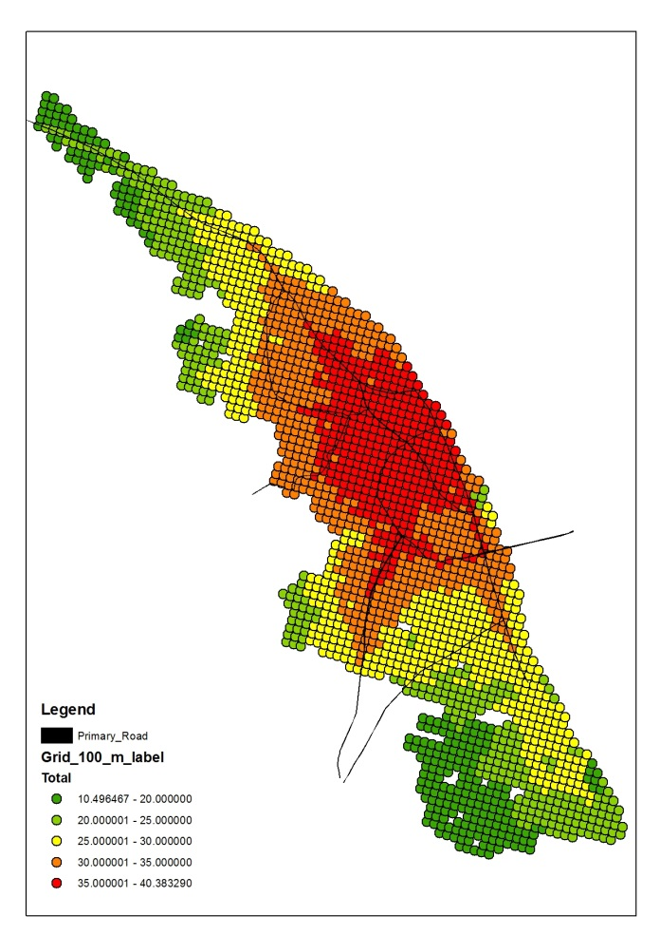
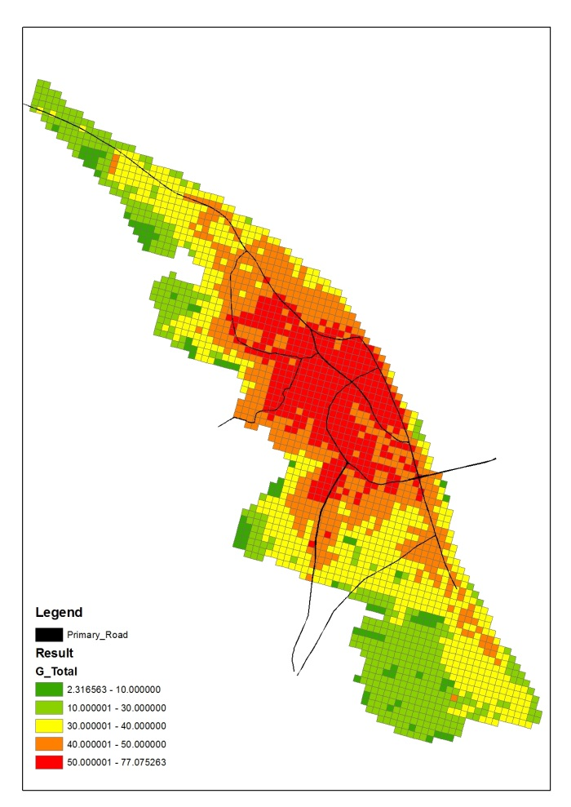
Comparative scenario of Mymensingh Municipality

Slide 14
Thank You
Q & A ???

