Slide 1
PROJECT:1
REDESIGN OF MYMENSINGH CENTRAL RAILWAY STATION AREA AS A TRANSPORTATION HUB

Slide 2
TRANSPORTATION HUB

Slide 4
WHY TRANSPORTATION HUB

Slide 5
WHY TRANSPORTATION HUB

Slide 6
WHY TRANSPORTATION HUB

Slide 7
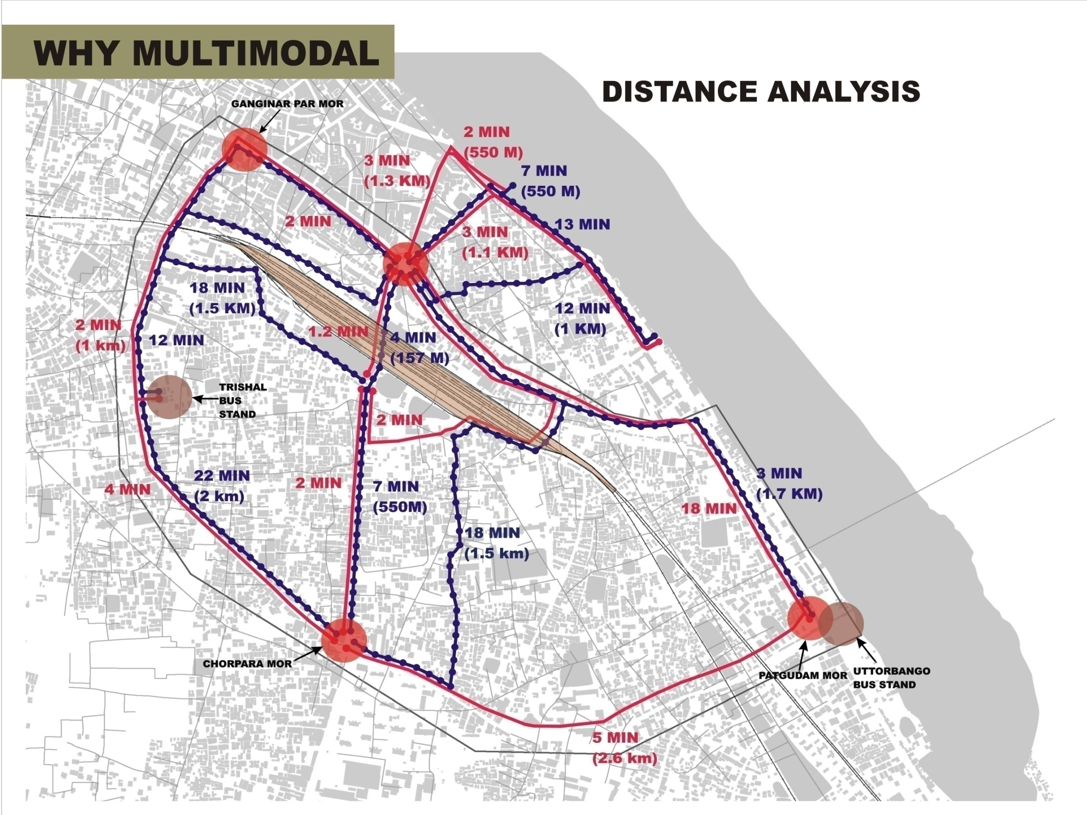
WHY TRANSPORTATION HUB

Slide 8
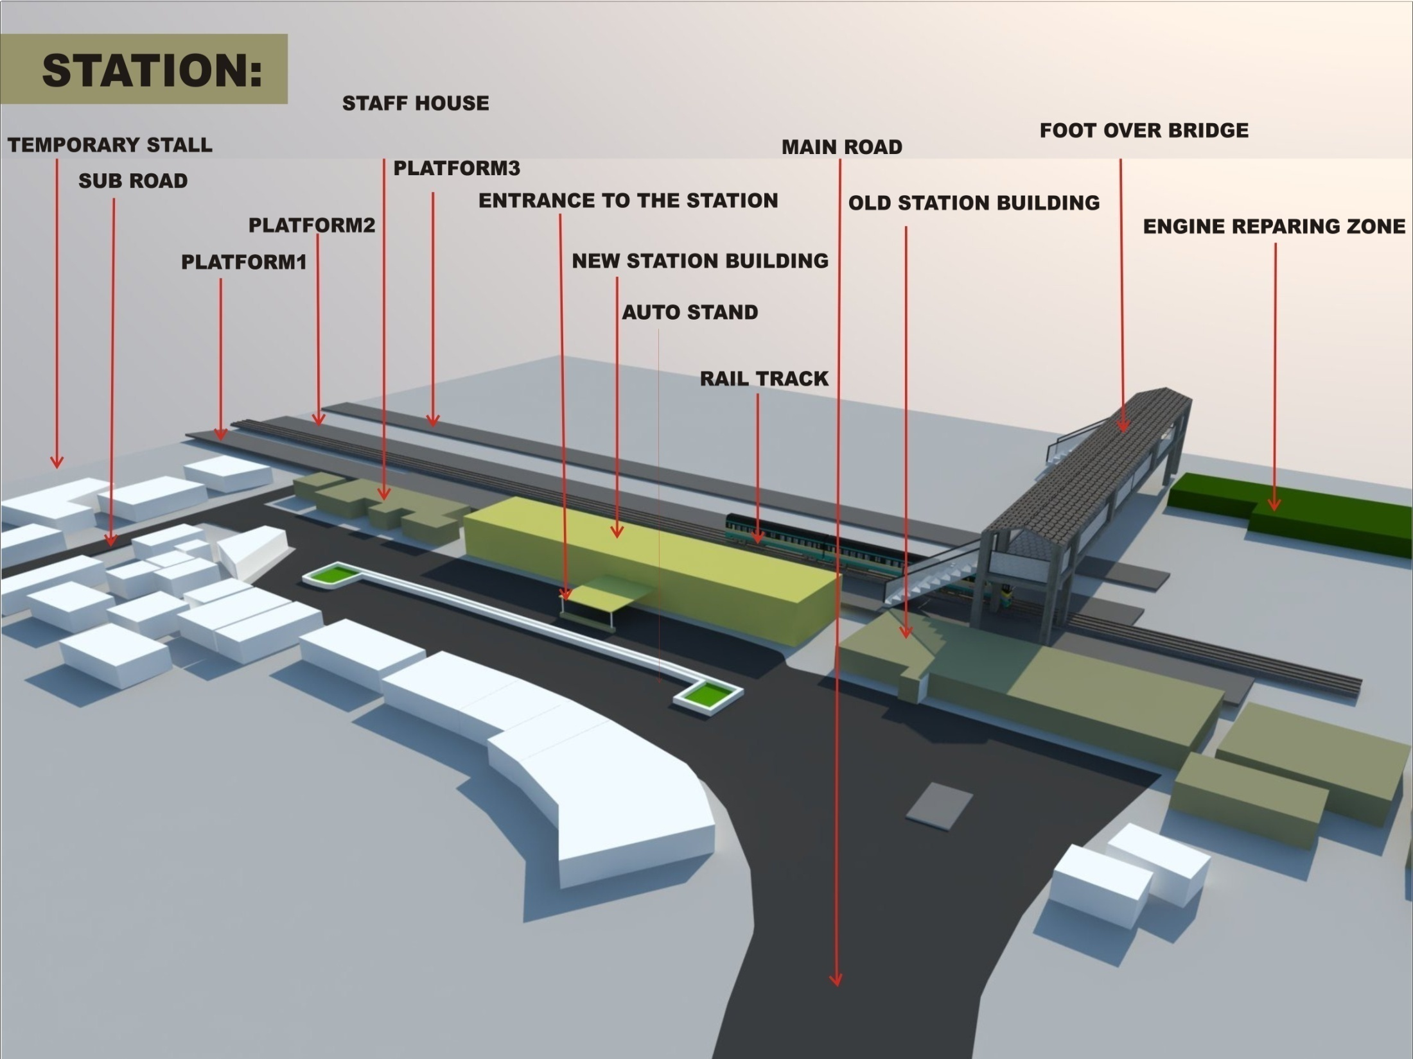

Slide 9
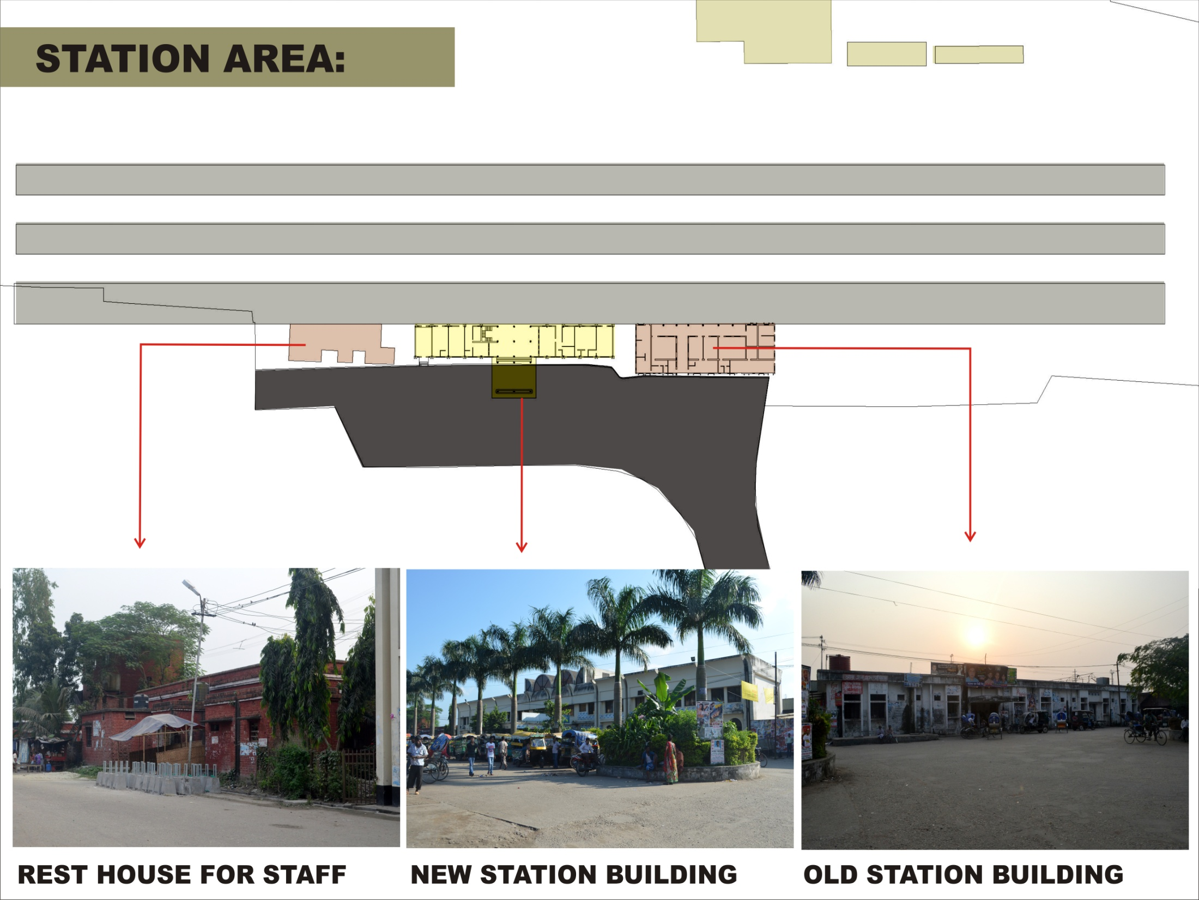

Slide 10
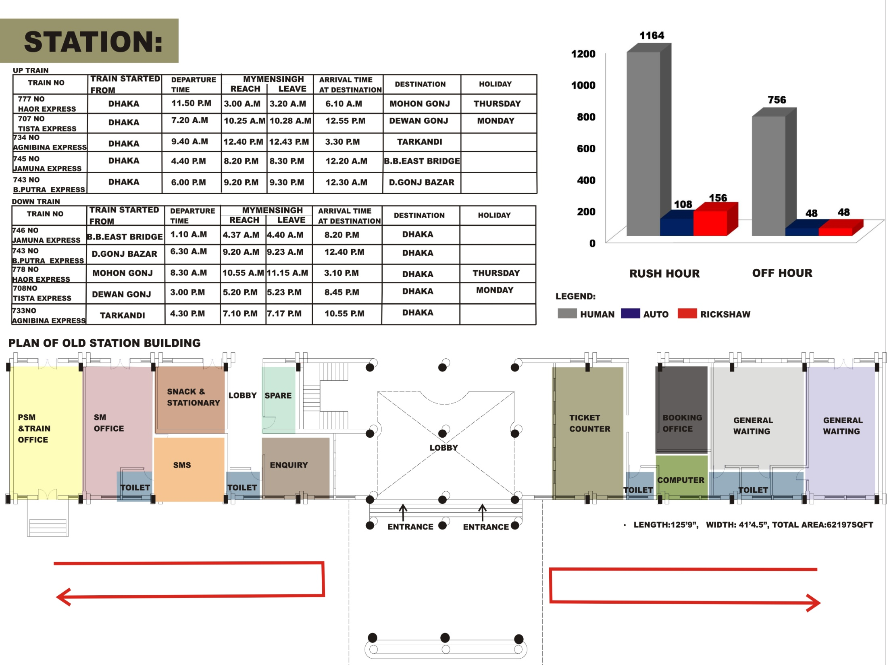

Slide 11
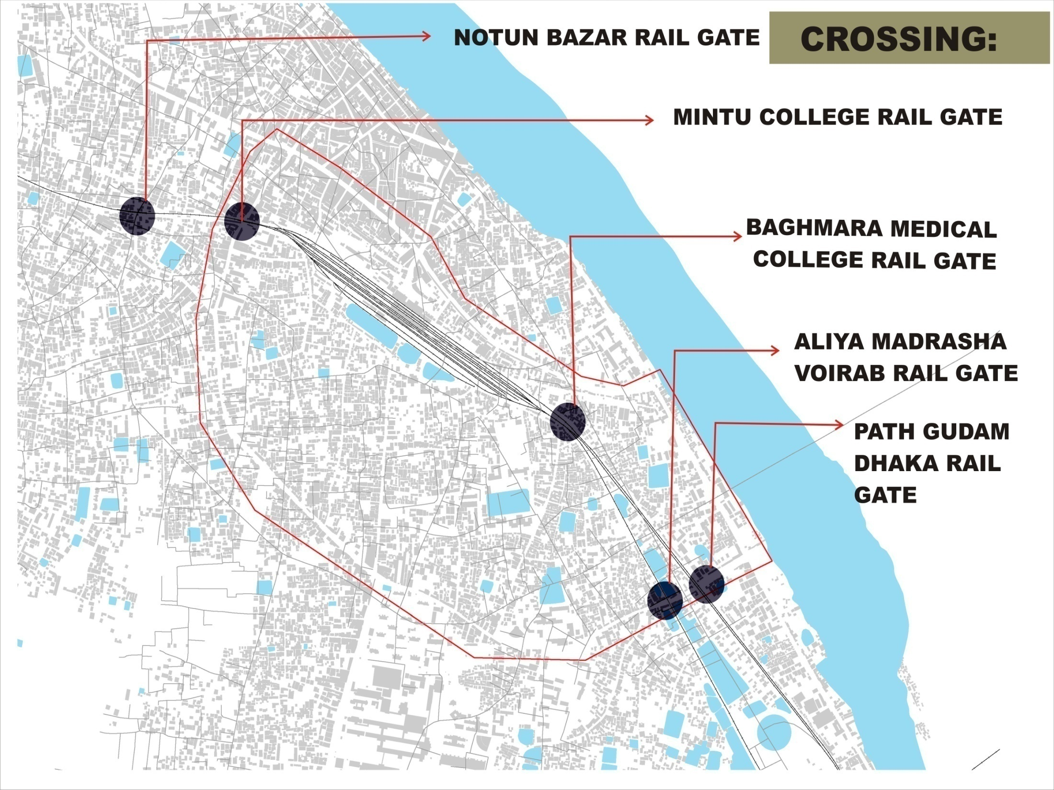

Slide 14
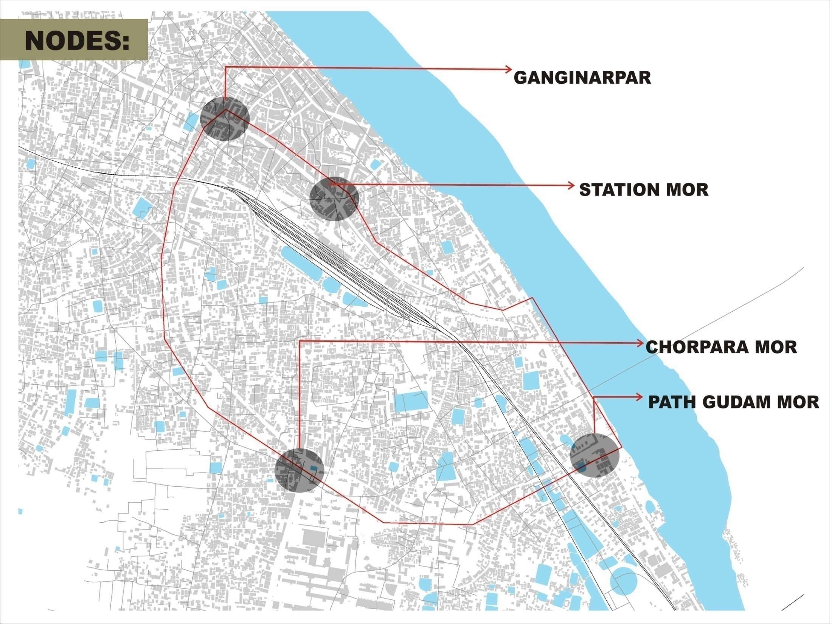

Slide 15
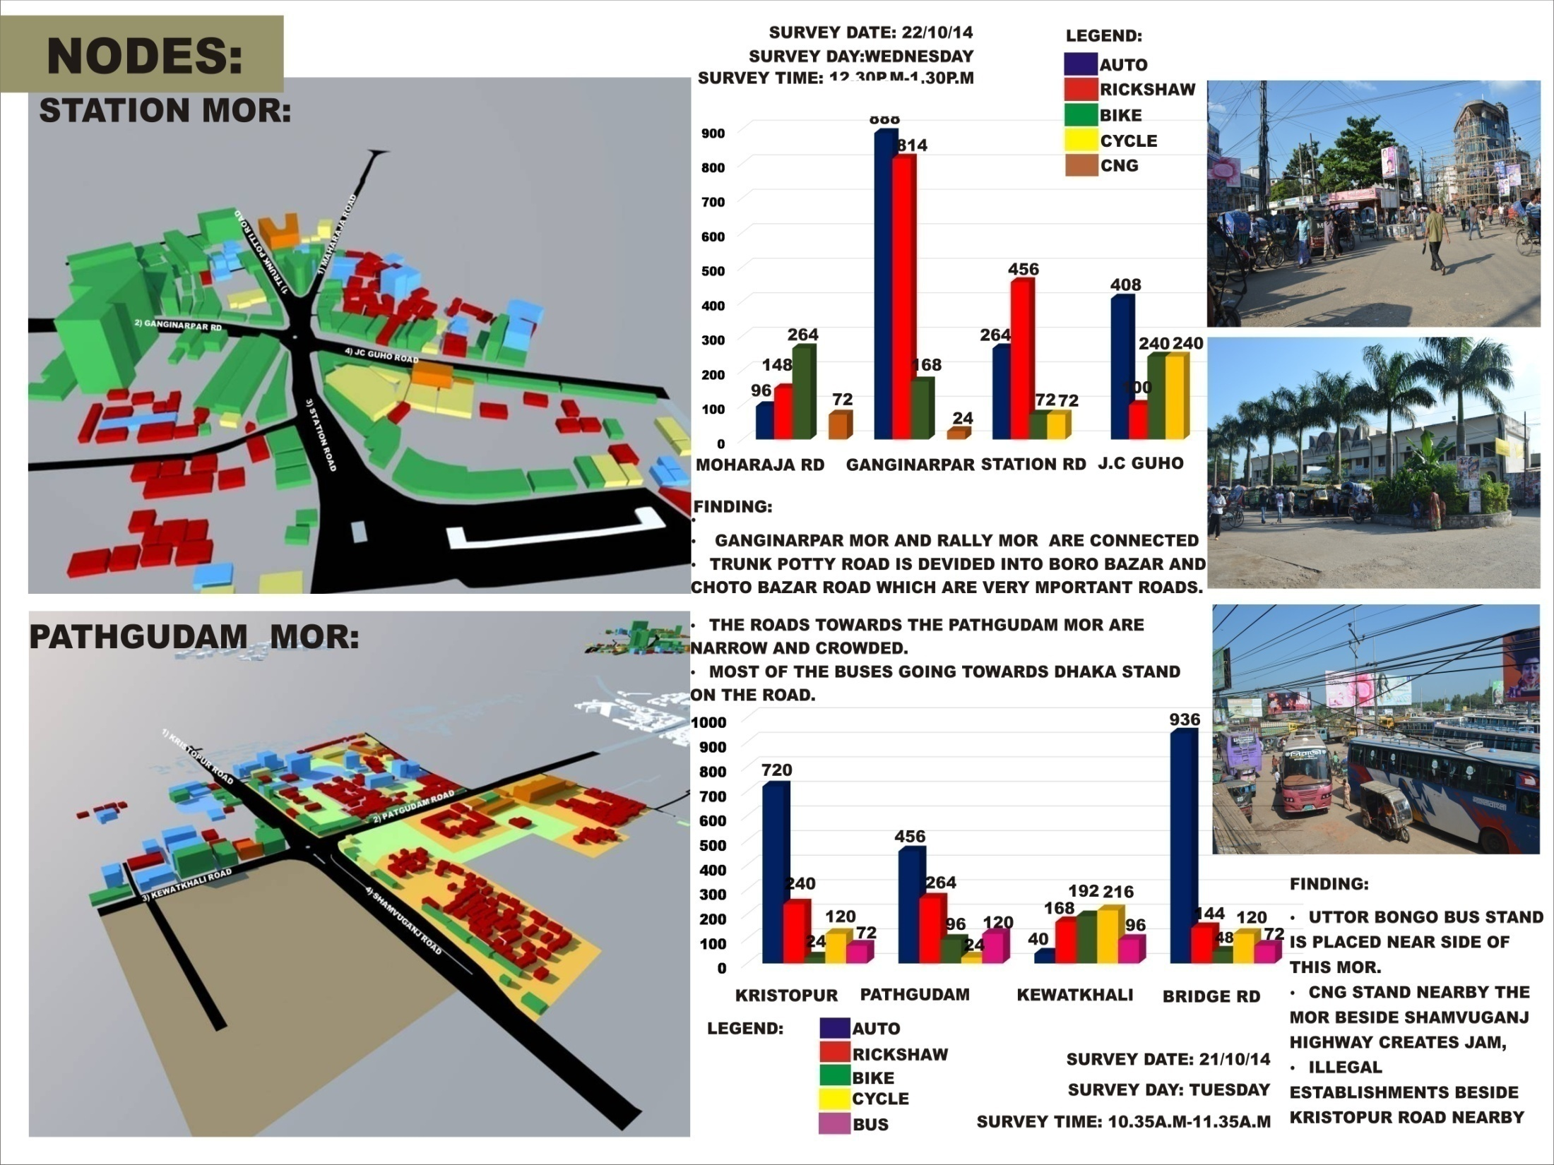

Slide 16
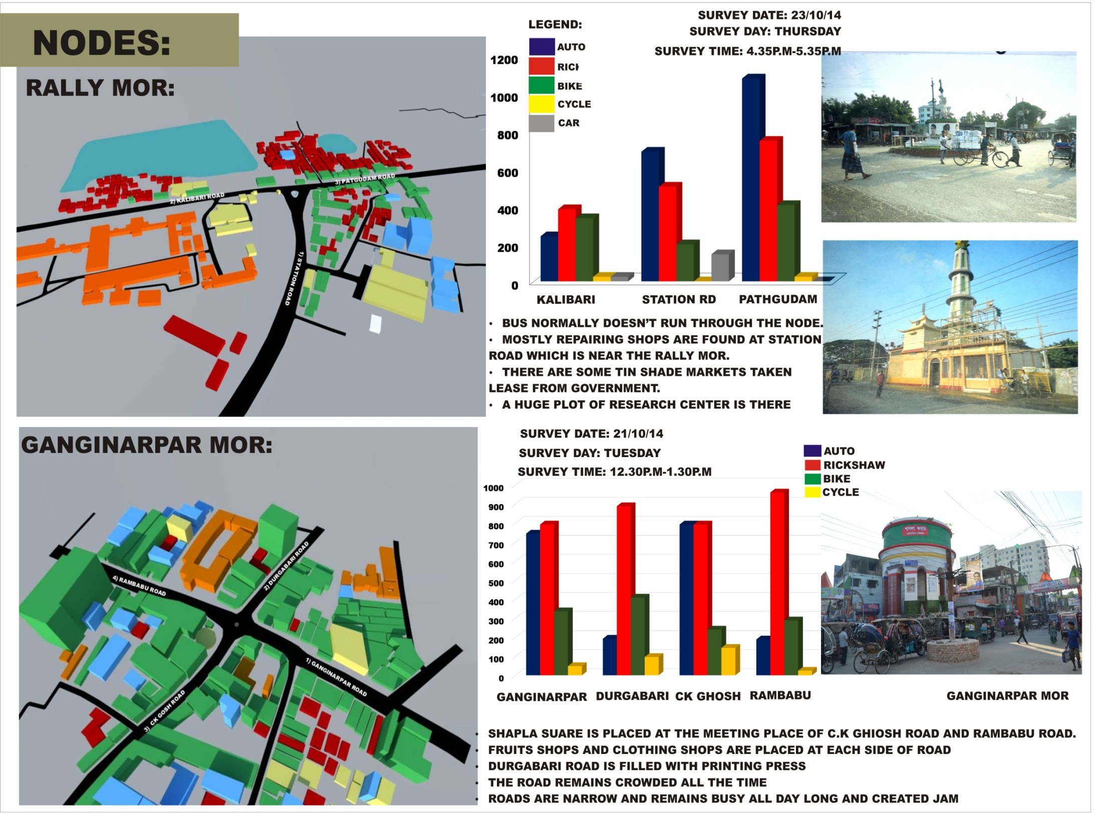

Slide 17
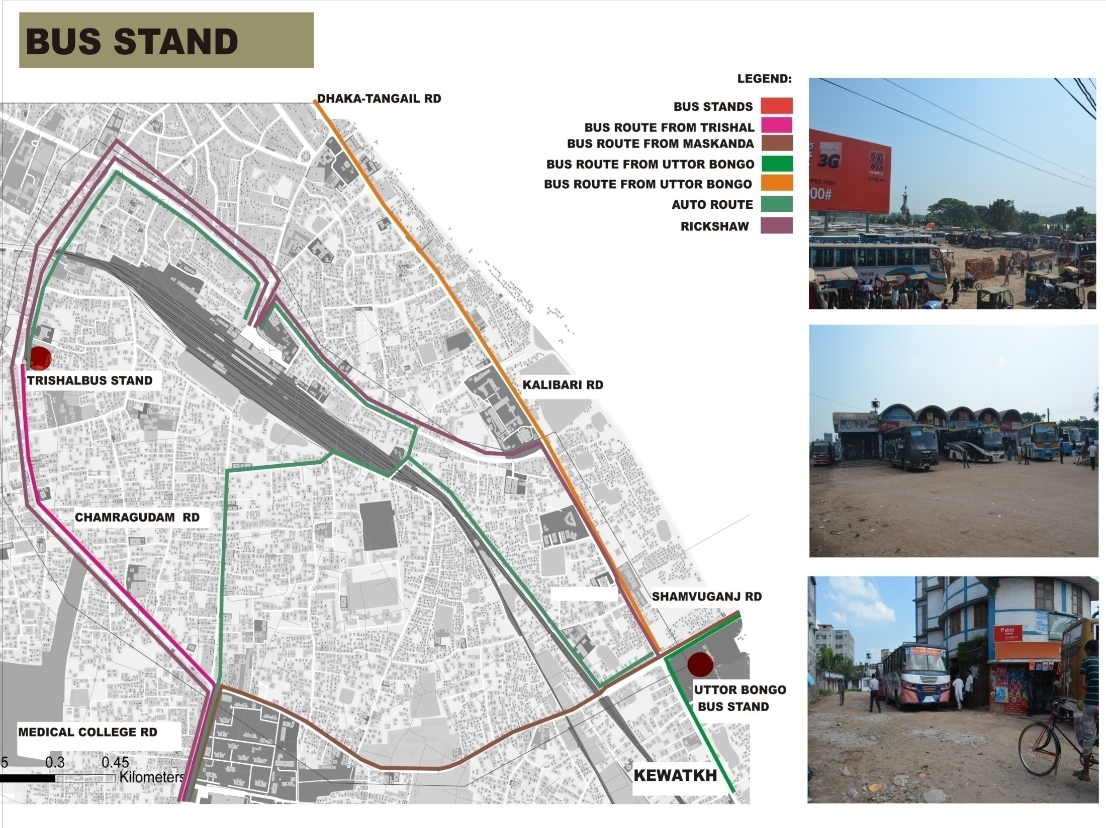

Slide 18
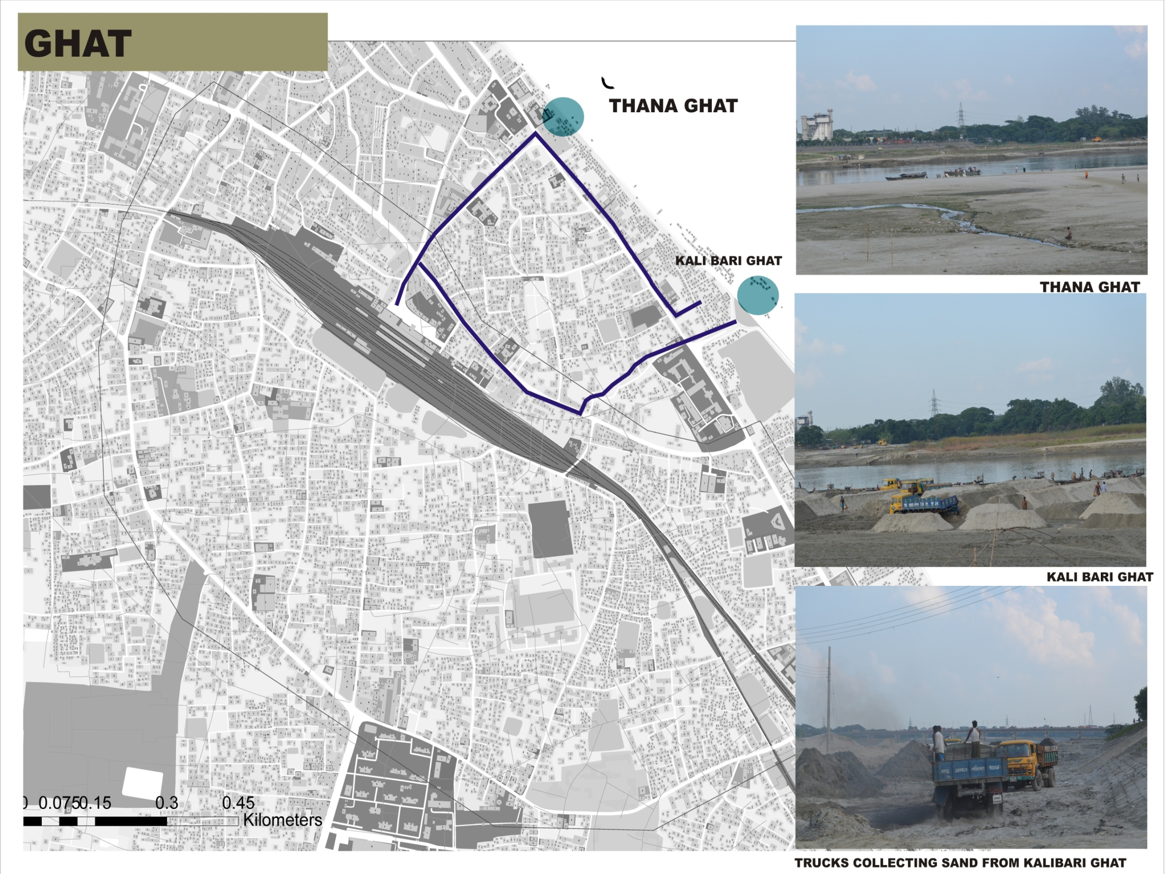

Slide 23
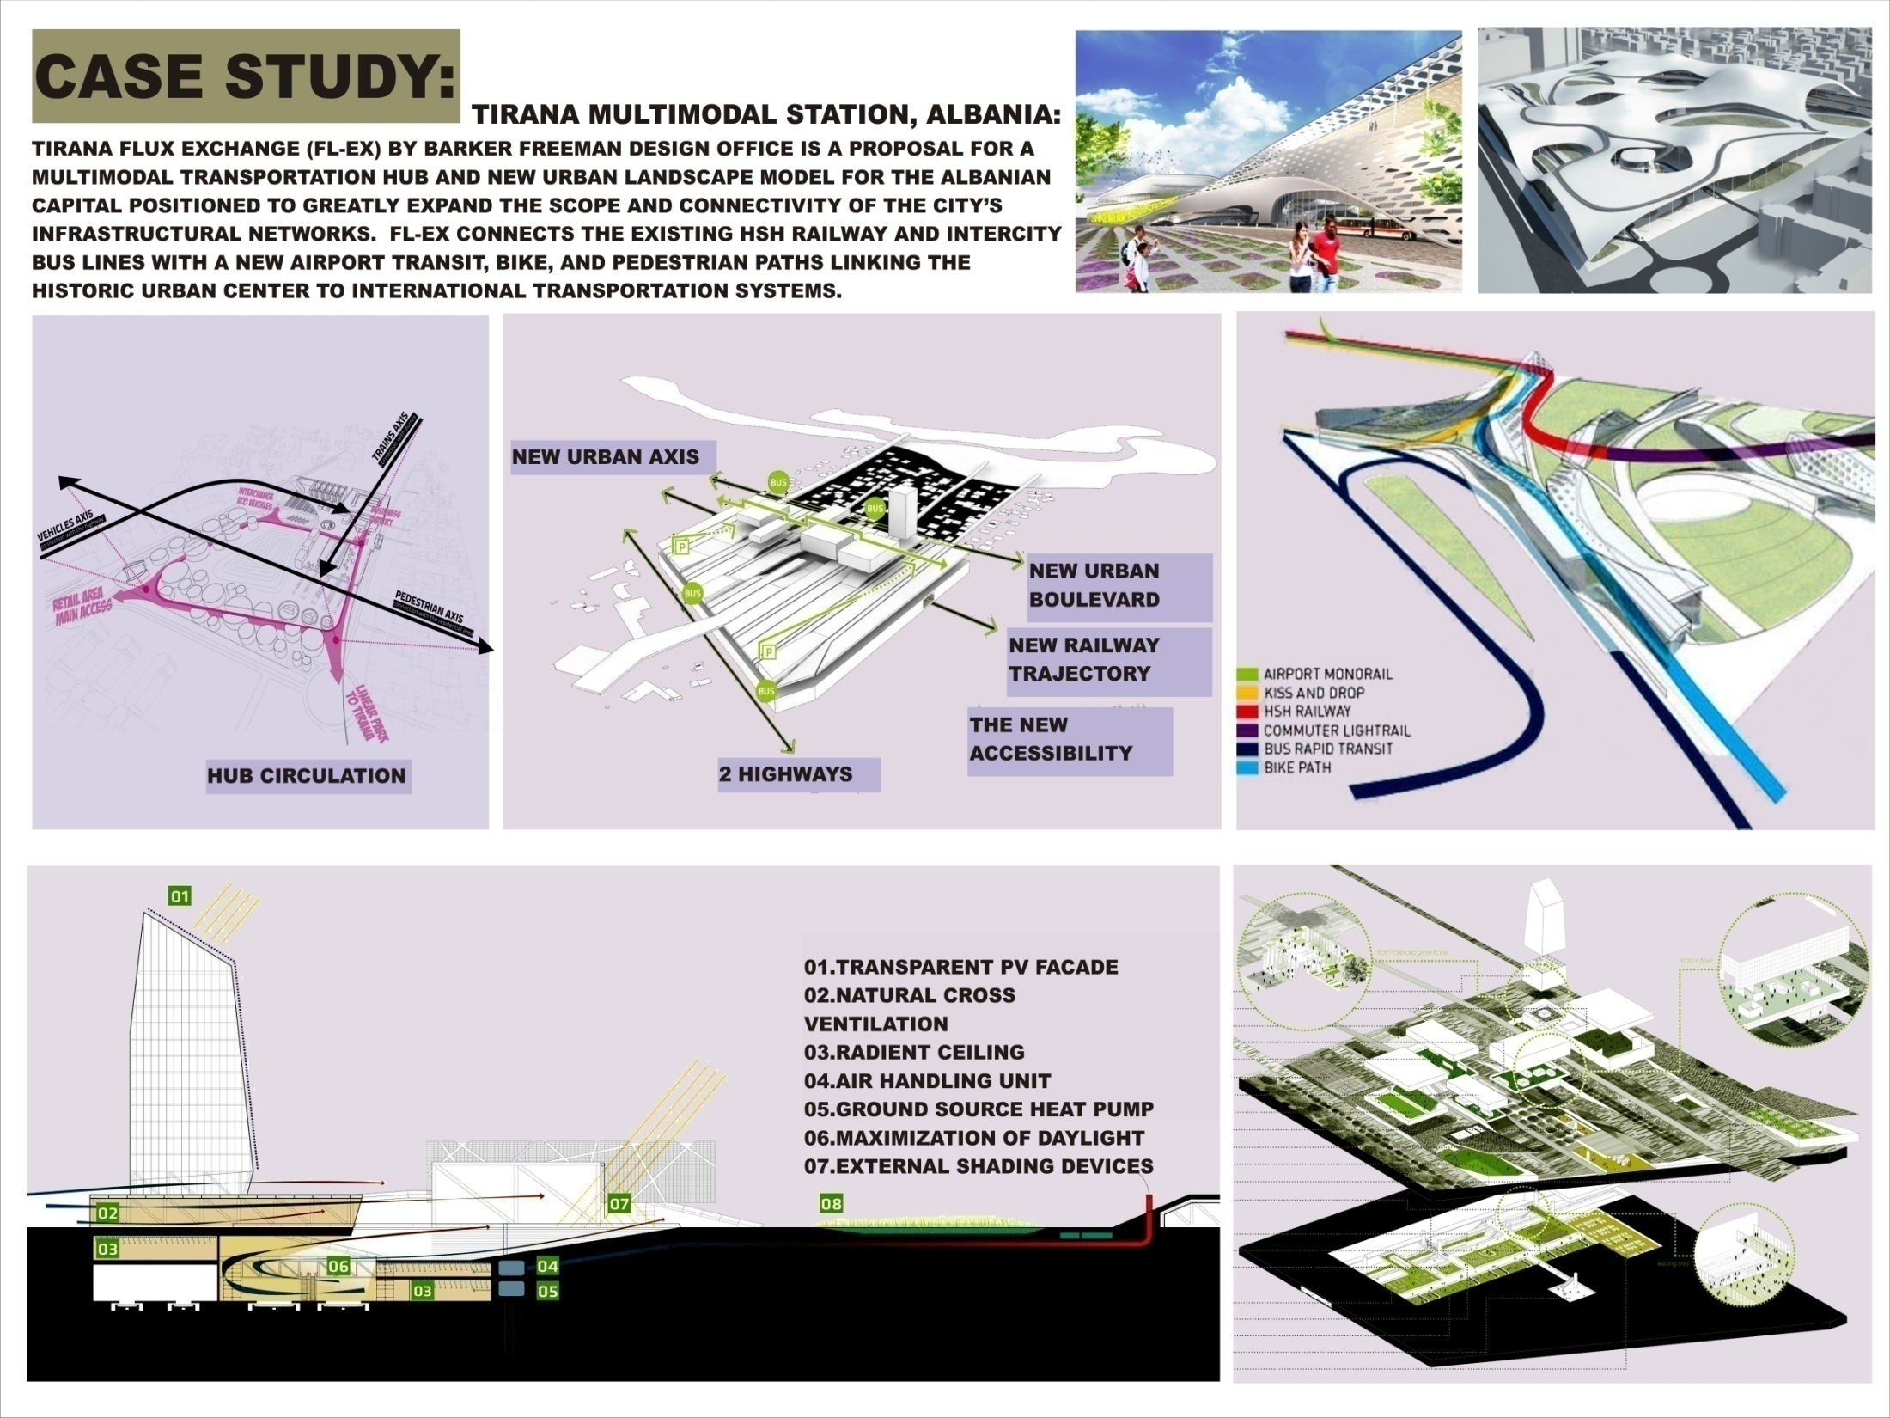

Slide 24
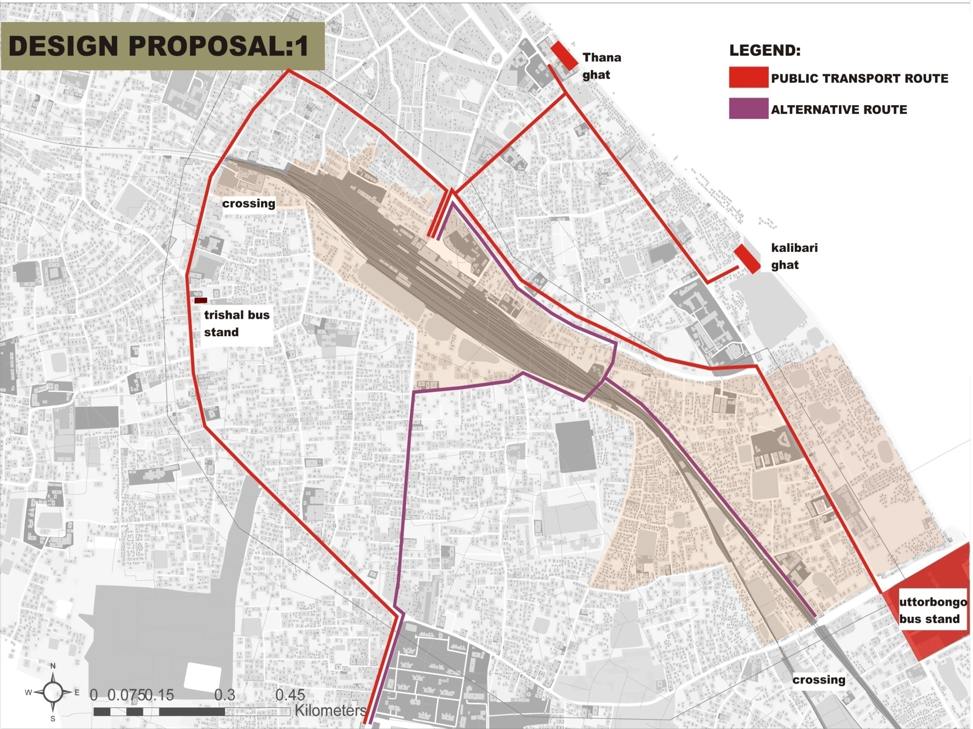

Slide 28
