Slide 1
Road Network Design

Slide 2
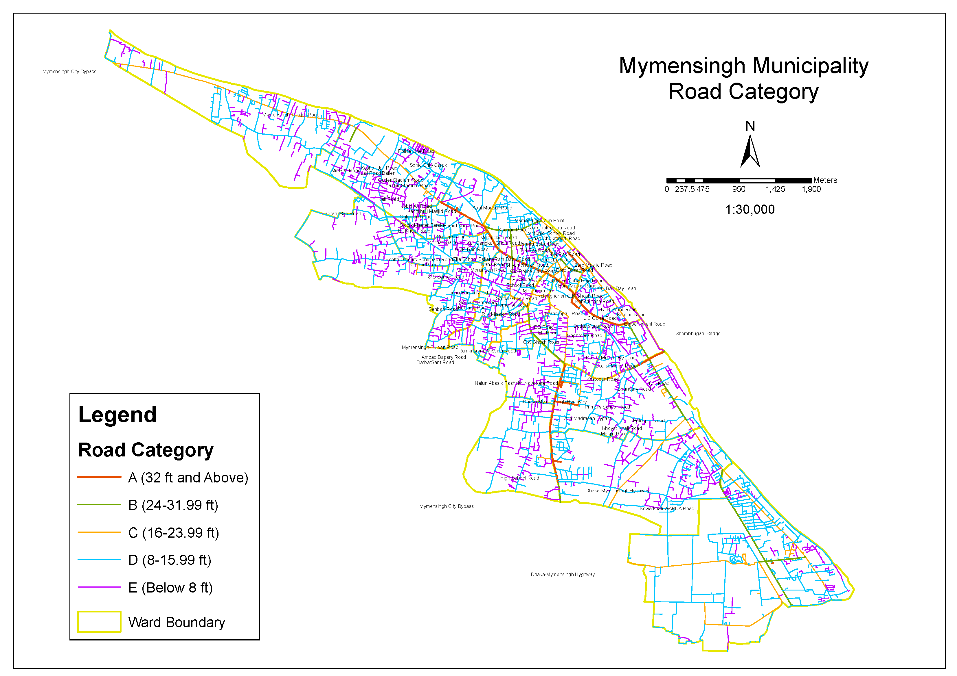
Existing Road Network

Slide 3
Existing Road Category According to Width
Ward No. | Road Category (Length in km) |  |  |  |  | Total
 | A(32ft Above) | B (24-31.99ft) | C (16-23.99ft) | D (8-15.99ft) | E (Below 8 ft)
1 |  |  | 5.41 | 13.06 | 7.36 | 25.82
2 | 1.33 | 0.2 | 4.9 | 24.86 | 11.99 | 43.28
3 | 2.89 | 0.79 | 0.62 | 11.62 | 4.09 | 20.01
4 |  |  | 0.14 | 8.33 | 5.68 | 14.15
5 | 1.53 |  | 0.93 | 20.59 | 4.52 | 27.56
6 | 0.03 |  | 1.99 | 10 | 6.91 | 18.93
7 |  | 1.14 | 3.09 | 7.74 | 1.74 | 13.72
8 | 0.33 | 0.33 | 3.24 | 3.41 | 2.54 | 9.84
9 | 3.93 | 1.61 | 2.21 | 3.18 | 4.17 | 15.09
10 | 1.53 | 0.65 | 1.22 | 4.68 | 3.79 | 11.87
11 |  |  |  | 3.38 | 1.57 | 4.95
12 |  |  |  | 3.61 | 2.97 | 6.58
13 |  |  | 0.78 | 4.34 | 1.64 | 6.77
14 |  |  |  | 3.65 | 3.57 | 7.22
15 |  |  | 0.43 | 8.01 | 6.56 | 15
16 | 1.53 | 0.34 | 3.14 | 2.39 | 2.51 | 9.91
17 | 4.83 | 1.03 | 2.58 | 6.4 | 5.67 | 20.52
18 |  | 1.51 | 0.12 | 3.39 | 5.71 | 10.72
19 | 4.04 | 2.14 | 8.63 | 20.59 | 11.11 | 46.5
20 | 3.3 | 3.82 | 9.69 | 22.51 | 9.92 | 49.25
21 | 0.02 | 2.59 | 7.77 | 34.63 | 5.06 | 50.08
Grand Total | 25.28 | 16.15 | 56.88 | 220.37 | 109.07 | 427.75

Slide 4
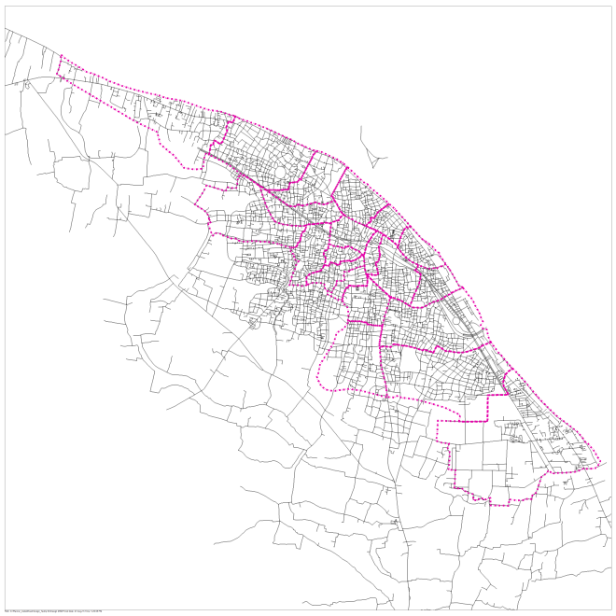
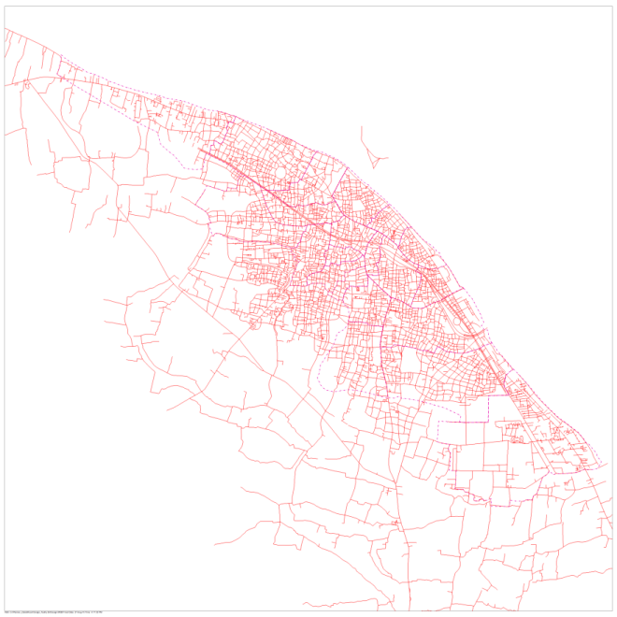
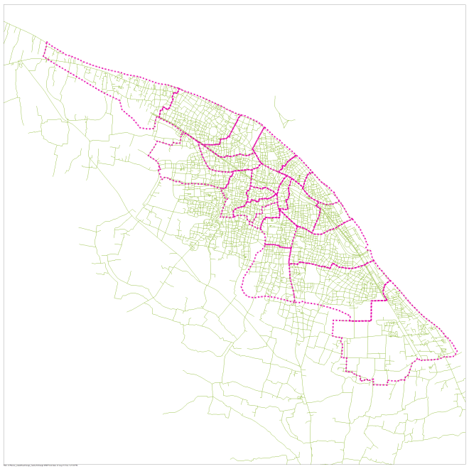
Road Widening
12 ft
16 ft
20 ft
Road Width | Affected Structure
12 ft | 12013
16 ft | 16592
20 ft | 20646

Slide 5
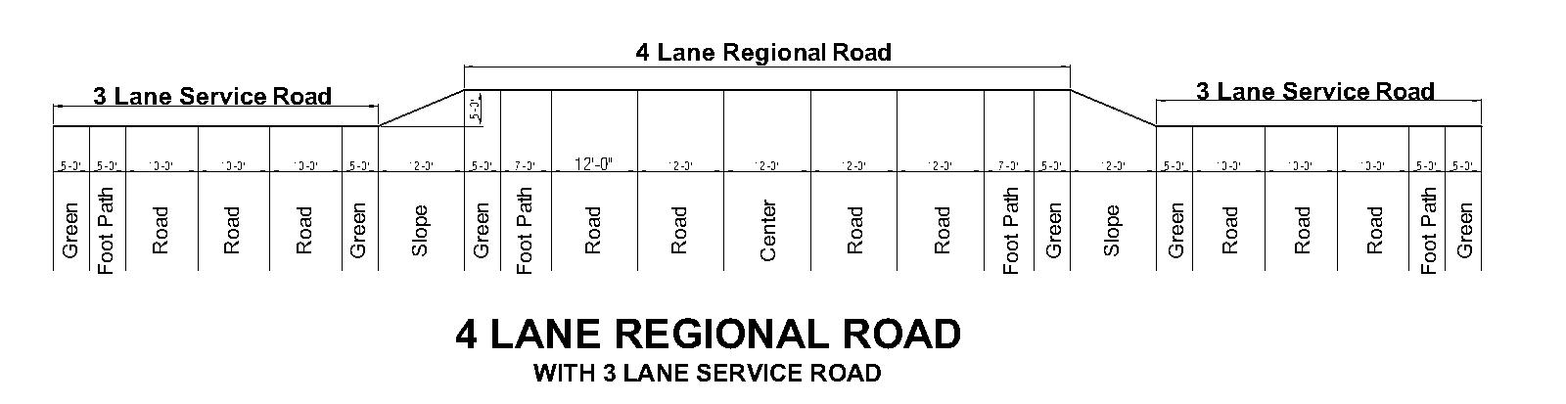
Define Road Category and Lane
Regional Road:
4 Lane (12ft per lane) Regional Road with 3 Lane (10ft per lane) Service Road
84 ft Regional Road
45 ft Service Road with Footpath
Cross Section of Regional Road:

Slide 6
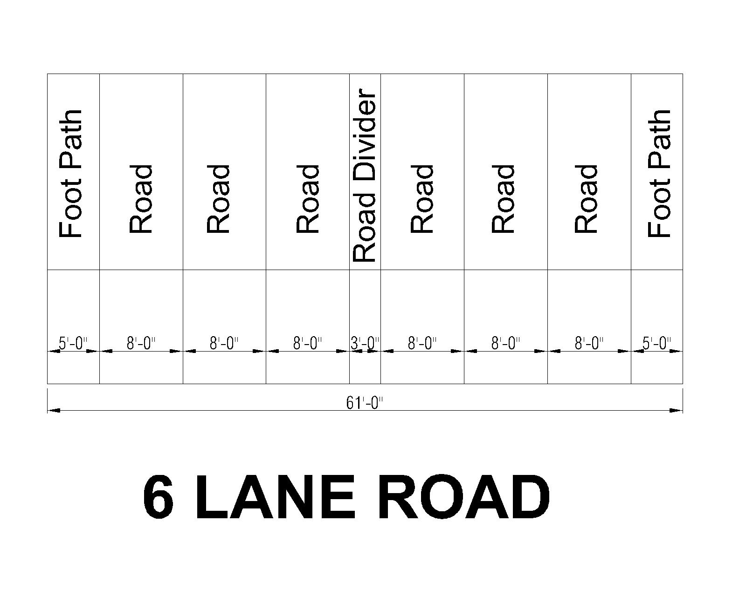
Define Road Category and Lane
2. Primary Road:
6 Lane (8 ft per lane) Road
3 ft Divider on Center and 5 ft Footpath both side
total 61 ft Primary Road
Cross Section of Primary Road:

Slide 7
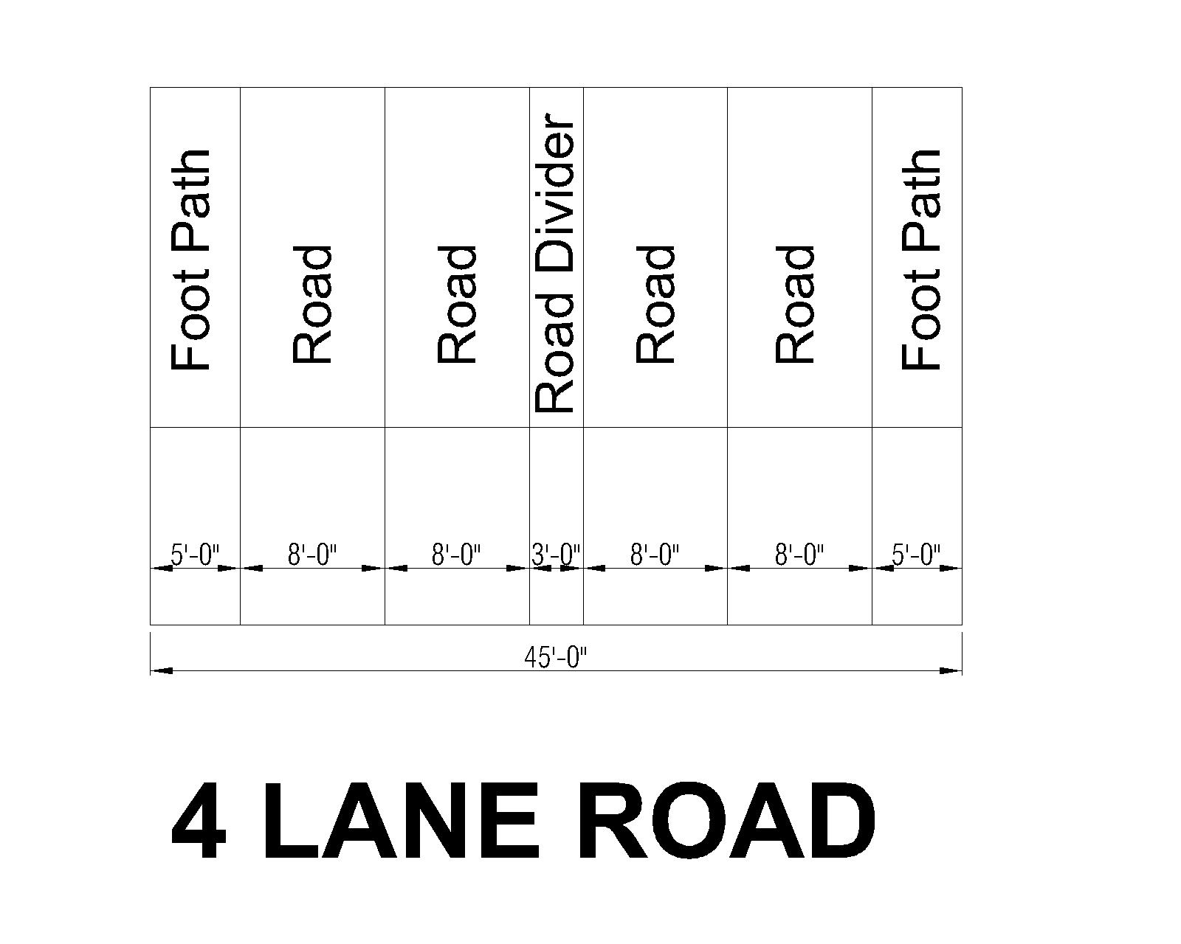
Define Road Category and Lane
3. Secondary Road:
4 Lane (8 ft per lane) Road
3 ft Divider on Center and 5 ft Footpath both side
total 45 ft Secondary Road
Cross Section of Secondary Road:

Slide 8
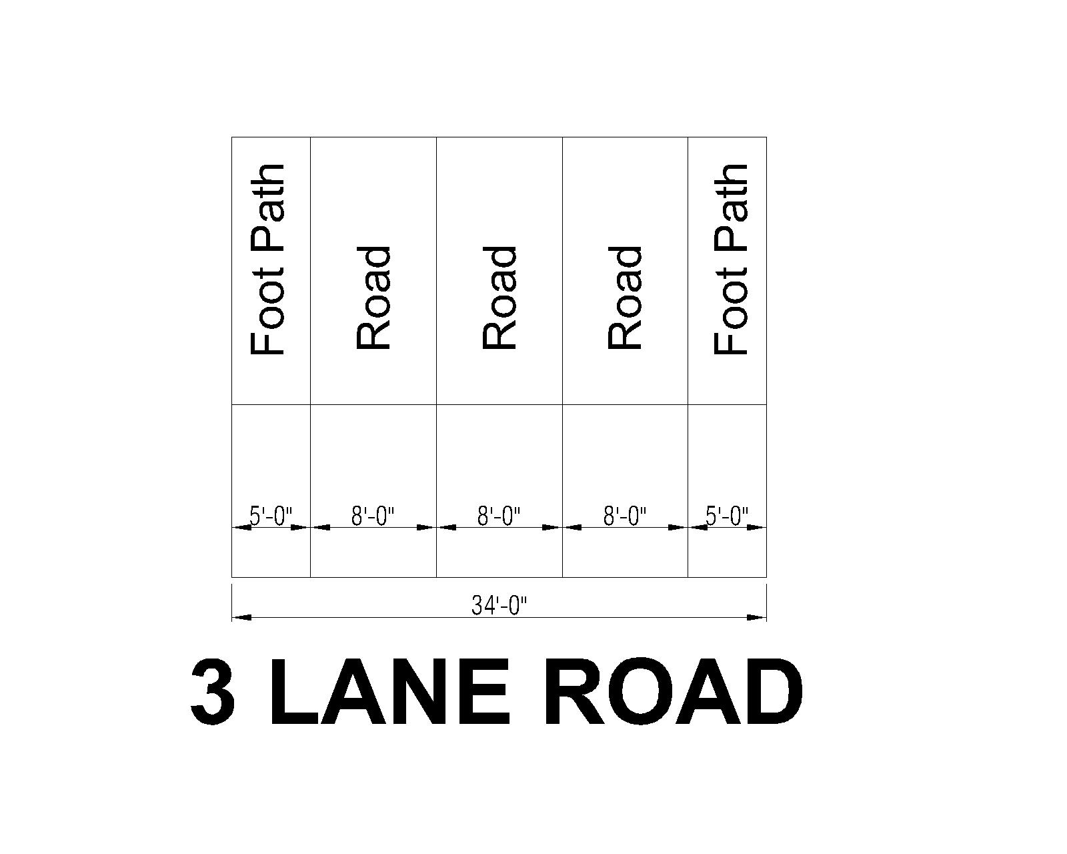
Define Road Category and Lane
4. Local Road:
3 Lane (8 ft per lane) Road
5 ft Footpath both side
total 34 ft Local Road
Cross Section of Local Road:

Slide 9
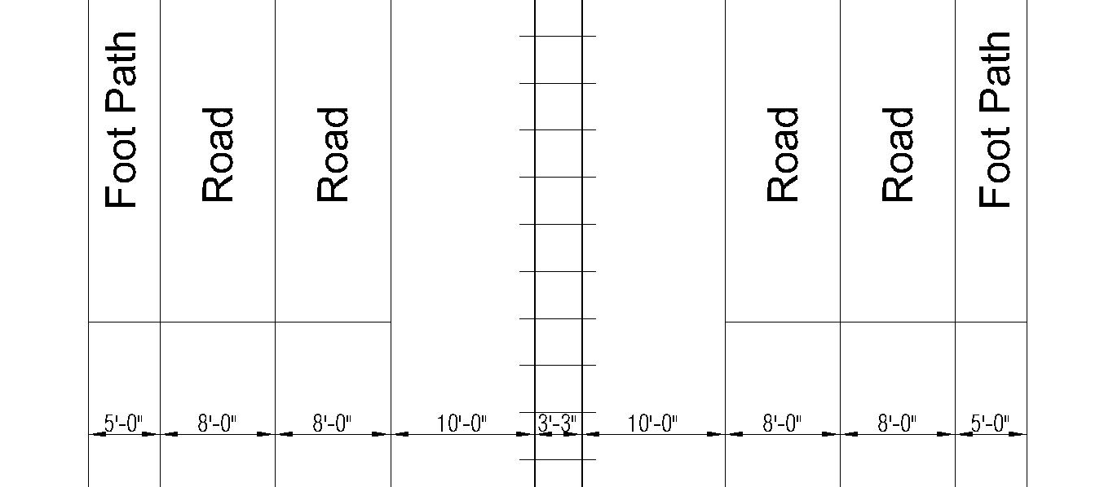
Define Road Category and Lane
5. Rail Road:
20 ft Rail Buffer
2 Lane Road on both side of Rail Track
5 ft Footpath both side
total 62 ft Rail Road
Cross Section of Rail Road:

Slide 10
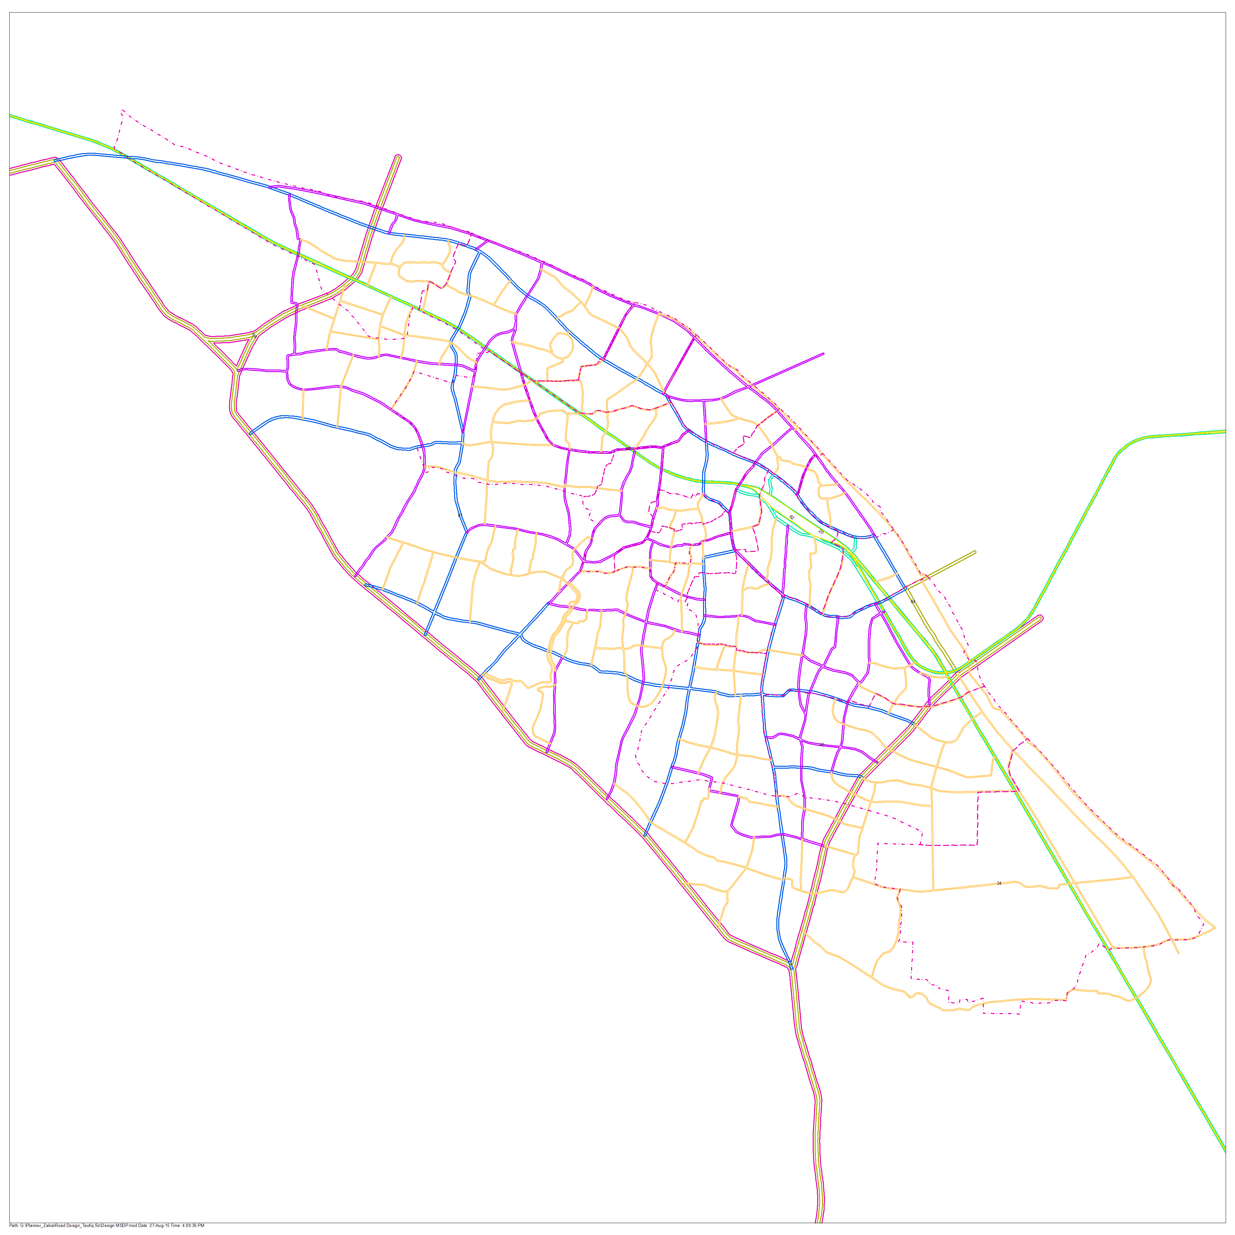
Urban Area
Proposed Road Network

Slide 11
Floor wise List of Affected Structure
Floor | Katcha | Pucca | Semi-pucca | Tin-Shed | Under Construction | Grand Total
0 | 4 |  | 23 |  |  | 27
1 | 2073 | 1150 | 4978 | 536 | 11 | 8748
2 | 4 | 498 | 19 | 4 |  | 525
3 |  | 311 | 4 |  |  | 315
4 |  | 184 | 2 |  |  | 186
5 |  | 81 | 1 |  |  | 82
6 |  | 28 | 1 |  |  | 29
7 |  | 1 |  |  |  | 1
8 |  | 1 |  |  |  | 1
9 |  | 2 |  |  |  | 2
10 |  | 7 |  |  |  | 7
11 |  | 2 |  |  |  | 2
13 |  | 1 |  |  |  | 1
14 |  | 1 |  |  |  | 1
Grand Total | 2081 | 2267 | 5028 | 540 | 11 | 9927

Slide 12
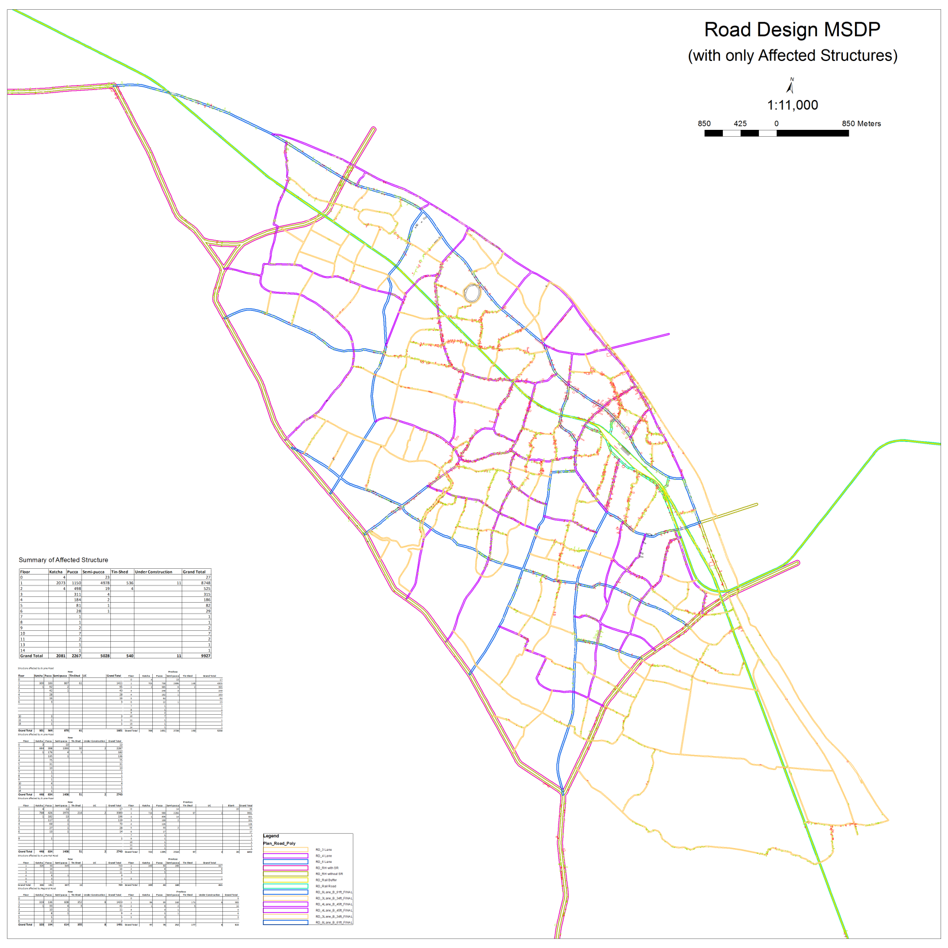

Slide 13
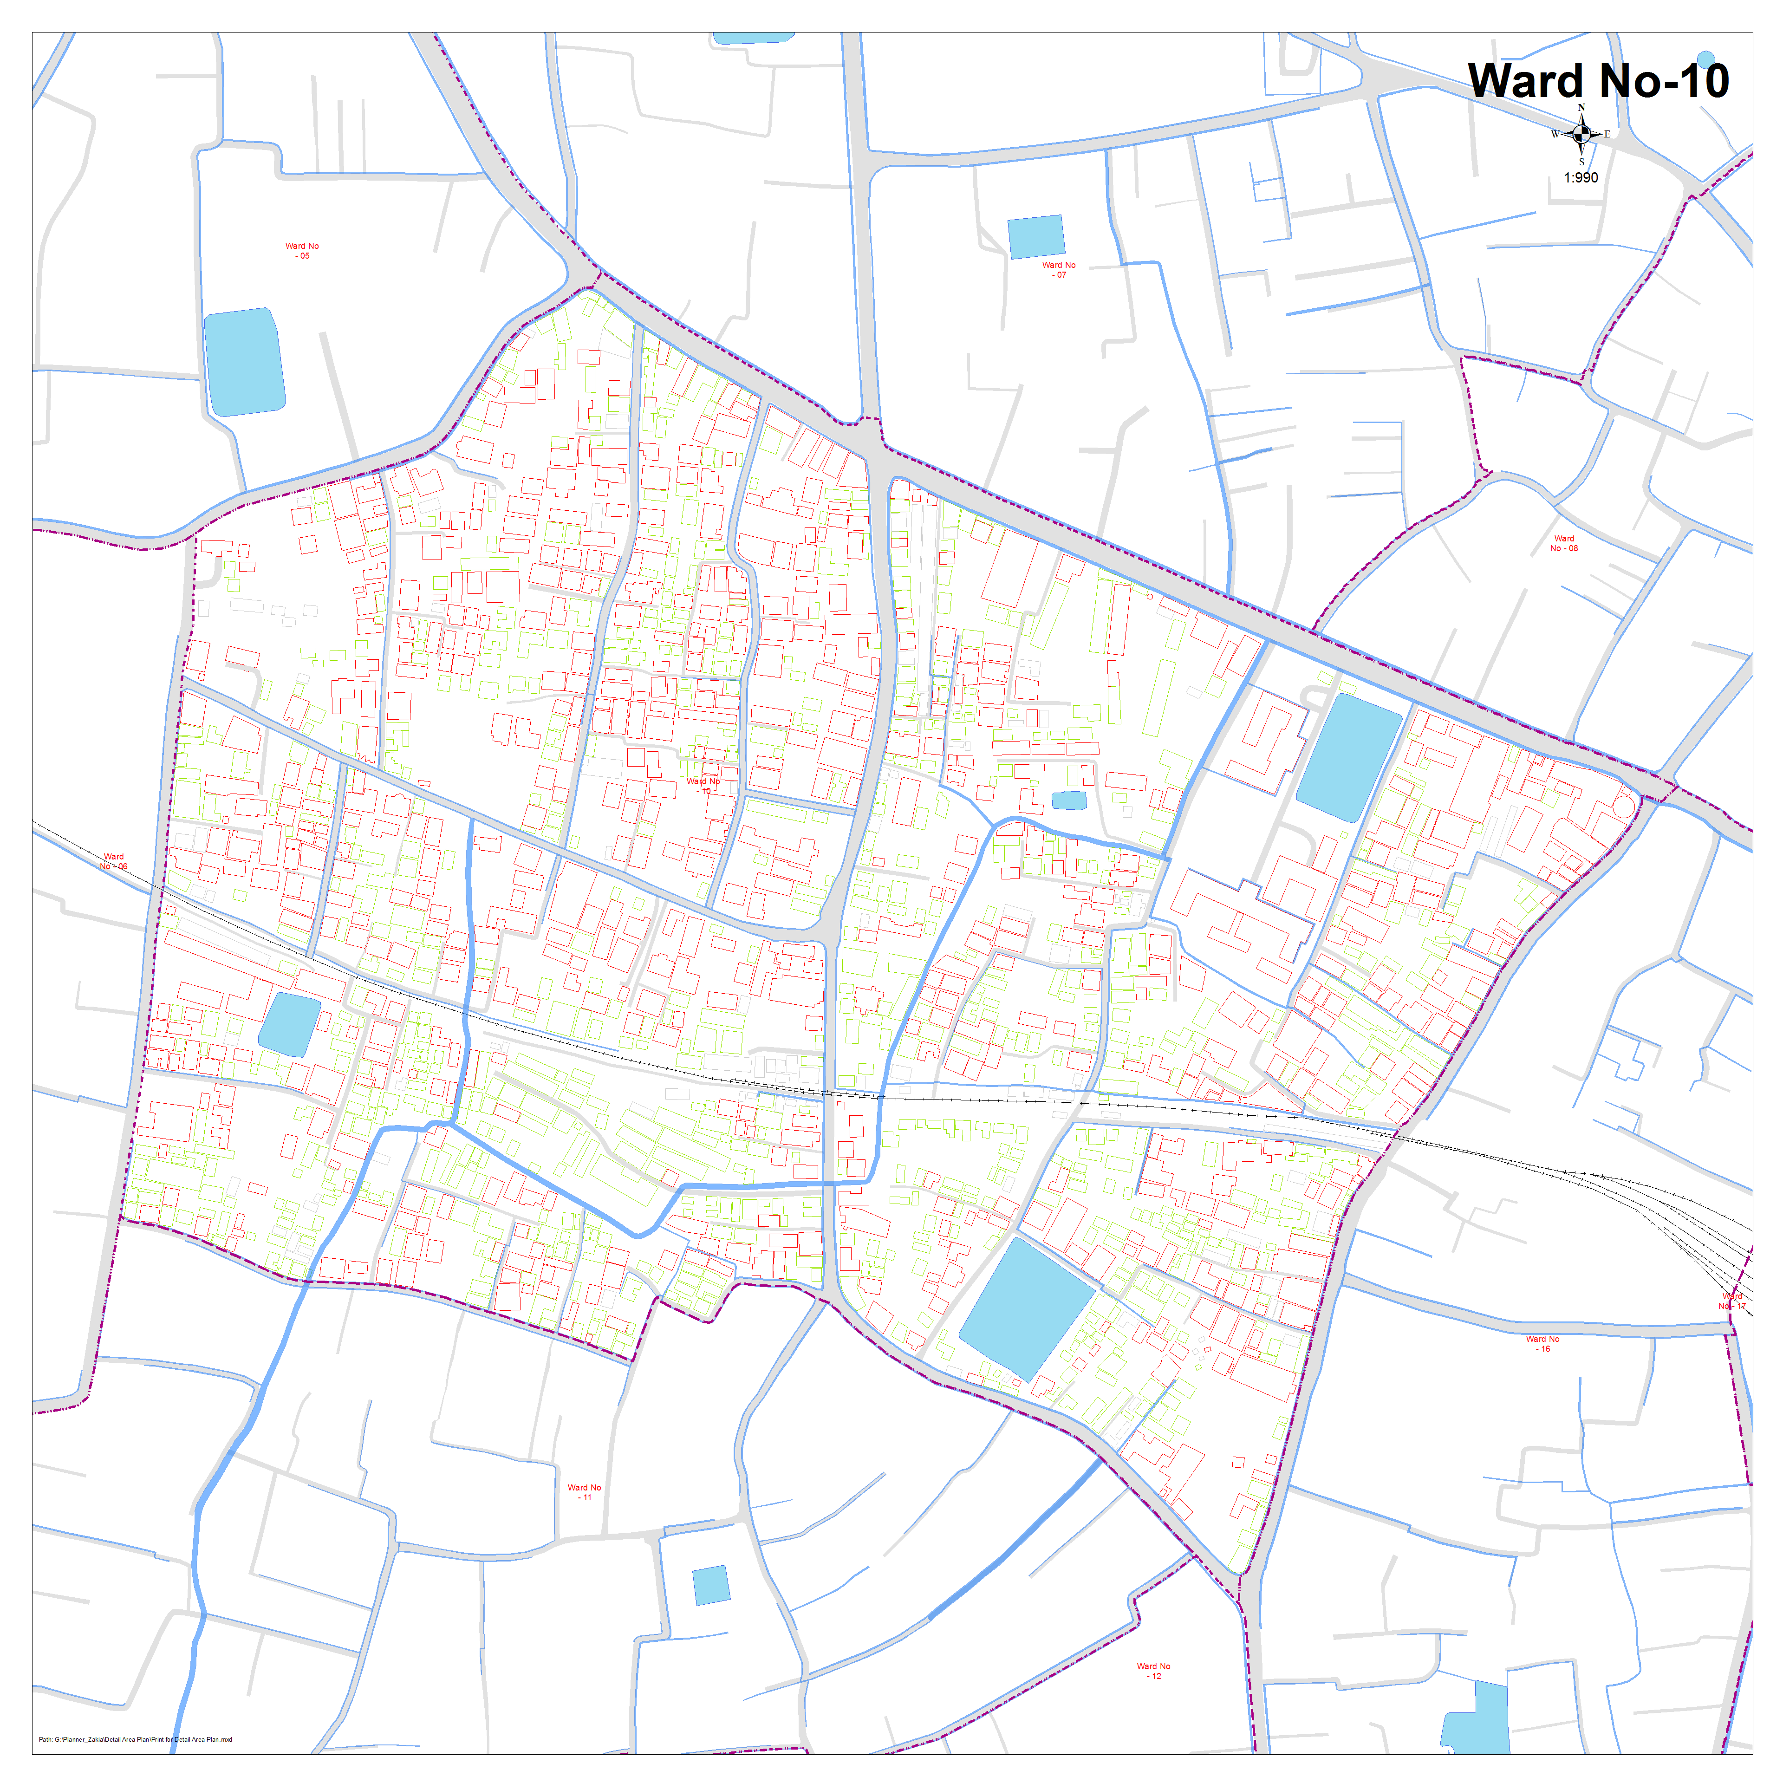
Detailed Road Design
Existing Road Network (Ward-10)

Slide 14
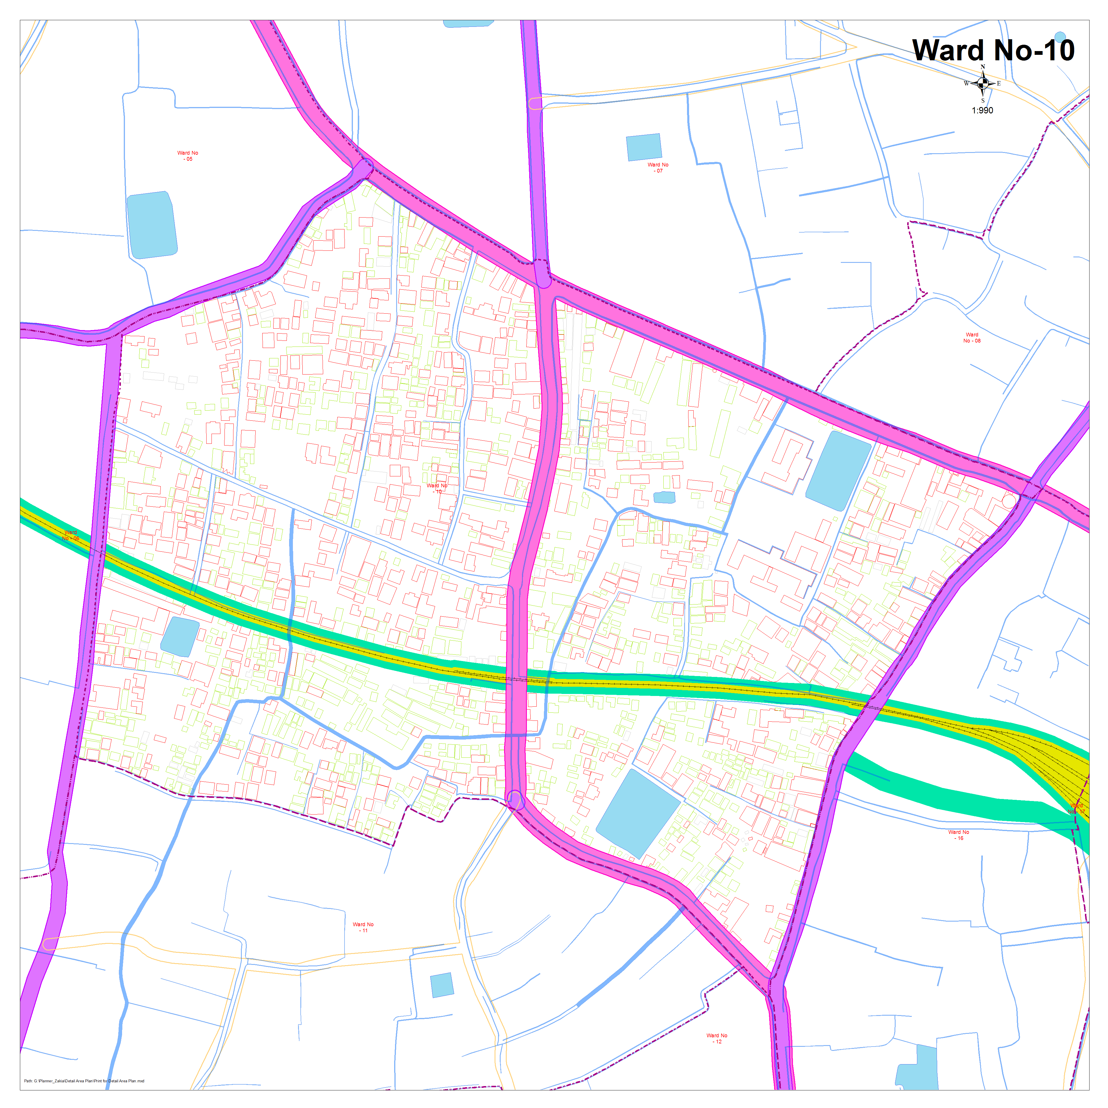
Detailed Road Design
(Ward-10)
Proposed Road Network According
to Previous Standard

Slide 15
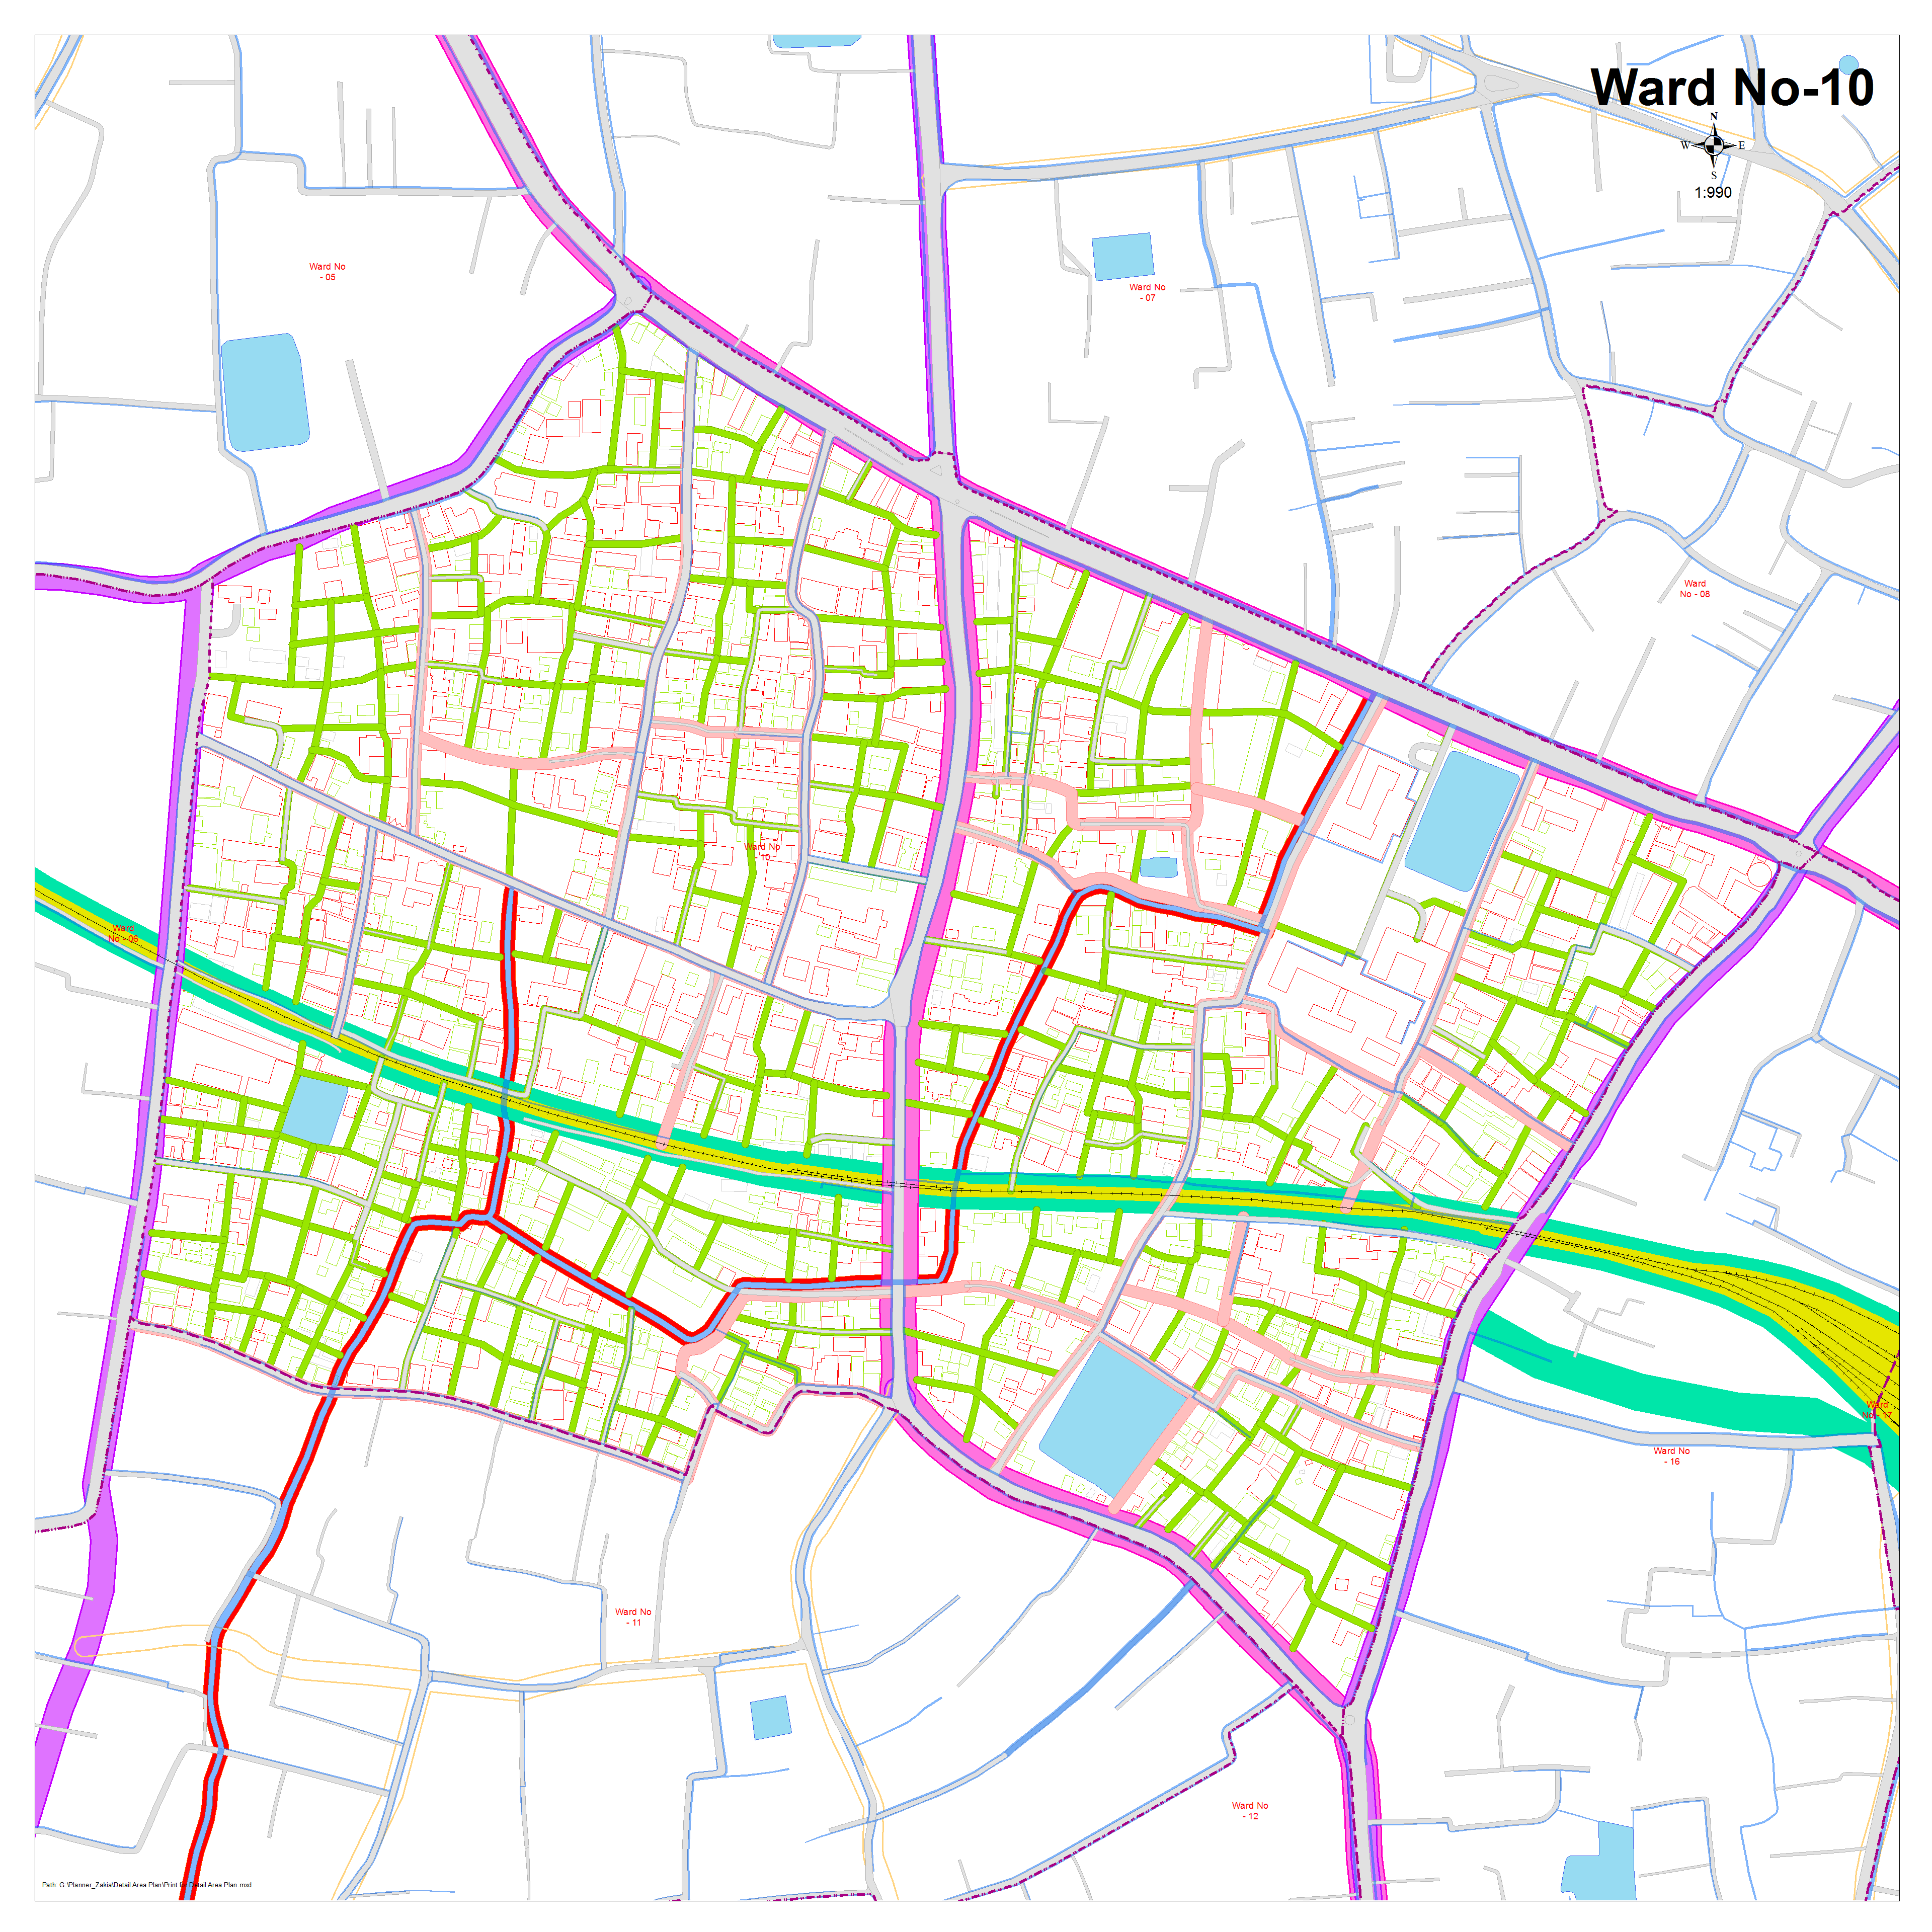
Detailed Road Design
(Ward-10)

