Slide 1
1st Step of Structure Plan Preparation
Image Collection and Processing

Slide 2
Steps of Image Collection & Processing
Sl. No . | Name of work
1 | Image Collection
2 | Processing of Image
3 | Rectification
4 | Cleaning of Image
5 | Bandwidth Colour Composition
6 | Geo Referencing of Image

Slide 3
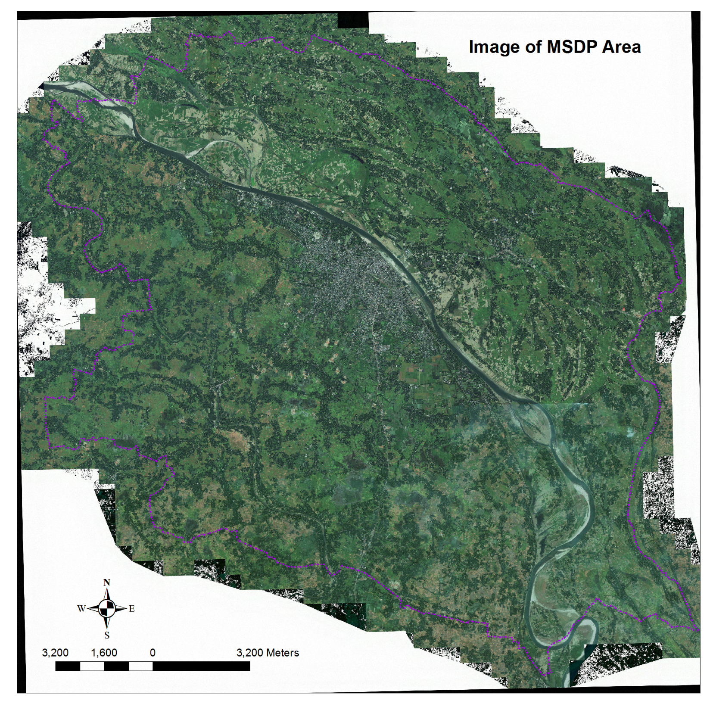

Slide 4
2st Step of Structure Plan Preparation
Digitization and Field Check

Slide 5
Steps of Digitization and Field Check
Sl | Name of work | Sl | Name of work
7 | Prepare .shp file for Digitization With Arc GIS | 30 | Varification of Ward wise database and Map fron Municipality
8 | Physical Feature Digitization from Image | 31 | Wardwise map Prepare and Print
9 | Prepared Map from Image Digitization for Field Check and Data Collection | 32 | Para/ Neighborhood Demarcation From BBS
10 | Physical Feature Survey and Data Collection with the help of Previously Digitized map | 33 | Field Check of Para/ Neighborhood Demarcation
11 | GIS Database Prepare and Update from Collected Field Data | 34 | Reform/Correction and Update of Para/ Neighborhood Boundary
12 | Field Check By MSDP Team | 35 | Parawise Database Preparation
13 | Additional Building Data Collection By MSDP Team | 36 | Parawise Map prepare and Print
14 | Floor wise Building Data Collected from Field By MSDP Team | 37 | Varification of Para wise database and Map from Municipality
15 | GIS Database Prepare and Update By MSDP Team | 38 | Unionwise Database prepare
16 | Physical feature database | 39 | Specify Growth centers from unions and
17 | Building use Decleration | 40 | Map Prepare and Print fron Union Database
18 | Landuse database | 41 | Field check of two Union and 10 Specific Growth cener
19 | Important point Feature database | 42 | Database of Unions and Growth Centers are Corrected and Updated
20 | Road Network Database | 43 | Print Growth Center and Union Database
21 | Waterbody Database | 44 | Print Unionwise Map
22 | Drainage database | 45 | Sample Field check of Different database
23 | Embankment,Bridge, Culvert Database | 46 | Analysis of Different Database
24 | Admin boundary Demarcation | 47 | Map Preparation From Different Database and
25 | KPI Demarcation | 48 | Print Map
26 | Educational Structure demarcation
27 | Religious Facilities Demarcation
28 | Ward wise Database prepare
29 | Ward wise Database and Map Print

Slide 6
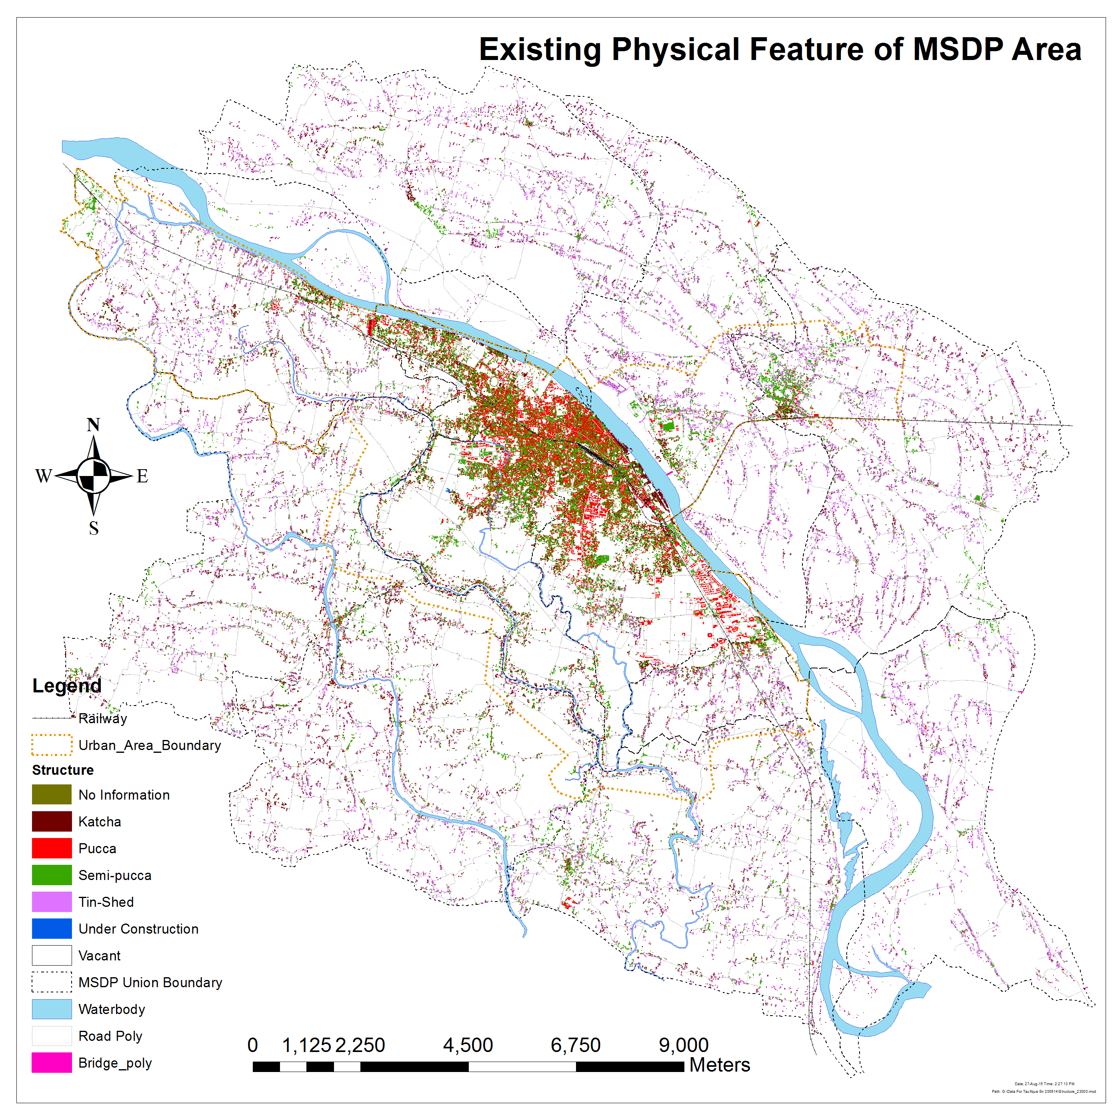
An Example
Physical Feature Survey

Slide 7
An Example
Sl No | Collected Information Type | Sl No | Collected Information Type
1 | Final__ID | 23 | NAME
2 | UDD_Name | 24 | STRUCTYPE
3 | UDD_Ward | 25 | FLOOR
4 | U_Gr_F_Us | 26 | MobileTowe
5 | U_1st_F_Us | 27 | HoldingNo
6 | U_2nd_F_Us | 28 | OccupantDa
7 | U_3rd_F_Us | 29 | OccupantNi
8 | U_4th_F_Us | 30 | OccupancyC
9 | U_5th_F_Us | 31 | StructureA
10 | U_6th_F_Us | 32 | StructureT
11 | U_7th_F_Us | 33 | HeavyOverh
12 | U_8th_F_Us | 34 | NumberApar
13 | U_9th_F_Us | 35 | SoftStory
14 | U_10_F_Us | 36 | PoundingPo
15 | U_11_F_Us | 37 | Stories
16 | U_12_F_Us | 38 | StrucShape
17 | U_Floor | 39 | Ground_Set
18 | UDD_Para | 40 | ShortColum
19 | U_Str_Typ | 41 | PhysicalCo
20 | U_Hol_Num | 42 | Struc_Slop
21 | U_House_H | 43 | Struse1T
22 | U_Con_Year | 44 | Struse2T
 |  | 45 | Struse3T
 |  | 46 | STRUSE4T

Slide 8
An Example

Slide 9
An Example
Existing Water body
Water body Type | Area in Acre | %
Borrow Pits | 47.21 | 0.37
Ditch | 544.27 | 4.27
Gheer (Fish Cultivation Only) | 1496.04 | 11.74
Khal | 327.15 | 2.57
Lake | 62.31 | 0.49
Marsh Land | 3065.74 | 24.05
Pond | 4505.13 | 35.34
River | 2699.19 | 21.18
Grand Total | 12747.05 | 100.00
Waterbody Type | Total No | %
Ditch | 2070 | 8.85
Gheer (Fish Cultivation Only) | 3344 | 14.30
Pond | 17976 | 76.85
Grand Total | 23390 | 100.00

Slide 10
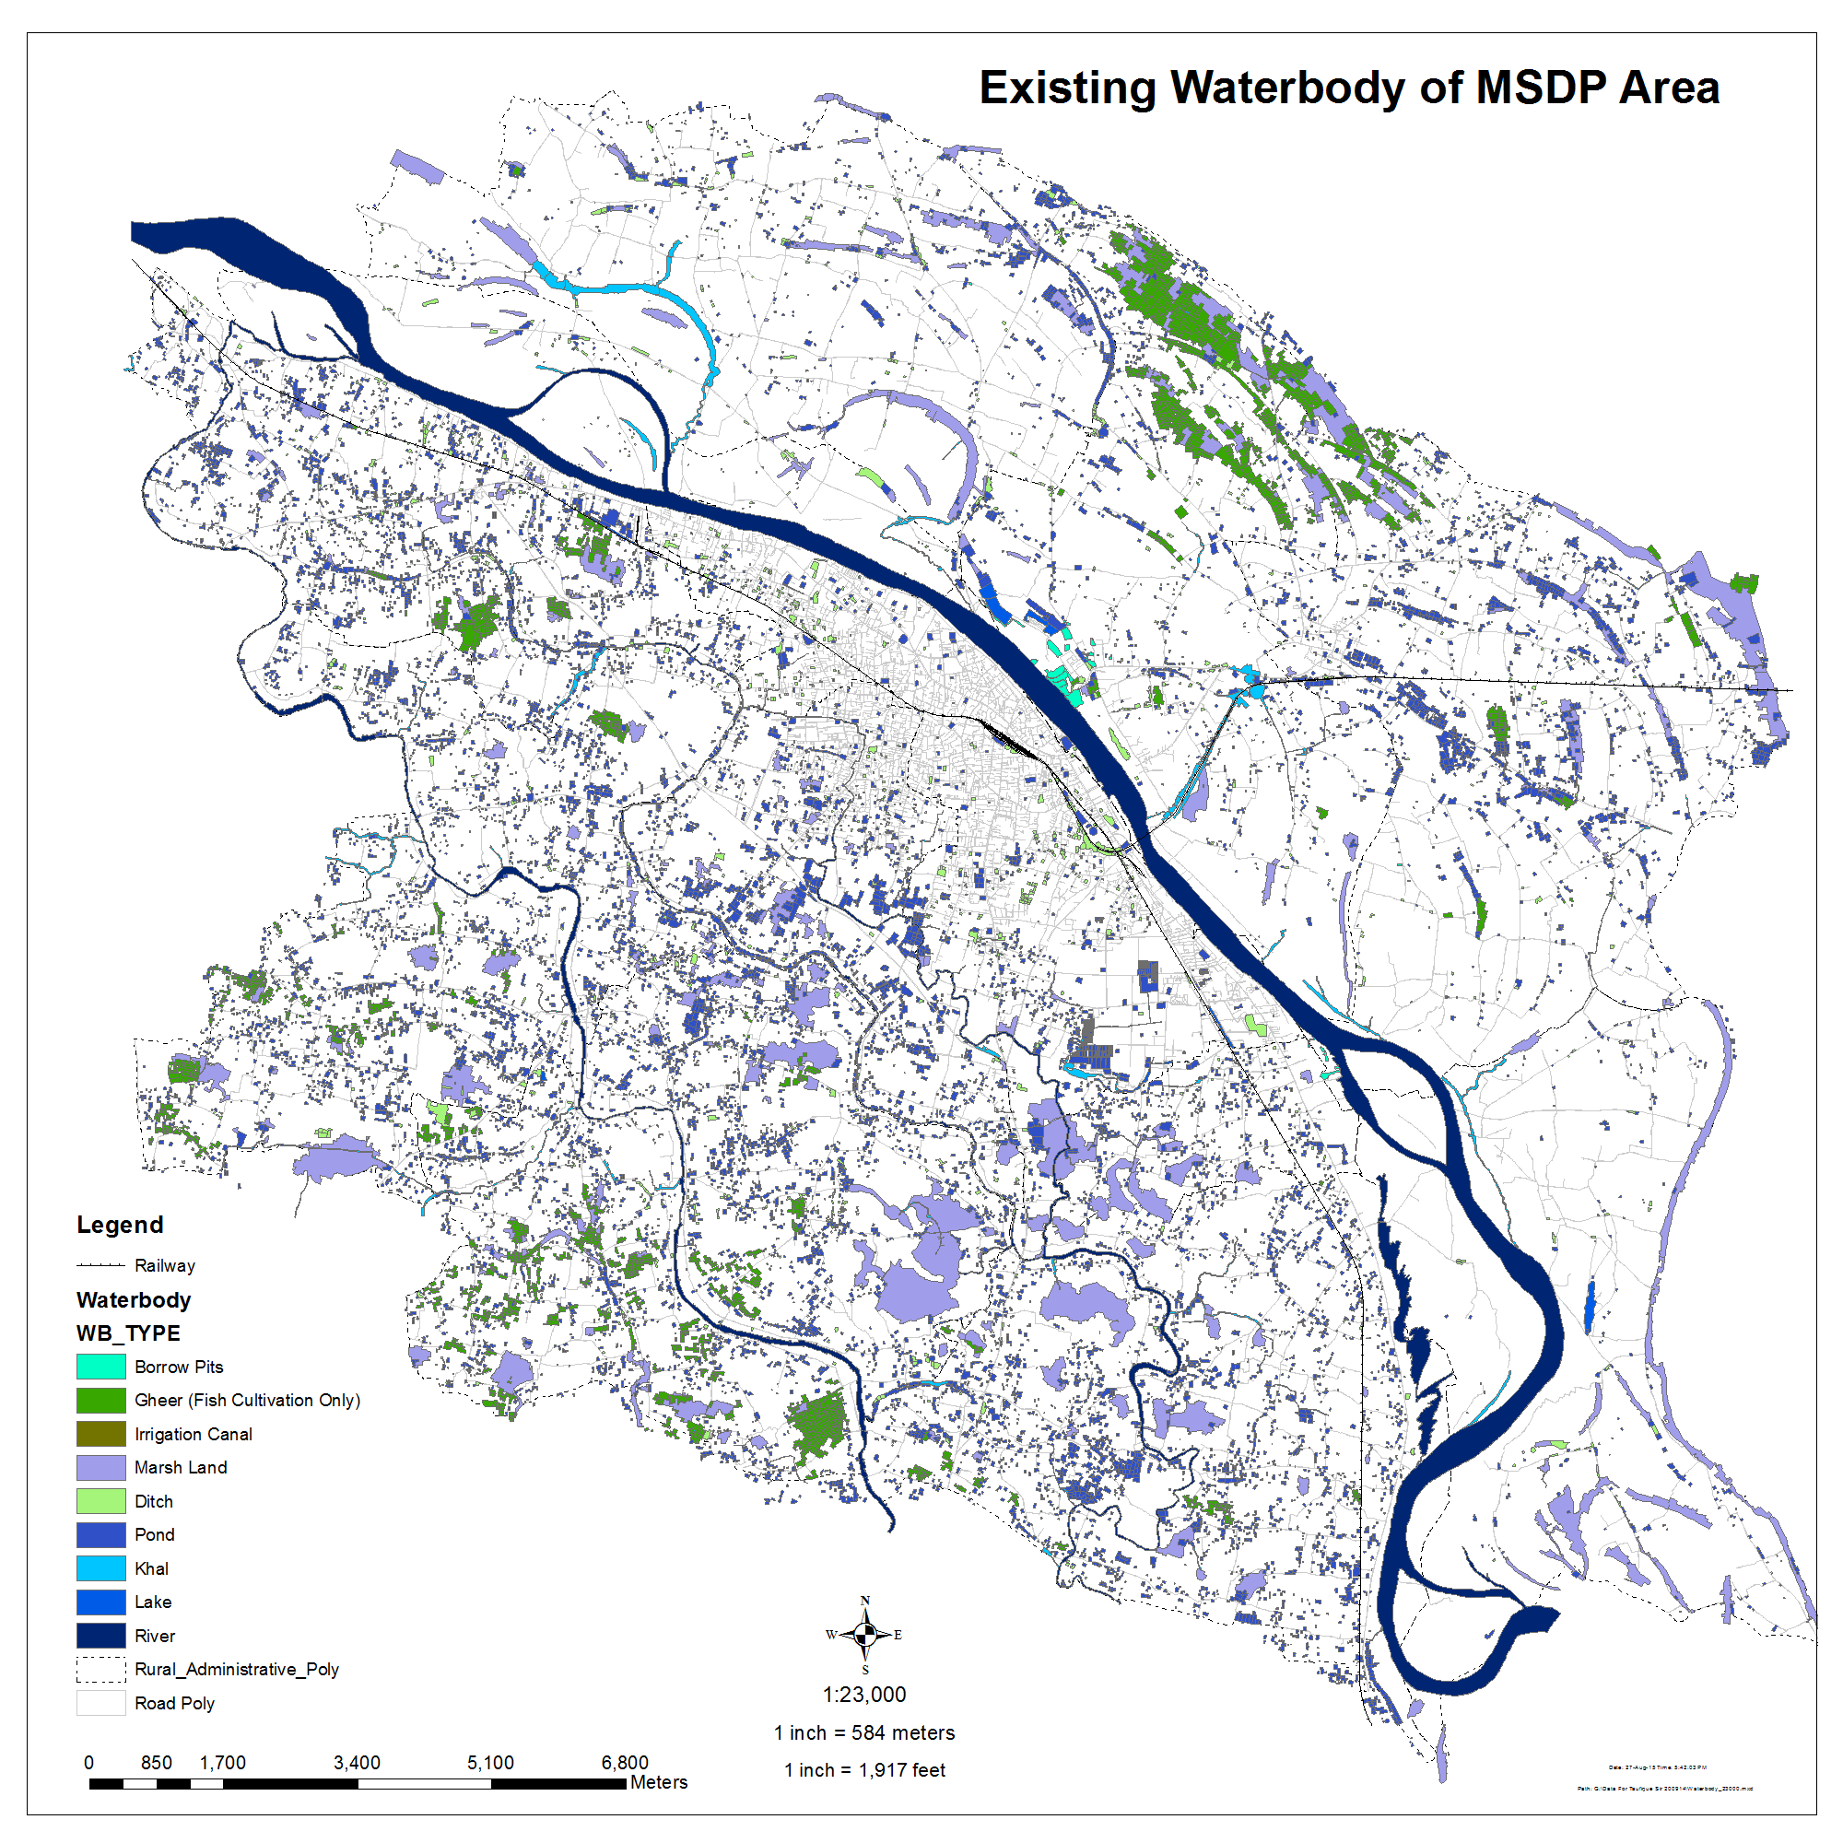
An Example

Slide 11
3rd Step of
Structure Plan Preparation
Mauza Map Digitization and Layout Preparation

Slide 12
Geo-referenced Mauza Check
GCP has been Collected in Total 58 Locations by Using RTK GPS
On Basis of these GCP Geo-referenced Mauza has been Checked
Source : GIS Database

Slide 13
4th Step of Structure Plan Preparation
Preparation of Digital Elevation Model

Slide 14
Steps of DEM Preparation
Sl | Name of work
93 | DTM points generated(10m interval) from 3d Image
94 | DEM Preparation
95 | Prepare Contour from DEM
96 | Collect RL from Field for DEM(RL) checking
97 | Find out Difference By using GIS Software
98 | Check Contour from Field(rl)
99 | DEM Correction and Finalization
100 | Contour Correction and Finalization
101 | Inundation Data collection
102 | Flood Map Preparation from DEM

Slide 15
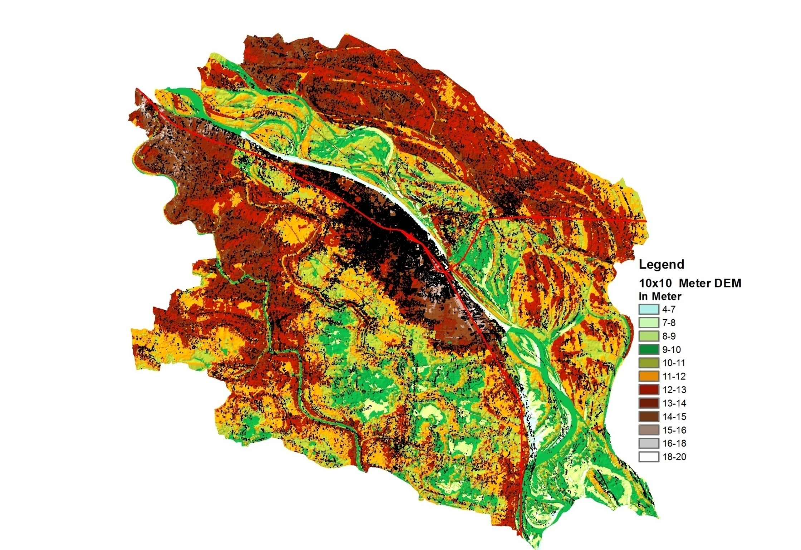
DEM

Slide 16
DEM Check & Correction
The Circles in Red Colour Marked Different Locations Where RL has been Collected for Checking of DEM
Total Dem Check Points 231
Source : GIS Database

Slide 17
5th Step of Structure Plan Preparation
Preparation of Drainage Map

Slide 18
Steps of Drainage Map Preparation
Sl | Name of work
225 | Prepare Drainage Map from Field Survey By Using RTK GPS and Total Station and GIS Software
226 | Inentify Missing link of Khal from Mauza Map
227 | Identify missing link from DEM
228 | Prepare Drainage Map for Print
229 | Detailed Field survey for Drainage and flow Direction
230 | Identify flow Direction
231 | Define Catchment Area for Drainage
232 | Edit Drain database
233 | Prepare Flow Direction Map
234 | Prepare Catchment Area Map and Print
235 | Re Edit by Expert
236 | Re prepare Catchment Map and Print
237 | Finalize Catchment Area and prepare Database
238 | Calculate rainfall data
239 | Link Rainfall data and Analyze
240 | Prepare Drain junction
241 | Analyze Drainage data and prepare Flooding node By Using Pcswmm Software
242 | Find Flooding Area
243 | Finalize Drainage Map

Slide 19
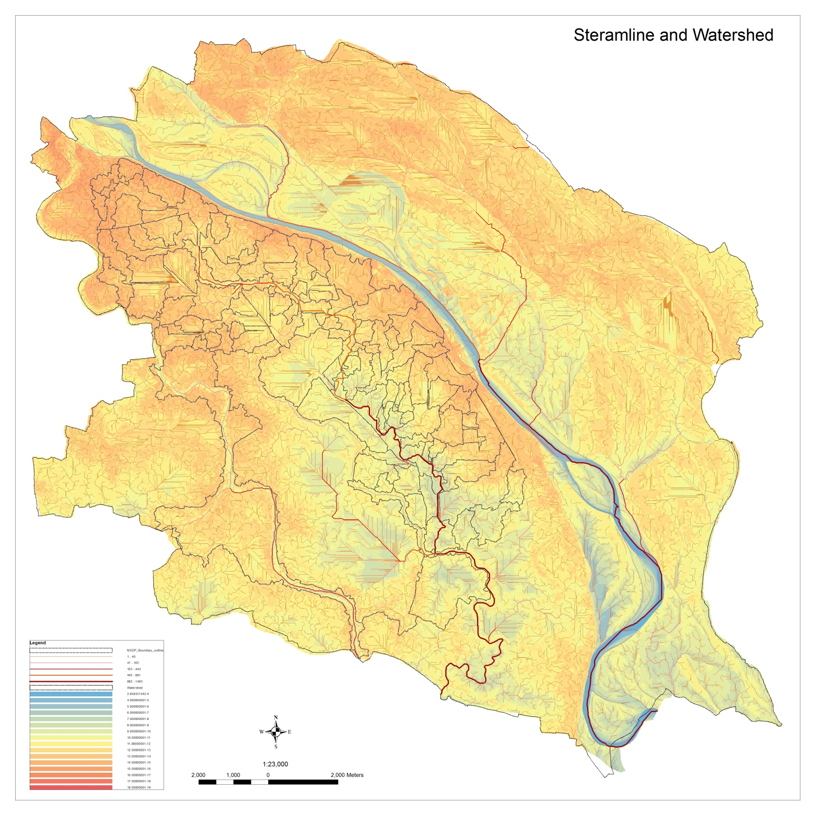

Slide 20
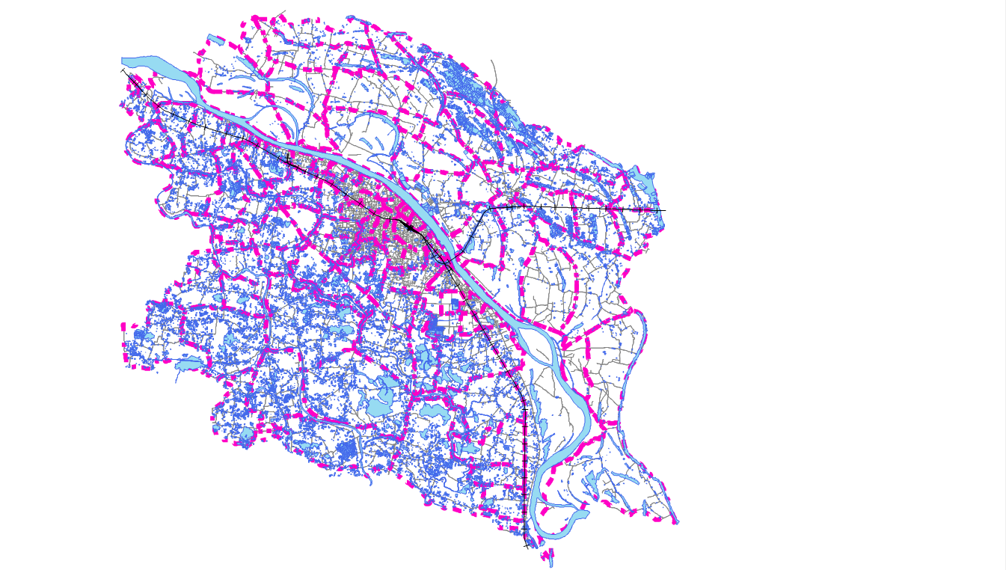
Delineation of Drainage Catchments for Both Urban & Rural Area
MSDP Area has been Divided into Different Catchments
Total Catchment No : 123
Rural Catchment No : 86
Urban Catchment No : 37
Source : GIS Database

Slide 21
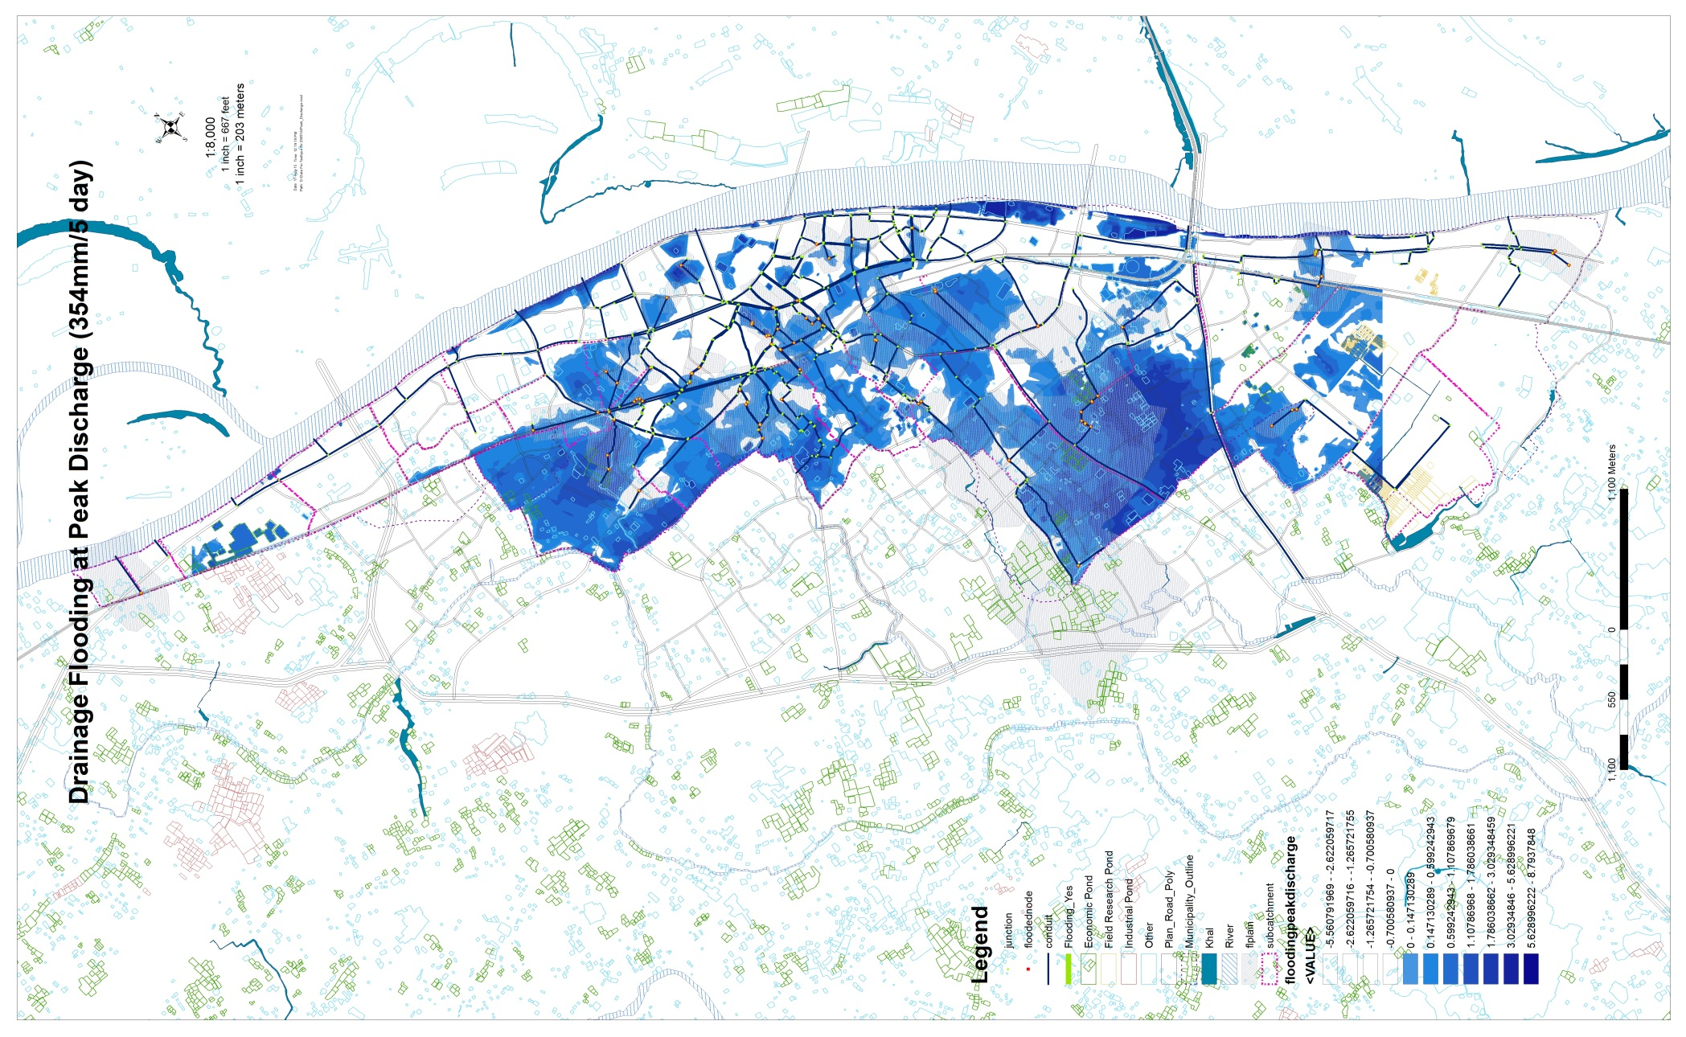

Slide 22
6th Step of Structure Plan Preparation
Preparation of
Eco Sensitive Land Map

Slide 23
Steps of Eco Sensitive Land Map Preparation
189 | Prepare Polygone from DEM According to elevation
190 | Reclass Elevation of DEM
191 | Prepare Database
192 | Classify Elevation
193 | Prepare Map and Print
194 | Check on Map
195 | Edit Map and Reclass
196 | Finalize Map and Print
197 | Add Missing link of Drainage From stream line generated from DEM
198 | Classify Waterbody According to Use
199 | Add Classified Waterbody
200 | Demark Eco Sensitive broad Land Zoning and prepare Map
201 | Print Map
202 | Finalize Eco Sensitive broad Land Zoning

Slide 24
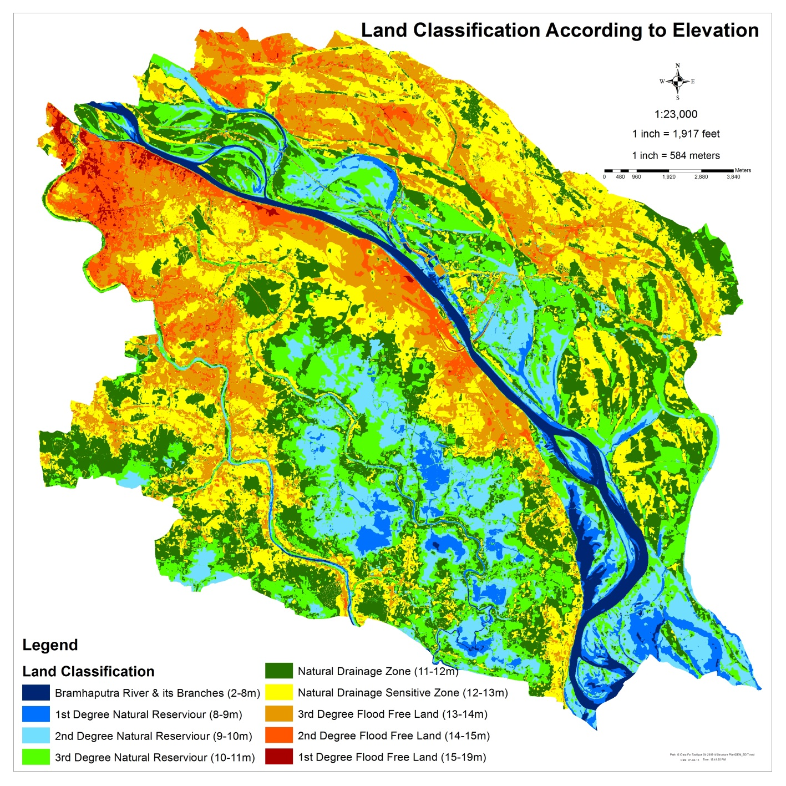

Slide 25
7th Step of Structure Plan Preparation
Preparation of
Ecological Sensitive Map

Slide 26
Steps of Ecological Sensitive Map Preparation
Sl | Name of work
260 | Print DEM Map With Grid
261 | Print Physical feature Map With Grid
262 | Print Map of Waterbody With Grid
263 | Prepare different map by Sketching on Different Printed Map at a2 days Workshop
264 | Sketch on printed DEM to find Land Elevation
265 | Sketch on Printed Physical feature Map to find out Existing Urban Area
266 | Sketch on Printed Physical feature Map to find Mature Urban Area
267 | Sketch on Printed Physical feature Map to find Existing Growth Centers
268 | Use Water Policy To find Ecological Zone
269 | Synchronization of all Type of Sketch to find out Ecological Zone
270 | Sketch on Synchronized Map to find Ecological Zone
271 | Scan Map
272 | Transfer Ecological Zone into ARC GIS formate
273 | Add water policy with Ecology Data
274 | Prepare Ecological Sencitive Map and Print

Slide 27
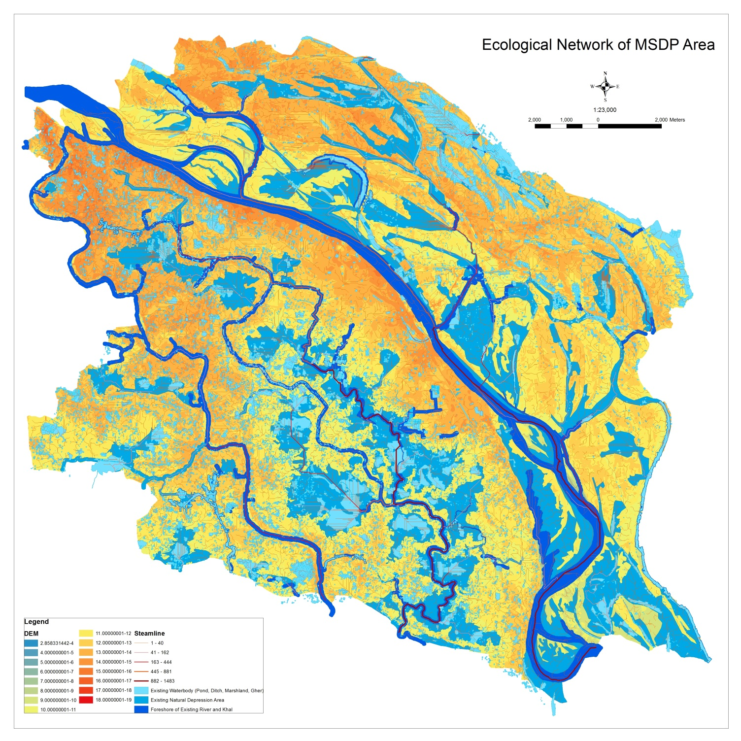

Slide 28
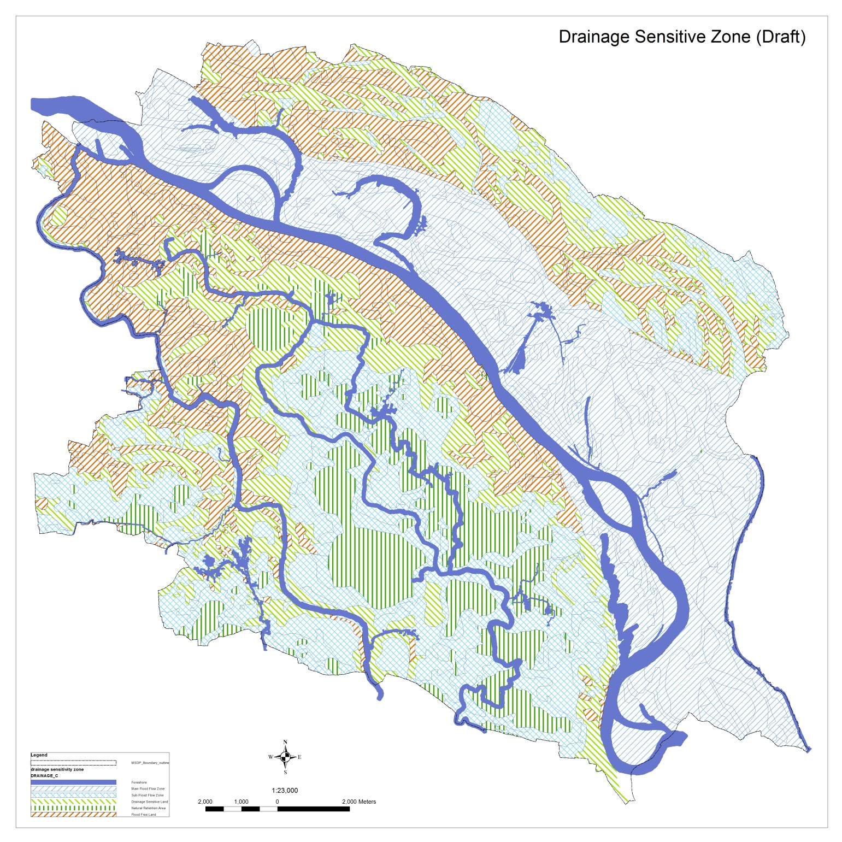

Slide 29
8th Step of Structure Plan Preparation
Preparation of Agricultural Map

Slide 30
Steps of Agricultural Map Preparation
Sl | Name of work
85 | Agriculture Map Prepared from Image
86 | Agriculture Map Verified from PRA with Sub Assistant Agriculture Officer
87 | Edit Agricultural data
88 | Reform and Update Agricultural Data
89 | Varification of Agricultural Map from Agri Office of Mymensingh
90 | Re Update of Agri Database
91 | PrepareCropping Pattern Map and print
92 | Finalization of Agricultural Map

Slide 31
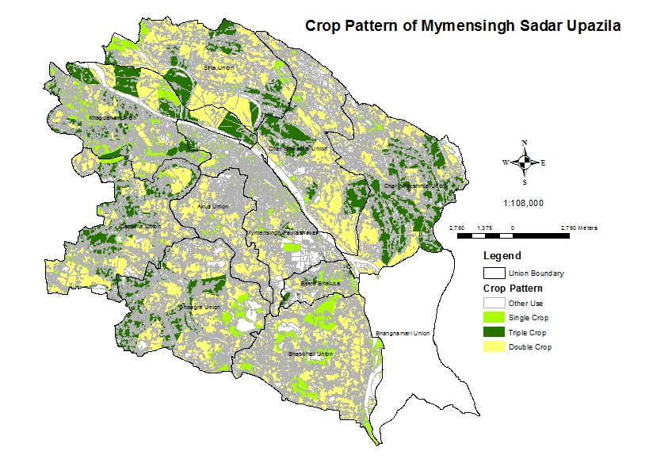

Slide 32
Crop Pattern of MSDP Area (From PRS Session)
There is no triple Crop Land in Akua & Bhabkhali
Highest Agricultural Land : KhagdaharUnion
Lowest Agricultural Land : Baera Union
Union Name | Crop Pattern (Area in Acre)
 | Single Crop | Double Crop | Triple Crop | Grand Total | %
Akua Union | 109.55 | 1470.84 |  | 1580.40 | 4.35
Baera Bhaluka | 196.70 | 327.81 | 152.50 | 677.02 | 1.87
Bhabkhali | 1194.96 | 3346.95 |  | 4541.92 | 12.51
Char Ishwardia Union | 145.80 | 2853.12 | 1107.99 | 4106.92 | 11.32
Char Nilakshmia Union | 79.48 | 2233.65 | 2591.71 | 4904.83 | 13.51
Dapunia Union | 371.15 | 2388.01 | 1637.54 | 4396.70 | 12.11
Ghaagra Union | 471.24 | 2808.74 | 1420.07 | 4700.04 | 12.95
Khagdahar Union | 1409.57 | 1507.65 | 2051.93 | 4969.16 | 13.69
Mymensingh Paurashava | 350.59 | 827.94 | 104.78 | 1283.31 | 3.54
Sirta Union | 431.74 | 3305.71 | 1397.43 | 5134.88 | 14.15
Grand Total | 4760.79 | 21070.42 | 10463.95 | 36295.17 | 100.00

Slide 33
9th Step of Structure Plan Preparation
Preparation of Geological Map

Slide 34
103 | Geological Survey (SPT, Borehole, MT, MSAW)
104 | Geological Survey Checking By MSDP Team
105 | Collection and Analysis of Geological Data
106 | Raster Data Preparation
107 | .shp file Prepared from Raster data
108 | Database Prepare for all type of Geological Survey
109 | Synchronization of all Type of Geological Data
110 | Geological Map Prepared and Print
111 | Explanatory Map prepared from analysis of Geological Data
112 | Height Sensitive Map Prepared from Geological Data
113 | Foundation Depth map Prepare
114 | Soil Layer Map Prepare
115 | Earthquake map Prepare
116 | Earthquake Intensity Map Prepare
117 | Varification of Geological Data from Expart
118 | A 2 Days Workshop on Geological Data and Map
119 | Re-Explanatory Map prepared from analysis of Geological Data
120 | Re Prepare of Height Sensitive Map
121 | Re Prepare Foundation Depth map
122 | Re Prepare Soil Layer Map
123 | Re Varification of Geological Data from Expart
124 | Re Prepare Earthquake map
125 | Re Prepare Earthquake Intensity Map
126 | Finalization of Geological Map
127 | Prepare Earthquake Impact Analysis Map Based on Building Height
128 | Demak Hot spot Zone After Earthquake
Steps of Geological Map Preparation

Slide 35
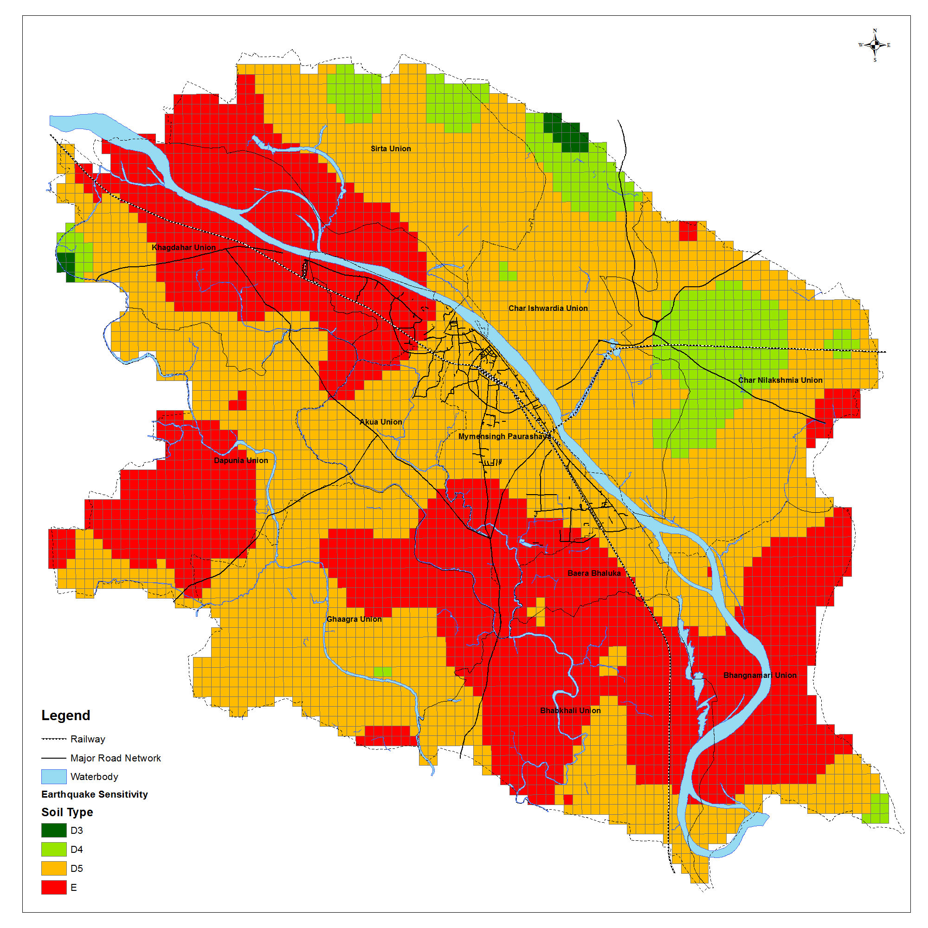
Soil Type Map

Slide 36
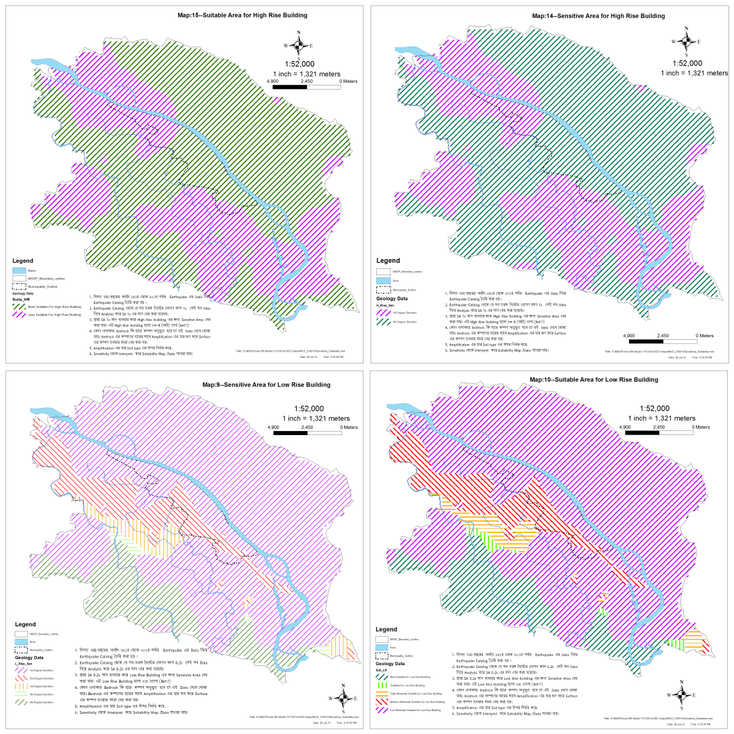

Slide 37
10th Step of Structure Plan Preparation
Preparation of
Earthquake Sensitive Map

Slide 38
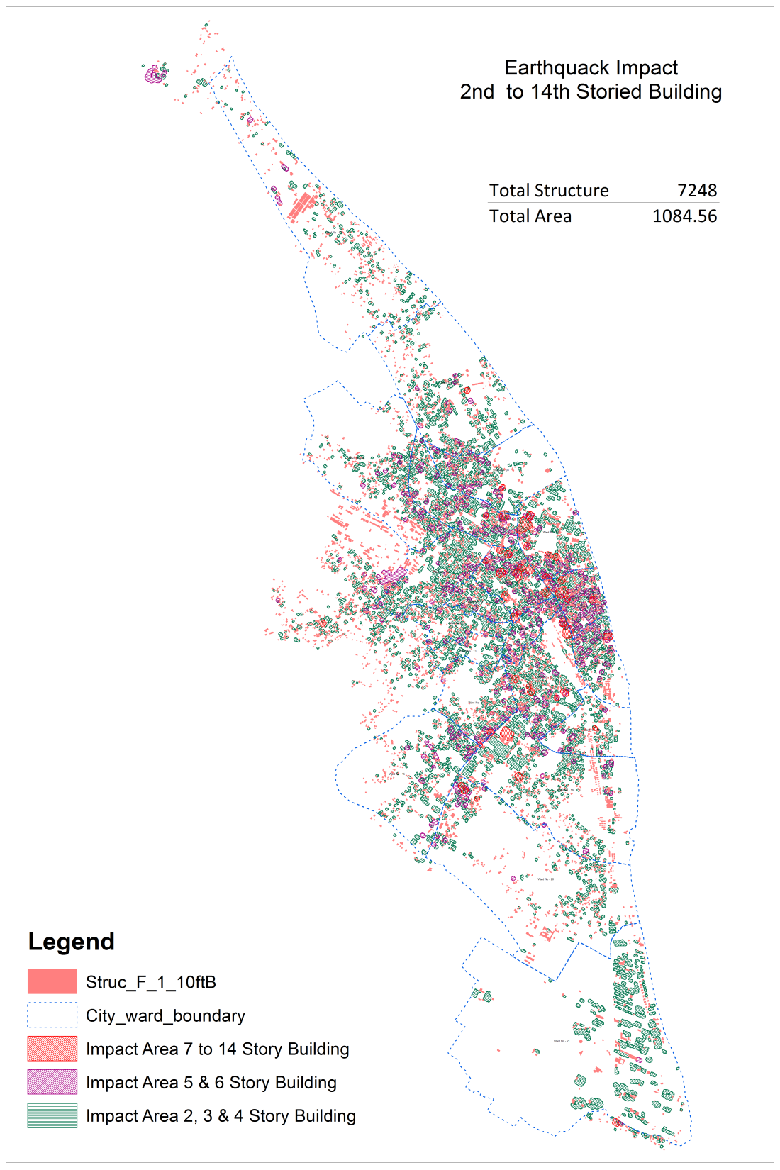

Slide 39
11th Step of Structure Plan Preparation
Preparation of
Urban Road Map

Slide 40
Steps of Urban Road Map Preparation
Sl | Name of work | Sl | Name of work
1 | Prepare and Finalize Road Network from Field survey by Using RTK GPS, Total station | 21 | Buffer Road centerline According to Road Type and Lane
2 | Categorization of Road According to Width | 22 | Identify Affected Structure
3 | Buffer all Road for a road network (12ft, 16ft & 20ft width) | 23 | Listing of Affected building By Type & Height
4 | Find out the Structures which are affected due to Road widenning | 24 | Affected Portion has been Identified from GIS Data
5 | Listing of Affected building By Type & Height | 25 | Prepare Map and database for print
6 | Affected Portion has been Identified from GIS Data | 26 | Re-Demarcation and Make decision on road Network System
7 | prepare Map and database for Field survey | 27 | Re adjust Road centerline According to Decision
8 | Map and Database Print for Check from field | 28 | Buffer Road centerline According to Road Type and Lane
9 | Data Check and Additional data has been Collected for Affected building from field Survey | 29 | Re-Identify Affected Structure
10 | Affected Building's Image has been Captured | 30 | Re Listing of Affected building By Type & Height
11 | Database Prepare & Updated | 31 | Re Identify Affected Portion from GIS Data
12 | Database linked with Previous Database | 32 | Re Prepare Map and database for print
13 | Images are linked with the database | 33 | Again new decisions are made on road Network System
14 | prepare Map and database for Print | 34 | Re adjust Road centerline According to Decision
15 | Print Road network Map | 35 | Buffer Road centerline According to Road Type and Lane
16 | Prepare Different Grid For road Network (100m,200m, 250m, 500m) | 36 | ReIdentify Affected Structure
17 | Print Road Network with Grid | 37 | Re Listing of Affected building By Type & Height
18 | Sketch on Printed Road Network Map | 38 | Re Identify Affected Portion from GIS Data
19 | Demarcation and Make decision on road Network System | 39 | Re Prepare Map and database for print
20 | Re adjust Road centerline According to Decision | 40 | Print Map
 |  | 41 | Finalize Road network for Urban Area

Slide 41
Categorization of Road
From the Road Data 96 type of Road width has been Identified
Sl No. | Road Width(m) | Length(M) | Sl No. | Road Width(m) | Length(M) | Sl No. | Road Width(m) | Length(M) | Sl No. | Road Width(m) | Length(M)
1 | 1.64 | 40.66 | 25 | 7.54 | 1361.3 | 49 | 12.14 | 885.56 | 73 | 21.32 | 4116.43
2 | 1.97 | 53.54 | 26 | 7.71 | 649.32 | 50 | 12.3 | 910.21 | 74 | 21.65 | 197.46
3 | 2.62 | 64.7 | 27 | 7.87 | 1198.99 | 51 | 12.46 | 1303.58 | 75 | 22.3 | 1624.59
4 | 3.28 | 4697.58 | 28 | 8.2 | 23300.68 | 52 | 12.79 | 129.41 | 76 | 22.96 | 883.03
5 | 3.61 | 235.06 | 29 | 8.53 | 5527.44 | 53 | 13.12 | 13437.2 | 77 | 23.94 | 1697.39
6 | 3.94 | 9447.65 | 30 | 8.69 | 14.22 | 54 | 13.45 | 662.63 | 78 | 24.6 | 538.43
7 | 4 | 53.39 | 31 | 8.86 | 2351.52 | 55 | 13.78 | 1387.64 | 79 | 24.93 | 10.91
8 | 4.26 | 2088.8 | 32 | 9.02 | 1022.19 | 56 | 13.91 | 298.67 | 80 | 25.75 | 104.4
9 | 4.59 | 1245.72 | 33 | 9.18 | 4829.82 | 57 | 13.94 | 2002.96 | 81 | 26.24 | 4362.42
10 | 4.92 | 18314.8 | 34 | 9.28 | 479.33 | 58 | 14.1 | 507.43 | 82 | 27.06 | 146.21
11 | 5.25 | 7394.48 | 35 | 9.35 | 450.01 | 59 | 14.76 | 2470.32 | 83 | 27.88 | 86.55
12 | 5.41 | 70.87 | 36 | 9.45 | 137.97 | 60 | 15.09 | 328.7 | 84 | 28.21 | 769.14
13 | 5.58 | 1110.94 | 37 | 9.51 | 1875.09 | 61 | 15.42 | 138.62 | 85 | 28.54 | 527.71
14 | 5.9 | 5746.58 | 38 | 9.74 | 79.51 | 62 | 15.74 | 2963.16 | 86 | 28.86 | 375.91
15 | 6.23 | 956.75 | 39 | 9.84 | 49450.47 | 63 | 16.4 | 4658.66 | 87 | 29.52 | 660.47
16 | 6.4 | 59.89 | 40 | 10.17 | 257.79 | 64 | 16.76 | 214.51 | 88 | 31.16 | 13.88
17 | 6.56 | 29596.87 | 41 | 10.33 | 1200.51 | 65 | 17.38 | 909.45 | 89 | 32.8 | 1933.6
18 | 6.72 | 28.54 | 42 | 10.5 | 8151.92 | 66 | 18.04 | 5805.48 | 90 | 34.44 | 313.27
19 | 6.89 | 793.9 | 43 | 10.66 | 83.26 | 67 | 18.37 | 2714.18 | 91 | 36.08 | 1527.5
20 | 7.02 | 65.18 | 44 | 10.82 | 3460.76 | 68 | 19.02 | 475.92 | 92 | 40.34 | 327.99
21 | 7.05 | 151.71 | 45 | 10.99 | 270.88 | 69 | 19.19 | 591.57 | 93 | 49.2 | 45.27
22 | 7.12 | 153.73 | 46 | 11.15 | 1328.86 | 70 | 19.68 | 2189.89 | 94 | 52.48 | 1598.2
23 | 7.22 | 6434.38 | 47 | 11.48 | 14695.92 | 71 | 20.66 | 63.27 | 95 | 60.68 | 154.29
24 | 7.38 | 72.46 | 48 | 11.81 | 3466.79 | 72 | 20.99 | 166.59 | 96 | 65.6 | 327.01
Source : GIS Database

Slide 42
Status of Road Type By Length and Area
Road Type | Length(M)
Tertiary C | 214551.22
Tertiary B | 33208.71
Tertiary A | 28107.96
Access | 3788.26
Primary | 2096.31
Secondary | 327.99
Total | 282080.44
Road Type | Road Area(Acre)
Tertiary C(<12ft) | 138.78
Tertiary A(>=18<30ft) | 44.03
Tertiary B(>=12<18ft) | 31.79
Access(>=30<39ft) | 11.33
Primary(>=45ft) | 8.02
Secondary(>=39<45ft) | 1.02
Total | 234.96

Slide 43
Sketch on Tracing while Road Designing

Slide 44
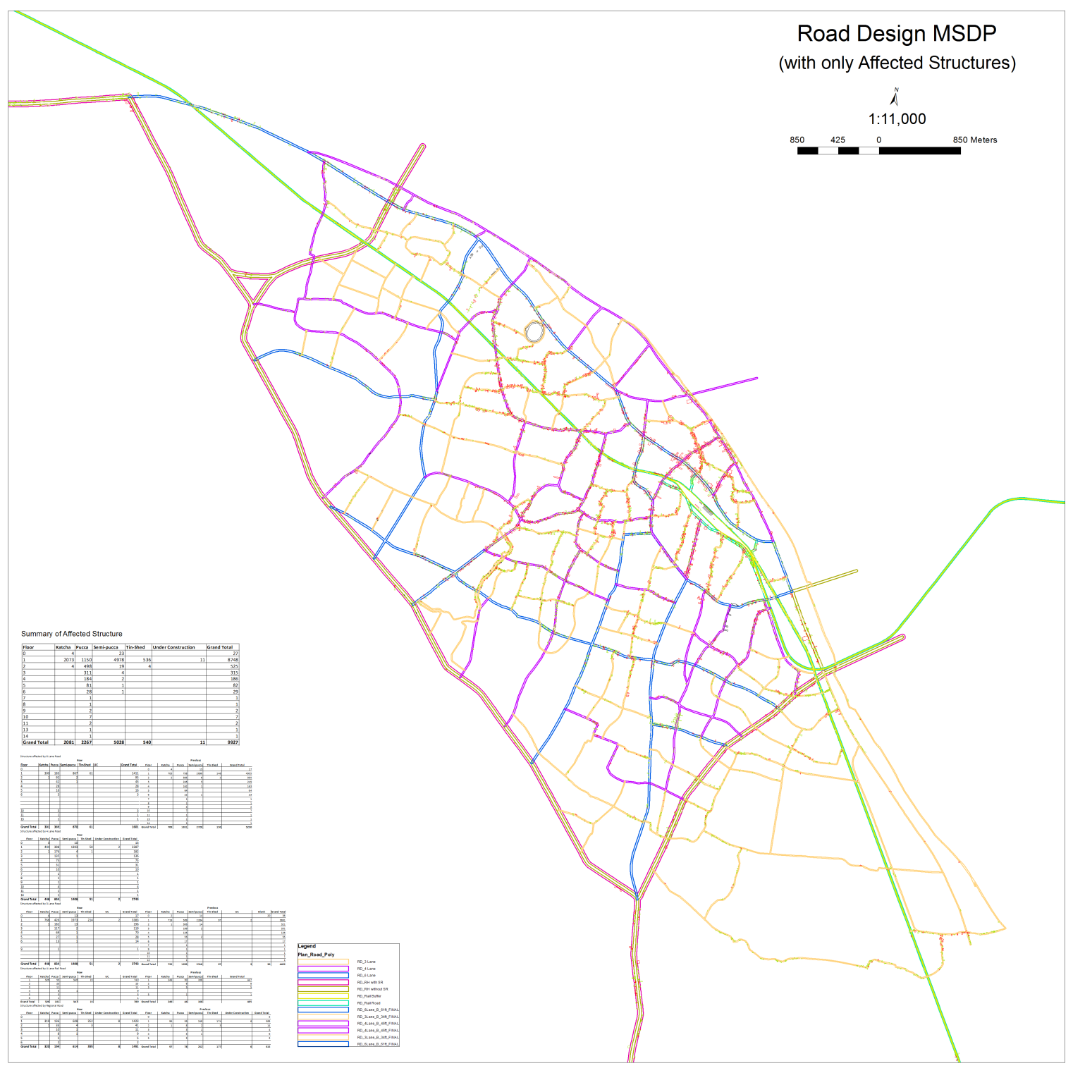
Design and Calculation of Structures

Slide 45
12th Step of Structure Plan Preparation
Preparation of
Regional Road Map

Slide 46
Steps of Regional Road Design Map Preparation
Sl | Name of work
1 | Prepare Physical Feature Map for MSDP Area
2 | Sketch on Printed Map for Regional Road Network
3 | Scan Map
4 | Geo-reference Map
5 | Edit and Prepare Road network
6 | Print Prepared Road Network
7 | Re sketch on Prited Road Network
8 | Scan Map
9 | Georeference Map
10 | Re Edit and Prepare Road network
11 | Print Re edited Network on Classification of Elevation
12 | Re suffle Road Network
13 | Define Type of Road and Define Width of road
14 | Buffer Road centerline According to Road Type and Lane
15 | Find out the Structures which are affected due to Road widenning
16 | Listing of Affected building By Type & Height
17 | Affected Portion has been Identified from GIS Data
18 | Prepare Database for Regional Road network
19 | Database Varified with Expert opinion
20 | Finalize Regional Road network for MSDP Area

Slide 47
Sketch on Tracing while Designing Regional Road

Slide 48
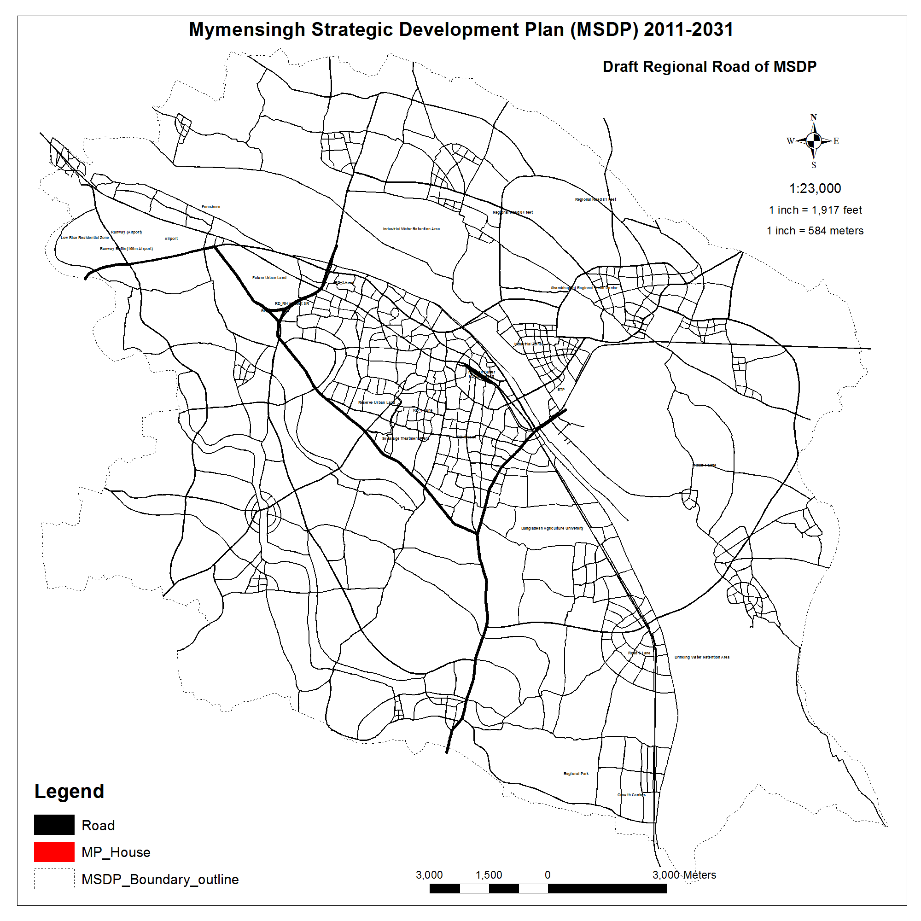

Slide 49
13th Step of Structure Plan Preparation
Preparation of
Growth Center Map

Slide 50
Steps of Growth Center Design Map Preparation
Sl | Name of work
1 | Identification of Growth Center
2 | Prepare growth center Map
3 | Add Forshore with Road from Ecological Zone
4 | Prepare Map with Road Network and Ecological Zone
5 | Print Map
6 | Sketch on Map for Designing Growth Center
7 | Scan Map
8 | Georeference Map
9 | Edit Road At Growth Center
10 | Buffer Road centerline According to Road Type and Lane
11 | Find out the Structures which are affected due to Road widenning
12 | Listing of Affected building By Type & Height
13 | Affected Portion has been Identified from GIS Data
14 | Prepare Database for Road network
15 | Database Varified with Expert opinion
16 | Finalize Road network at growth Centers for MSDP Area

Slide 51
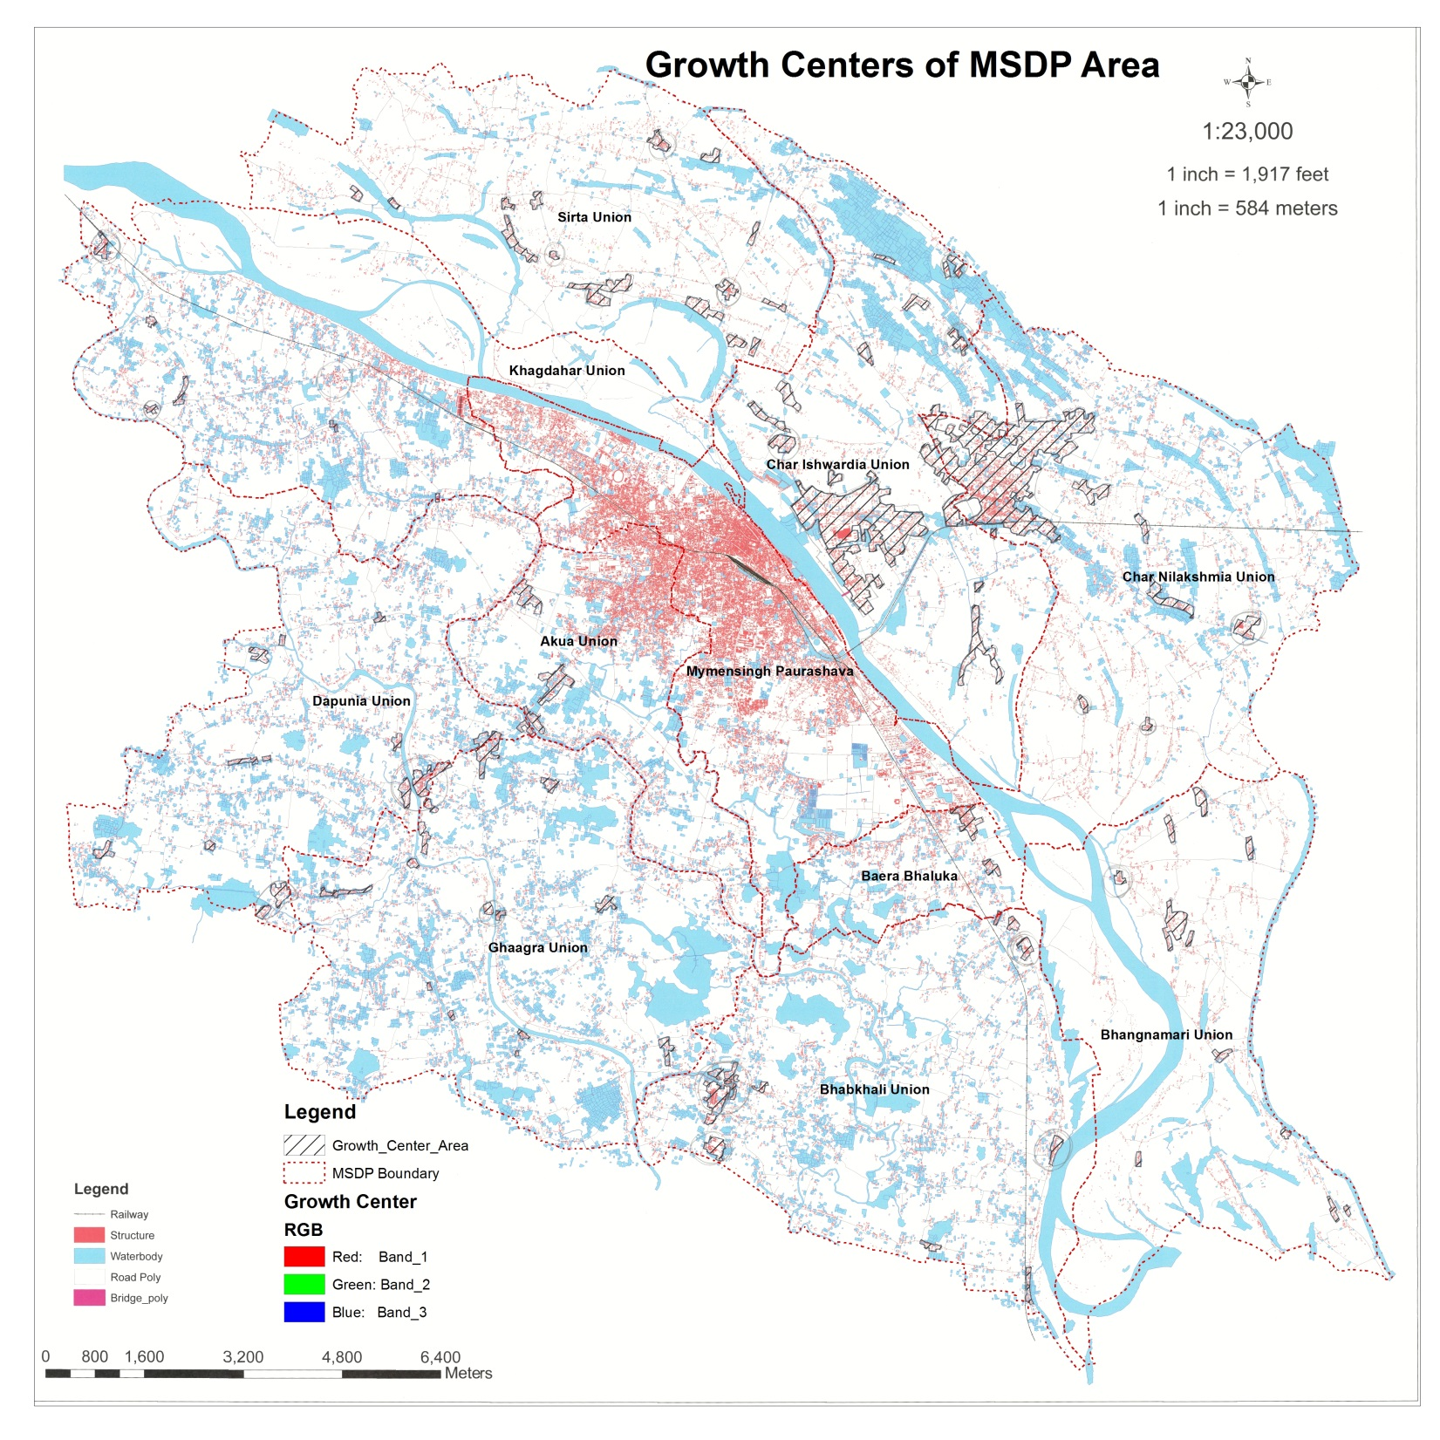

Slide 52
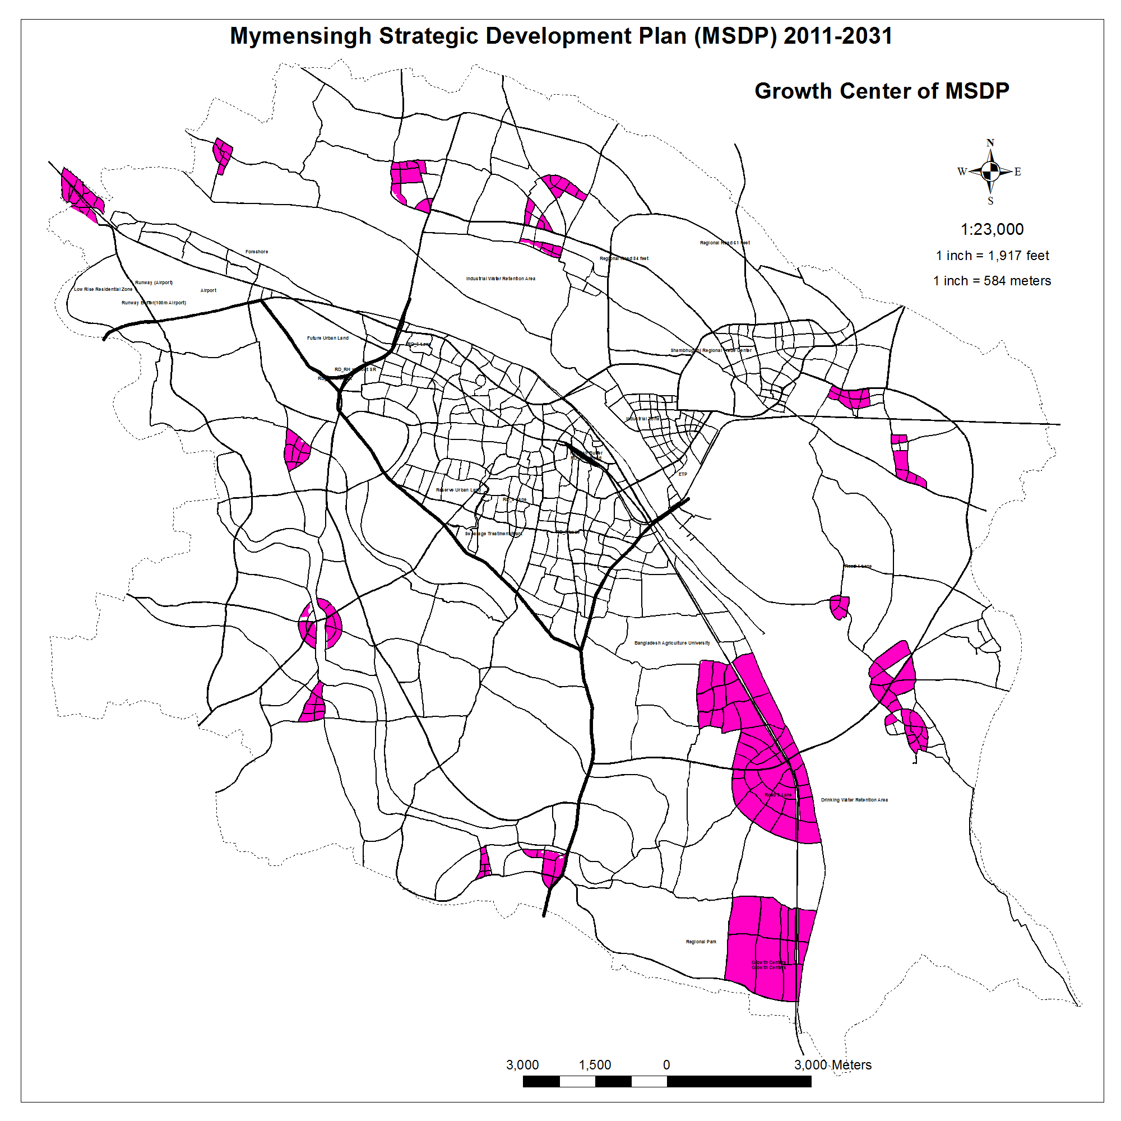

Slide 53
13th Step of Structure Plan Preparation
Preparation of
Fire Escape Map

Slide 54
Steps of Fire escape Map Preparation
Sl | Name of work
1 | Prepare Physical Feature Map of Municipality For Fire Service and civil Difence
2 | Map Print
3 | Sketch Drawn By Fire Service and civil Defense on Map at PRA
4 | Data Collected from Fire Service and civil Difence through PRA
5 | Scan Map
6 | Georeference Map
7 | Prepare & Update Database for fire escape Route
8 | Prepare fire incidence .shp file and database
9 | Prepare Map and Print
10 | Analyze Fire Incidence Data and Find out Hot Spot
11 | Prepare Escape Route
12 | Finalize Fire Escape Route

Slide 55

Fire Escape Road of Municipality Proposed By
Fire Service & Civil Defense
Fire Escape Map has been Prepared from PRA Session Which was held with Fire Service & Civil Defense
Source : GIS Database

Slide 56
14th Step of Structure Plan Preparation
Preparation of
Crime Map

Slide 57
Steps of Crime Map Preparation
Sl | Name of work
1 | Collect Crime Data from Thana
2 | Prepare .shp file for Crime Data
3 | Analyze Data
4 | Prepare Crime hot Zone Map & Database

Slide 58
Fire Incidence Data Collection and Database Preparation
Collection of Last five years Data
Total Incidence 380
Source : GIS Database

Slide 59
15th Step of Structure Plan Preparation
Preparation of
Network Analysis Map

Slide 60
Steps of Network Analysis Map Preparation
Sl | Name of work
1 | Sample Data Collected from Socio Economic Survey for Educational Network Analysis
2 | Prepare .shp file for Primary Educational Institute Analysis
3 | Analyze and prepare Map
4 | Prepare .shp file for Secondary Educational Institute Analysis
5 | Analyze and prepare Map
6 | Prepare .shp file for Higher Secondary Educational Institute Analysis
7 | Analyze and prepare Map
8 | Prepare .shp file for University Analysis
9 | Analyze and prepare Map
10 | Sample Data Collected from Socio Economic Survey for Bazaar Network Analysis
11 | Prepare .shp file for Bazar Analysis
12 | Analyze and prepare Map
13 | Sample Data Collected from Socio Economic Survey for Health Facility Network Analysis
14 | Prepare .shp file for Health Facilities Analysis
15 | Analyze and prepare Map
16 | Sample Data Collected from Socio Economic Survey for Religious Facility Network Analysis
17 | Prepare .shp file for Religious Facilities Analysis
18 | Analyze and prepare Map

Slide 61
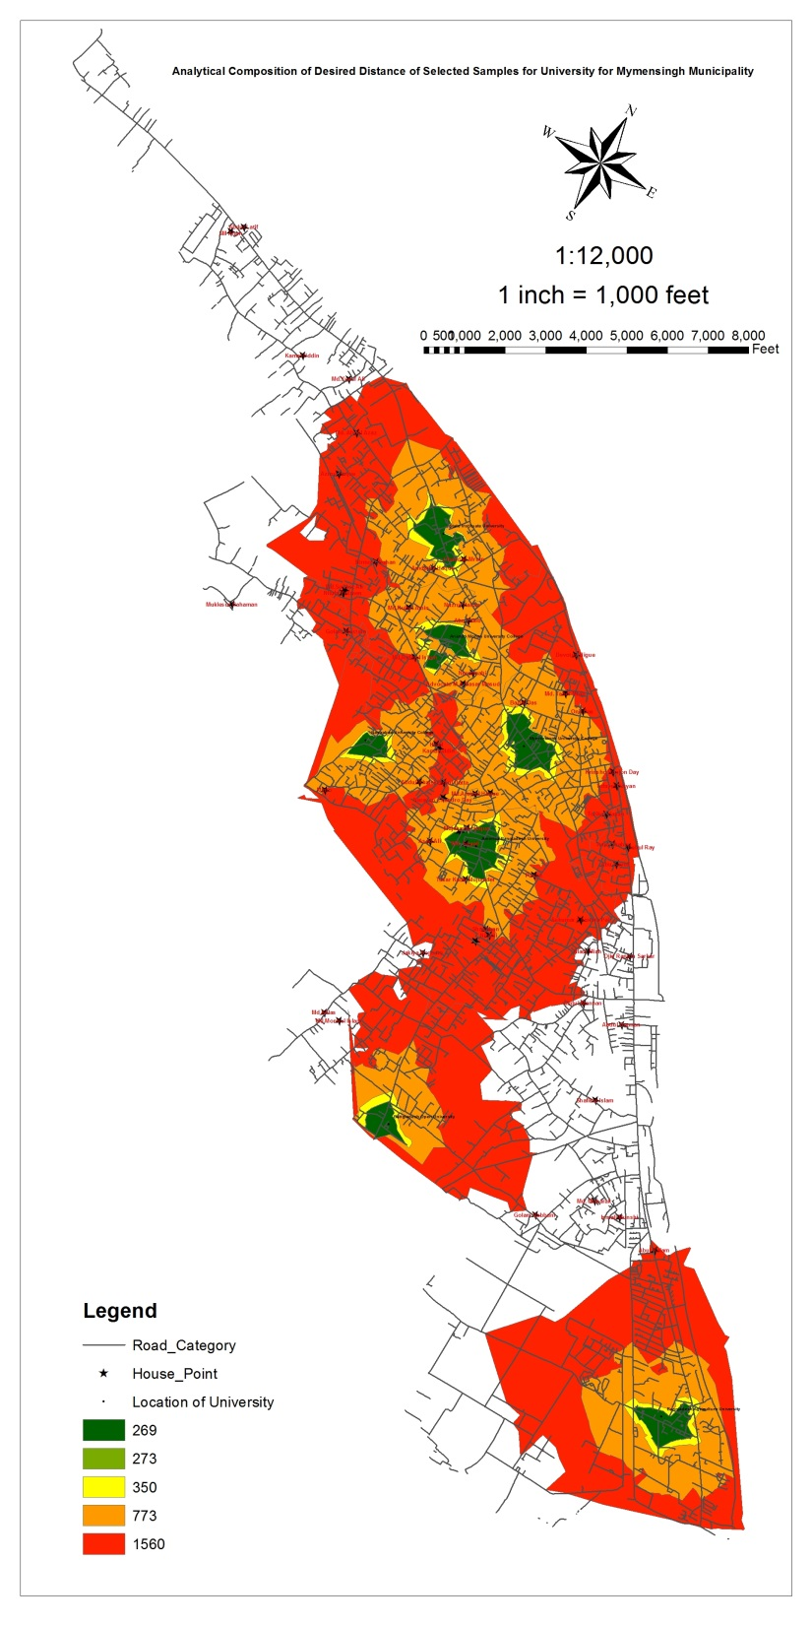
Analytical Example of University

Slide 62
16th Step of Structure Plan Preparation
Preparation of
Draft Structure Plan Map

Slide 63
Steps of Draft Structure Plan Map Preparation
Sl | Name of work
1 | Proposals of Draft Structure Plan were Drafted Synchronizing all of the data (Drainage, Road, land elevation, Geology, Landuse, PRA Data, Network Analysis)
2 | Draft Structure Plan Map Prepared
3 | Print of Draft Structure Plan Map
4 | In house Dialogue of Professionals has been performed on this Draft Plan
5 | Edit of Structure Plan Proposals
6 | Draft Structure Plan Map Prepared
7 | Print of Draft Structure Plan Map
8 | Again In house Dialogue of Professionals has been performed on this Draft Plan
9 | Edit of Structure Plan Proposals
10 | Prepare Structure Plan Map

Slide 64
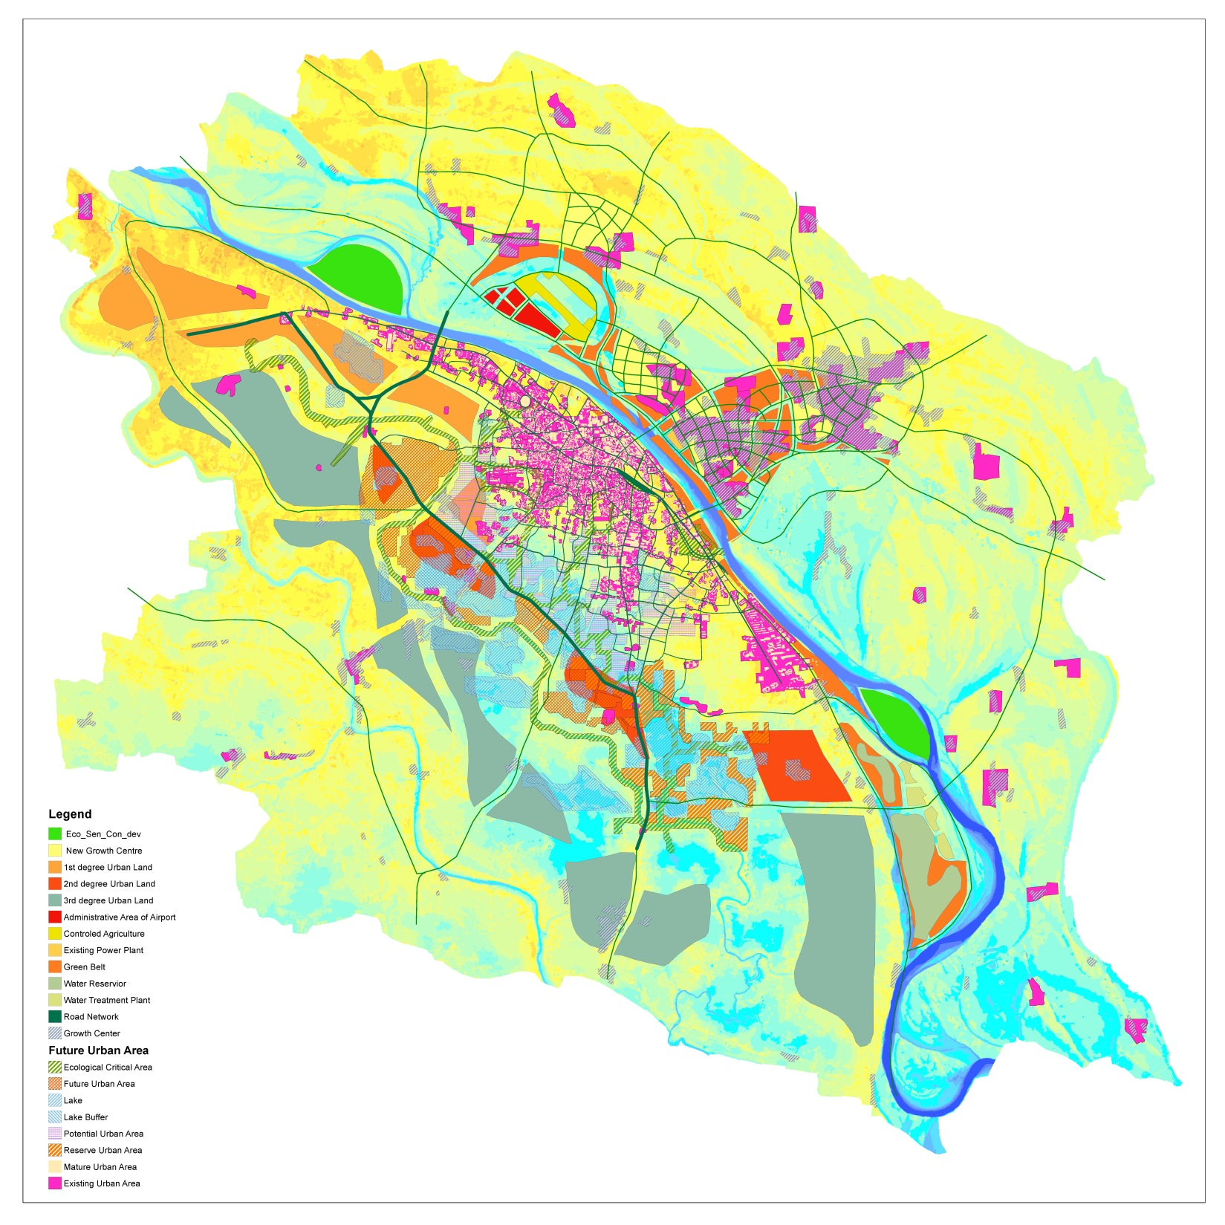
Conceptual Structure Plan

Slide 65
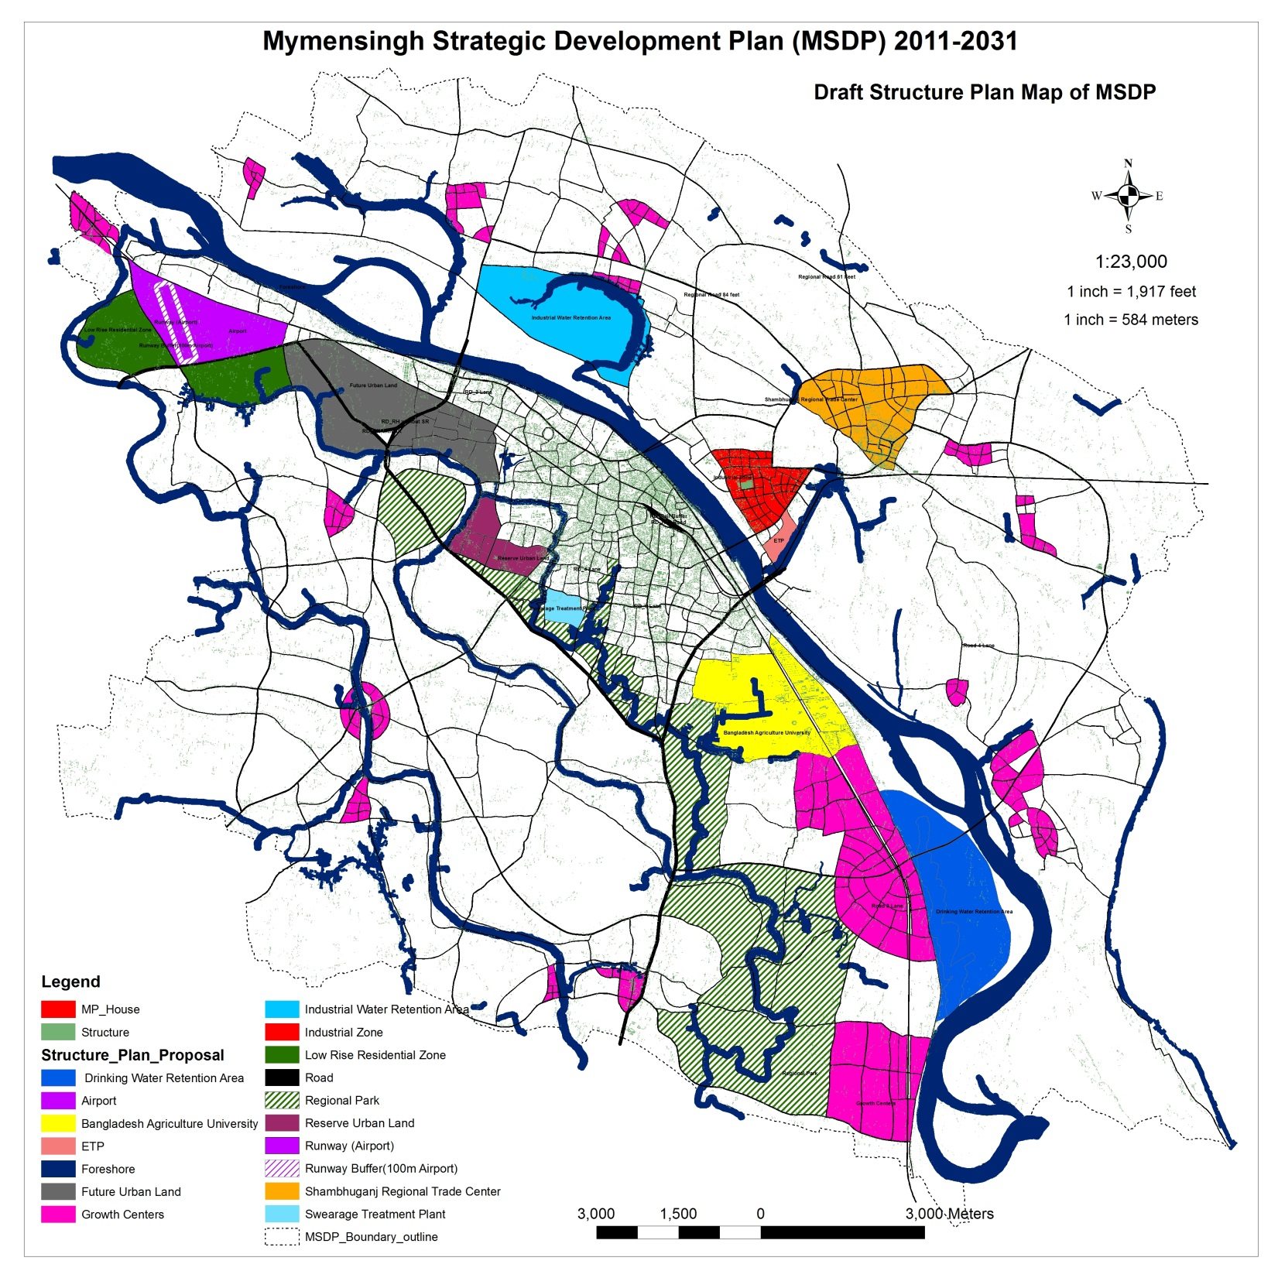

Slide 66
Special Achievement

Slide 67
Thanks

