Slide 1
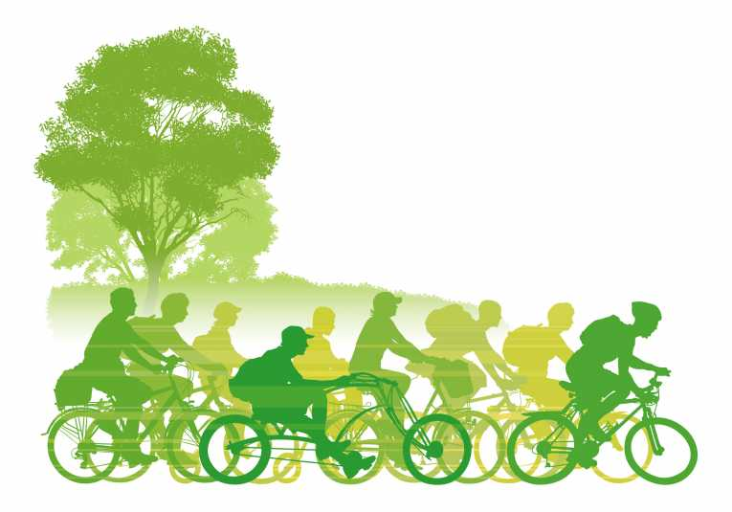
Sustainable Transportation for Mymensingh
Ahsanul Kabir, PhD
Urban and Rural Planning Discipline
Khulna University
Sustainable Transportation

Slide 2
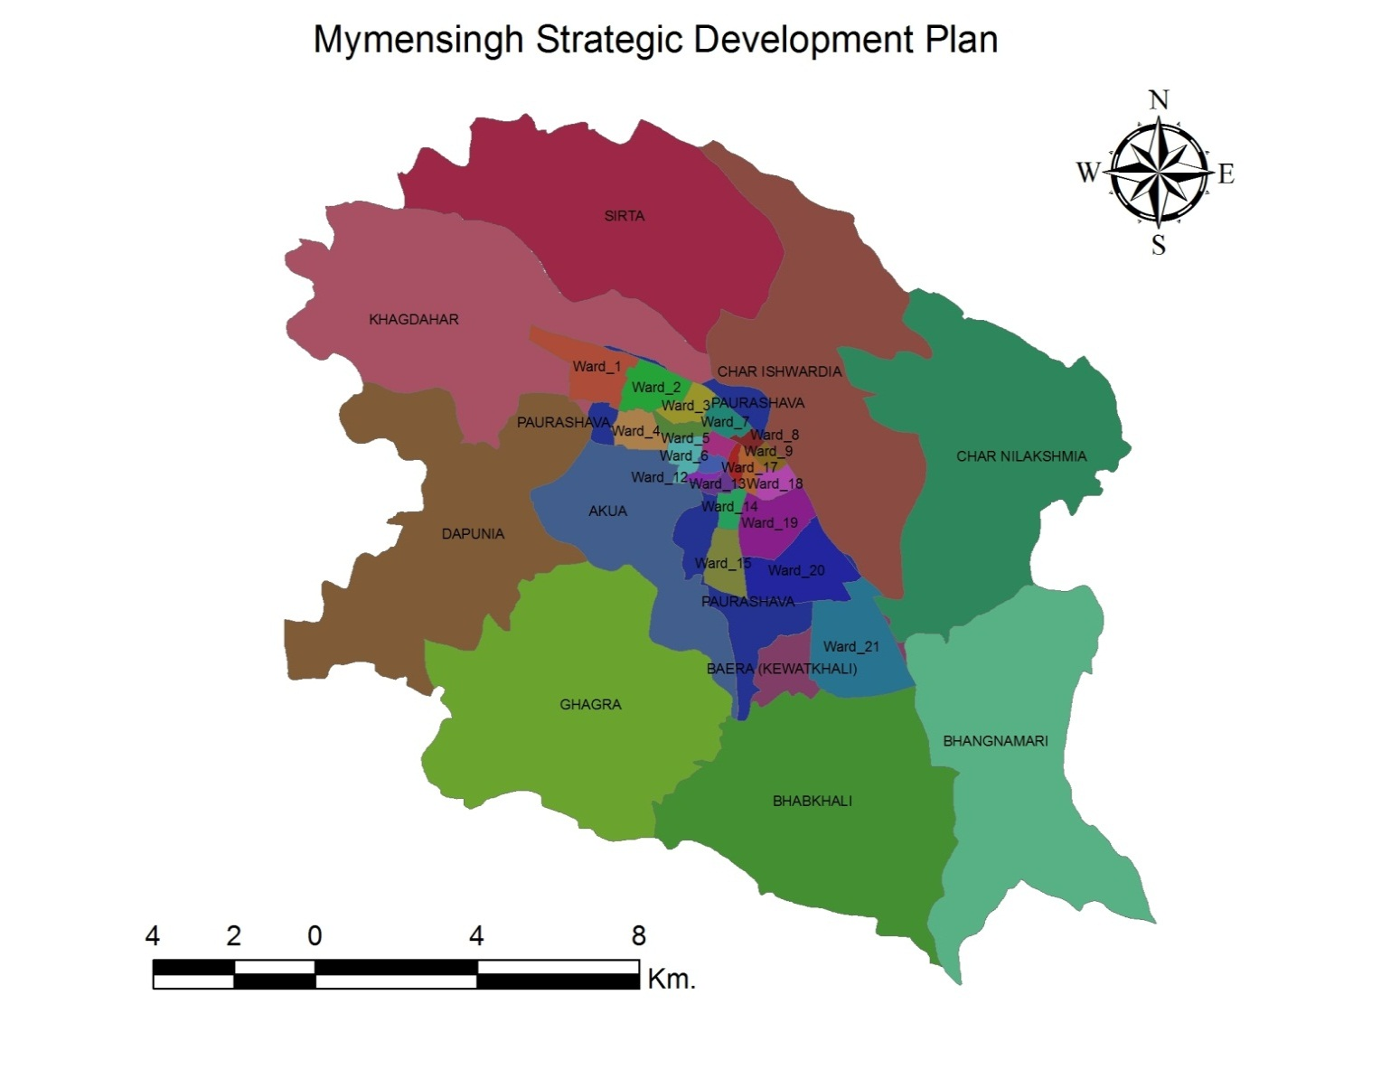
Objectives
to develop a sustainable development plan for the study area ensuring to accommodate future growth in a sustainable manner.
to aid the MSDP projects in its transport component in making/ designing a city.

Slide 3
Sustainable City
Standard
Urban Strategy
Required / Affordability
Projection
Urban Area
Generalized Urban Development Process

Slide 4
Transport in Municipal Planning
Urban Area
Population Prediction
Standard
Landuse Requirement
Landuse Plan
New Roads
Transport Plan
Road Geometry
Terminal, Bus stand

Slide 5
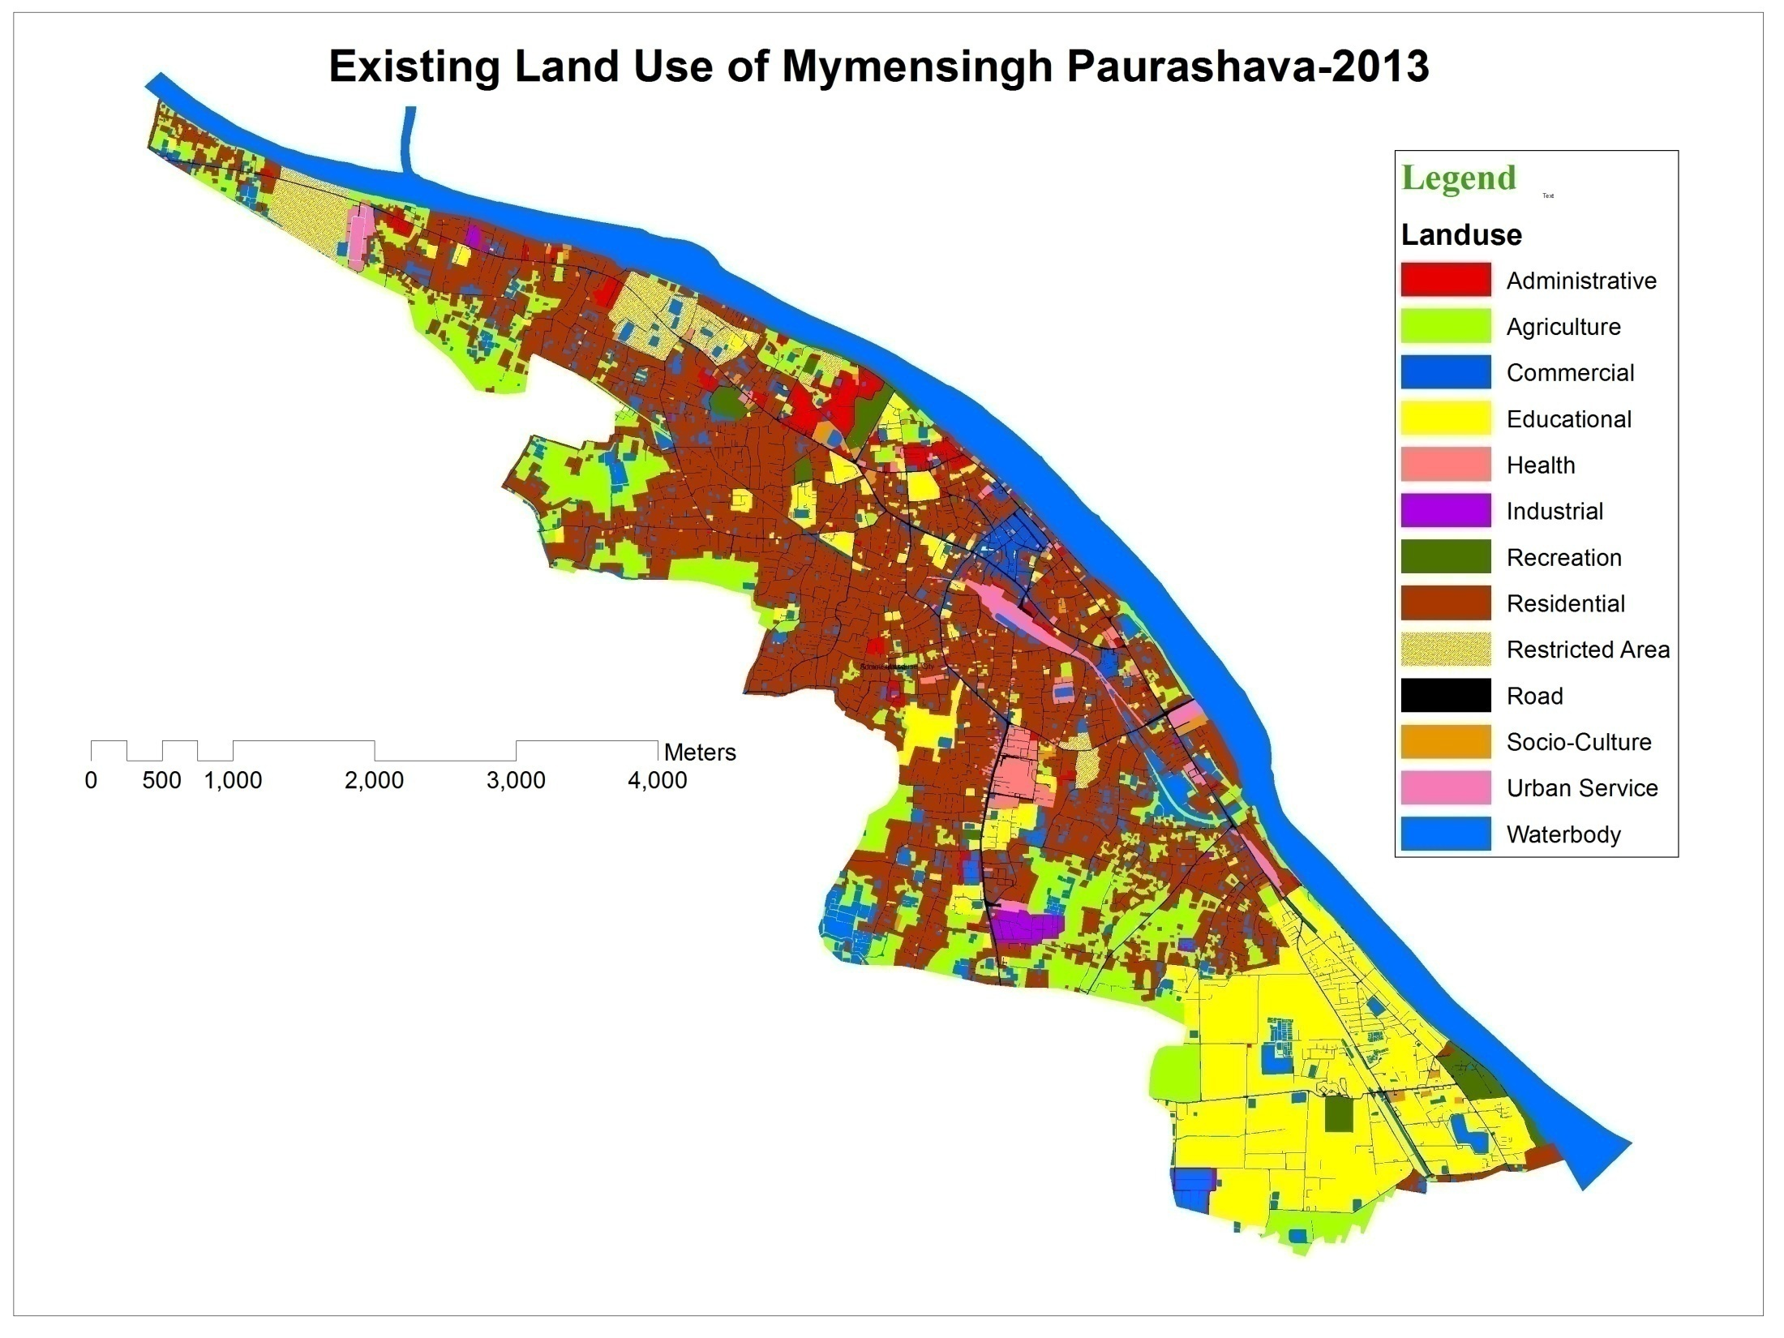

Slide 6
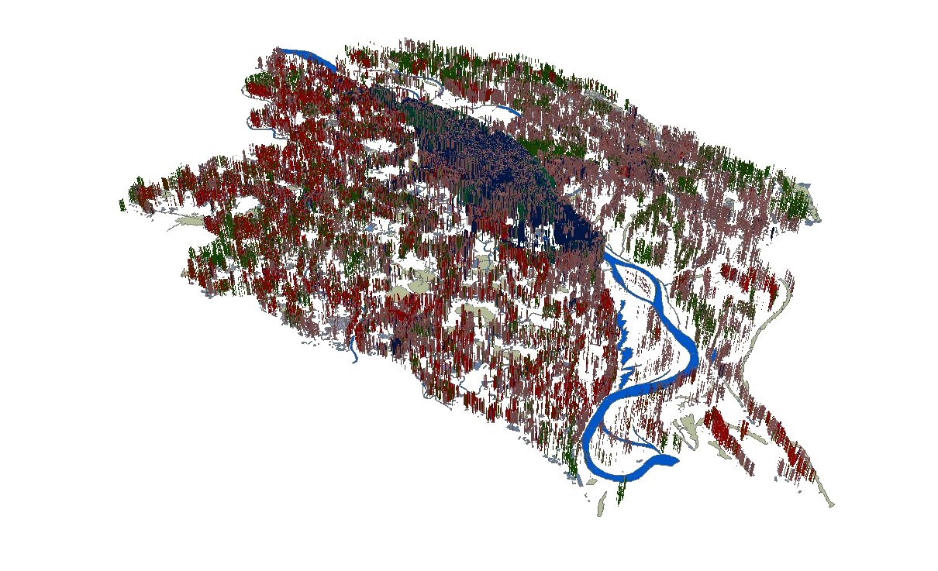
Buildings in Mymensingh

Slide 7
Mode Choice

Slide 8
Transport Planning Component in MSDP
MSDP Area
Population Prediction
Standard
Landuse Requirement
Landuse Plan
Commercial
Locations
Public Opinion
Schools
HealthCare
New Roads
Transport Plan
Public Transport
Road Geometry
Policy

Slide 9
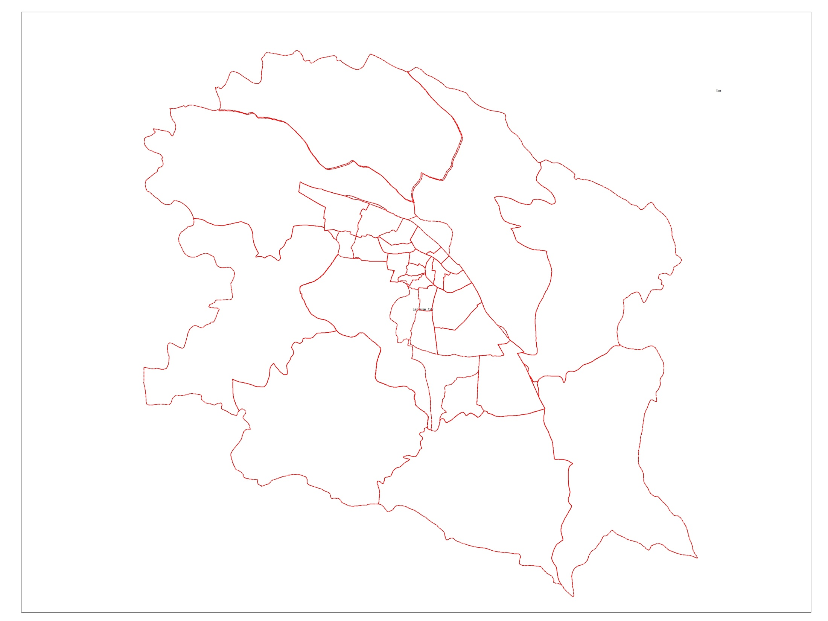
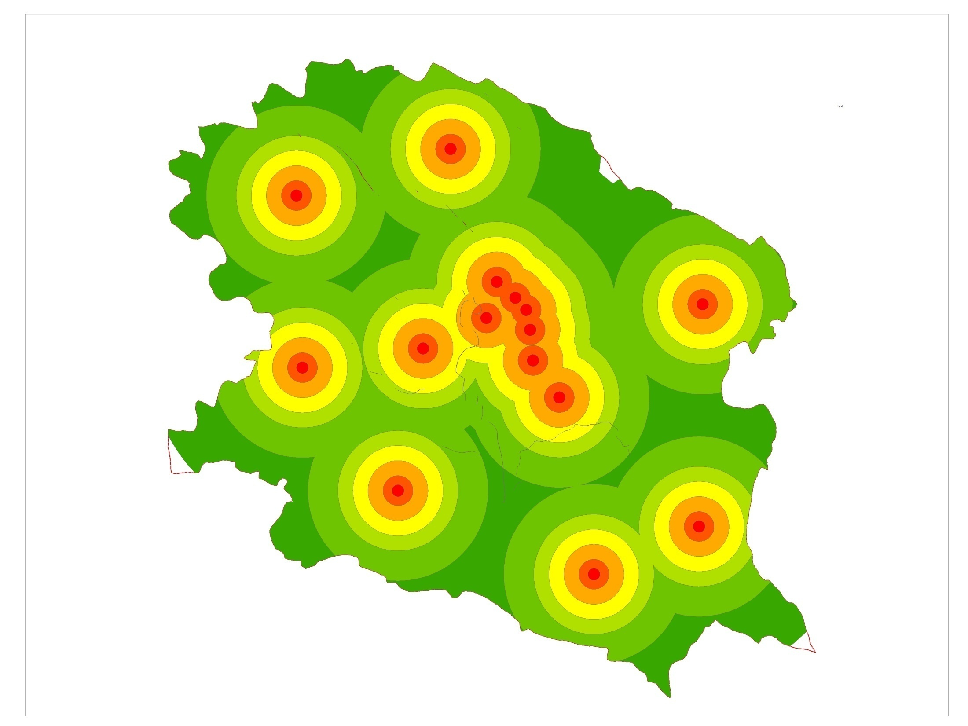
Activity Hub and Connectivity
Public Transport (Decentralized)

Slide 10
Activity Hub and Connectivity
Public Transport (Centralized)

Slide 11
Proposed Approach for Addressing Transportation Issue in the MSDP
Activity Spots
Road Network
Congestion
Optimization Model
Strategy / Policy
New Roads / Connectors
Transport Route/Path
Traffic Management
Road Improvement (Widening/Footpath)

Slide 12
Transportation System in MSDP
Mode
Mode for working purpose

Slide 13
Transportation System in MSDP
Mode
Mode for shopping purpose

Slide 14
Transportation System in MSDP
Mode
Mode for educational purpose

Slide 15
Transportation System in MSDP
Mode
Mode for social purpose

Slide 16
Transportation System in MSDP
Mode
Mode for other purpose

Slide 17
Transportation System in MSDP
Easy Bike Route

Slide 18
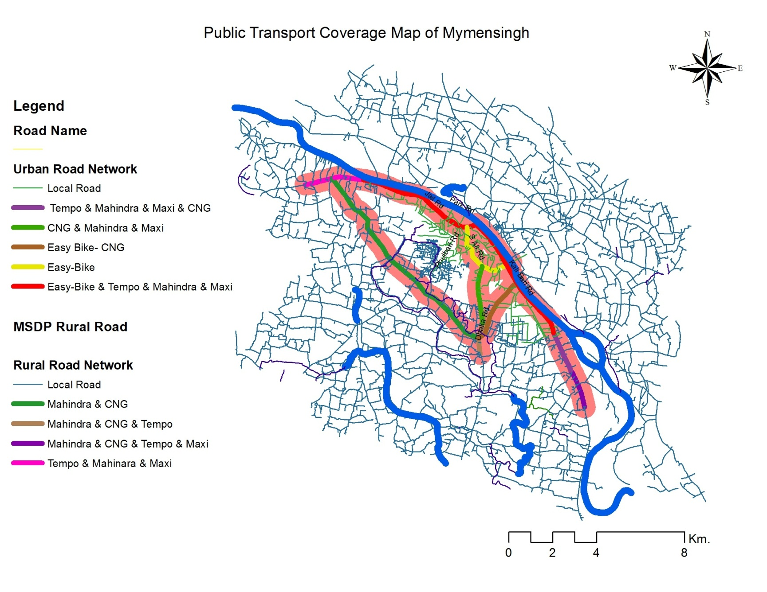
Transportation System in MSDP
Public Transport Coverage

Slide 19
Road Network
MSDP Road Classification
Urban Road
Rural Road
Arterials
Pucca
Collectors
Semi-Pucca
Major and Minor Road (Local roads)
Katcha

Slide 20
Road Network
MSDP Road Classification
MSDP Road Classification | Class | Length (Km.)
Urban Road | Arterial Road | 7.34
 | Connector Road | 16.10
 | Major and Minor Road (Local Roads) | 68.14
Rural Road | Pucca | 248.47
 | Semi-Pucca | 22.20
 | Katcha | 676.52
 | Unknown | 0.06

Slide 21
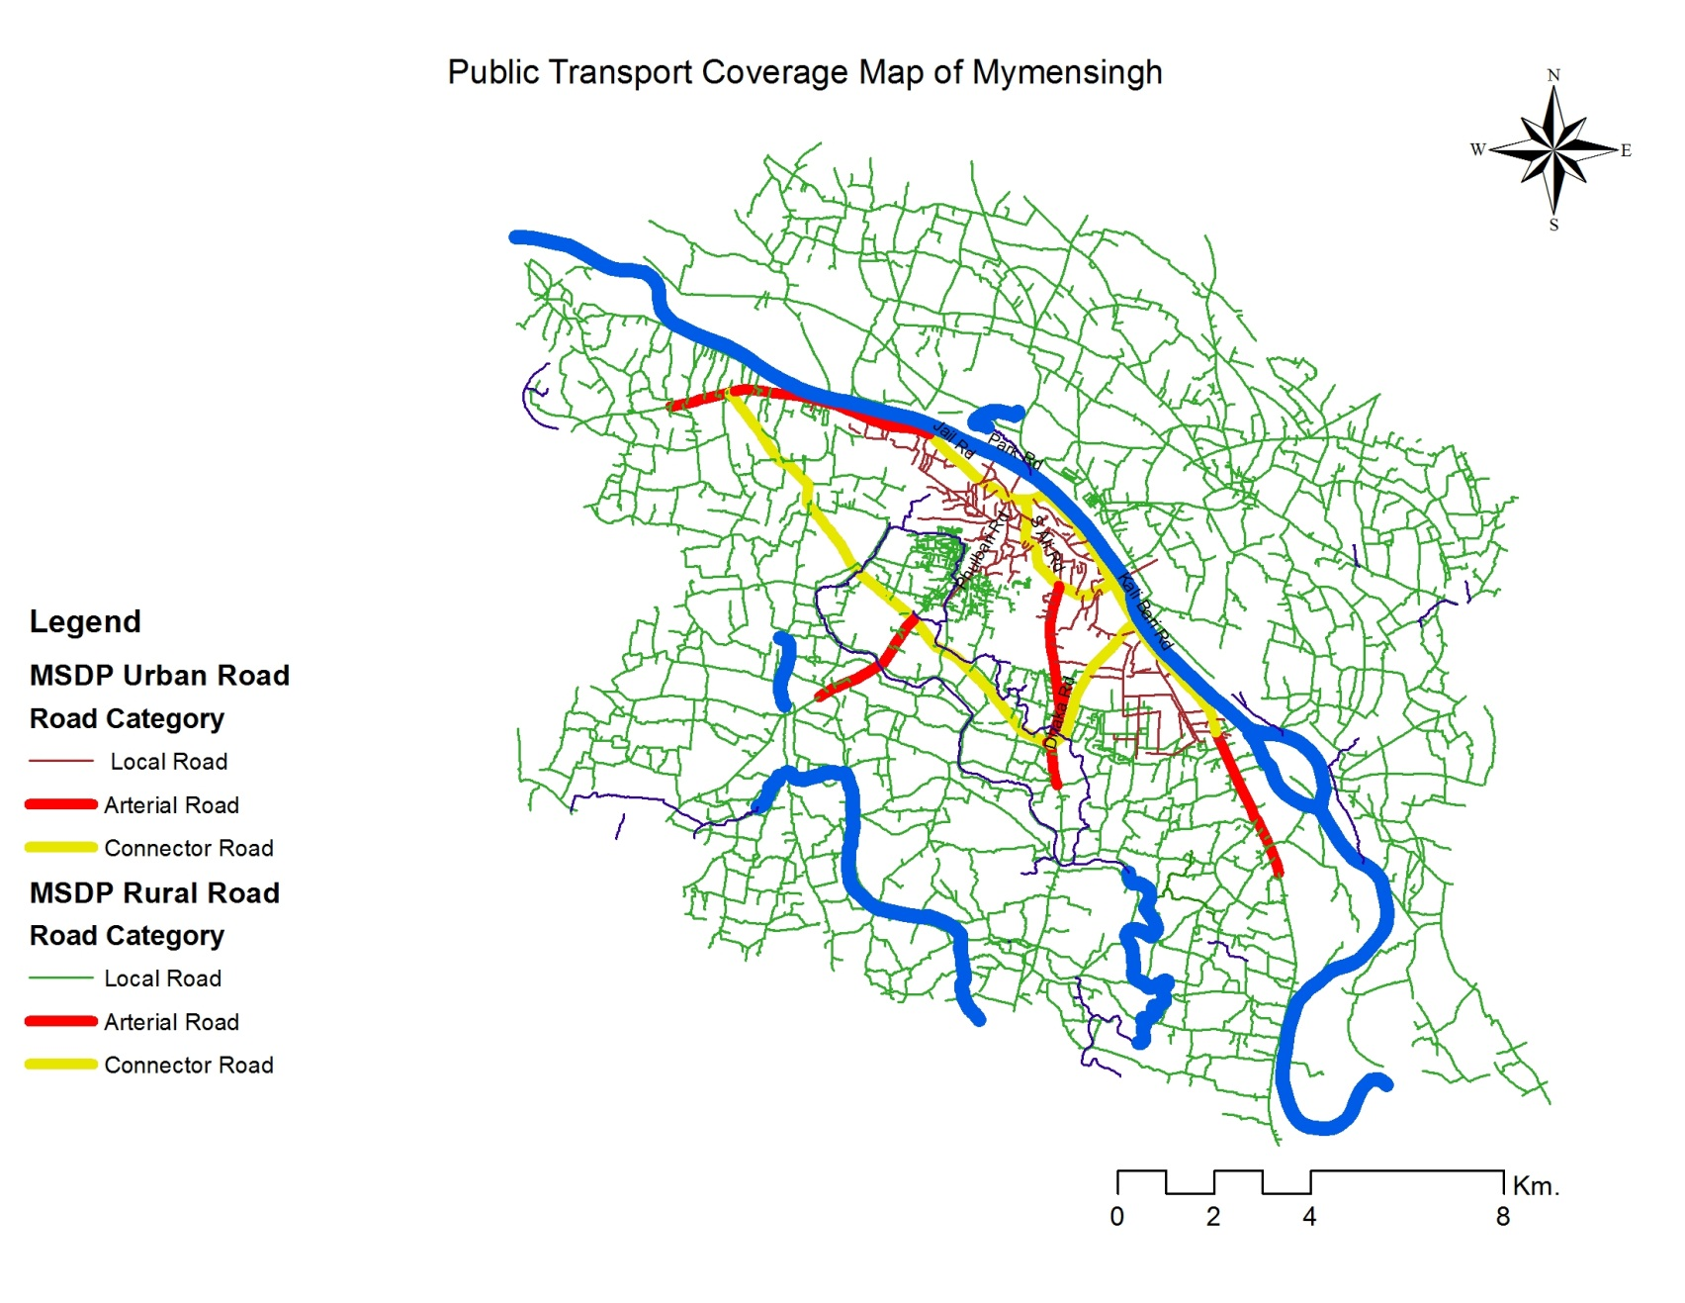
Road Network
MSDP Road Classification

Slide 22
Road Network
MSDP Road Classification
Type of local road of the Household
Type of Local Road of the House | Condition of Main Road |  | Total
 | Good Condition | Bad Goodition
Bitumine | 69.3 | 31.2 | 67.1
Brick-dust | 13.1 | 35.4 | 14.4
Brick Covered | 11.3 | 10.4 | 11.3
Raw | 6.3 | 22.9 | 7.2
Total | 100.0 | 100.0 | 100.0

Slide 23
Problem faced by the city dwellers

Slide 24
Travel Behavior
Mode
Transport Mode is used for the Purpose of Travel
Mode | Purpose of Travel in Percentage (%) |  |  |  |  |  | Total
 | Going to Workplace | School/College/ University/Educa-tional Institution | Shopping | Picnic/ Entertainment/ Sports | Visiting to Relatives | Others
Rickshaw | 39.5 | 30.9 | 56.0 | 41.5 | 44.4 | 50.0 | 40.4
Van | 45.8 | 63.8 | 42.7 | 35.8 | 11.1 | 37.5 | 46.0
Cycle | .3 | .0 | .0 | .0 | .0 | .0 | .2
Motor cycle | 1.3 | .0 | .0 | .0 | .0 | .0 | .9
walking | 3.0 | .0 | 1.3 | .0 | .0 | .0 | 2.3
car | 3.3 | 2.1 | .0 | .0 | 5.6 | .0 | 2.7
micro-bus | 6.2 | 2.1 | .0 | 22.6 | 38.9 | 6.2 | 6.9
others | .6 | 1.1 | .0 | .0 | .0 | 6.2 | .7
Total | 100 | 100 | 100 | 100 | 100 | 100 | 100

Slide 25
Travel Behavior
Mode
Transport Mode used to Go to Medical Institution
Medical Institution | Transport mode used to go to Medical institution in percentage (%) |  |  |  |  |  | Total
 | Don’t go any where | Walking | Rickshaw | Van | Easy Bike | Others
Don’t go any where | 89.5 | 0 | 0 | 0 | 10.5 | 0 | 100.0
Degree Holder Doctor | 0 | 9.7 | 79.0 | 0 | 11.3 | 0 | 100.0
Govt. Hospital | 0 | 14.7 | 78.8 | .0 | 6.0 | .5 | 100.0
Private Clinic | 0 | 0 | 94.4 | 5.6 | 0 | 0 | 100.0
Community Clinic | 0 | 0 | 100.0 | 0 | 0 | 0 | 100.0
Pharmacy (Practitioner) | 0 | 50.0 | 50.0 | 0 | 0 | 0 | 100.0
Hakiim/Kabiraz | 0 | 100.0 | 0 | 0 | 0 | 0 | 100.0
Total | 5.8 | 12.7 | 73.9 | .3 | 6.9 | .3 | 100.0

Slide 26
Travel Behavior
Mode
Transport Mode used to go for Leisure Facility
Source of Leisure Facility | Transport used to go for Leisure Facility in Percentage (%) |  |  |  |  |  |  | Total
 | Don’t go any where | Rickshaw | Van | Motor Cycle | Car | Micro bus | Walking
Don’t go any where | 100.0 | 0 | 0 | 0 | 0 | 0 | 0 | 100.0
Play Ground | 0 | 60.4 | 36.6 | 0 | 0 | 0 | 3.0 | 100.0
Place of natural beauty | 0 | 16.2 | 82.0 | .9 | .9 | 0 | 0 | 100.0
Shopping mall | 0 | 13.8 | 81.2 | 0 | 1.2 | 0 | 3.8 | 100.0
Park | 0 | 14.1 | 83.7 | .3 | .7 | .3 | 1.0 | 100.0
Club | 0 | 0 | 100.0 | 0 | 0 | 0 | 0 | 100.0
Tourist Spot | 0 | 0 | 85.7 | 0 | 0 | 14.3 | 0 | 100.0
Brahmaputra river | 0 | 23.2 | 74.2 | 0 | .5 | 0 | 2.1 | 100.0
Fair | 0 | 25.0 | 68.8 | 0 | 0 | 0 | 6.2 | 100.0
Cinema hall | 0 | 16.7 | 83.3 | 0 | 0 | 0 | 0 | 100.0
Total | 2.1 | 21.8 | 73.3 | .2 | .6 | .2 | 1.7 | 100.0

Slide 27
Travel Behavior
Cost
Average Cost for Trip Purpose
Average Cost for Trip Purpose | Urban (BDT) | Rural (BDT)
Cost For Work Trip Purpose | 37.46 | 29.32
Cost For Shopping Trip Purpose | 21.4 | 30.89
Cost For Educational Trip Purpose | 26.17 | 32.95
Cost For Social Trip Purpose | 31.67 | 62.92
Cost For Other Trip Purpose | 66.24 | 213.33

Slide 28
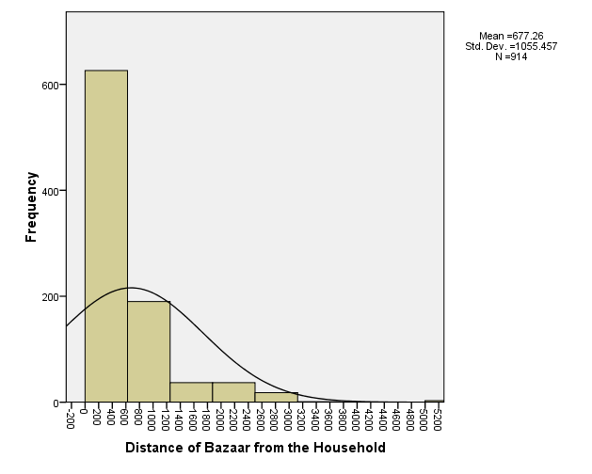
Travel Behavior
Distance
Travel Distance and Time from the Home to Bazar

Slide 29
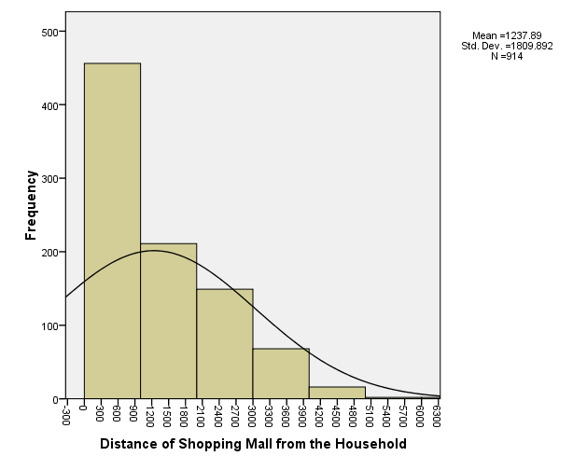
Travel Behavior
Distance
Travel Distance and Time from the Home to Shopping

Slide 30
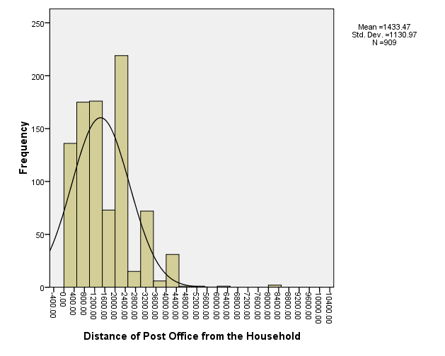
Travel Behavior
Distance
Travel Distance and Time from the Home to Post Office

Slide 31
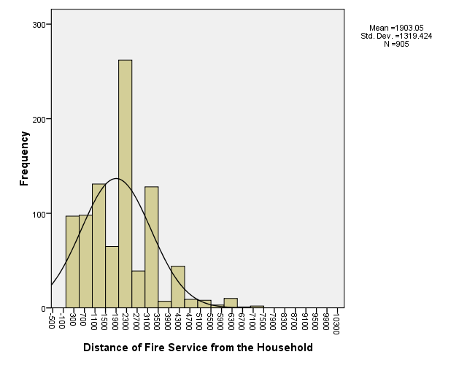
Travel Behavior
Distance
Travel Distance and Time from the Home to Fire Service Station

Slide 32
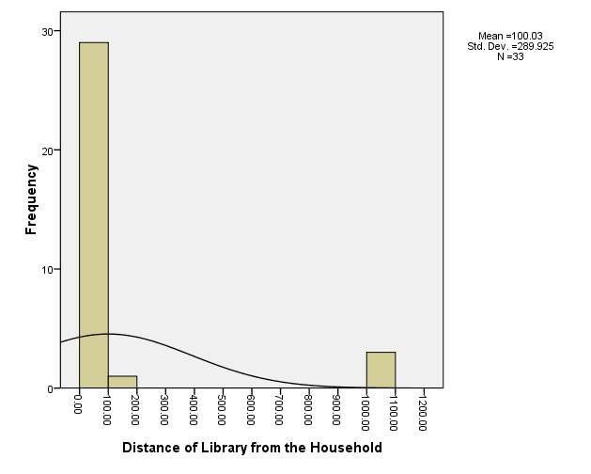
Travel Behavior
Distance
Travel Distance and Time from the Home to Library

Slide 33
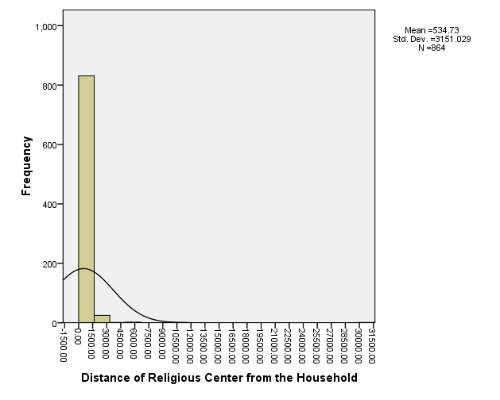
Travel Behavior
Distance
Travel Distance and Time from the Home to Religious Centre

Slide 34
Transport Planning Component in MSDP
MSDP Area
Population Prediction
Standard
Landuse Requirement
Landuse Plan
Commercial
Locations
Public Opinion
Schools
HealthCare
New Roads
Transport Plan
Public Transport
Road Geometry
Policy

Slide 35
Thank You

