Slide 1
PROJECT: 03
UNDERSTANDING THE DYNAMICS OF SHAMBHUGANJ BAZAR AREA AND ITS REVITALIZATION

Slide 2
WHAT IS
REVITALIZATION?
Urban Revitalization Means To Impart New Life Or Vigor To A COMMUNITY And It Can Include Efforts To Revitalize A Flagging Economy.
The Process Addresses Five Key Elements:
1. The Neighborhood’s Or Community’s Image
2. Market Forces That Act On The Neighborhood Or Community
3. The Physical Conditions
4. The Social Conditions
5. Stakeholder’s Ability To Manage Community Issues And Affairs

Slide 3
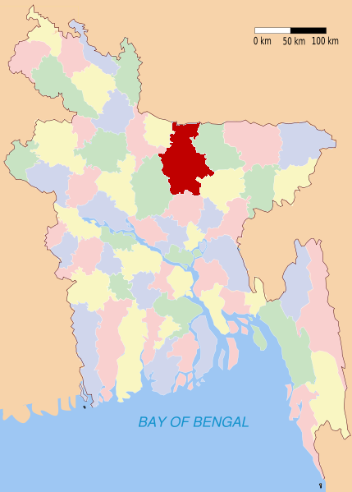
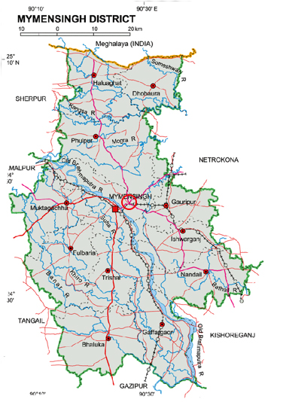
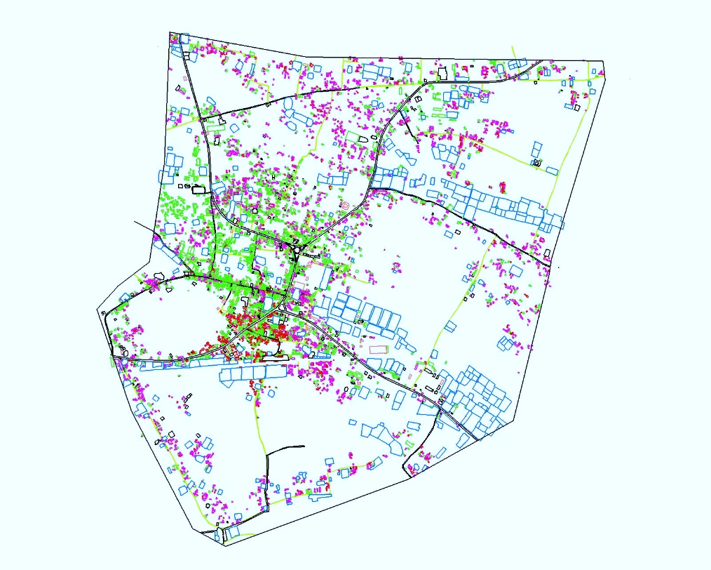
INTRODUCTION
ADMINISTRATIVE
STRUCTURE
SHAMBHUGANJ IS AN AREA OF MYMENSINGH, BANGLADESH.IT IS SITUATED ON THE NORTHERN SIDE OF THE BRAHAMAPUTRA RIVER.SHAMBHUGANJ IS CONNECTED TO THE MYMENSINGH TOWN BY THE SHAMBHUGANJ BRIDGE
WHY WE CHOOSE
1. REVENUE
2. LOCATION
3. PROBABLE GROWTH CENTRE
BANGLADESH
DHAKA DIVISION
MYMENSINGH
DISTRICT
SADAR UPAZILA
CHAR NILAKSHMIA UNION
SHAMBHUGANJ
SHAMBHUGANJ
MYMENSINGH

Slide 4
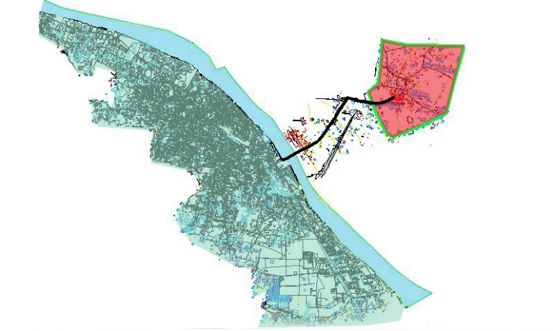
LOCATION
CONNECTIVITY BETWEEN MYMENSINGH TOWN & SHAMBHUGANJ
SHAMHUGANJ BRIDGE ROAD
5 KM
SHAMBHUGANJ
MYMENSINGHTOWN

Slide 5
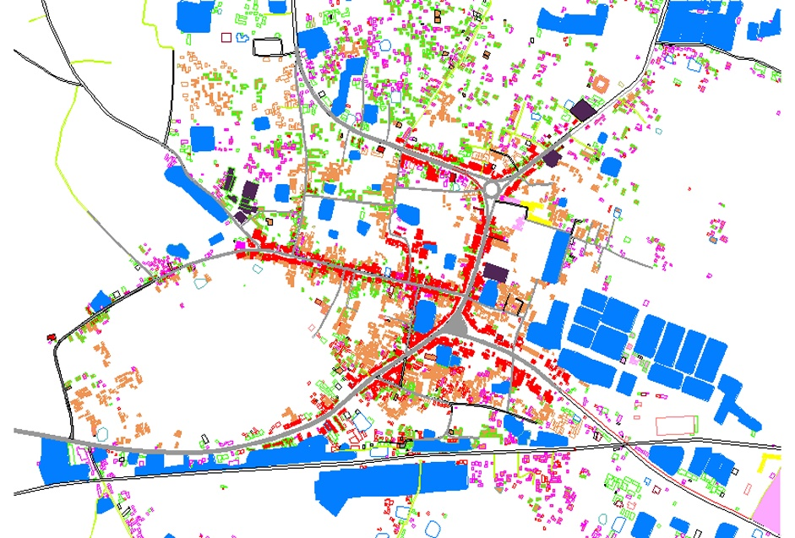
EXISTING SHAMBHUGANJ BAZAR AREA AND ROAD CONNECTIVITY
HALUAGHAT ROADS
NETROKONA ROAD
BYPASS ROAD
BAZAR ROAD
MYMENSINGH TOWN
ROAD
RAIL LINE
KISHORGANJ ROAD
PLACE | DISTANCE
MYMENSINGH TOWN | 5 KM
KISHORGONJ | 62KM
NETROKONA | 36KM
HALUAGATH | 51KM
SHERPUR | 65KM
0
.5 KM
LEGEND
COMMERCIAL
WATER BODY
RESIDENTIAL
GREEN

Slide 6
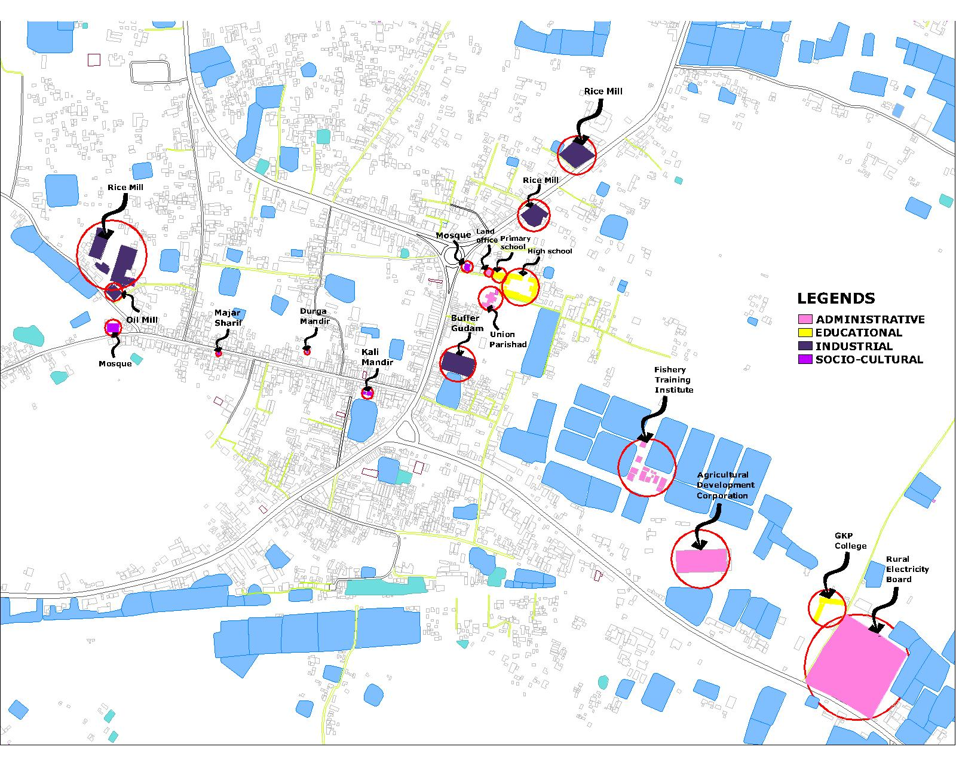
EXISTING SHAMBHUGANJ BAZAR AREA IMPORTANT BUILDING

Slide 7
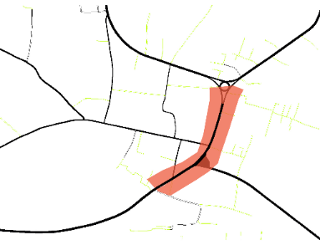
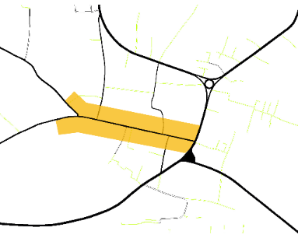
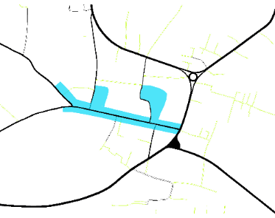
CHRONOLOGICAL CHANGE
REASON OF ESTABLISHMENT
GREATER MYMENSINGH
WAS FAMOUS FOR JUTE AND RICE. BECAUSE OF ITS POSITION & CONNECTIVITY JUTE & RICE BAZAR WAS ESTABLISHED IN SHAMBHUGANJ IN THE BRITISH PERIOD.
JUTE & RICE
FIG: BRITISH PERIOD BAZAR AREA
AGRICULTURAL TOOLS
COMMODITIES
JUTE & RICE
FIG: PAKISTAN PERIOD BAZAR AREA
FIG: PRESENT BAZAR AREA

Slide 8
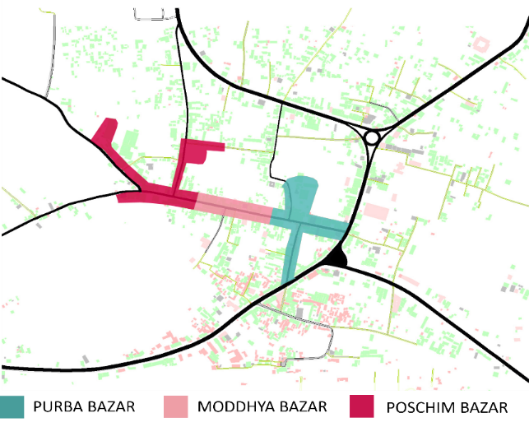
BAZAR PARTS

Slide 9
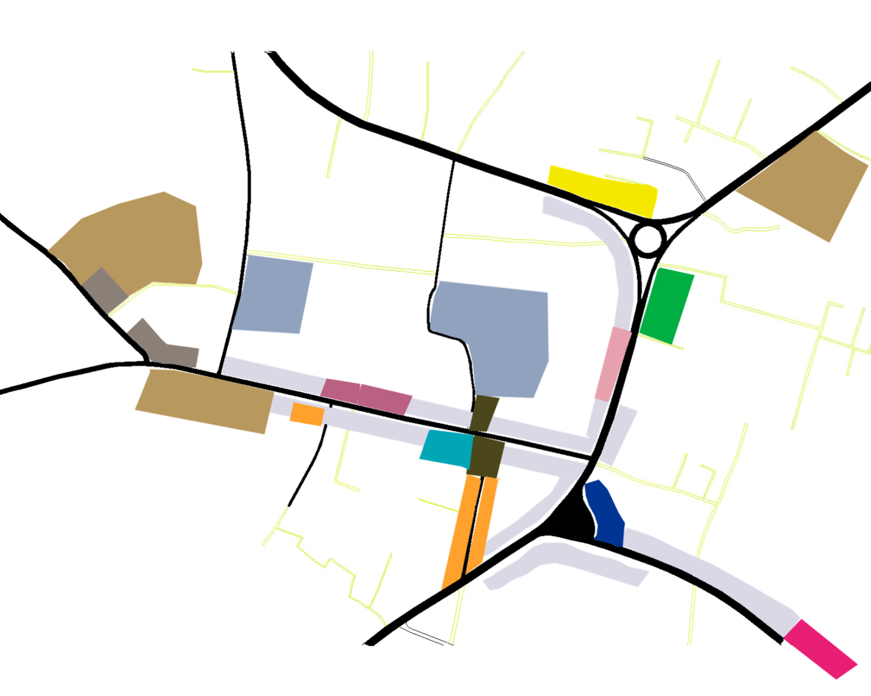
COMMERCIAL VIEW
RICE
OIL
COW HIDE
POTATO
FISH
MEAT
MIXED USE
CLOTH
RESTAURENT
FERTILIZER
RE- BAR
BAMBOO
WOOD

Slide 10
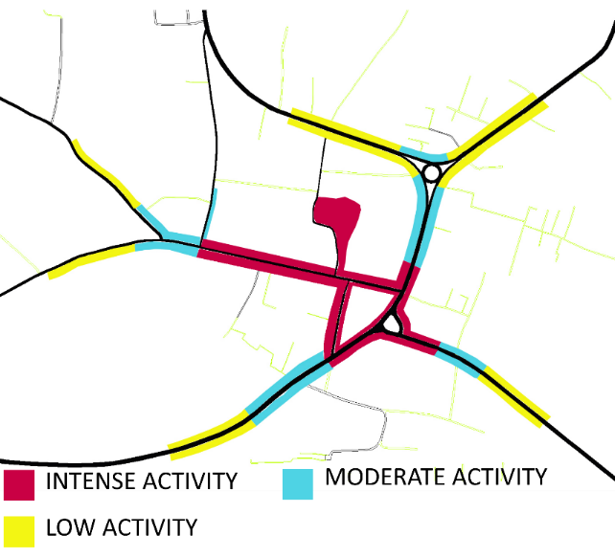
ACTIVITY AREA
SHOPNAR MOR
BAZAR ROAD
TIN RASTAR MOR

Slide 11
BAZAR AT A GLANCE
MAIN BAZAR PARTS
MAIN HAT DAY
PURBA BAZAR
MODHYA
BAZAR
POSCHIM
BAZAR
SUNDAY
THURSDAY
COW HIDE HAT DAY
MAIN TRADE
SATURDAY
TUESDAY
SOCIO-CULTURAL ORGANIZATION
COW HIDE
RICE
FISH
POTATO
COW HIDE MARKET PARTS
MAZAR OF BURA PIR
MANDIR
PURBA BAZAR
KALI
MANDIR
DURGA
MANDIR
POSCHIM
BAZAR

Slide 12
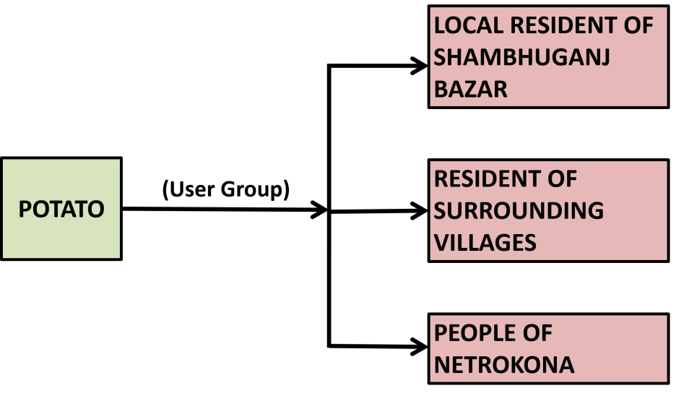
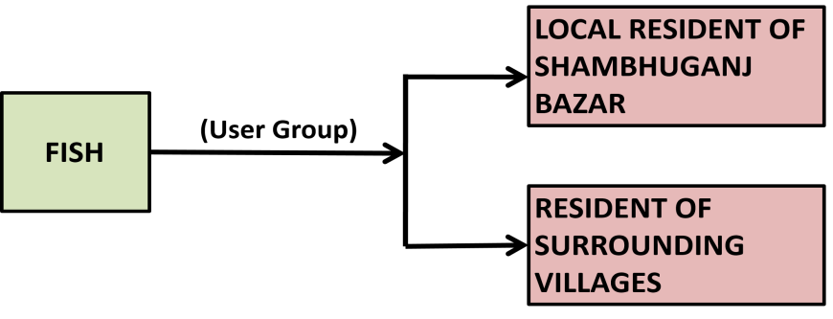
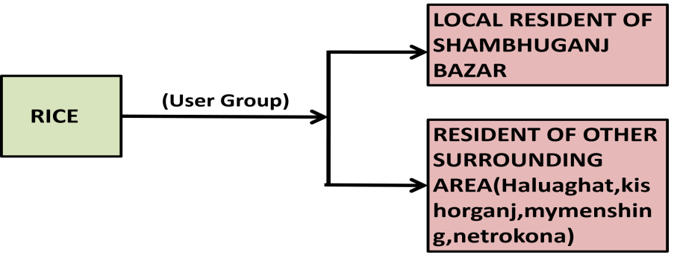
TRADES IN DIFFERENT PARTS OF BAZAR
PURBA BAZAR (MAIN BAZAR)
MODDHYA BAZAR
POSCHIM BAZAR
NO OF PERMANENT SHOP : 261
TEMPORARY SHOP : 320
NO OF PERMANENT SHOP : 146
TEMPORARY SHOP : 103
NO OF PERMANENT SHOP : 142
TEMPORARY SHOP : 96
MAIN TRADE:
FISH
MEAT
VEGETABLE
DRY FISH
RICE
PLASTIC
LEATHER
MAIN TRADE:
DRY FISH
JWELARY
TAILOR
TEA STALL
STATIONARY
POTATO WHOLE SALE
PHONE FAX
CLOTH
MAIN TRADE:
RICE MILL
OIL MILL
LEATHER
BAG SHOP
USER GROUP
(User Group)
PEOPLE OF DHAKA TANNERY
COWHIDE

Slide 13
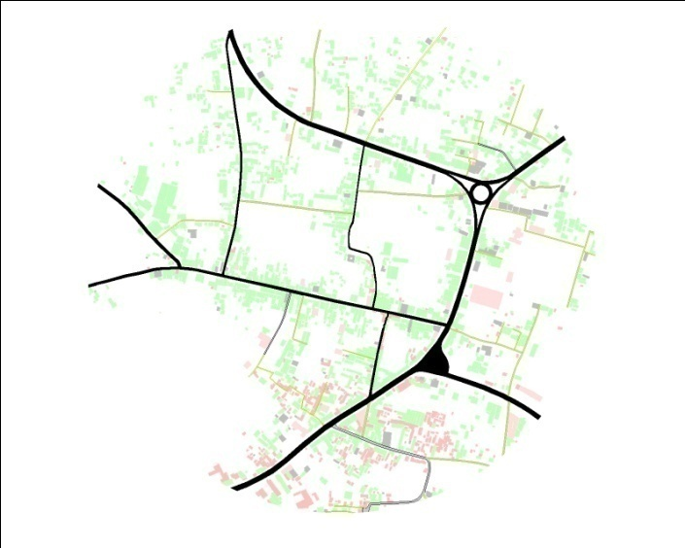
PRODUCT DIAGRAM
COW HIDE
m
MYMENSHING
m
m
HALUAGHAT
NETROKONA
m
m
SHERPUR
KISHORGONG
PROCESSING OF RAW HIDE:
CLEANING THE REMAINING MEAT
WASHING THE HIDE
MIXING WITH SALT
m
DHAKA

Slide 14
PRODUCT DIAGRAM
FISH
m
SYLHET
m
m
TRISHAL
MOHONGANJ
m
m
VOIRAB
CHITTAGONG
TOTAL WHOLE SELLER : 05 NOS
TOTAL RETAIL SELLER : 110 NOS
m
SURROUNDING
BAZAR

Slide 15
PRODUCT DIAGRAM
PADDY
SHERPUR
NETROKONA
HALUAGHAT
HALUAGHAT
Processing paddy:
Processing paddy in auto rice
mill within 12 hours.
m
m
HALUAGHAT
NETROKONA
m
KISHORGANJ
MYMENSINGH
m
DHAKA

Slide 16
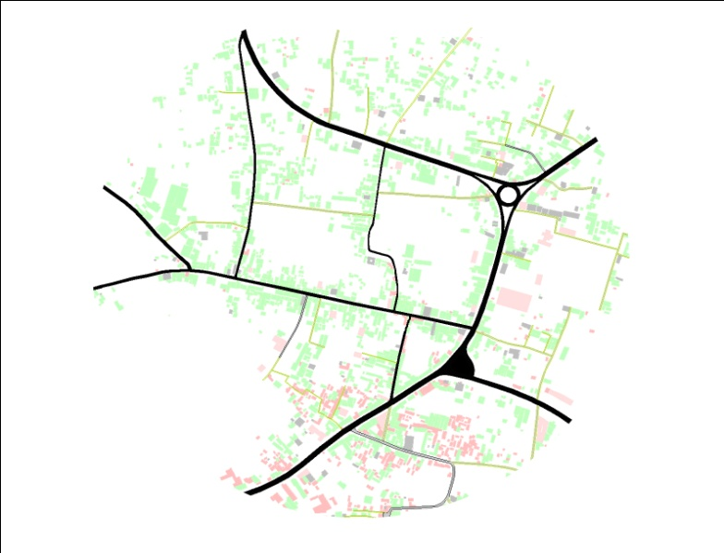
PRODUCT DIAGRAM
POTATO
m
m
BOGRA
LALMONIRHAT
m
m
RANGPUR
RAJSHAHI
m
m
NETROKONA
SURROUNDING
BAZAR
TOTAL WHOLE SELLER : 05 NOS

Slide 17
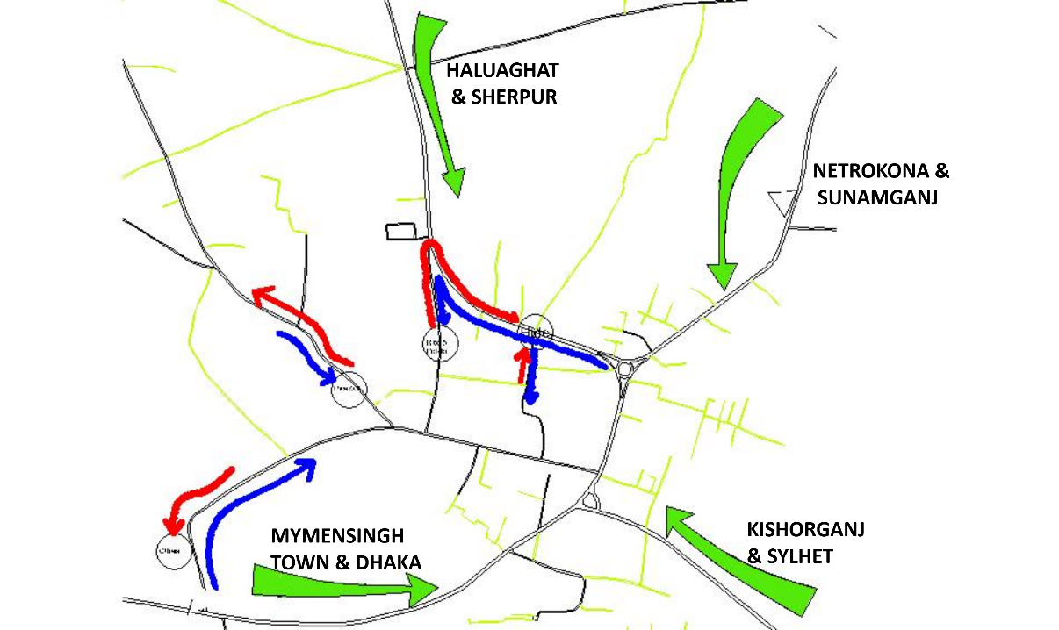
SERVICE ENTRY
LEGEND
0
.5 KM
ENTRY
EXIT

Slide 18
ECONOMIC VALUE OF BAZAR
LAND AREA & ECONOMIC VALUE OF MAIN PRODUCT
TRADE | TENDER AREA(0.73ACRE) |  |  | DAY | VALUE ADD FROM SEIZED AREA | VALUE ADD FROM USED AREA | NET PROFIT FROM USED AREA
 | USED AREA (ACRE) | UNUSED AREA(ACRE) | SEIZED BY LOCAL PEOPLE
COW HIDE | 0.36 | 0.13 | 0.24 | 5 | 0 | 56,00,000 | 32,20,000
HAT | 0.49 | 0 | 0.24 | 2 | 0 | 5,65,000 | 5,23,100
 |  |  |  | 1 WEEK | 0 | 61,65,000 | 37,43,100
 |  |  |  | 1YEAR | 0 | 32,05,80,000 | 19,46,41,200
LAND AREA OF BAZAR
BAZAR LAND | AREA (ACRE)
TENDER AREA | 0.73
FISH BAZAR | 0.15
ROAD SIDE AREA | 0.52
Total | 1.4
LAND VALUE
PRODUCT NAME | LEESE HOLDER COLLECTION PER YEAR
COW HIDE | 14560000
FISH | 401500
cow | 1664000
goat | 254800
chicken | 260000
vegetable | 365000
TOTAL | 17505300

Slide 19
ECONOMIC VALUE OF BAZAR
LAND AREA AND ECONOMIC VALUE OF MAIN PRODUCTCO ON GOVT. LAND
ITEME | AREA(1.4 ACRE) | VALUE ADD PER WEEK | NET PROFIT PER WEEK | VALUE ADD PER YEAR | NET PROFIT PER YEAR | LAND USE IN PERSENTAGE
COW HIDE | 0.36 | 56,00,000 | 32,20,000 | 29,12,00,000 | 16,74,40,000 | 25.71%
HAT | 0.49 | 5,65,000 | 5,23,100 | 2,93,80,000 | 2,72,01,200 | 35%
FISH | 0.15 | 8,40,000 | 83,23,000 | 4,36,80,000 | 4,32,79,600 | 10.71%
VEGETABLE | 0.13 | 4,90,000 | 4,83,000 | 2,54,80,000 | 2,51,16,000 | 9.28%
 | Total | 74,95,000 | 46,23,700 | 38,97,40,000 | 26,30,36,800
ECONOMIC VALUE OF MAIN PRODUCT ON PRIVATE LAND
 | ITEME | VALUE ADD PER WEEK | VALUE ADD PER YEAR
ON PRIVATE LAND | RICE | 1,12,00,000 | 58,24,00,000
 | POTATO | 2,88,000 | 1,49,76,000
 | RE-BAR | 181,819 | 94,54,588
 | TOTAL | 1,16,69,819 | 60,68,30,588

Slide 20
ECONOMIC VALUE OF BAZAR
ITEME | per week value add | per week net profit | PER YEAR VALUE ADD | per year net profit
COW HIDE | 56,00,000 | 32,20,000 | 2,91,200,000 | 16,74,40,000
FISH | 8,40,000 | 8,32,300 | 4,36,80,000 | 4,32,79,600
HAT | 5,65,000 | 5,23,100 | 2,93,80,000 | 2,72,01,200
VAGETABLE | 4,90,000 | 4,83,000 | 2,54,80,000 | 2,51,16,000
RICE | 1,12,00,000 |  | 58,24,00,000
POTATO | 2,88,000 |  | 1,49,76,000
RE-BAR | 1,81,819 |  | 94,54,588
TOTAL | 1,91,64,819 | 50,58,400 | 99,65,70,588 | 26,30,36,800
ITEME | VALUE ADD PER YEAR | NET PROFIT PER YEAR | LEESE HOLDER COLLECTION
COW HIDE | 29,12,00,000 | 16,74,40,000 | 1,45,60,000
HAT AREA | 2,93,80,000 | 2,72,01,200 | 21,78,800
FISH | 4,36,80,000 | 4,32,79,600 | 4,01,500
VEGETABLE | 2,54,80,000 | 2,51,16,000 | 3,65,000

Slide 21
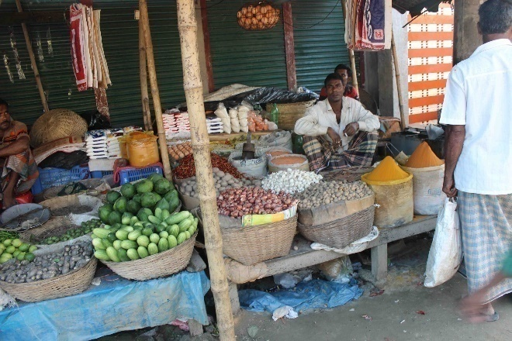
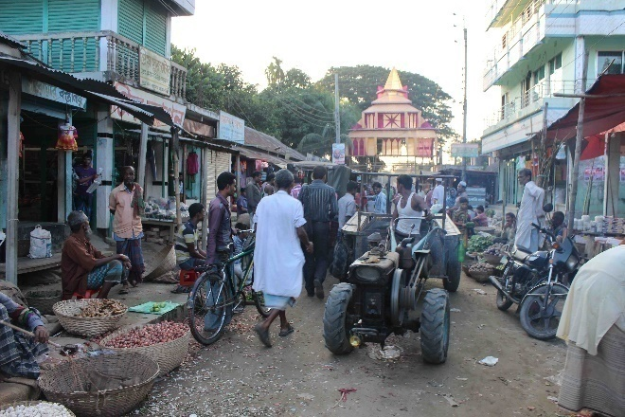
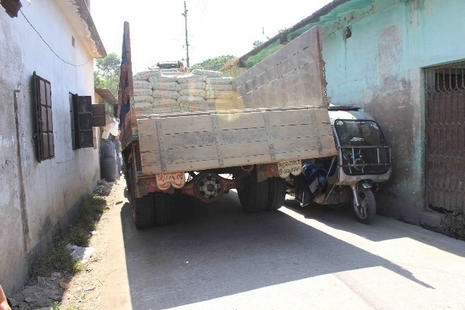
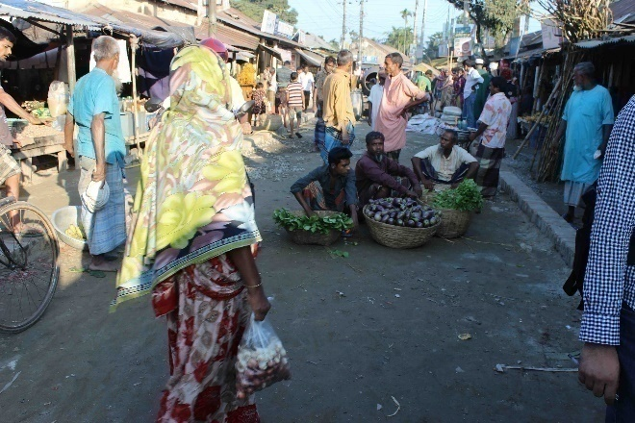
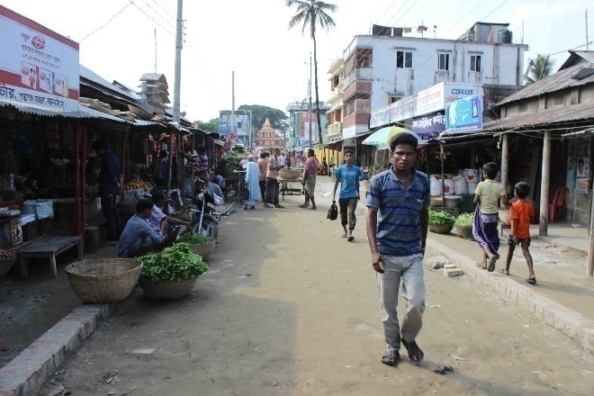
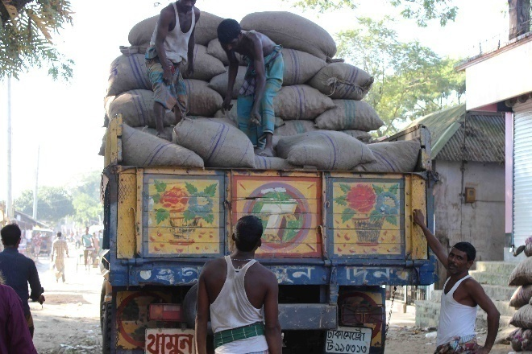
FINDINGS
1.NARROW ROAD
2.ROAD WIDTH:15 FEET
3.NO DEFINED PEDESTRIAN
4.SECONDARY ROAD WIDTH:7-8 FEET
5.NO DRAINAGE SYSTEM
6.BAZAR IS FLOODED DURING RAINY SEASON
7.NO PUBLIC TOILET
8.INSUFFICIENT SHED FOR COW HIDE MARCKET.
9.VEGETABLE SELLER SIT ON THE ROAD.
10.NO SPACE FOR TRADITIONAL FAIR
11.AUSTOMI FAIR SITS ON THE BAZAR ROAD.
MAIN PROBLEMS OF BAZAR
1.NARROW ROAD SO THAT THE VAHICLE CAN’T MOVE AND THE ROAD GETS BLOCKED.
2.NO DRAINAGE SYSTEM OF THE BAZAR AREA SO THAT ROAD GETS FLODDED DURING RAINY SEASON.
3.NO SPACE FOR THE VEGETABLE SELLER.THEY SIT ON THE ROAD.
4.THE DENSIT OF THE SHOP IS VERY HIGH.
5.NO PLACE FOR THE TEMPORARY SHOPS.
6.THERE IS NO PLACE FOR VAN, RICKSHAW,MOTOR CYCLE,PARKING .
7.NO LOADING –UNLOADING AREA FOR THE WHOLE SALE BUSINESS.
8.SERVICE VEHICLE CANNOT MOVE PROPERLY BECAUSE OF THE NEWLY ESTABLISHED ILLEGAL SHOP AT POSCHIM BAZAR .

Slide 22
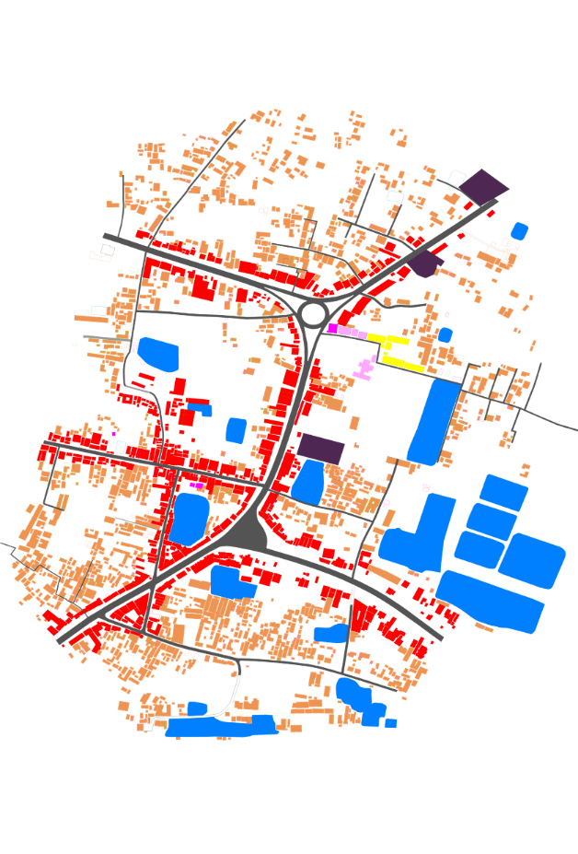
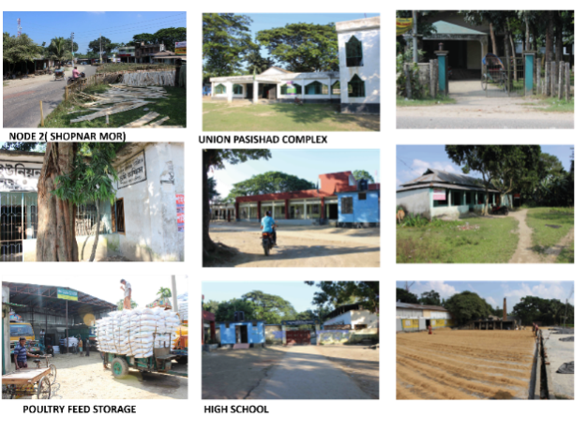
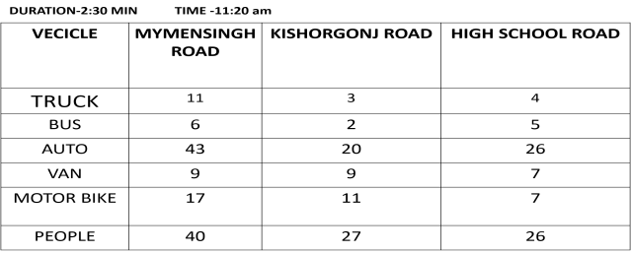
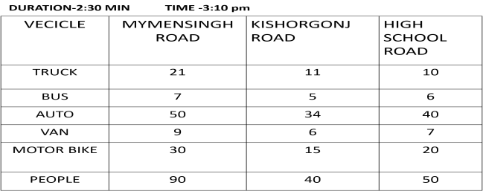
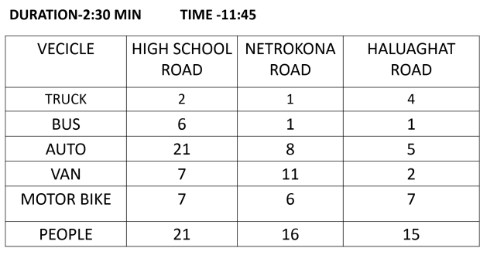
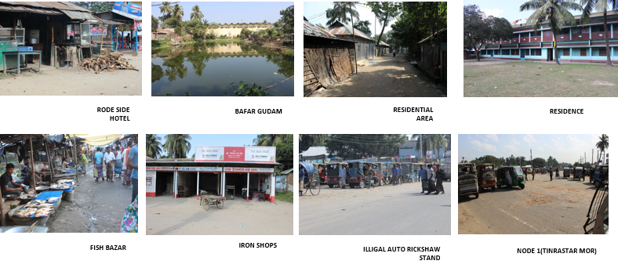
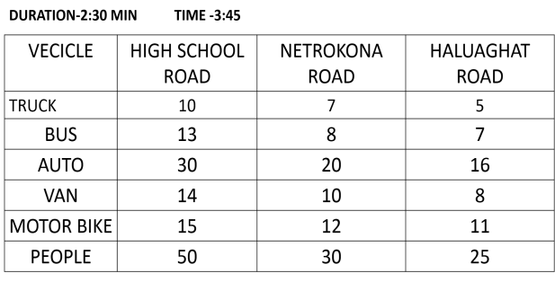
NODE
NODE-1 (TIN-RASTAR MOR)
MAIN FEATURE:
MIXED USE SHOP
SEVSRAL RESTURENTS
ILLEGAL TRUCK STAND
RESIDENTIAL AREA BESIDE ROAD
BAFAR GUDAM
PROBLEMS:
-TRUCK STAND ON THE MAIN ROAD
-AUTO RICKSHAW STAND IN THE ROAD
-NO TRAFFIC RULLES
-NO DRAINAGE SYSTEM
-NO DEFINE PEDISTRIAN
MAIN FEATURE:
-UNION LAND OFFICE
-UNION PARISHAD COMPLEX
-GRAMEEN BANK
-BRACK BANK
-A POULTRI FEED STORAGE
-RICE MILL
-A HIGH SCHOOL
-PRIMARY SCHOOL
-RE BAR MARCKET
NODE-2(SHOPNAR MOR)
PROBLEMS:
-NO DEFINED PEDESTRAIN
-NO DRAIN AGE SYSTEM
-NARROW ROAD

Slide 23
SWOT ANALYSIS
STRENGTH
1. STRONG TRANSITIONAL POINT.
2. STRONG COMMUNITY BONDAGE.
3. EASY DISTRIBUTION OF PRODUCT
WITHIN SURROUNDING BAZAR.
4. GREAT PLATFORM FOR COW HIDE TRADE.
5. STRONG VALUE ADDING POINT FOR RICE.
WEEKNESS
1.NO DRAINAGE SYSTEM
2. NARROW ROAD.
3. POOR GARBAGE MANAGEMENTSYSTEM.
4.TRAFFIC CONGESTION.
5.LACK OF PROPER SPACE FOR DIFFERENT TYPES OF
TRADE.
6. NO SPACE FOR LOADING UNLOADING AND PARKING.
OPPORTUNITY
1. POTENTIALITY FOR BUSINESS
2. LARGE JOB MARKET FOR DAY
LABOURERS
3. A PROMINENT SOURCE OF REVENUE
4. POSSIBLE GROWTH CENTRE
FOR THIS REGION.
THREAT
1. NO ENOUGH INFRUSTRUCTURE
2. ENVIRONMENTAL POLLUTION BY COW HIDE.
3. REQUISITION OF GOVT. LAND BY COMMON
PEOPLE.
4. POSSIBILITY OF MASSIVE LOSS
DURING FIRE HAZZARD.
CONFLICT ANALYSIS
1. DIFFERENT TYPES OF BUSINESSMAN WANT SAME PLACE.
2. PEOPLE DON’T WANT THE SHOSHAN AREA IN THE BAZAR AREA
3. THE LEESEHOLDER DON’T WANT TO GIVE SPACE FOR SMALL BUSINESSMAN
4. MAXIMUM REVENUE COME FROM COWHIDE BUT IT IS HARMFUL FOR ENVIRONMENT

Slide 24
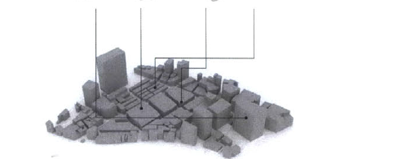
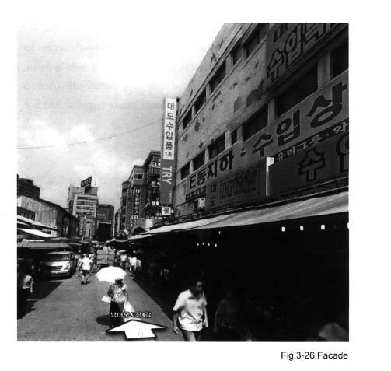
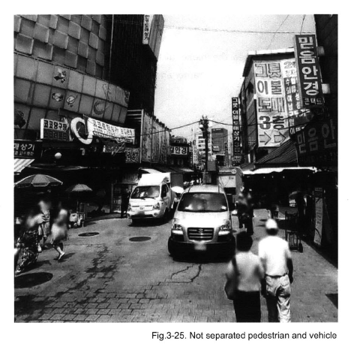
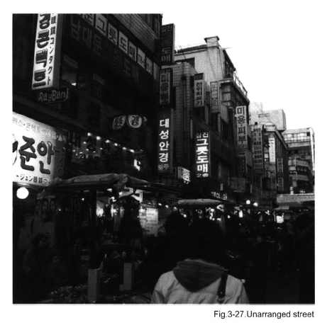
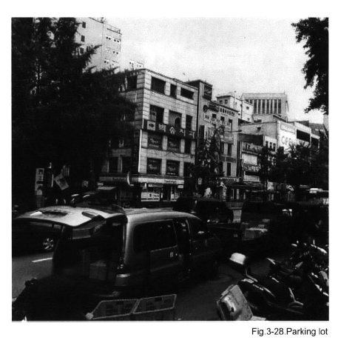
Case study
Revitalizing & Reinventing THE NAMDAEMUN MARKET, KOREA
EXISTING MASTER PLAN
PROBLEMS
-NO SEPERATERD PEDESTRIAN AND VEHICLE
-CONFLICTED CONNECTION BETWEEN BUILDINGS
-PARKING LOTS
-ACCESS
-UN-ARRANGED STREETS

Slide 25
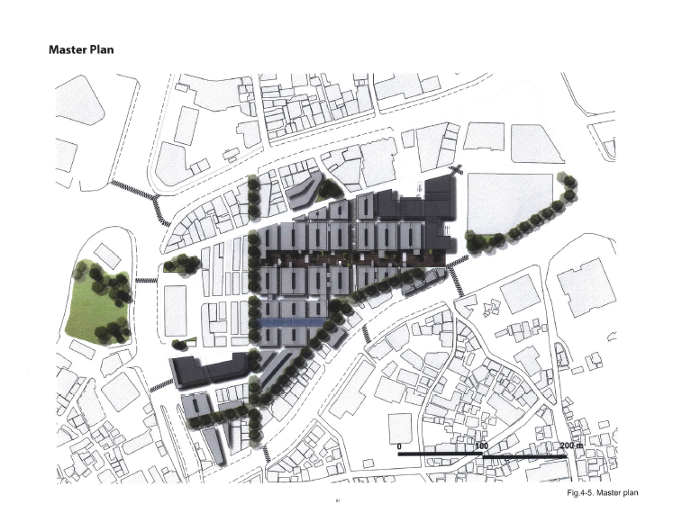
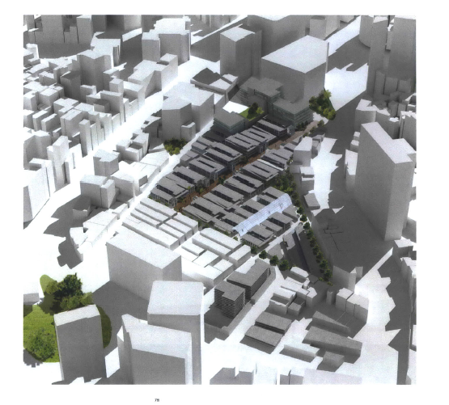
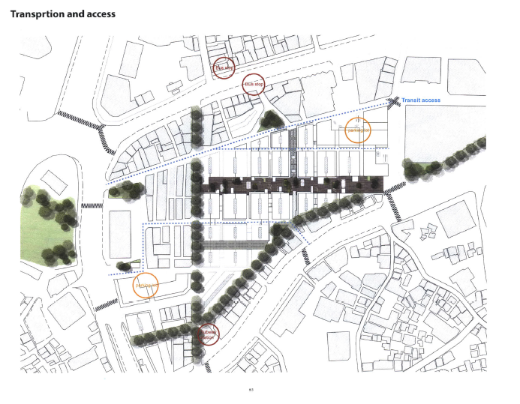
AFTRE REVITALIZATION
:CONCEPT
BIRDS EYE VIEW
PARKING
BUS STOP

Slide 26
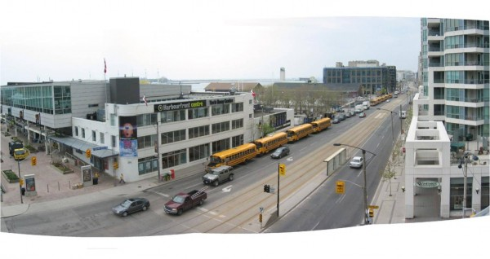
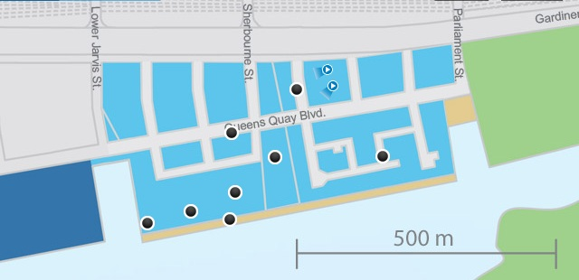
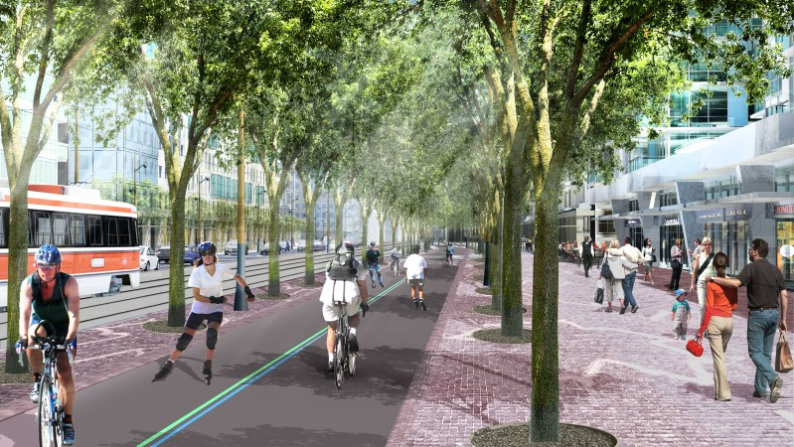
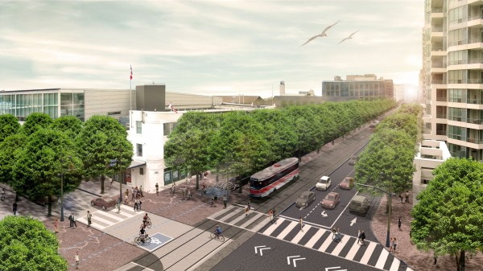
QUEENS QUAY BLVD REVITALIZATION
BEFORE
PEDISTRAIN
AFTER

Slide 27
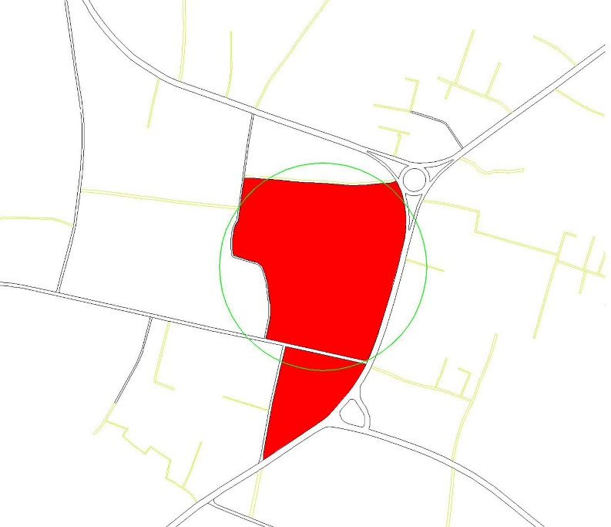
PROPOSAL :
TOTAL AREA FOR THIS LOCATION IS ABOUT 9.68 ACRE.PEOPLE
CAN TRAVEL IN THIS PLACE WITHIN 5 MIN WALKINGDISTANCE.
WHY WE CHOOSE :
MAXIMUM OPEN SPACE IN THIS LOCATION,MINIMUM NUMBER OF PUCCA AND SEMI
PUCCABUILDING.
COW HIDE BAZAR AND COW,GOAT AND CHICKEN BAZAR ARE PERFORMING IN
THIS PLACE.BUT OUR PROPOSAL IS SHIFTING THOSE FUNCTIONS IN ANOTHER
PLACE.POSSIBLY IN EXISTING SHOSHAN.BECAUSE SHASHAN IS NOT APPROPRIATE
IN RESIDENTIAL AREAS.SO WE WANT TO SHIFT THIS SHASHAN OUTSIDE FROM
THE RESIDENTIAL AREA.
KACCA(1) | 140
SEMI PUCCA(1) | 895
PUCCA(1) | 45
PUCCA(2) | 20
TINSHADE(1) | 240
UNER CONSTRUCTION(1) | 2
PUCCA(3) | 8
PUCCA(4) | 2

Slide 28
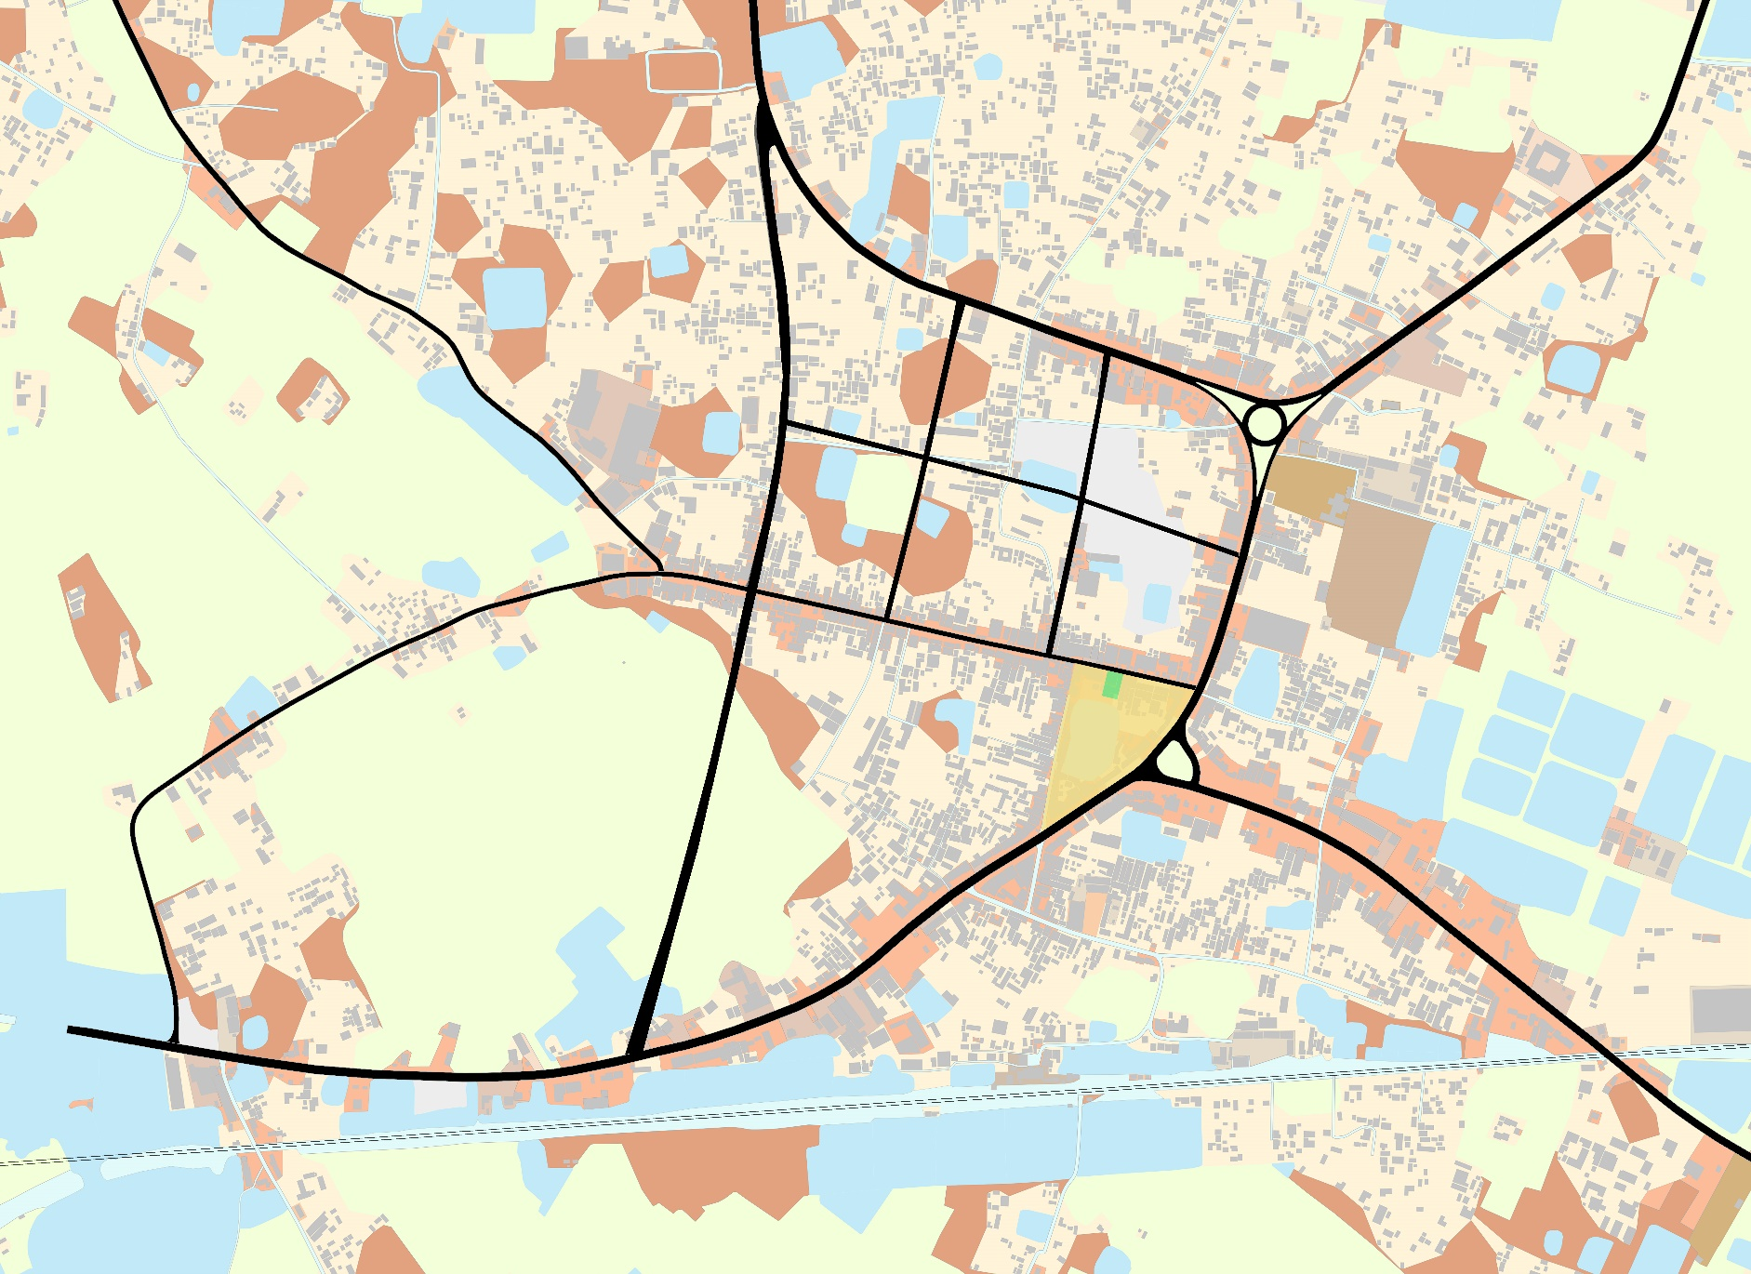
PROPOSAL
RESIDENTIAL
AREA
LOADING
UNLOADING
AREA & TRUCK STAND
VEGETABLE
BAZAR
WHOLE
SALE SHOP
COW & HIDE
HAT
FISH BAZAR
SQUARE
0
.5 KM

Slide 29
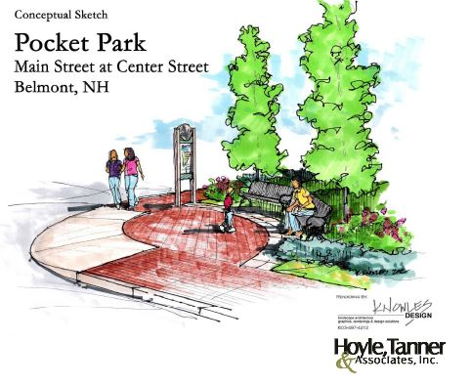
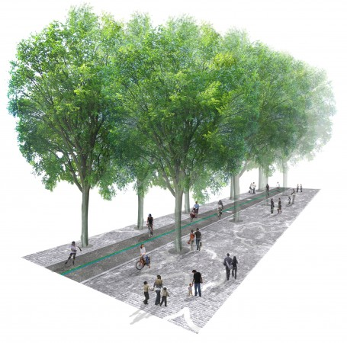
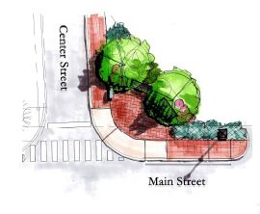
PROPOSAL
Conceptual sketch
Wide Pedestrian
At Main Street

Slide 30
THANK YOU

