Slide 1
PROJECT 02
BRAHMAPUTRA NOD
RIVERFRONT DEVELOPMENT
“DREAM PLACE” OF
JAINUL ABEDIN

Slide 2
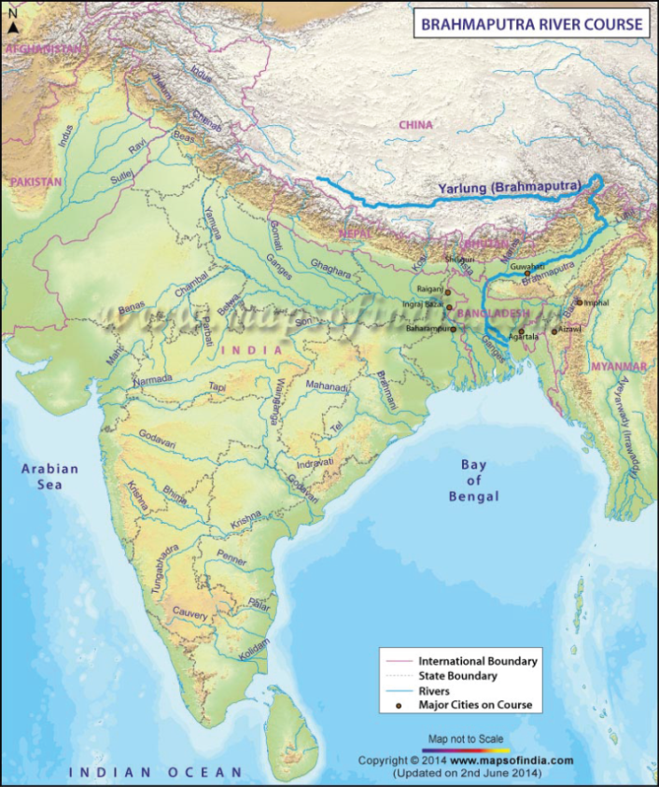
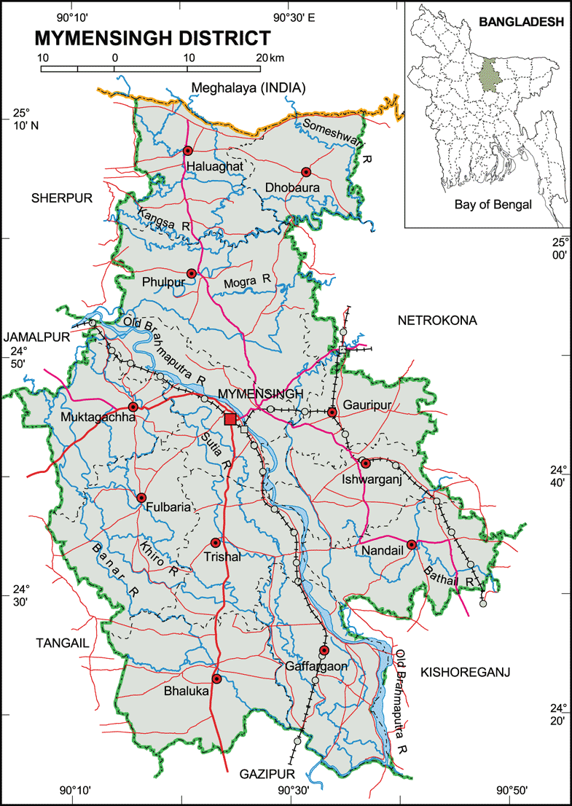
BRAHMAPUTRA NOD
ORIGIN: ANGSI GLACIER, NORTH SIDE OF HIMALAYA.
IN BANGLADESH, BRAHMAPUTRA IS JOINED BY TEESTA RIVER.
DISCHARGE: BAY OF BENGAL.
BRAHMAPUTRA, MAJOR SOURCE OF TRANSPORTATION, COMMUNICATION, ACTIVITY, LIFE AND LIVING.
ABOUT 150YRS AGO, AS A RESULT OF EARTHQUAKE MYMENSINGH SADAR TOOK ITS PRESENT FORM.
Brahmaputra Nod -
Lifeline of Mymensingh Sadar as
The town grew up centering the
river.

Slide 3
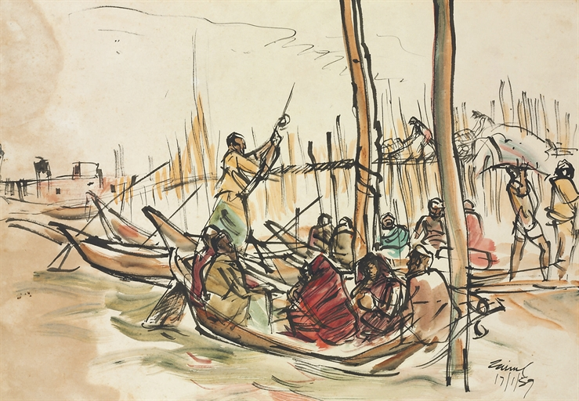
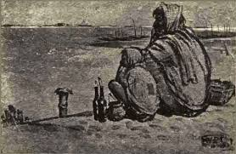
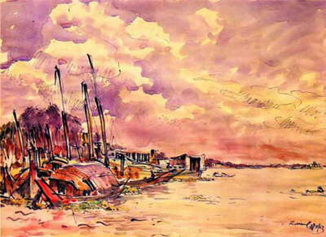
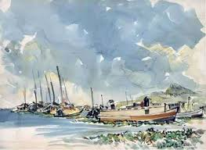
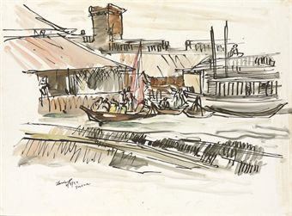
JAINUL ABEDIN : OUR INSPIRATION
IN JAINUL ABEDIN’S CANVAS WE OBSERVE 3 PLANES.
LAND IN THE FOREGROUND
RIVER IN THE MIDDLE
HORIZON RECEDING INTO DISTANCE

Slide 4
METHODOLOGY
LITERATURE REVIEW AND BACKGROUND STUDY
OBJECTIVE FORMULATION
DATA COLLECTION
GHAT IDENTIFY ACTIVITY PATTERN OF GHATS CLASSIFICATION
SEWERAGE CONTOUR EARTHQUAKE SOIL CONDITION TRANSPORT
ANALYSIS
GHAT ANALYSIS QUALITY OF GHATS TYPOLOGY
URBAN FORM ROAD NETWORK HERITAGE WALKWAY
FORMULATION OF STRATEGIES

Slide 5
SITE
LOCATION : Mymensingh Sadar,Mymensingh
LENGTH OF RIVERFRONT : 11.5KM
AREA UNDER CONSIDERATION: 2.1937SQ.KM
WIDTH: 184M-336M(approx)

Slide 6
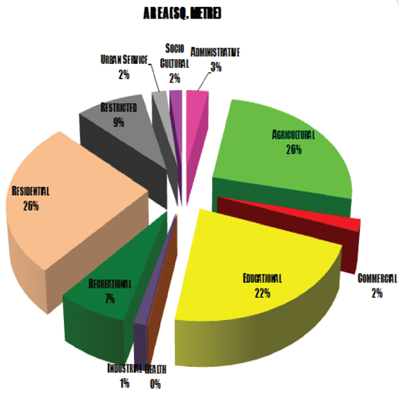
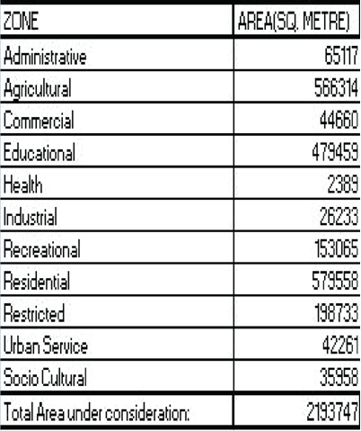
LANDUSE
LANDUSE

Slide 7
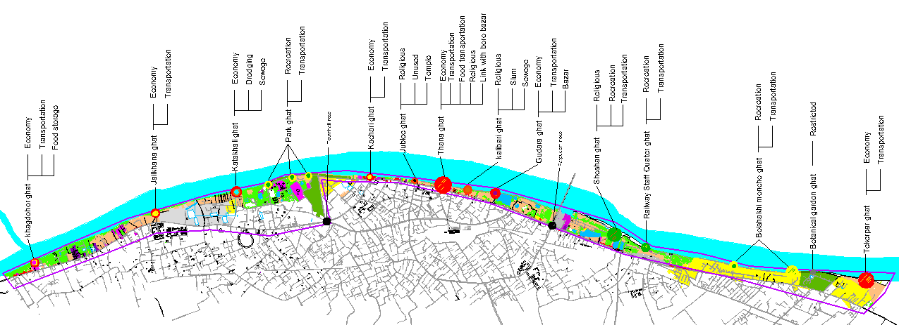
GHAT IDENTIFY & ACTIVITY PATTERN
“GHAT” A CONNECTING POINT BETWEEN A LANDMASS AND A WATER BODY.
WE CAN CLASSIFY GHAT AS FOLLOWS BASED ON THEIR USE:
RELIGIOUS GHAT
CREMATORY GHAT
GHAT USED FOR CLEANING
ACTIVITY PATTERN

Slide 8
CLASSIFICATION OF GHATS
ECONOMIC
RECREATION
KHAGDOHOR GHAT
KATAKHALI GHAT
KACHARI GHAT
THANA GHAT
GUDARA GHAT
TEKER PAR GHAT
PARK GHAT
BOISHAKHI MONCHO GHAT
BOTANICAL GARDEN GHAT
TRANSPORTATION
JAILKHANA GHAT
KACHARI GHAT
THANA GHAT
GUDARA GHAT
PARK GHAT
RAILWAY STAFF QUARTER GHAT
RELIGIOUS
SHOSHAN GHAT
KALIBARI GHAT
JUBLEE GHAT

Slide 9
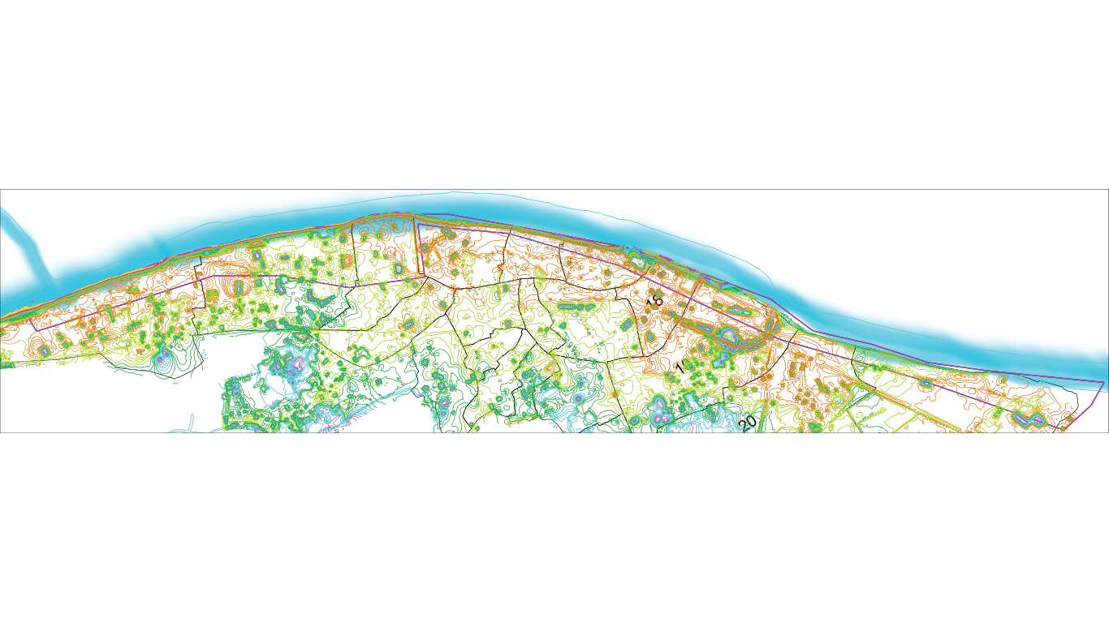
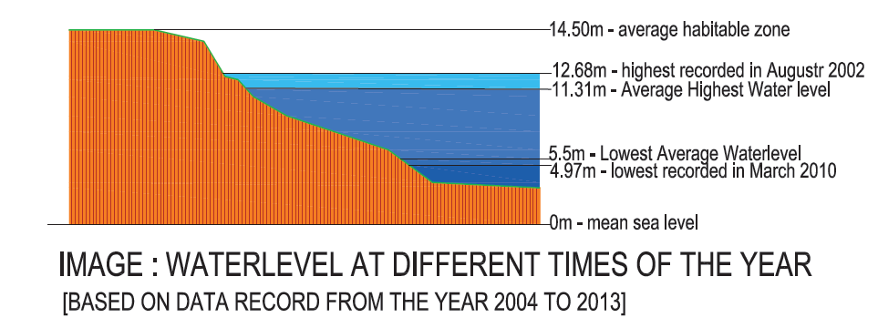
SEWERAGE OUTLET
CONTOUR

Slide 10
INCOMPITABLE LAND USES | REVITALIZATION OF RIVER
ENCROACHMENT | REHABILITATION OF SLUM DWELLERS
UNDER UTILIZATION OF OPEN SPACE | FACILITATE ECONOMIC DEVELOPMENT AND SOCIAL INTEGRATION
INACCESSIBILITY | CONNECTING RIVERFRONT WITH CITY BY WALKWAYS
SLUMS | CREATE CITY LEVEL RECREATIONAL AND GREEN SPACES
HERITAGE AND NATURAL VISTAS | SEWEGAE AND WATER TREATMENT PLANT
KEY ISSUES
MAJOR OBJECTIVES

Slide 11
TYPOLOGY & CLUSTER
CLUSTER
CLUSTER 1
CLUSTER 2
CLUSTER 3
TYPE A1 (FOOD STORAGE)
TYPE B1 (RECREATION)
TYPE C1 (ECONOMIC)
TYPE D1
(DUMPING & DREDGING)
TYPE C2 (ECONOMIC)
TYPE E1 (RELIGIOUS)
TYPE C3 (ECONOMIC)
TYPE E2 (RELIGIOUS)
TYPE C4 (ECONOMIC)
CLUSTER 3
TYPE B2 (RECREATION)
CLUSTER 5
CLUSTER 6
TYPE B3 (RELIGIOUS)
TYPE B3 (RECREATION)

Slide 12
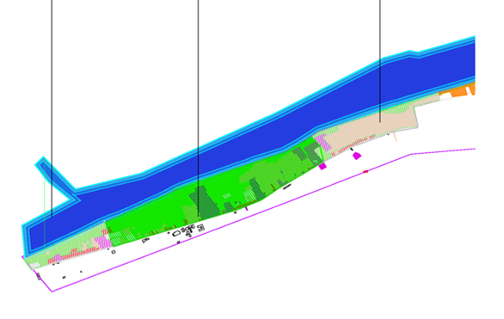
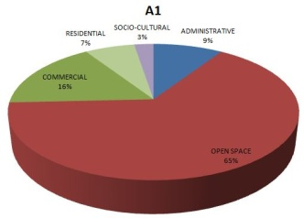
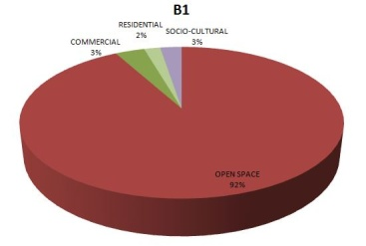
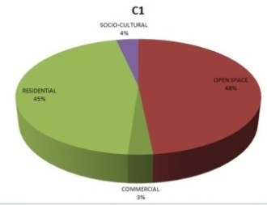
CLUSTER :1
TYPE-A1: FOOD STORAGE
BOUNDARY: BGB CAMP TO TCB OFFICE.
LENGTH:442.9M
AREA:7537 SQ. M
WALKTIME:8.058MINUTES
INFRASTRUCTURE: BGB CAMP,TCBOFFICE,
CENTRAL FOOD DEPOSITORY.
T
TYPE A1: FOOD
STORAGE
TYPE B1: RECREATION
TYPE C1:
ECONOMIC
TYPE-B1: RECREATION
BOUNDARY: AGRI DEV. BOARD TO WATER.DEV.BOARD
LENGTH:1069M
AREA:33194 SQ. M.
WALKTIME:21.38MINUTES
INFRASTRUCTURE: AGRI DEV.BOARD, WATER
DEV BOARD,SILVER CASTLE, RIVE PALACE.
TYPE-C1: ECONOMY
BOUNDARY: WATER DEV BOARD TO POLICE LINES
SCHOOL
LENGTH:1184M
AREA:12793 SQ. M
WALKTIME:13.68 MINUTES
INFRASTRUCTURE: WATER DEV BOARD,POLICELINE
TYPE A1:
FOOD STORAGE
TYPE B1: RECREATION
TYPE C1:
ECONOMIC
PROBLEM: A ZONE WITH LOTS OF OPPORTUNITY, BUT IS BEING UNDERUSED.

Slide 13
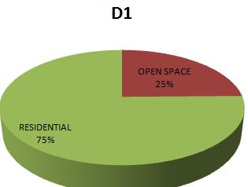
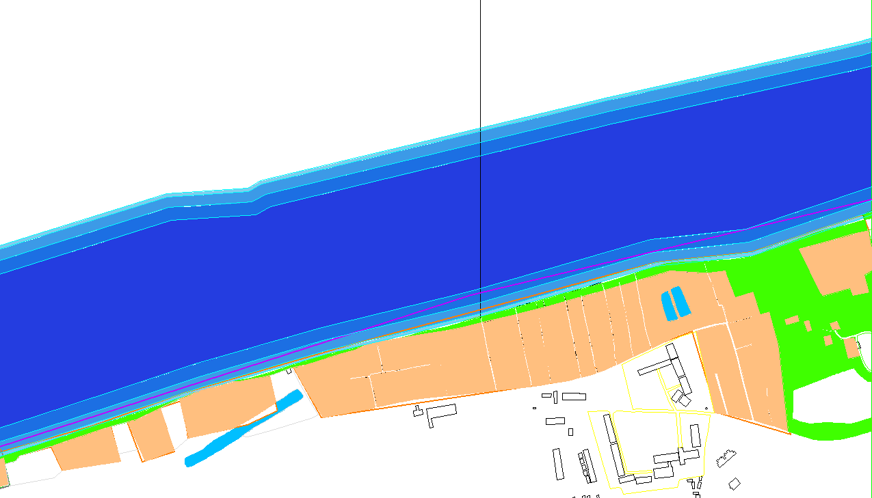
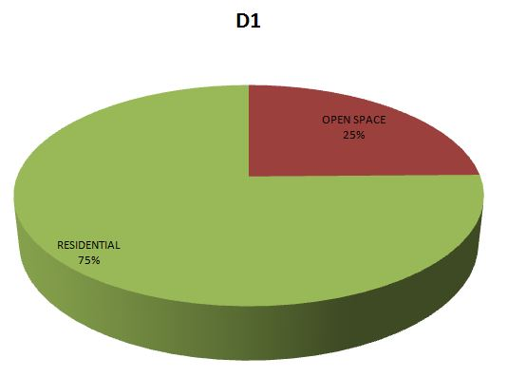
CLUSTER 2
TYPE-D1: DUMPING
BOUNDARY: POLICE LINES TO POLICE LINES SCHOOL
AND COLLEGE
LENGTH:1184M
AREA:15385 SQ. M
WALKTIME:23.68MINUTES
INFRASTRUCTURE: AGRI DEV. BOARD,WATER DEV.
BOARD,SILVER CASTLE,RIVER PALACE
TYPE D1: DUMPING
PROBLEMS:
HIGHLY POLLUTED ZONE, USED FOR DUMPING WASTES FORM POLICE LINE AND ALSO UNTREATED SEWER WASTES. BESIDES DREDGING CREATES PITS UNDER WATER WHICH IS FATAL FOR LOCAL PEOPLE. LARGE NUMBER OF SLUM

Slide 14
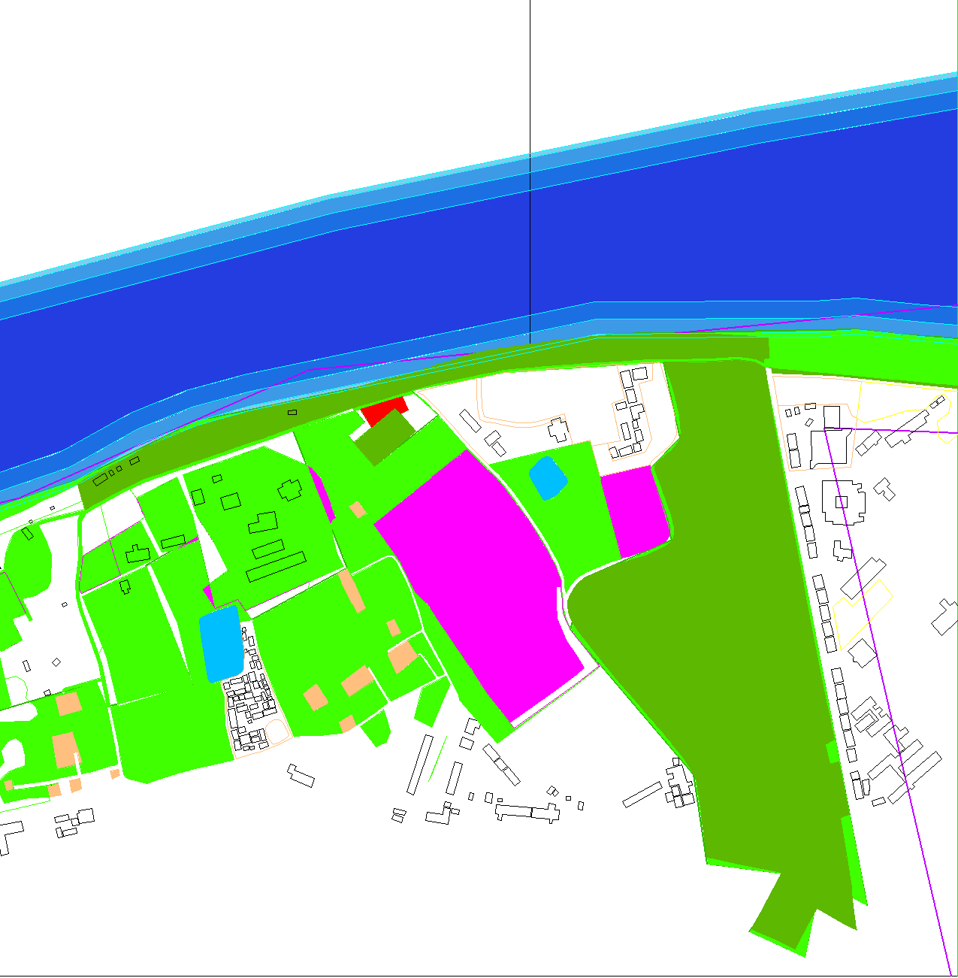
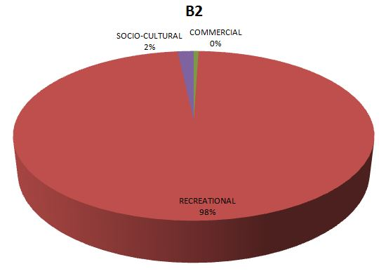
CLUSTER 3
TYPE B2: RECREATION
TYPE-B2: RECREATION
BOUNDARY: J.A SANGRAHASHALA TO
HIMUR ADDA RESTAURANT
LENGTH:1986M
AREA:29068 SQ. M.
WALKTIME:39.72MINUTES
PROBLEMS:
THOUGH MAJOR RECREATIONAL ZONE, INSUFFICIENT WITH RESPECT TO THE NUMBER OF POPULATION. MIGHT BE CONSIDERED UNDERUSED WITH RESPECT TO THE OPPORTUNITY IT OFFERS.

Slide 15
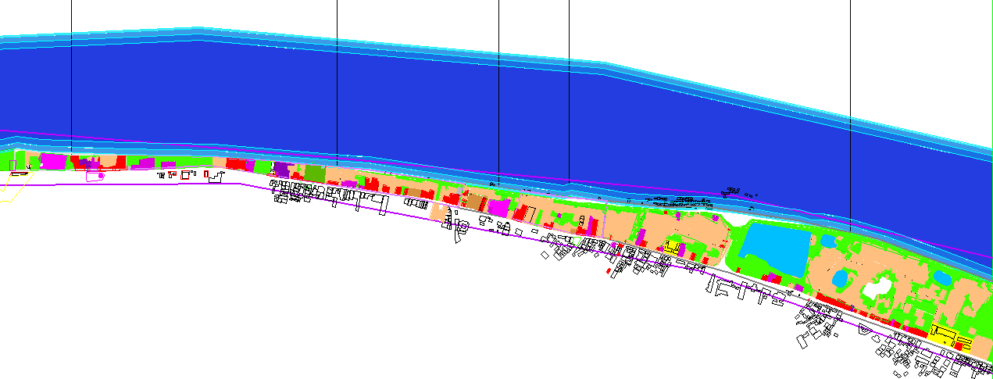
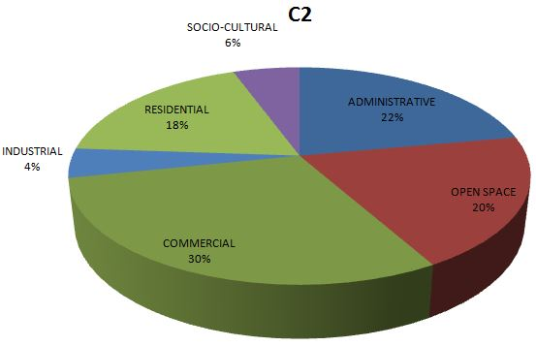
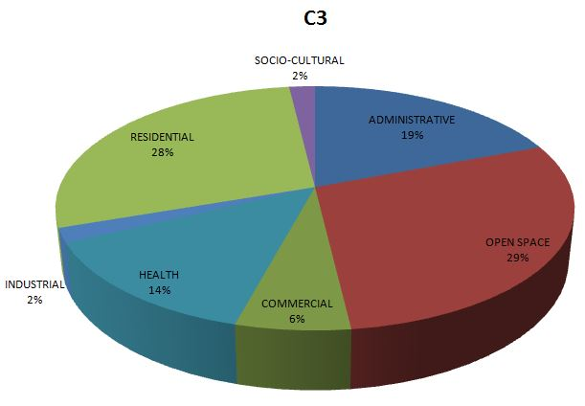
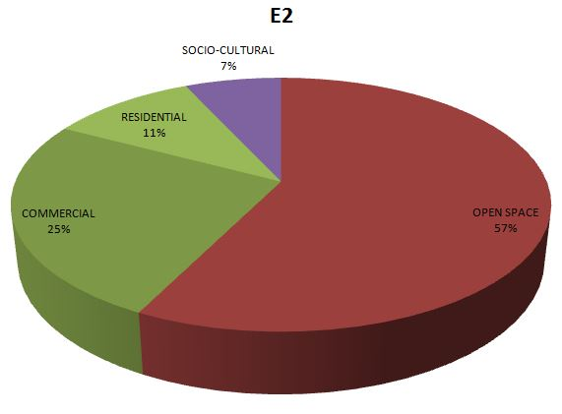
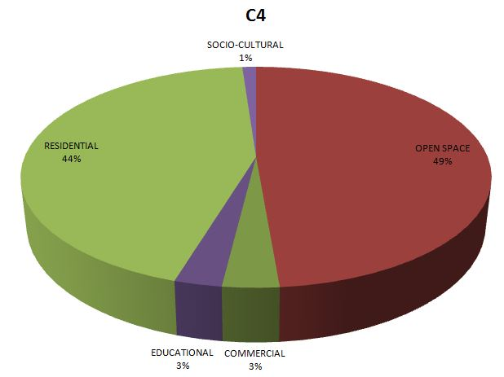
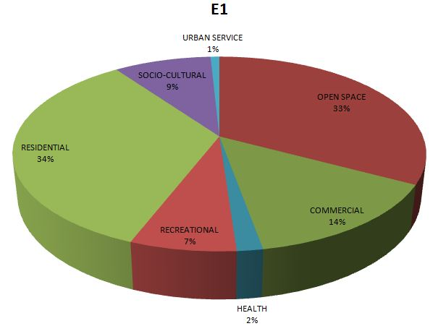
CLUSTER 4
TYPE C2:
ECONOMIC
TYPE E1:
RELIGIOUS
TYPE C3:
ECONOMIC
TYPE E2:
RELIGIOUS
TYPE C4:
ECONOMIC
TYPE C2: ECONOMIC
TYPE E1: RELIGIOUS
TYPE C3: ECONOMIC
TYPE E2: RELIGIOUS
TYPE C4: ECONOMIC

Slide 16
CLUSTER 4
TYPE-C2: ECONOMY
BOUNDARY: LOCAL SERVER STATION TO MYMENSINGH 0 POINT
LENGTH:268M
AREA:2046 SQ. M
WALKTIME:5.6MINUTES
INFRASTRUCTURE: KACHARI, LOCAL SERVER STATION
TYPE-E2: RELIGIOUS
BOUNDARY: TRAFFIC OFFICE TO BORO KALIBARI
LENGTH:255M
AREA: 3214 SQ. M
WALKTIME: 5.1MINUTES
INFRASTRUCTURE: BORO KALIBARI, LOKNATH
TEMPLE, BISWANATH TEMPLE
TYPE-E1: RECREATION
BOUNDARY: MAZAR TO SHIV TEMPLE
LENGTH:753M
AREA:5883 SQ. M.
WALKTIME:15.06MINUTES
INFRASTRUCTURE: MAZAR, MATH, ASRAM,
TYPE-C4: ECONOMY
BOUNDARY: BORO KALIBARI TO PATGUDAM NODE
LENGTH:1080M
AREA:33272 SQ. M.
WALKTIME:21.60MINUTES
INFRASTRUCTURE: HAJI HASHEM ALI COLLEGE,
BAHAI SCHOOL AND LIBRARY, SURYAKANTA
MALARIA RESEARCH INSTITUTE
TYPE-C3: ECONOMY
BOUNDARY: KOTOALI THANA TO TRAFFIC OFFICE
LENGTH:174
AREA:1712
WALKTIME:3.48
INFRASTRUCTURE: KOTOALI THANA, TRAFFIC OFFICE
POURASAVA MARKET

Slide 17
PROBLEMS:
COMMUNICATION WITH CHAR, BUT NOT SUFFICIENTLY DEVELOPED AS TRANSPORTATION POINT.
THE RELIGIOUSLY IMPORTANT GHATS ARE LOSING THEIR IDENTITY DUE TO ILLEGAL ENCROACHMENT.
SLUMS ON THE DAM ARE CAUSING THREAT THAT MIGHT POLLUTE THE RIVER.
A ZONE OF CONFLICTION-SAND TRANSPORTATION AND FOOD TRANSPORTATION
RELIGIOUSLY AND HISTORICALLY IMPORTANT GHATS WHICH HAS SLUMS

Slide 18
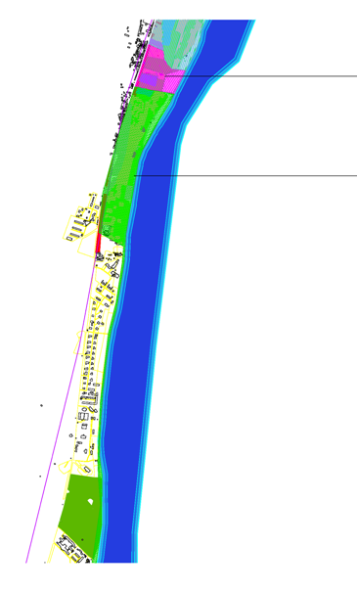
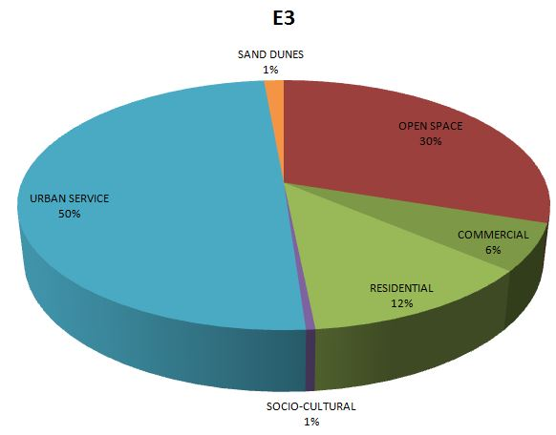
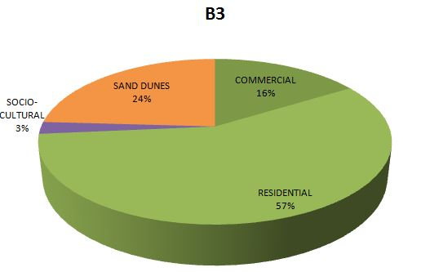
CLUSTER :6
TYPE E3 : RELIGIOUS
TYPE B3: RECREATION
TYPE-E3: RELIGIOUS
BOUNDARY: SHOSHAN – RAILWWAY BRIDGE
LENGTH:389M
AREA:7537 8066SQ. M
WALKTIME:7.78MINUTES
INFRASTRUCTURE: CREMATORY, EIDGAH, RAIL BRIDGE
TYPE-B3: RECREATION
BOUNDARY: RAILWAY STAFF QUARTER TO BOTANICAL GARDEN
LENGTH:2474M
AREA:30947SQ. M.
WALKTIME:49.48MINUTES
INFRASTRUCTURE: BAU, BOTANICAL GARDEN, RAILWAY STAFF
QUARTER.
TYPE E3 : RELIGIOUS
PROBLEMS:
A ZONE WITH LOTS OF OPPORTUNITY, BUT IS BEING
UNDERUSED.
TYPE B3: RECREATION

Slide 19
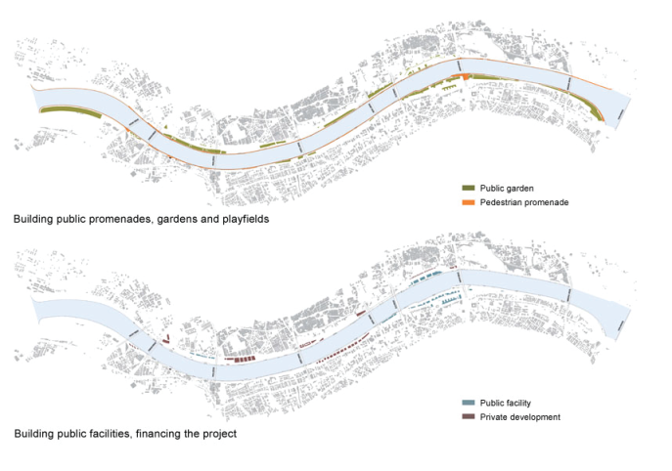
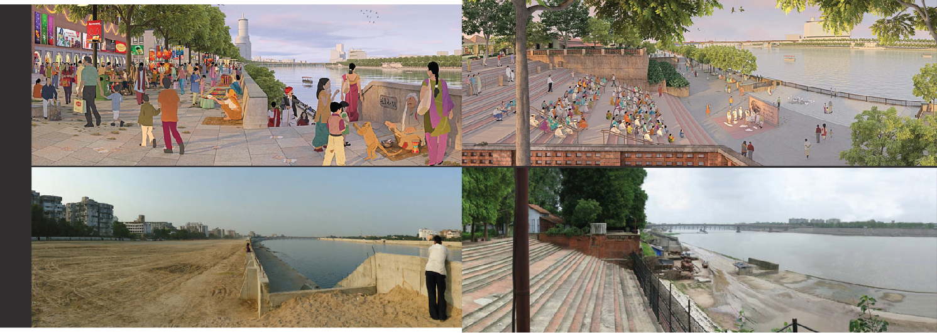
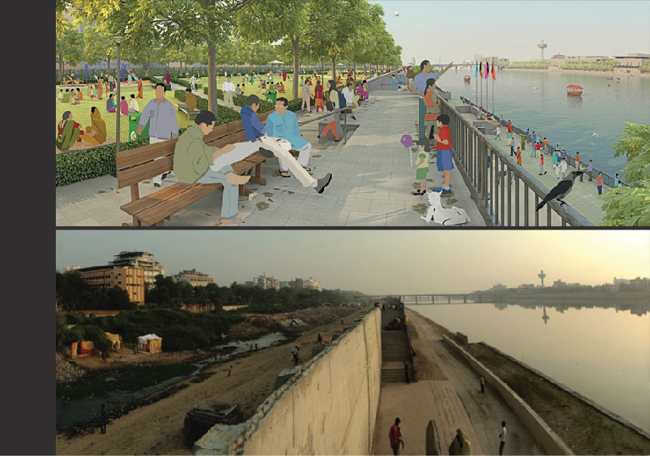
CASE STUDY 1: SABARMATI RIVERFRONT DEVELOPMENT PROJECT
- AHMEDABAD, 1997 - ONGOING
- APPROXIMATELY 200 HECTARES OF LAND FROM THE RIVERBED
- RETAINING WALLS HAVE BEEN BUILT
- SEWAGE INTERCEPTOR LINES WITH NEW PUMPING STATIONS HAVE BEEN CONSTRUCTED
- SLUM DWELLERS WILL BE RELOCATED WITH ‘PUCCA’ HOUSING
- 11.5 KM LONG PEDESTRIAN ALONG THE RIVER SIDE
- PUBLIC FACILITIES TO BE BUILT : CULTURAL CENTERS, MUSEUMS, SPORTS FACILITIES, TRADE FAIR GROUNDS AND OPEN AIR MARKETS
-A SMALL PORTION OF THE RECLAIMED LAND WILL BE SOLD FOR COMMERCIAL DEVELOPMENT

Slide 20
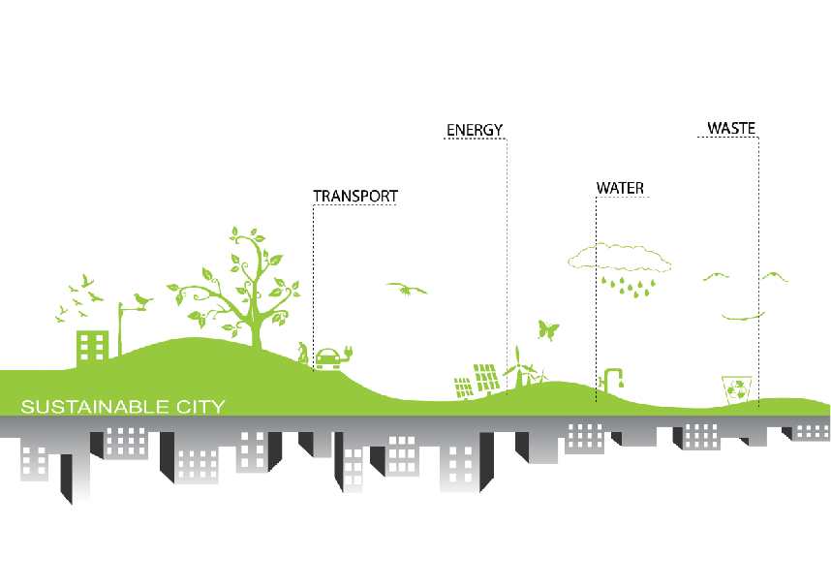
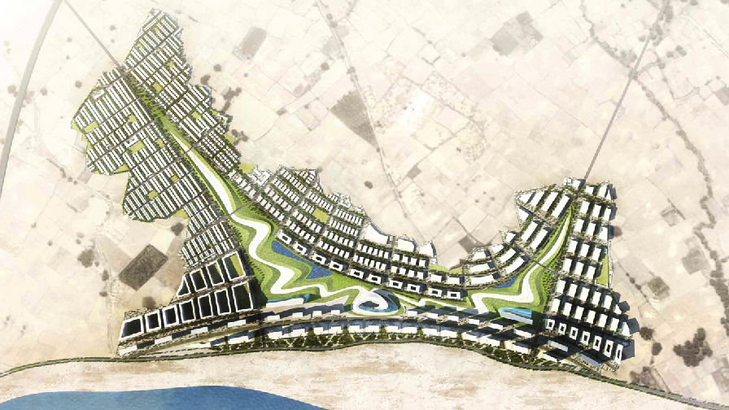
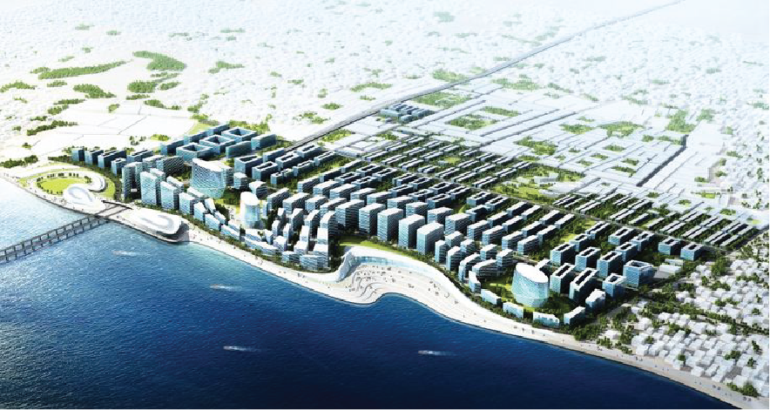
CASE STUDY 2 TRANS GANGA RIVERFRONT DEVELOPMENT
-SPREAD ACROSS 1156 ACRES,
-SUSTAINABLE CITY DESIGN WITH TWO LEVELS
-FIRSTLY AT THE DESIGN LEVEL ELEMENTS REQUIRED TO MAKE A CITY SUS TAINABLE HAVE BEEN GRAFTED IN THE MASTER PLAN
-SECONDARY AT THE IMPLEMENTATION STAGE GREEN ROOF, EARTH COOLING, SOLAR PANELS, GROUND WATER RECHARGE, WASTE MANAGEMENT HAVE BEEN PROPOSED
LAND USE: COMMERCIAL, INDUSTRIAL, MIXED USE, RESIDENTIAL AND PUBLIC AMENITIES.

Slide 21
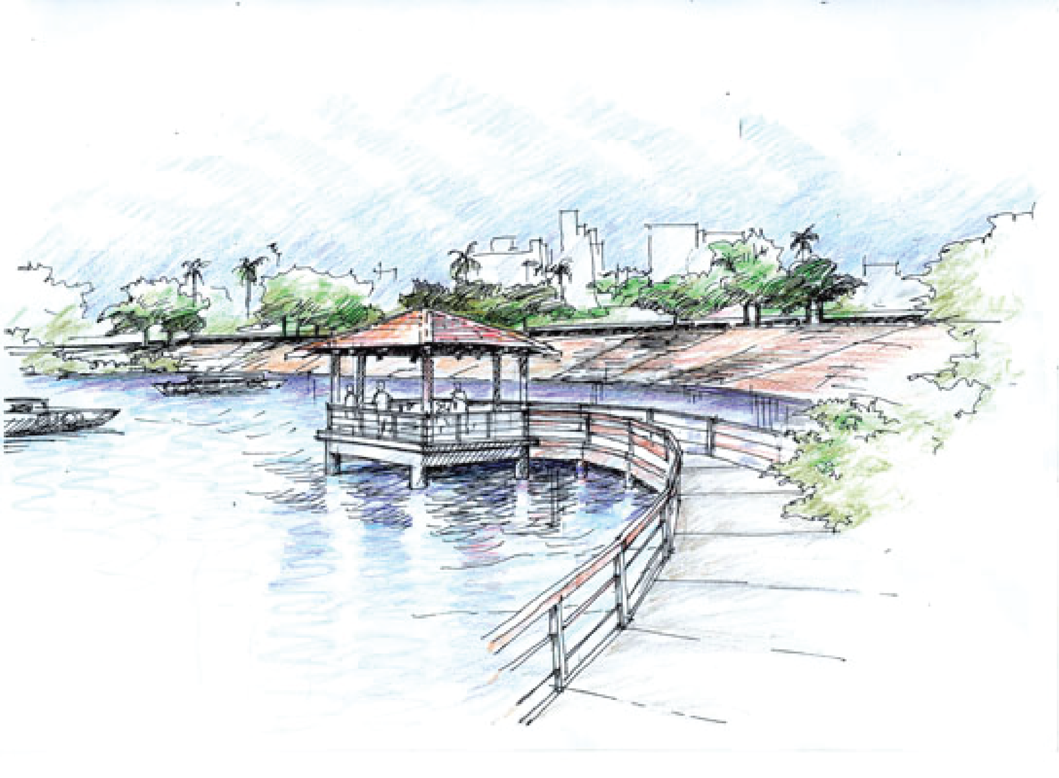
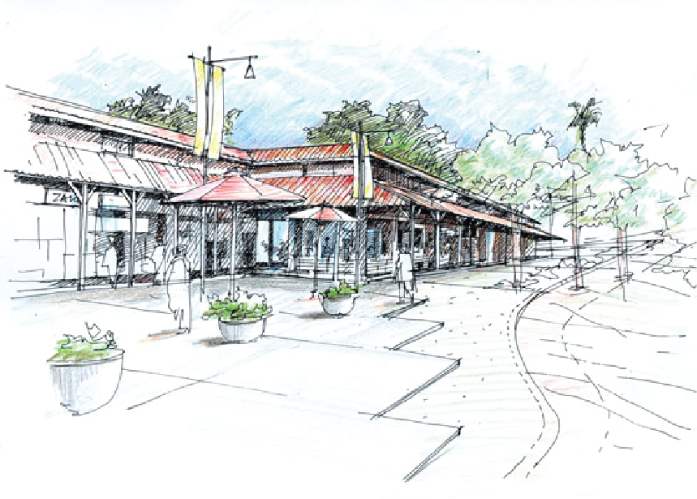
CASE STUDY 3 BRAHMAPUTRA RIVERFRONT DEVELOPMENT GUWAHATI, ASSAM (ONGOING)
LENGTH: 20 KM
- PLAN OF THE FIRST PHASE IS OVER A 7KM LENGTH
-CONTINUITY AND ACCESS ALONG THE RIVER
-LINKAGES FROM THE CITY TO THE RIVERFRONT
-RESTRUCTURING LAND USE,
-DEVELOPMENT OF CULTURAL PRECINCT
-REVITALISATION OF THE RIVER ECOLOGY, RIVERSIDE PROMENADE, GHATS, PLAZAS AND PARKS, ART GALLERY, CONSERVATORY, CONFERENCE FACILITIES AND YOUTH CENTRE, LOCAL PRODUCE MARKETS, LIGHTING, STREET FURNITURE & PUBLIC ART, HERITAGE MANAGEMENT & CONSERVATION

Slide 22
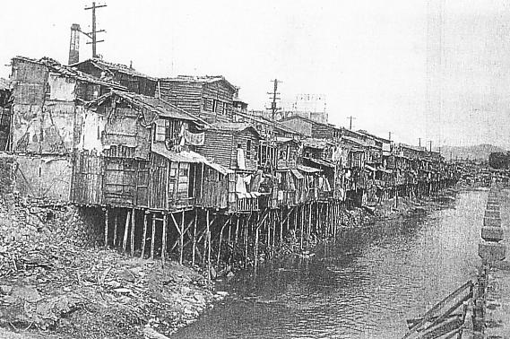
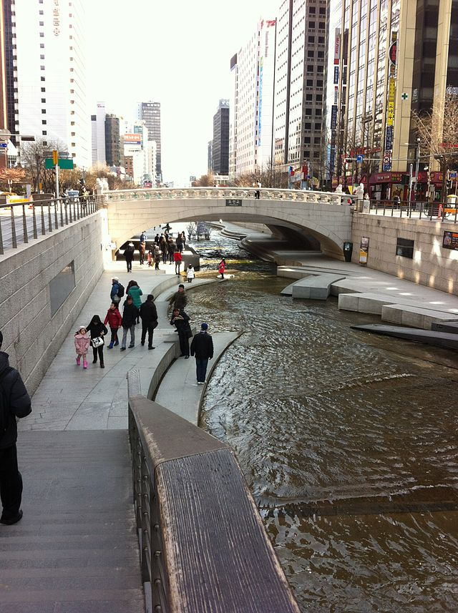
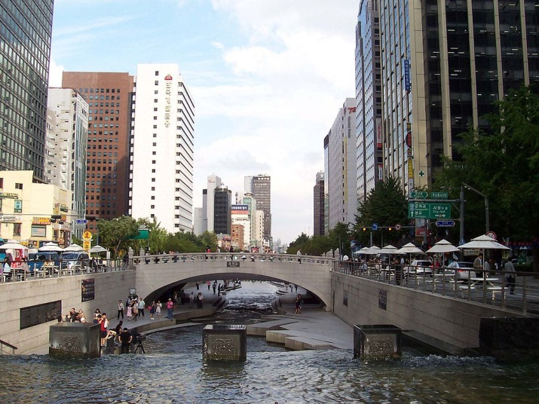
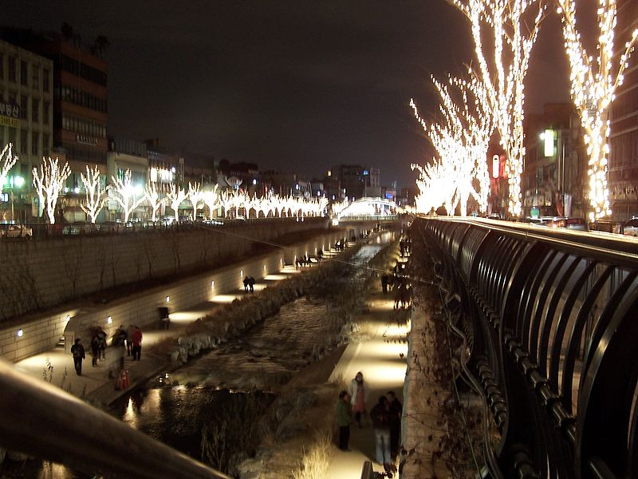
THE CHEONGGYECHEON RIVER RESTORATION PROJECT, SEOUL, SOUTH KOREA
CASE STUDY 4
-OPENED TO THE PUBLIC IN SEPTEMBER 2005
-CREATING THE ENVIRONMENT WITH CLEAN WATER AND NATURAL HABITATS WAS THE MOST SIGNIFICANT ACHIEVEMENT OF THE PROJECT.
-BUSINESS AND INDUSTRIAL AREA CENTERED ON THE STREAM.
-THE PROJECT RESULTED IN A SPEEDING-UP IN TRAFFIC AROUND THE CITY WHEN THE MOTORWAY WAS REMOVED.
-THE PROJECT ATTEMPTED TO PROMOTE THE URBAN ECONOMY THROUGH AMPLIFYING URBAN INFRASTRUCTURE FOR A COMPETITIVE CITY WITHIN THE EXISTING BUSINESS AND INDUSTRIAL AREA CENTERED ON THE STREAM.

Slide 23
LEARNING FROM CASE STUDY
RIVERFRONT QUALITIES | TO CREATE GREAT WATERFRONTS
ACCESS LINKAGE EDGE USES ATRACTION AND DESTINATIONS IDENTITY AND IMAGE AMENITIES WATER USES FLEXIBILITY IN DESIGN SEASONAL STRATEGY LANDUSE MANAGEMENT DIVERSE FUNDING SOURCES | MAKE PUBLIC GOALS AS PRIMARY OBJECTIVES CREATE MULTIPLE DESTINATIONS CONNECT THE DESTINATIONS ENCOURAGE 24HR ACTIVITY OPTIMIZE PUBLIC ACCESS SUPPORT MULTIPLE MODES OF TRANSPORTATION INTEGRATE SEASONAL ACTIVITIES INTO EACH DESTINATION MAKE ICONIC BUILDINGS SERVE, AS MULTIPLE FUNCTIONS USE PARKS TO CONNECT DESTINATIONS

Slide 24
PROPOSAL (RIVER FRONT)
GREEN BELT

Slide 25
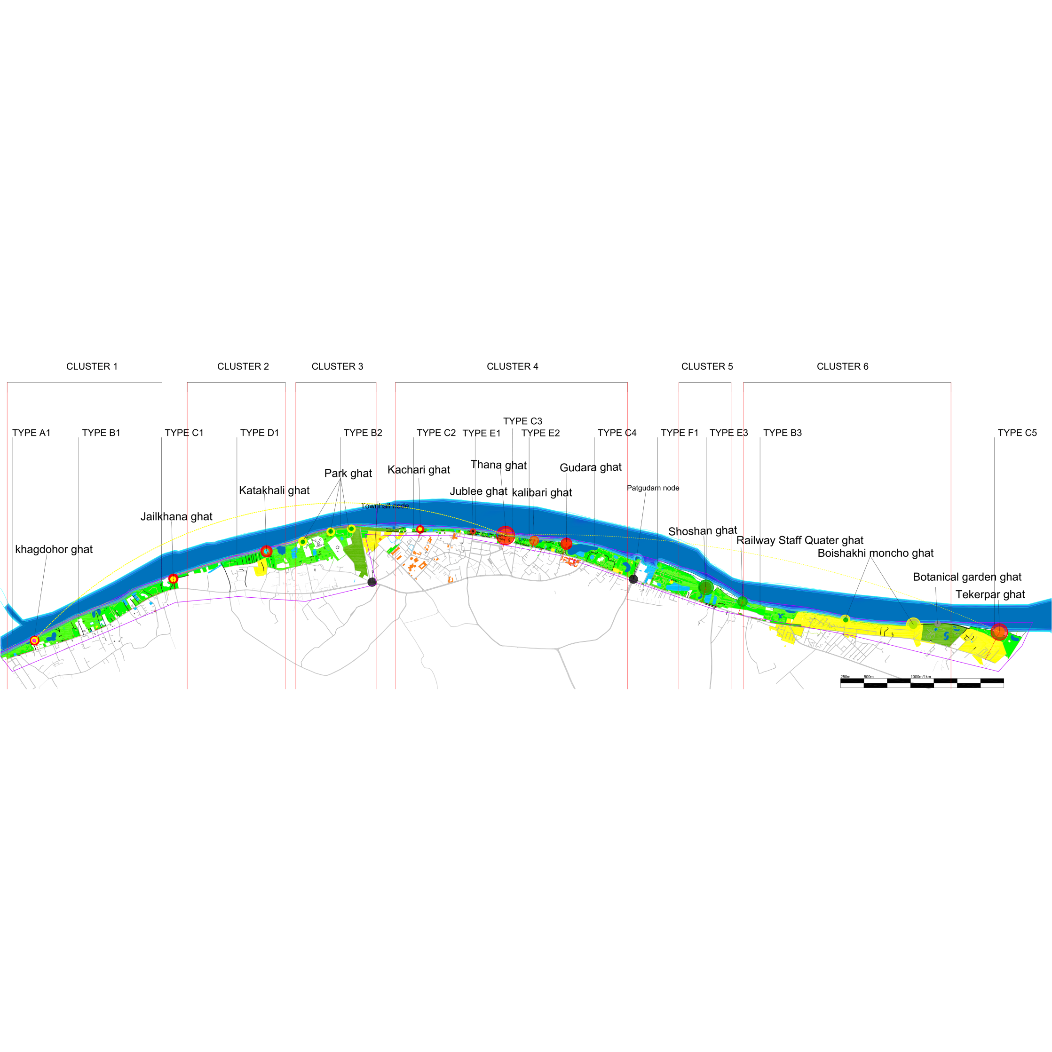
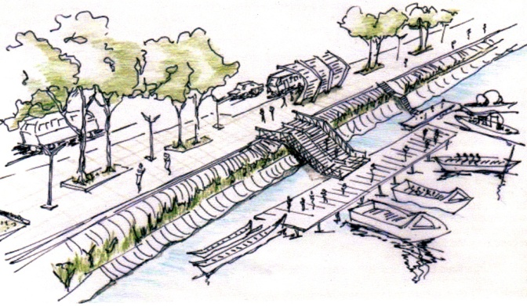
PROPOSAL (MASTER PLAN)
CREATING POCKET
- FOR PROPER DRAINAGE OF FLOOD WATER
- FOR CONNECTING RIVER WATER CLOSE TO ROAD
CONNECTING THE GHATS DIRECTLY WITH ROAD
- CREATING VISTA
- MAKING DIRECT LINK WITH THE HERITAGE
- CONNECTING MAJOR INFRASTRUCTURE WITH THE RIVER
- SKYLINE
CONNECTING THE WHOLE RIVERFRONT VIA
- A PEDESTRIAN WALKROUTE
BI-CYCLE ROUTE
- WATER TAXI ROUTE

Slide 26
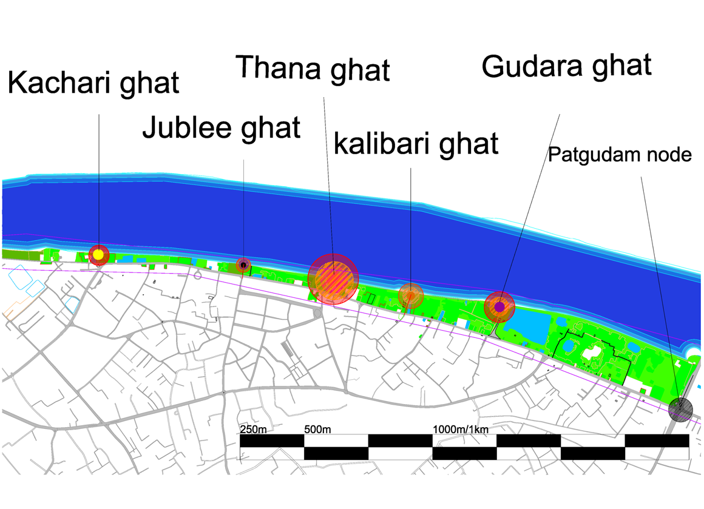
PROPOSAL (CLUSTER 4)
KACHARI GHAT TO PATGUDAM MOR
GREEN BELT

Slide 27
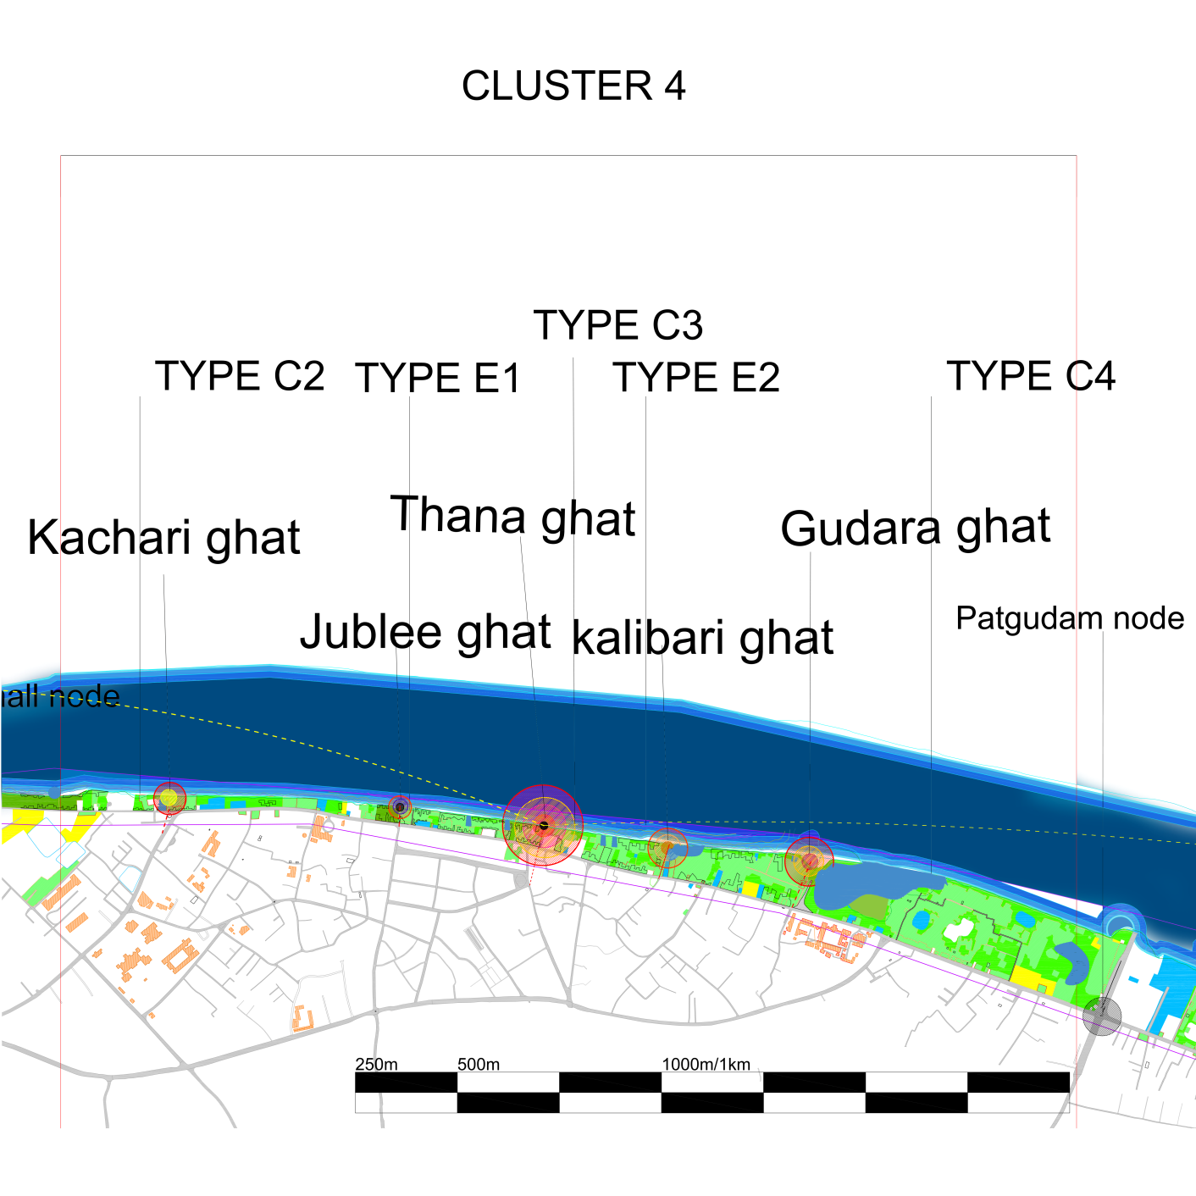
PROPOSAL (CLUSTER 4)

Slide 28
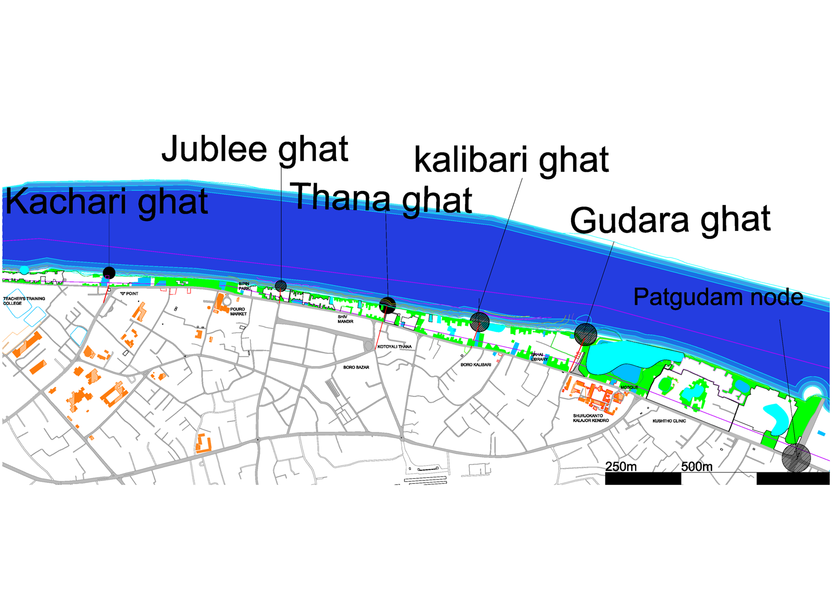
PROPOSAL (CLUSTER 4)
URBAN SOLID –VOID RELATION

Slide 29
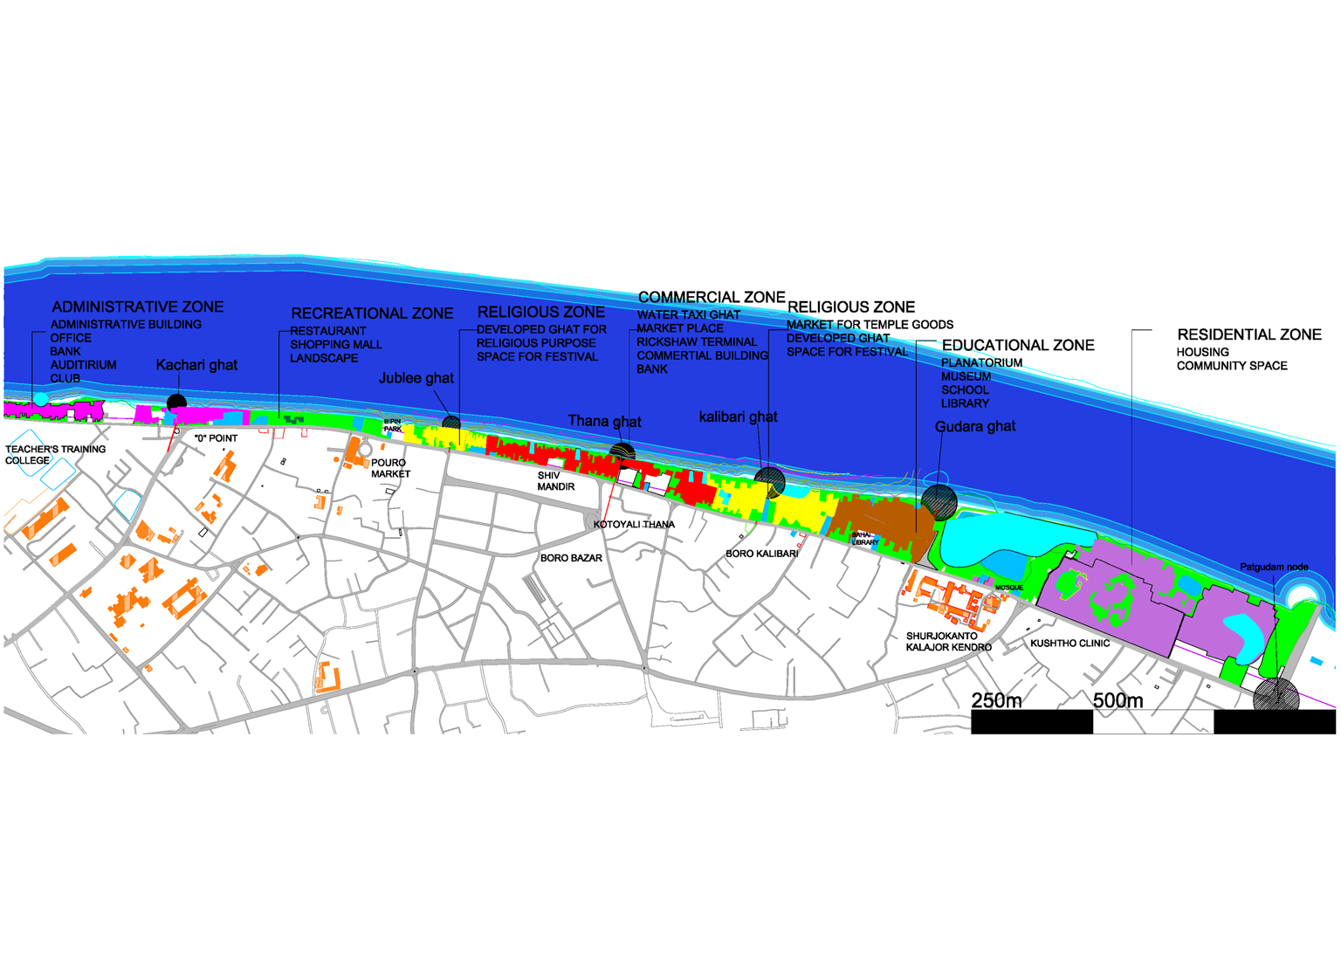
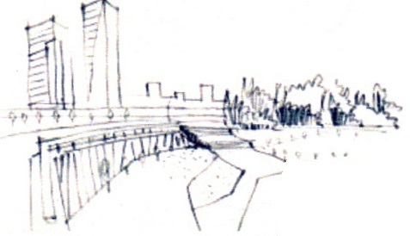
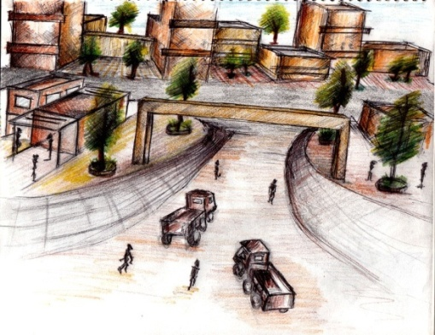
PROPOSAL (CLUSTER 4)
PROPOSALS

