Slide 1
OPEN SPACE ADAPTATION IN DISASTER MANAGEMENT :DESIGNING RECREATIONAL FACILITIES AND OPEN SPACES IN MYMENSINGH CITY AND THEIR POSSIBLE UTILIZATION IN DISASTER MANAGEMENT PROGRAM
PROJECT 08

Slide 2
OPEN SPACE ADAPTATION IN DISASTER MANAGEMENT :DESIGNING RECREATIONAL FACILITIES AND OPEN SPACES IN MYMENSINGH CITY AND THEIR POSSIBLE UTILIZATION IN DISASTER MANAGEMENT PROGRAM

Slide 3
OPEN SPACE ADAPTATION IN DISASTER MANAGEMENT :DESIGNING RECREATIONAL FACILITIES AND OPEN SPACES IN MYMENSINGH CITY AND THEIR POSSIBLE UTILIZATION IN DISASTER MANAGEMENT PROGRAM

Slide 4
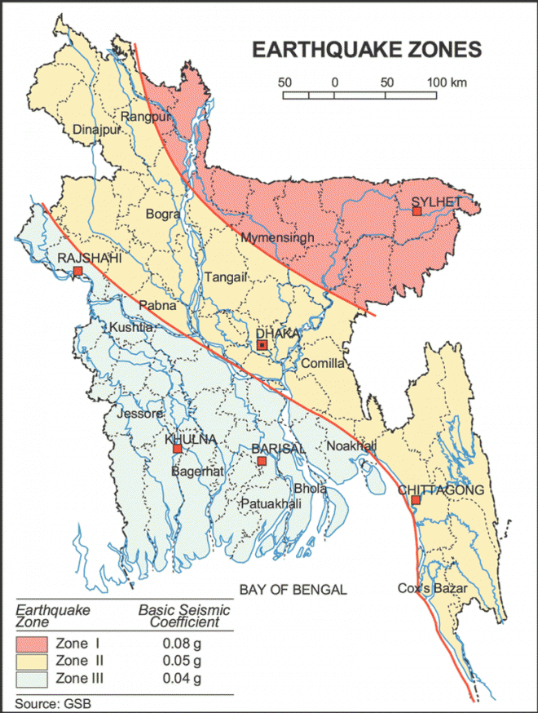
Mymensingh lies in one of the most earthquake-prone areas of Bangladesh. The town that completely destroyed during the Great Indian Earthquake of 12 June 1897, for which the surface wave magnitude was 8.7 .
Earthquake History of Mymensingh

Slide 5
Open spaces in urban areas primarily serve as breathing
space for the citizen. Necessity of urban open space for
recreational facilities are universally agreed. Alongside
various recreational and social use of open spaces, their
importance in the disaster preparedness is increasingly
being recognized. Open spaces are required to provide
emergency and basic services on the aftermath of disasters.
Emergency Shelter
Providing supporting services
Temporary hospitals
Supply relief materials
Operate and manage rescue and relief functions

Slide 6
Case Study: Rana Plaza
Rana Plaza Story With Enam Medical College & Adhar Chandra School

Slide 7
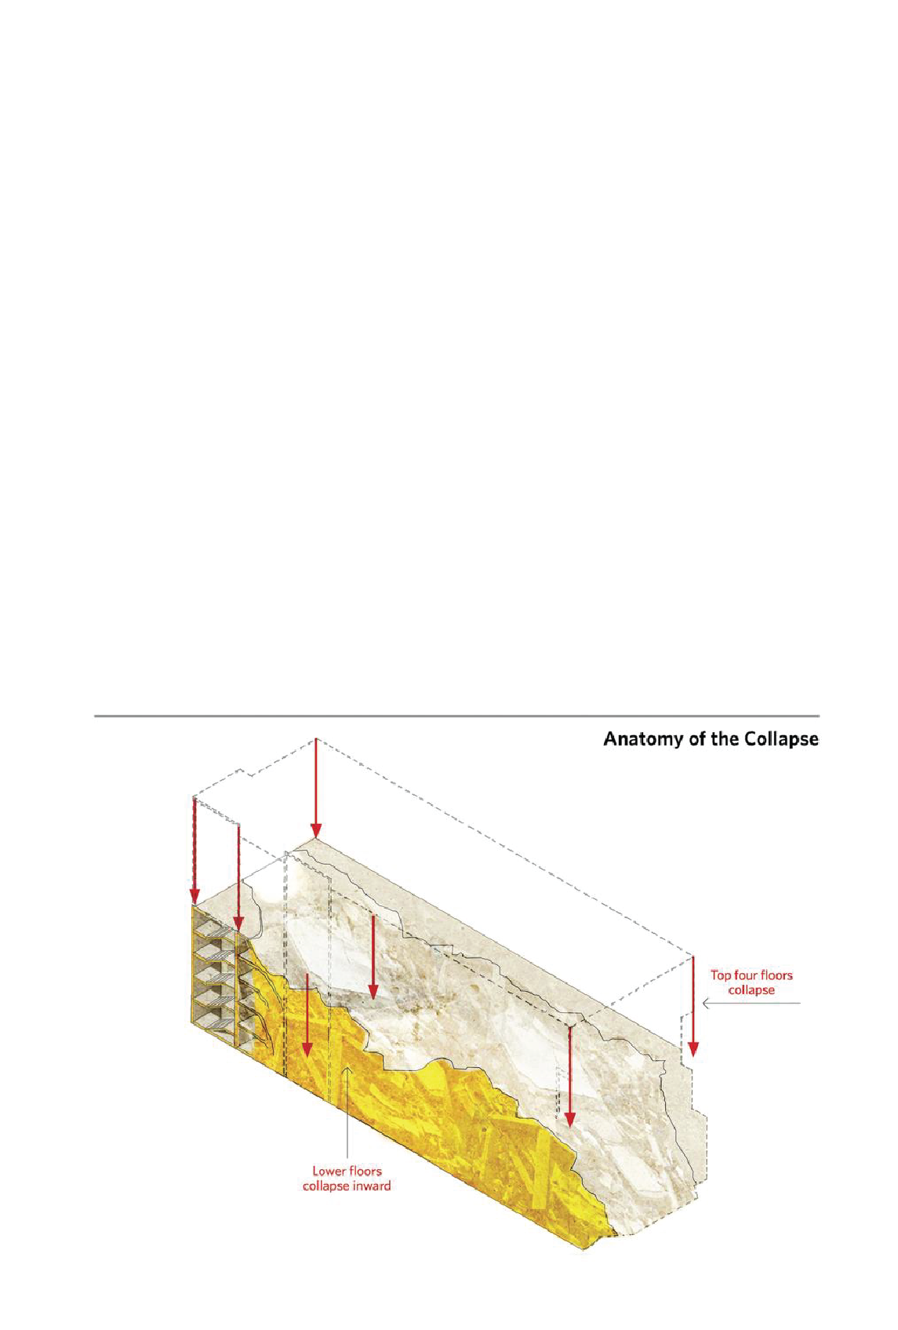
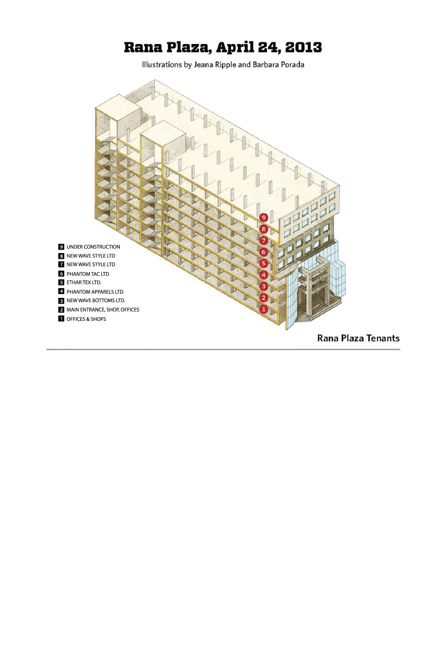

Slide 8
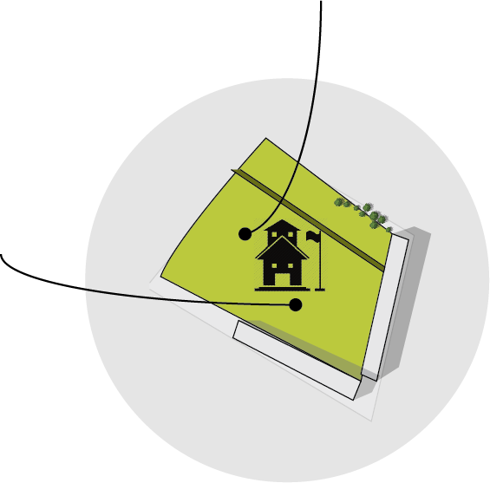
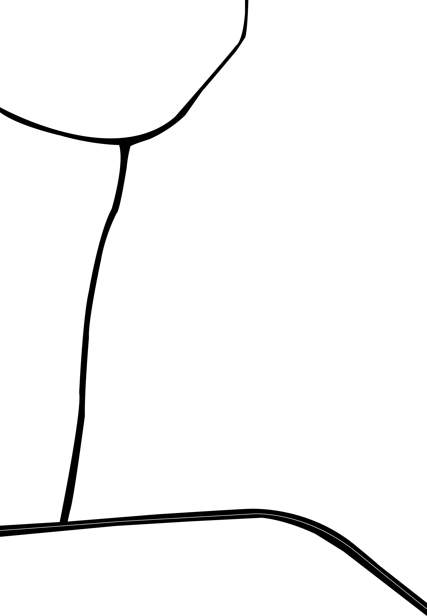
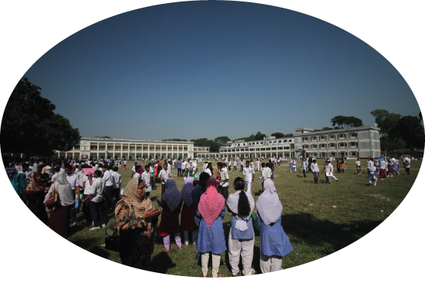
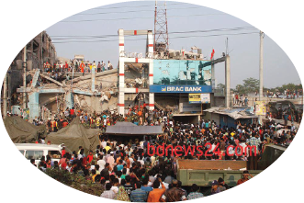
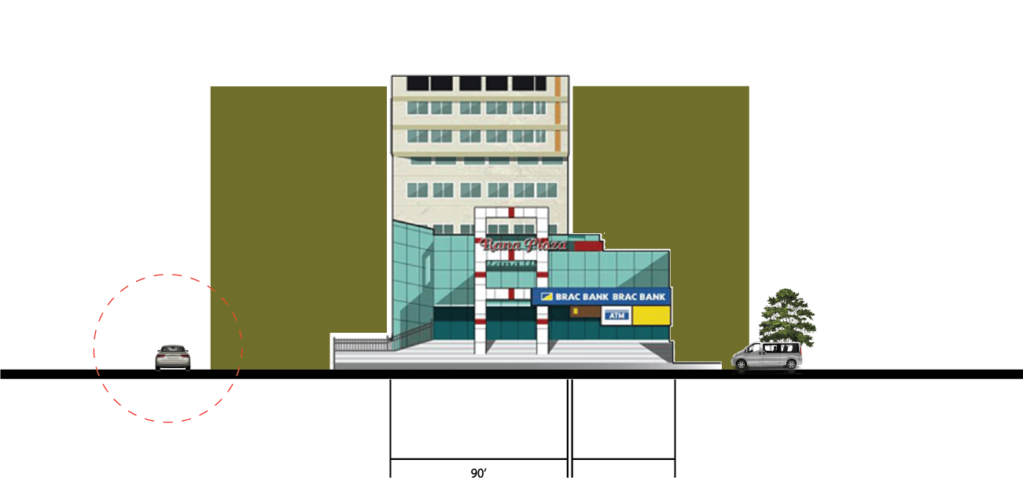
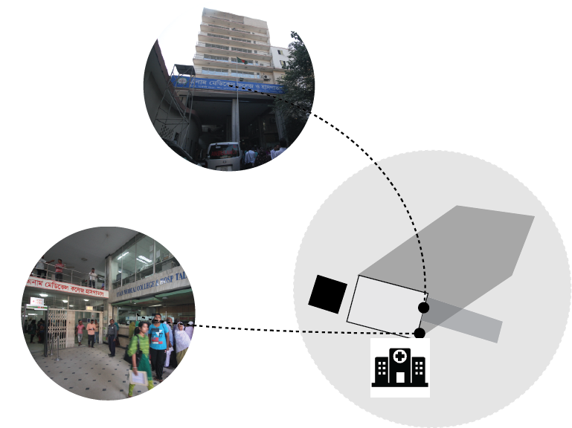
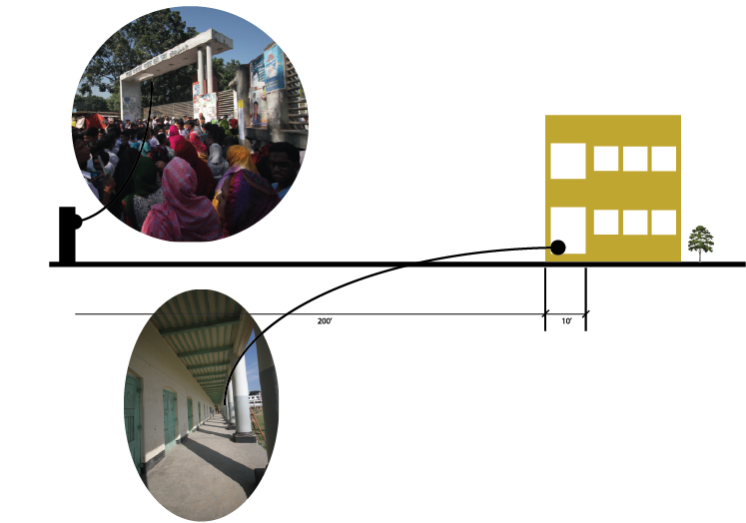
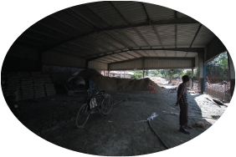
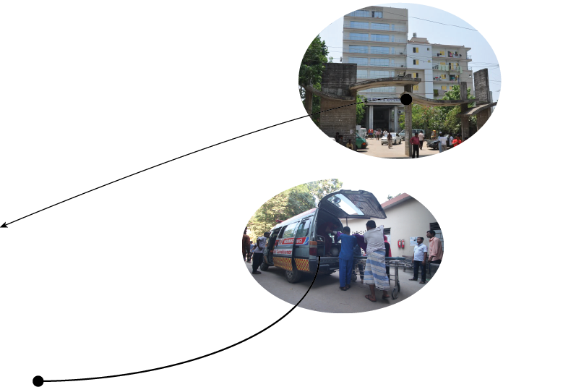
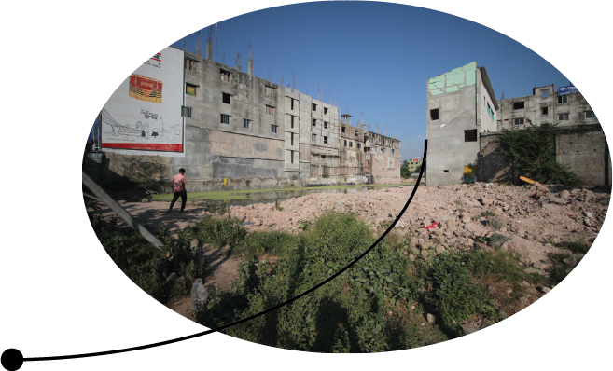
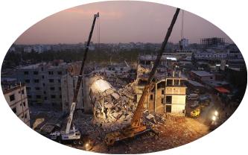
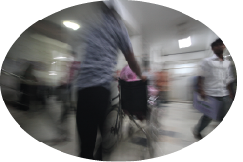
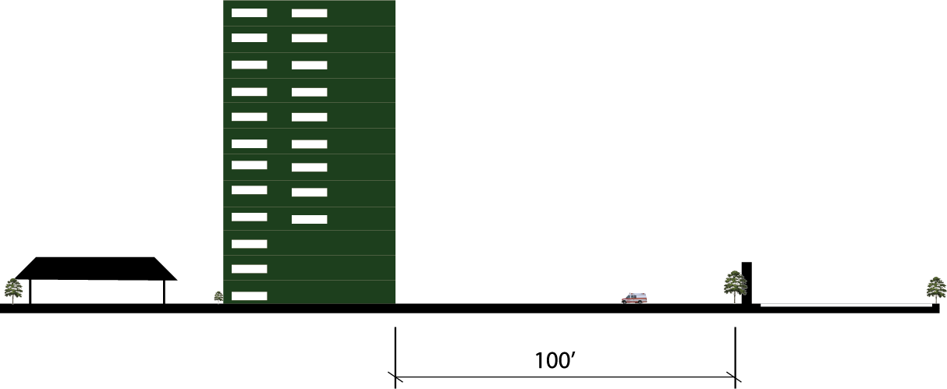
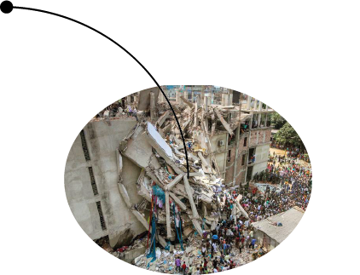

Slide 9
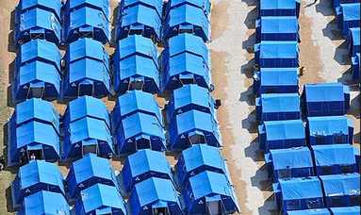
International Case Study : Kobe Earthquake 1995
DESTRUCTION
FIRE
SHELTER

Slide 10
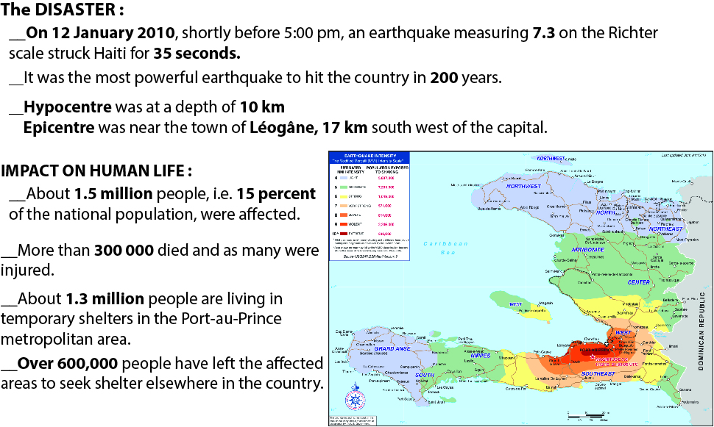
International Case Study : Haiti 2010

Slide 11
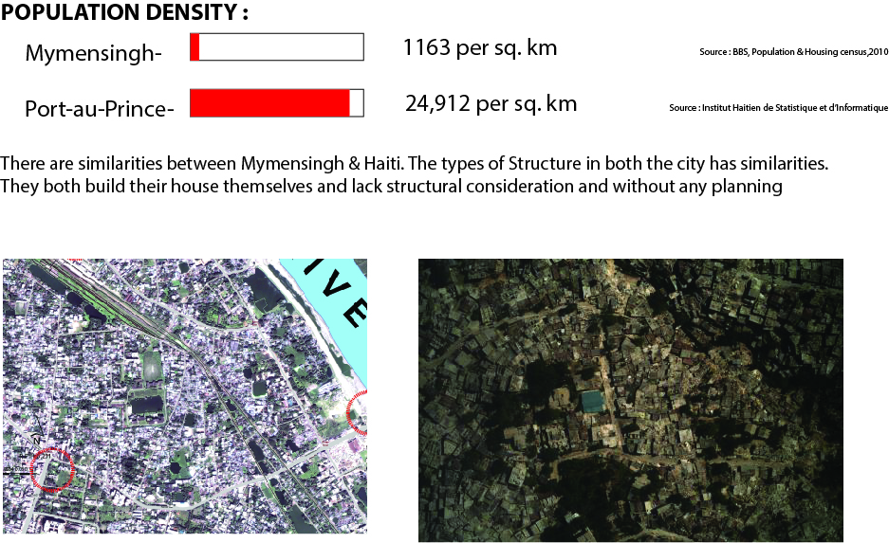

Slide 15
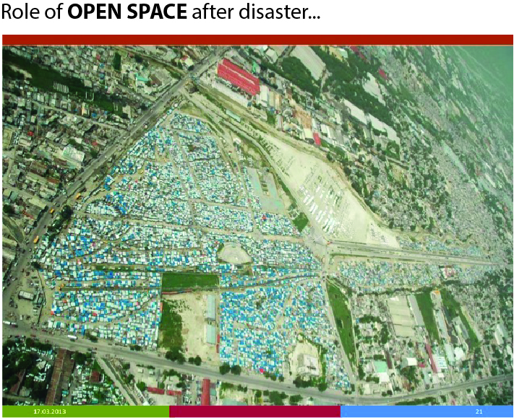
SHELTER CAMPS

Slide 16
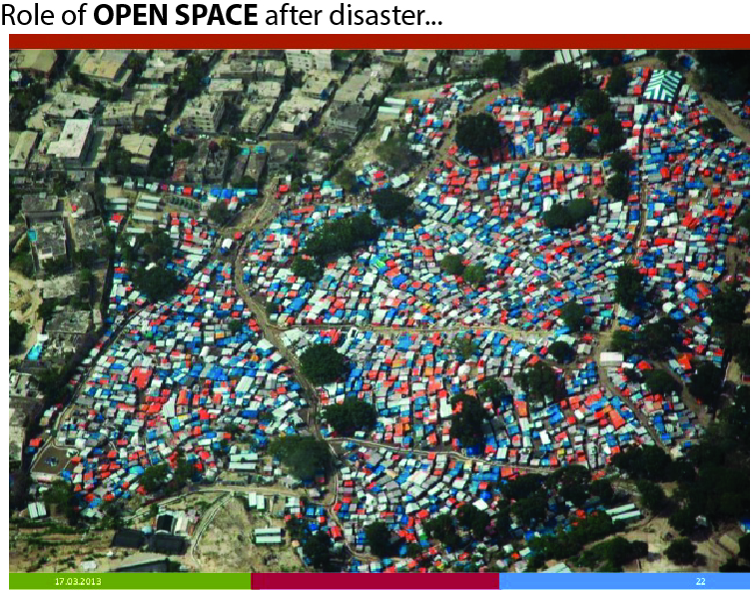
SHELTER CAMPS

Slide 17
Road Network
Open Spaces
Urban Facilities
Water
HOSPITAL
SCHOOL
DESIGN PERIMETERS

Slide 18
ROAD NETWORK
Existing city road network
Catagorizing roads acording to it’s width
Usable standard road networks
For mymensingh city
Excluding roads under 3 meter
Identifying evacuation routes
Locating highrises

Slide 19
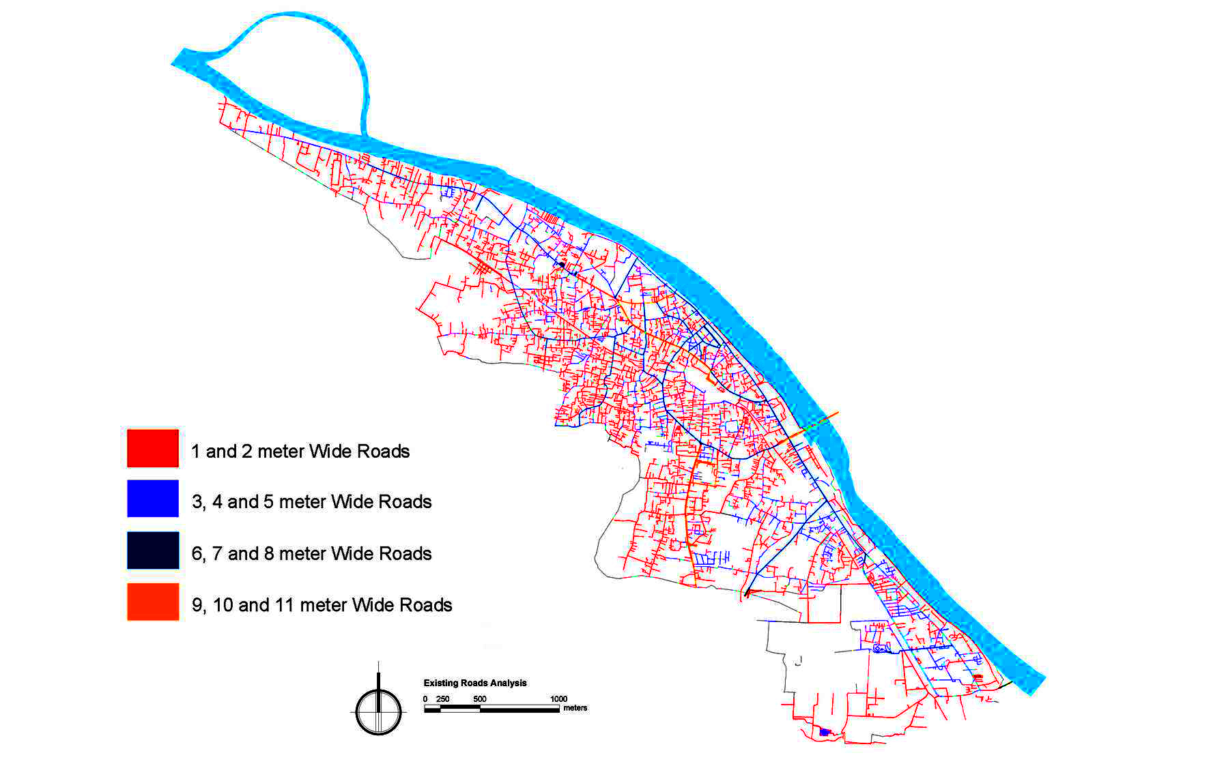
EXISTING ROAD ANALYSIS

Slide 20
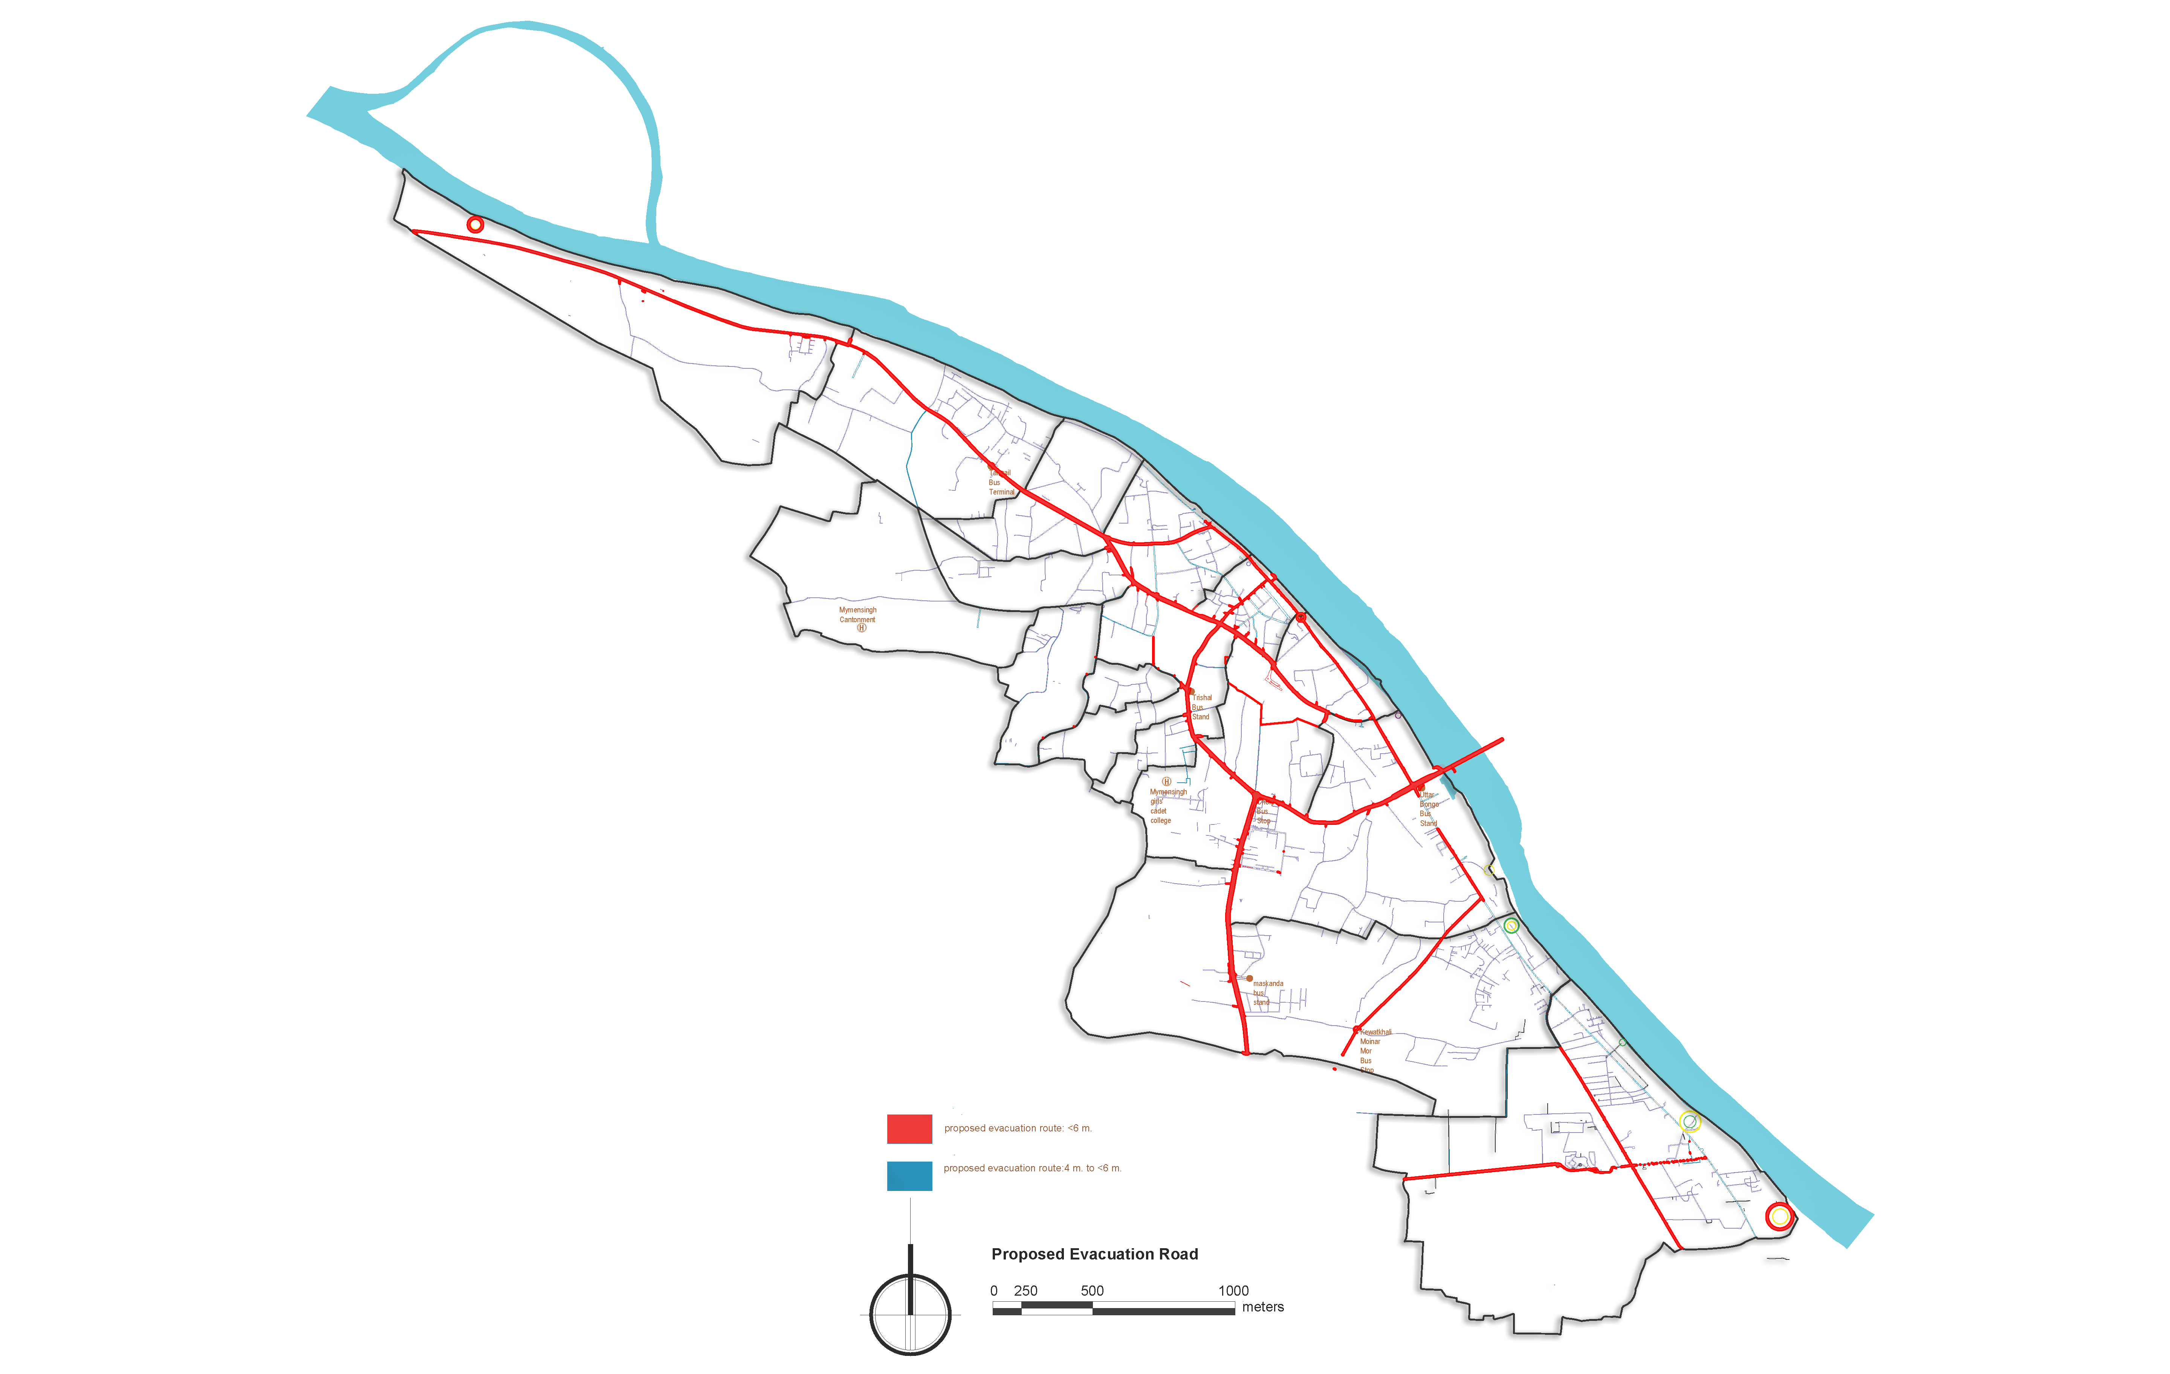

Slide 21
OPEN SPACES
Existing Open Spaces
Joining Open spaces considering one&two story buildings
Super imposing Usable open spaces with imp. Schools
&
Catchment
Usable & non-usable open spaces
Identifying existing schools
Identifying imp. schools

Slide 22
EXISTING OPEN/GREEN SPACES

Slide 23
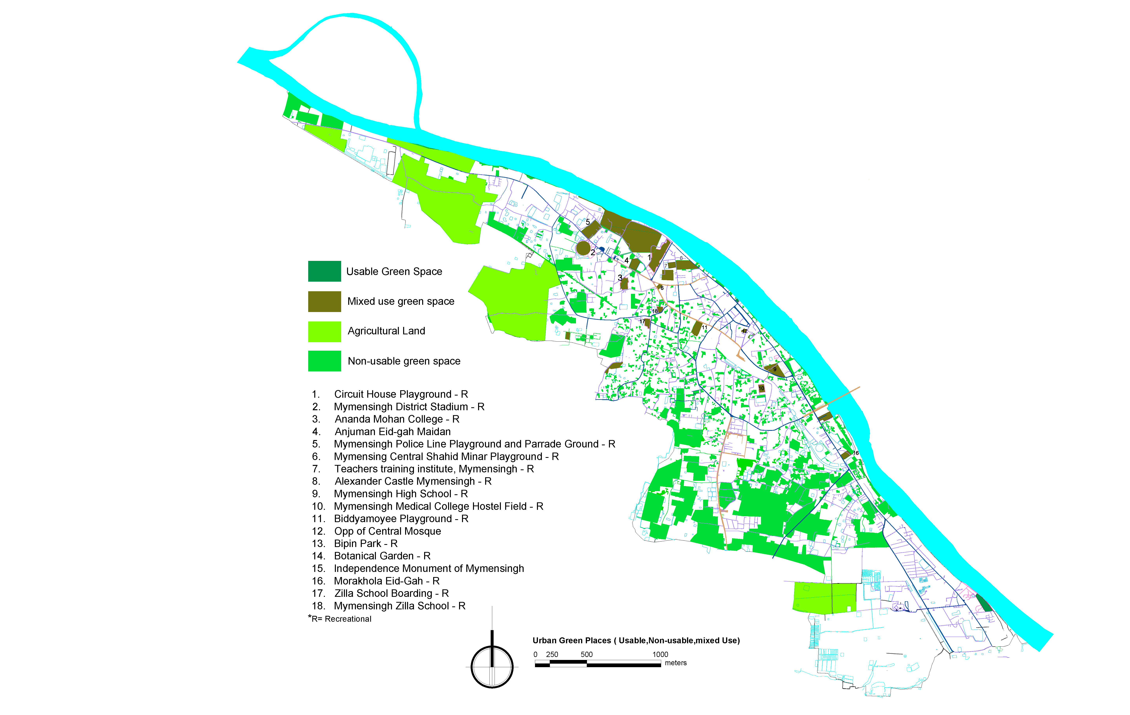

Slide 24
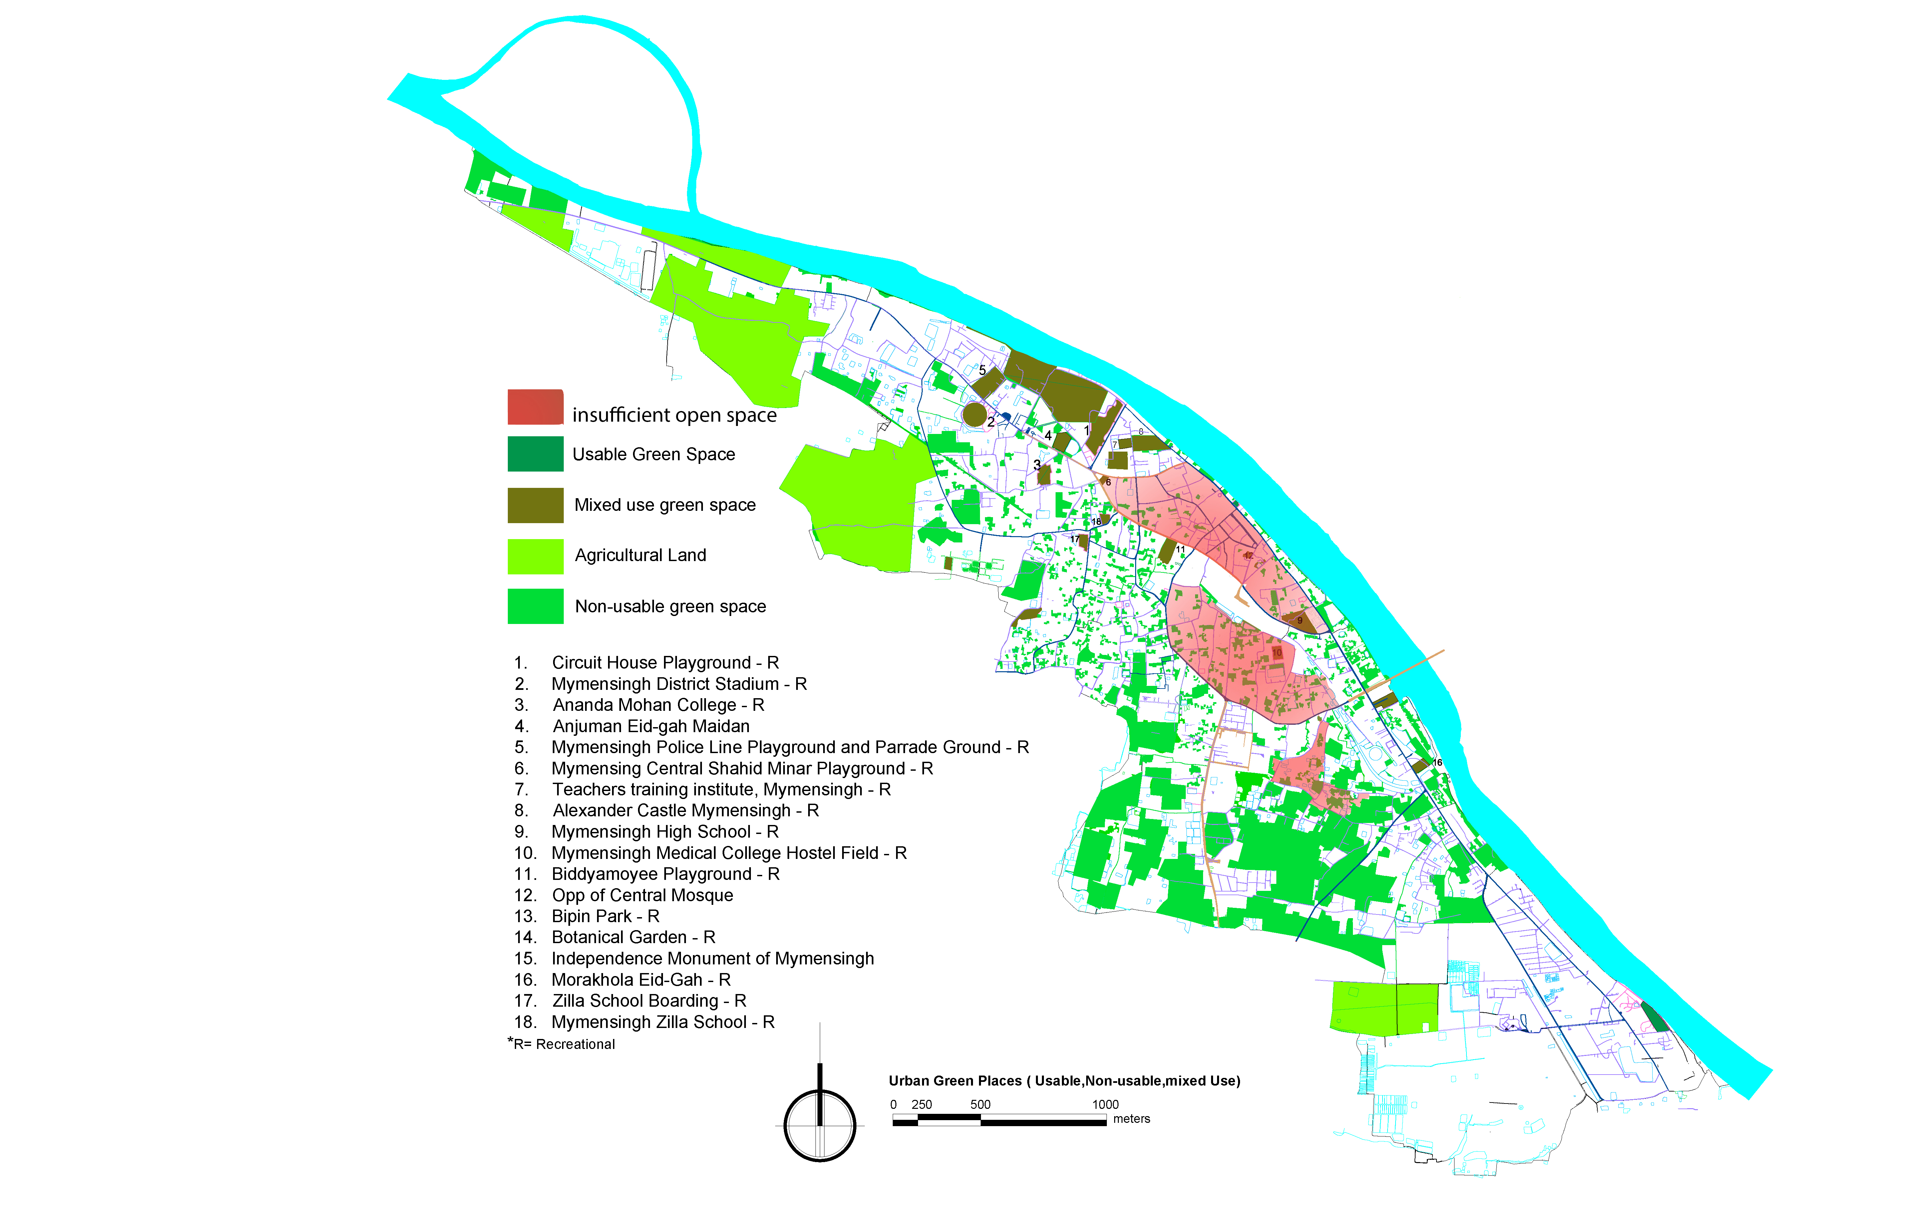

Slide 25
SCHOOL
FOR SHELTER PURPOSE
Super imposing Usable open spaces with imp. Schools &
Catchment
Existing SCHOOL
usable. SCHOOL

Slide 26
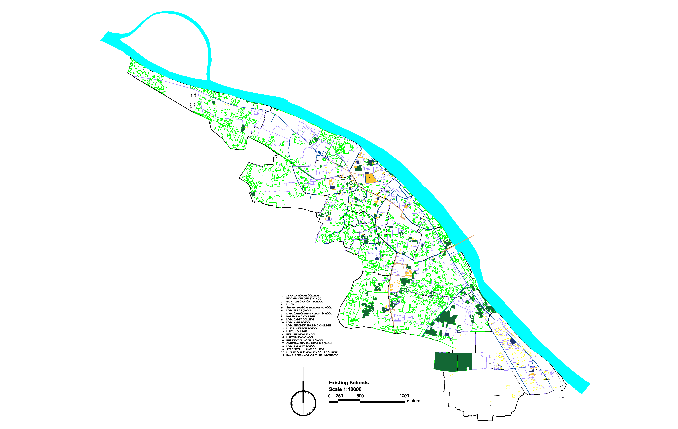

Slide 27
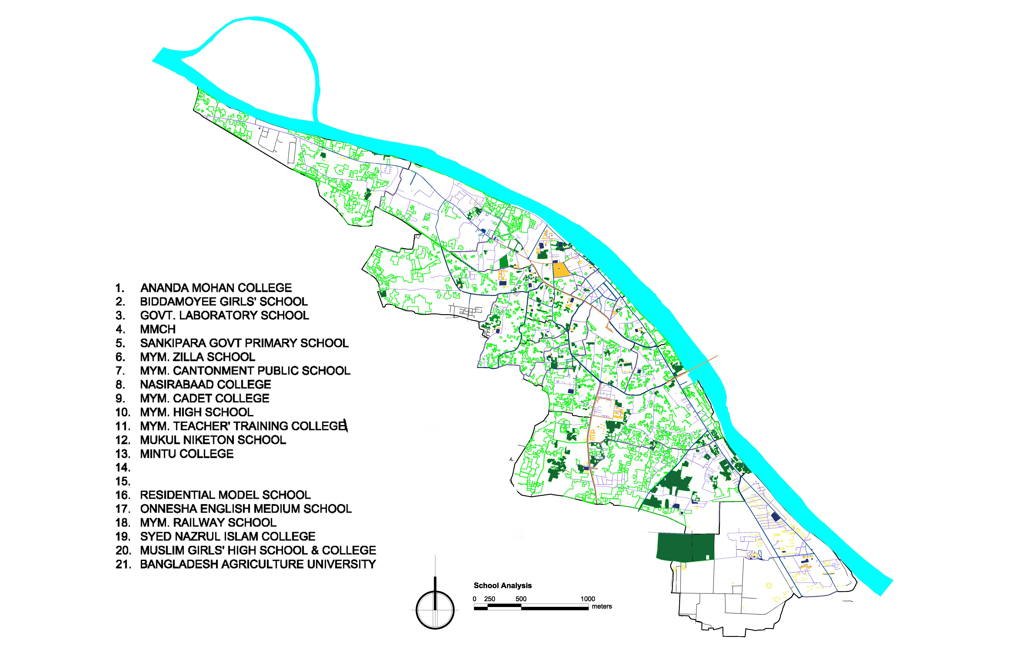
USABLE SCHOOL

Slide 28
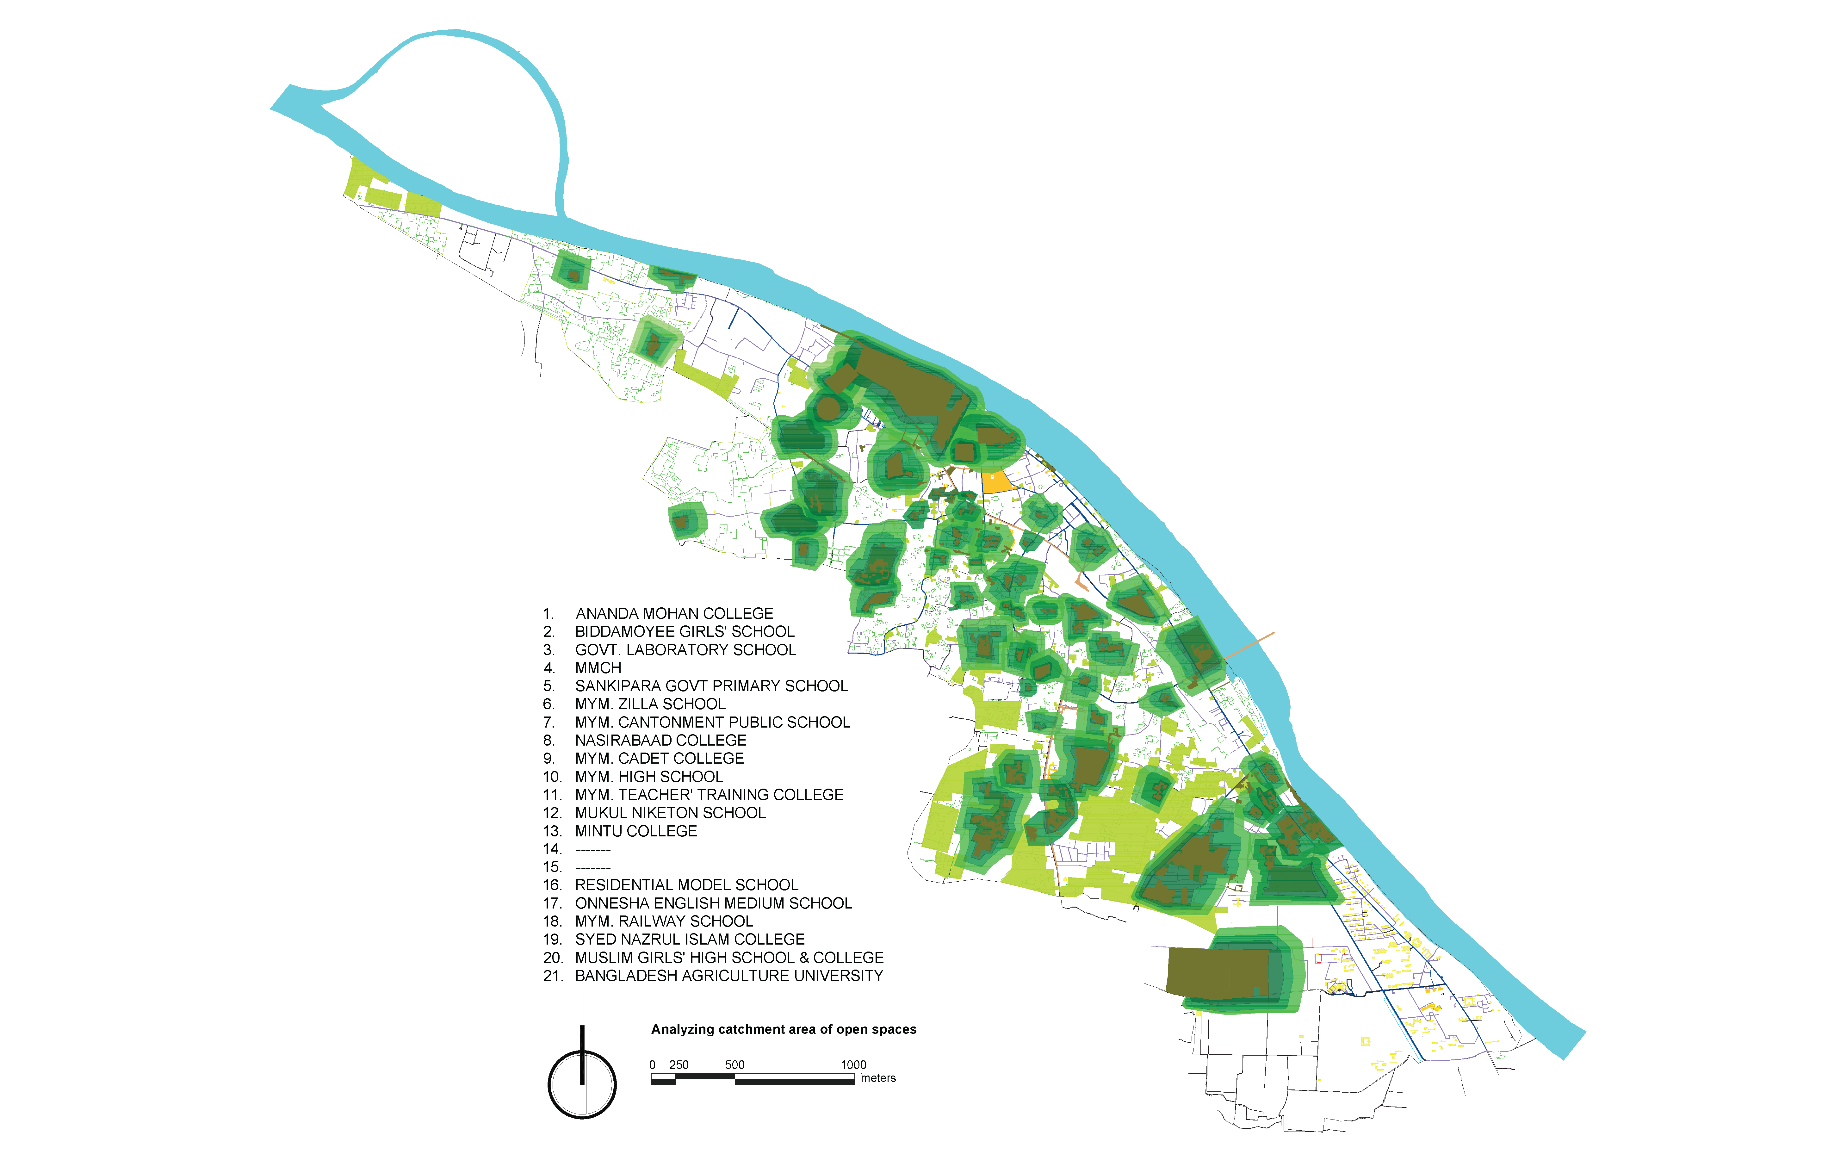
ANALYSE CATCHMENT AREA OF USABLE OPEN SPACES

Slide 29
HOSPITALS
Existing Hospitals
Super imposing Usable open spaces with imp. Schools + imp. Hospitals &
Catchment
usable. hospitals
usable. Hospitals CATCHMENT

Slide 30
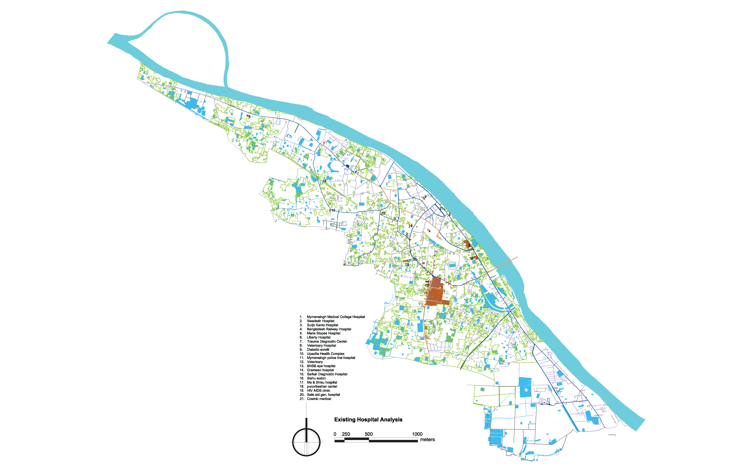
EXISTING HOSPITAL

Slide 31
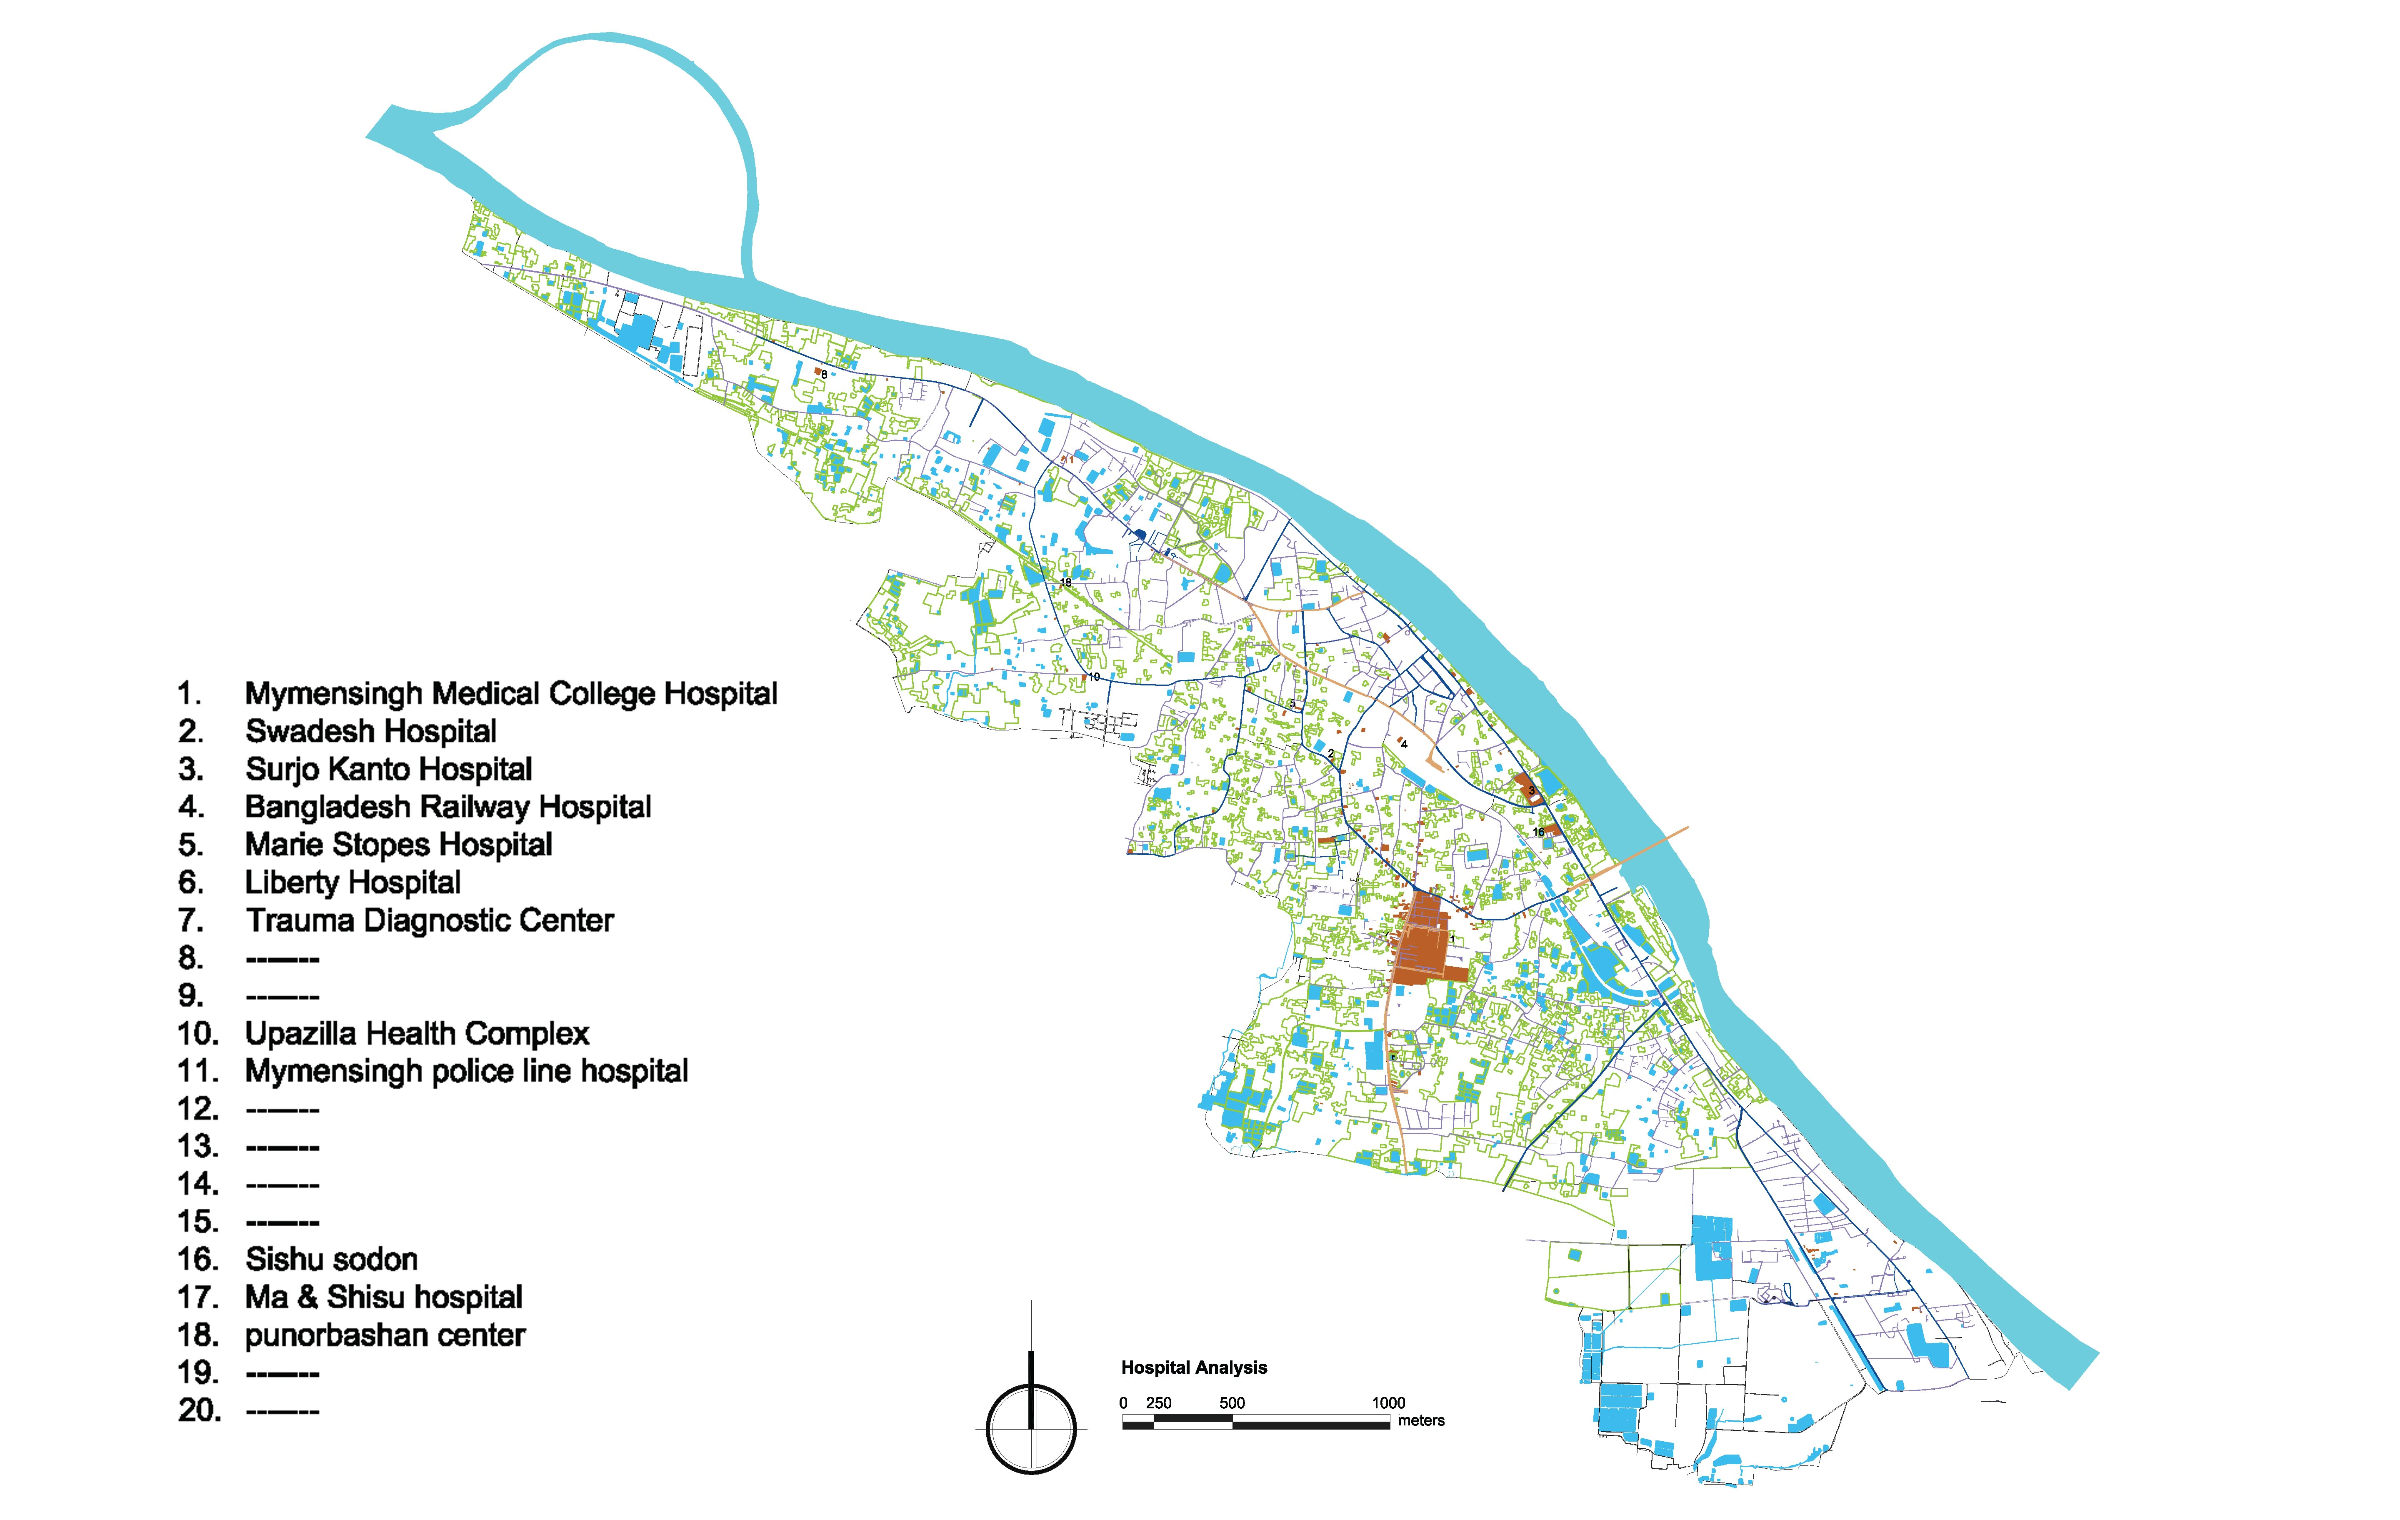
USABLE
HOSPITAL ANALYSIS

Slide 32
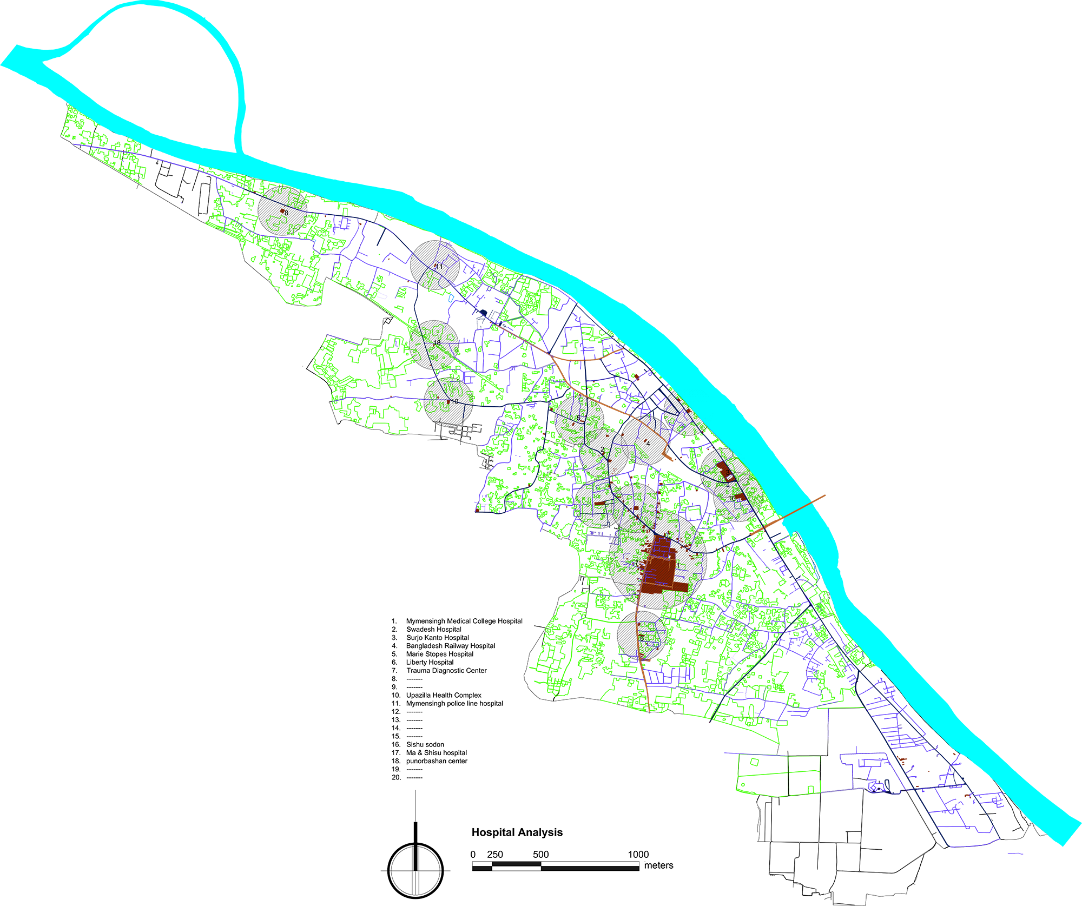
ANALYSIS OF USABLE HOSPITAL AND ITS CATCHMENT

Slide 33
Administrative
Recreationl Spaces
Super imposing All Urban facilities +
Previous
Urban Facilities
Public gathering
Transportation
Historical structtures

Slide 34
RECREATIONAL SPACE CATEGORISE

Slide 35
EXISTING HISTORICAL BUILDING

Slide 36
ADMINISTRATION

Slide 37
TRANSPORTATION

Slide 39
Water
Water existing
Usable water
Finding usable waterbodies
Water sources
Usable water cathcment
Drainage & water log

Slide 40
WATER SOURCE ANALYSIS
WATER SOURCE ANALYSIS

Slide 41
WATERBODY CATCHMENT AREA ANALYSIS
TINKONA PUKUR
EIDGAH POND
TEACHERS TRAINING INSTITUTE POND
MOHILA SOMITI POND
ANONDO MOHAN
POCHA PUKUR
MYMENSINGH LAB. SCHOOL POND
DC OFFICE POND
BASA BARI MARKET POND
EACHRS TRAINING COLLEGE FOR WOMEN
BIDDYAMOYE SCHOOL POND
MYMENSINGH MED. COLLEGE HOSTEL POND
RAILWAY STAFF QUARTER POND.
ATANI POND
POLICE LINE POND
KASOR WATER BODY
ZILLA SCHOOL POND
AGGRICULTURE UNIVERSITY WATERBODY
RAILWAY WATERBODY

Slide 42
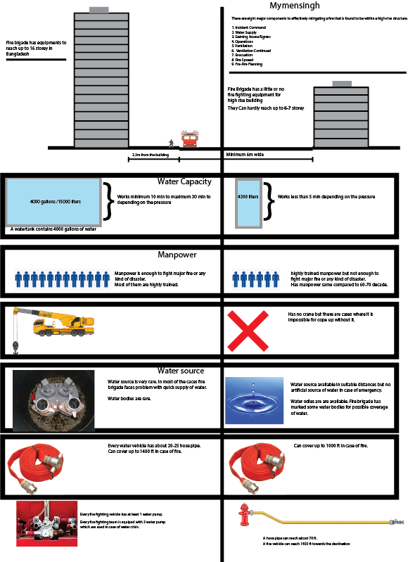
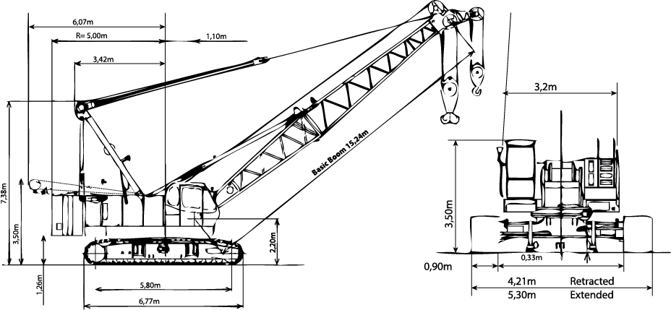
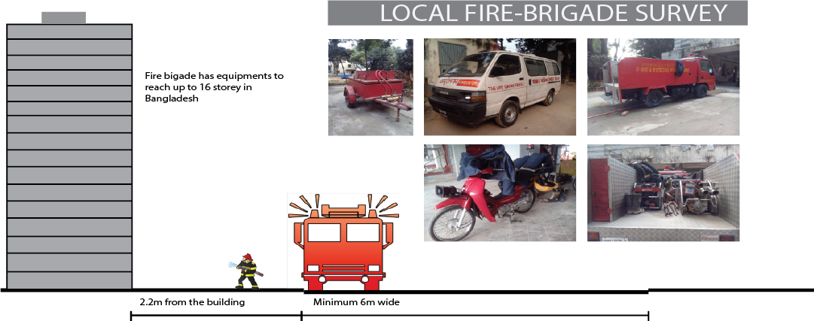
RESCUE BY FIRE BRIGADE

Slide 43
WHAT WE
PROPOSE

Slide 44
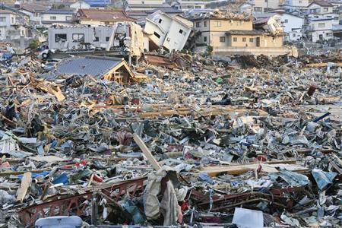
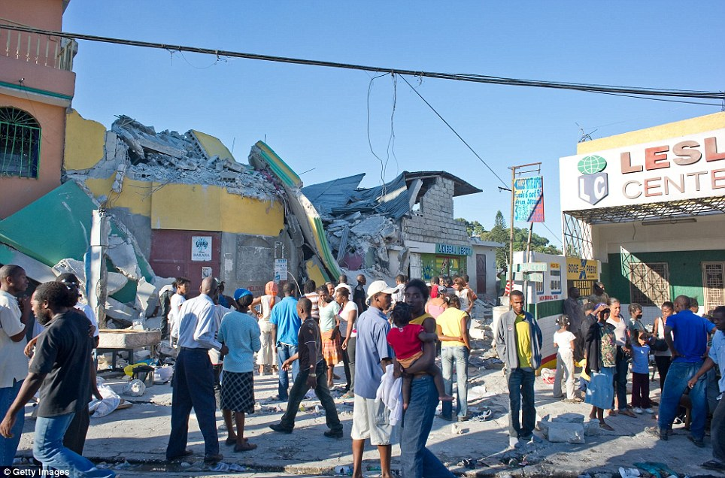
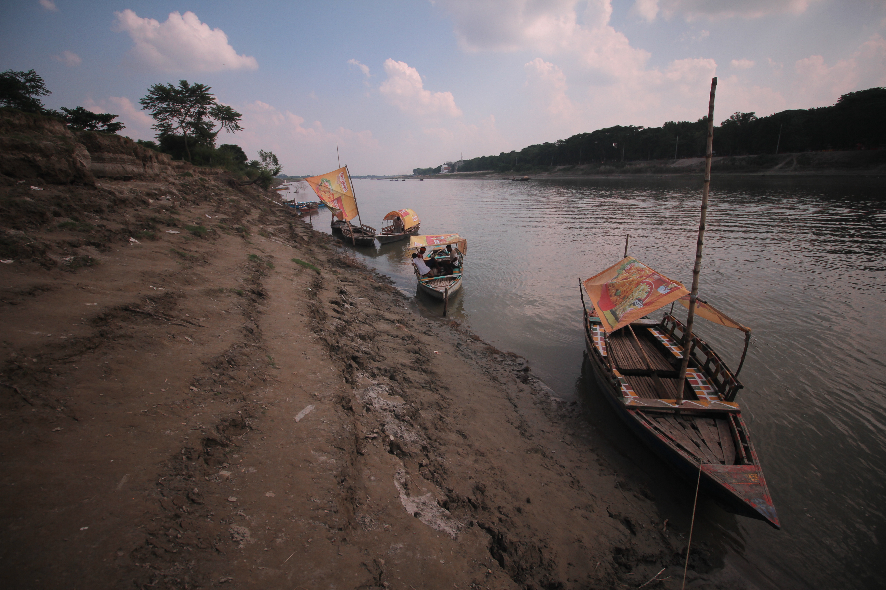
TO RUN TO ANY OPEN SPACE,BASICALLY COME DOWN ON ROADS
DESTRUCTION
BASIC HUMAN RESPONSE AFTER DISASTER
BIGGEST OPEN SPACE & ESCAPE ROUTE: RIVER

Slide 45
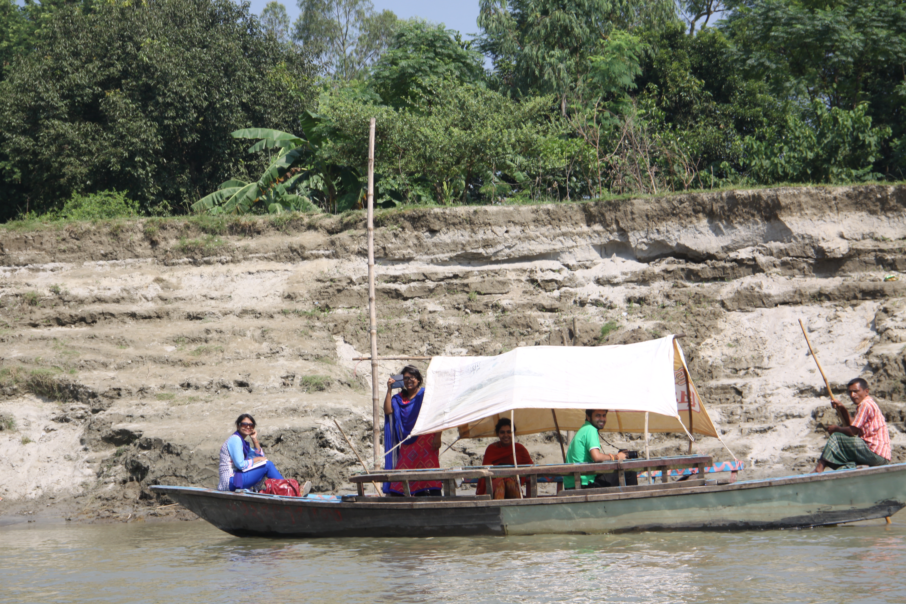
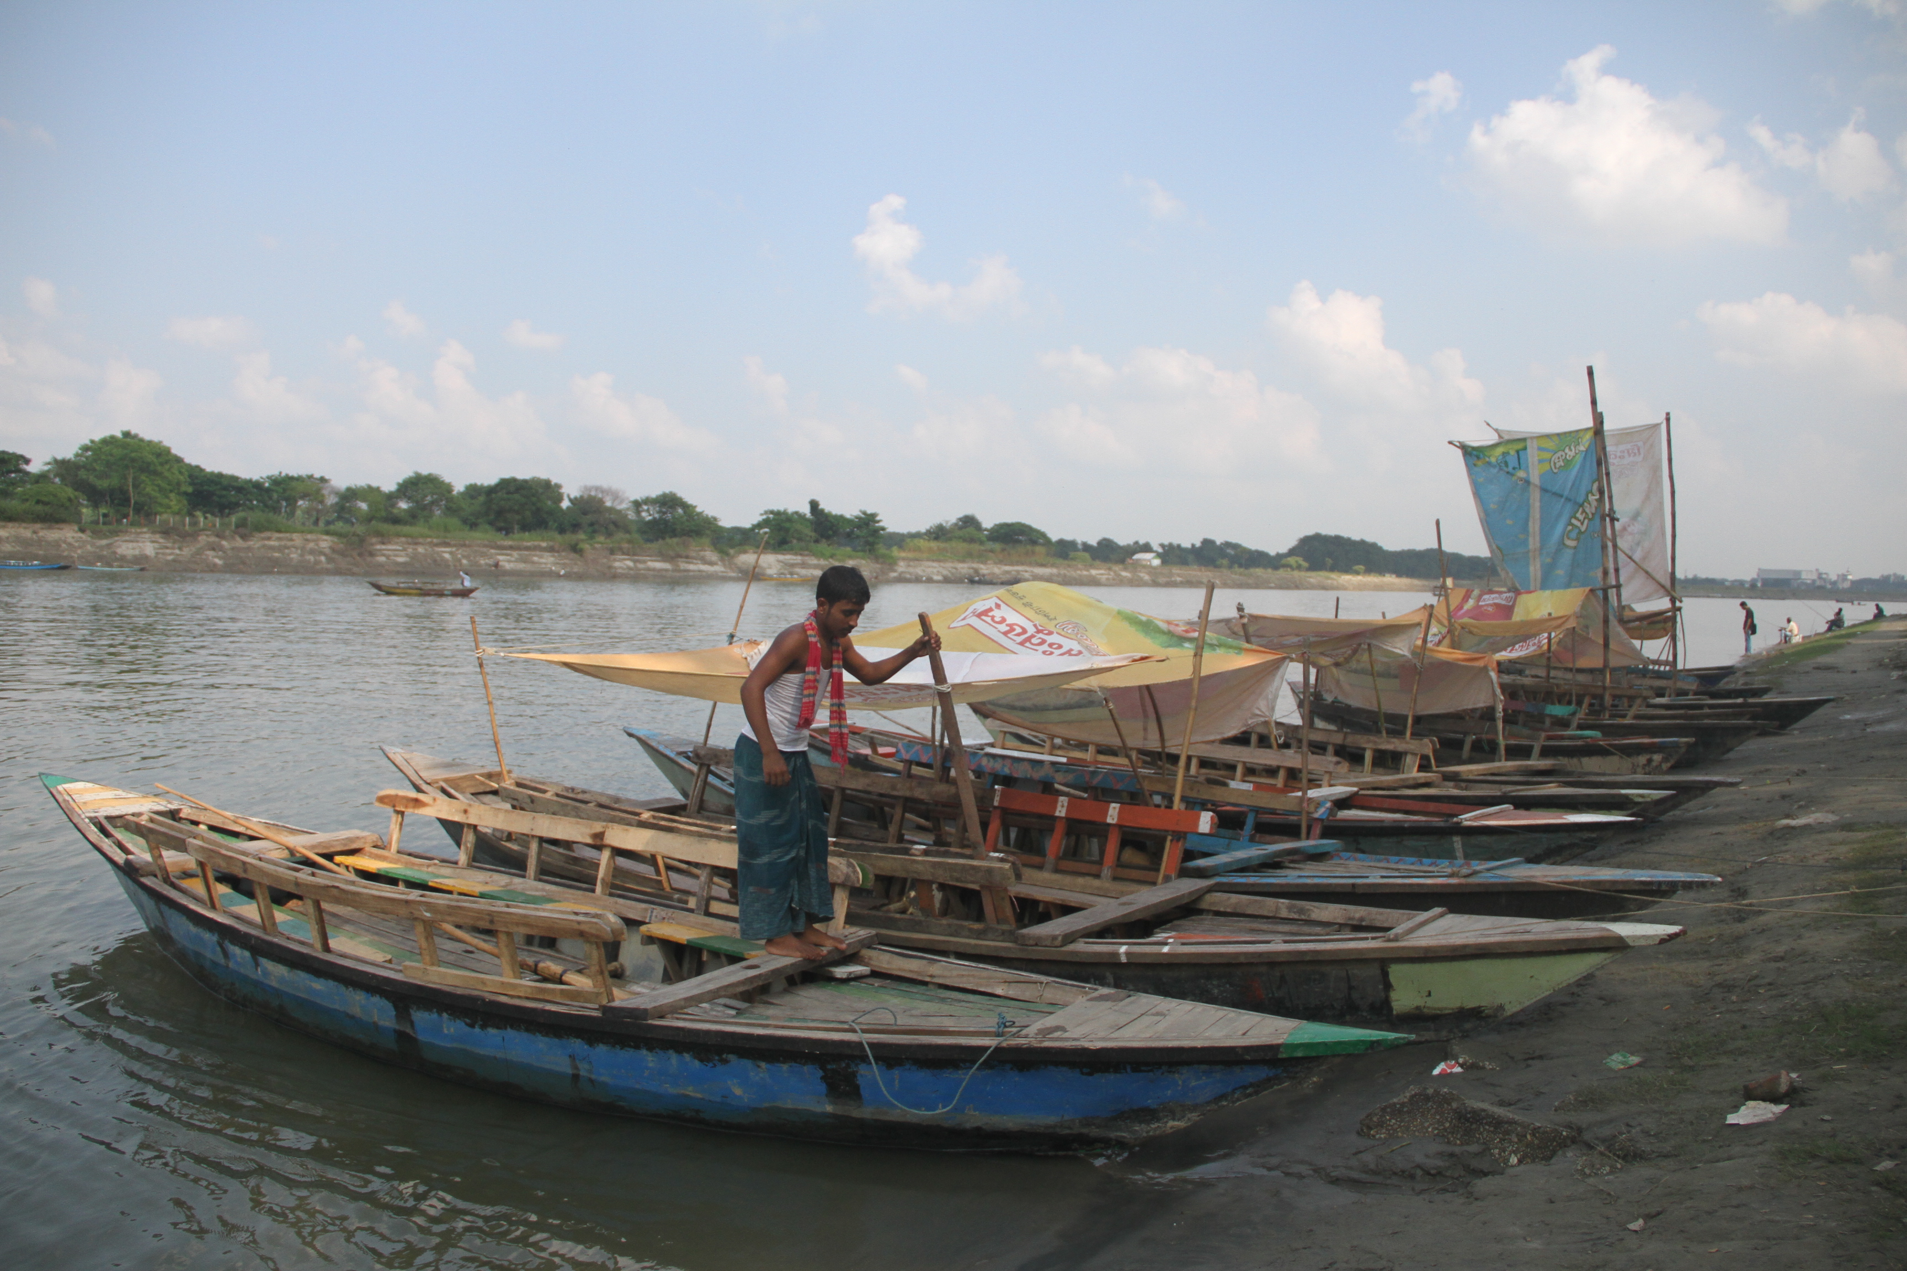
RIVER AS EVACUATION ROUTE

Slide 46
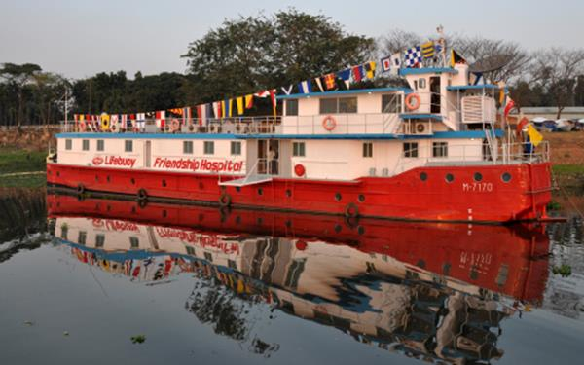
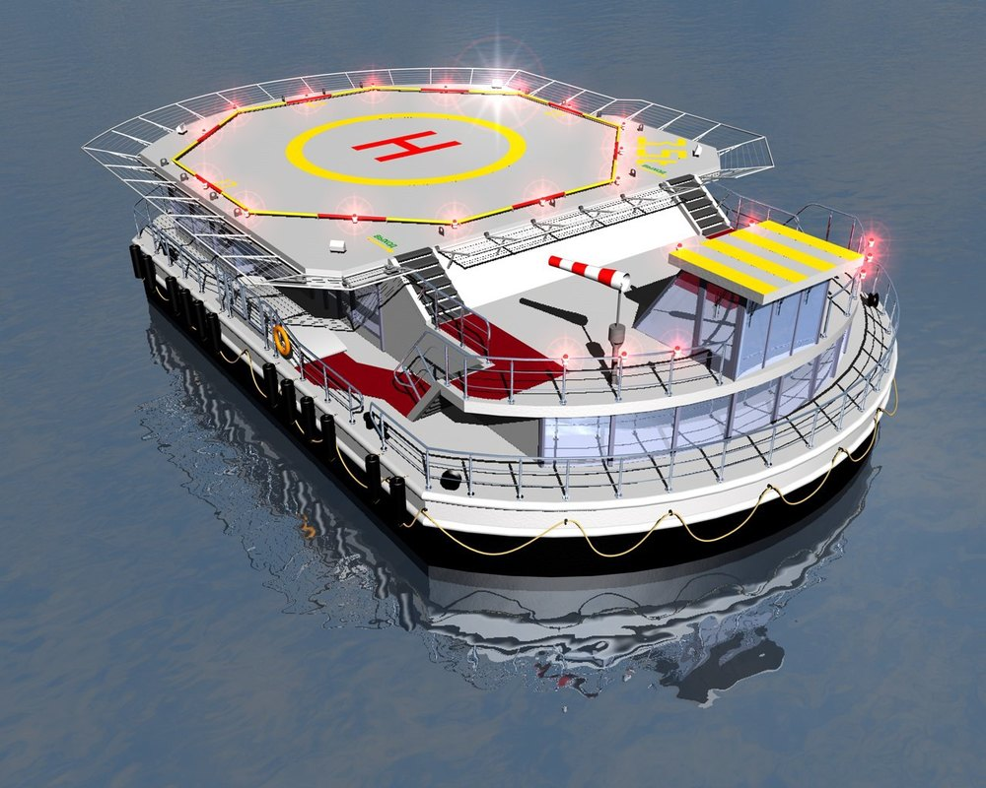
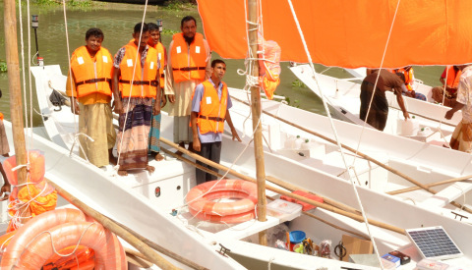
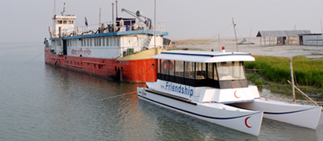
RIVER AS EMERGENCY USE
WATER AMBULANCE
FLOATING HOSPITAL
FLOATING HELIPAD
WATER CARRIER
RELIEF BOATS

Slide 47
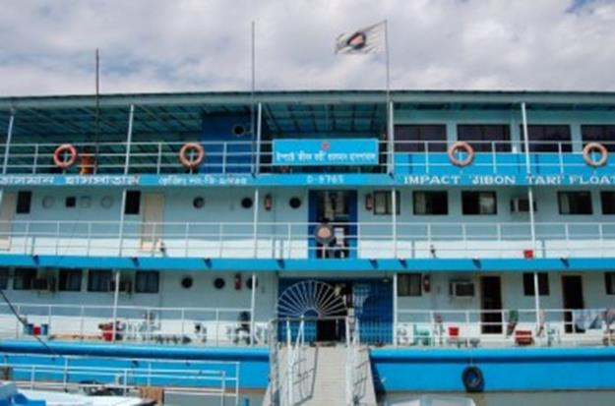
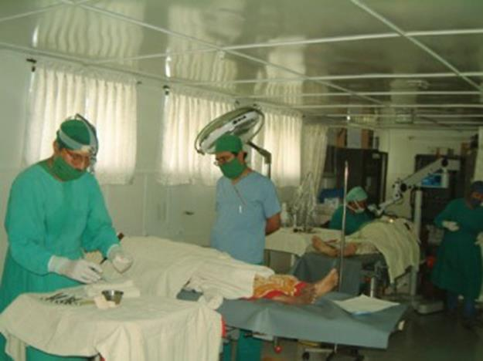
‘TAKING THE HOSPITAL TO THE PEOPLE': JIBON TARI FLOATING HOSPITAL
The vessel is 40 metres by 10 metres and built on three decks housing wards, an operating theatre, a training centre, laboratories and even its own water purification plant.
It moors at each site for about 12 weeks and offers surgical and medical care, training and health education. The Jibon Tari’s fame has spread quickly and crowds of people greet it at each site in the hope of treatment. In a country as impoverished as Bangladesh, the need for a service like this is almost limitless.

Slide 48
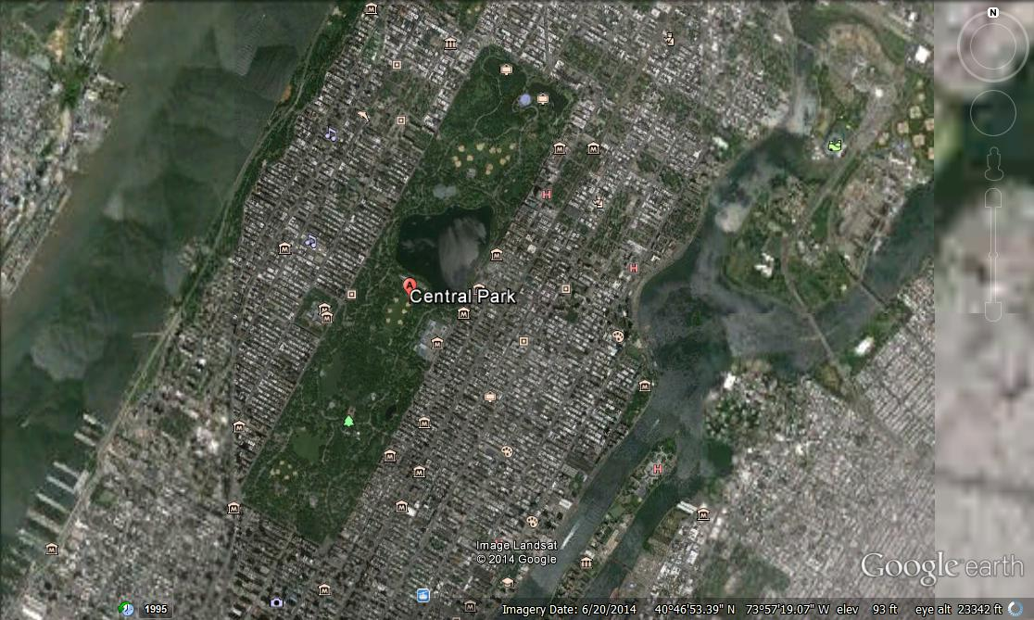
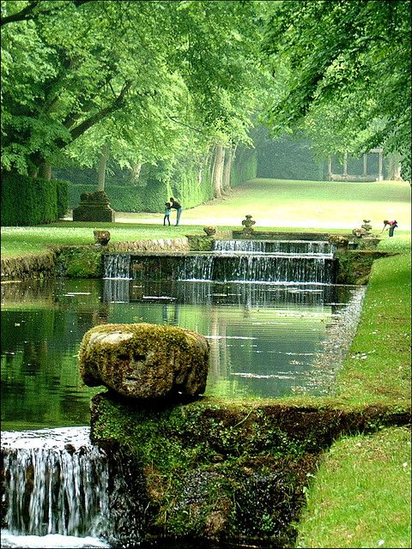
Breathing HUB

Slide 49
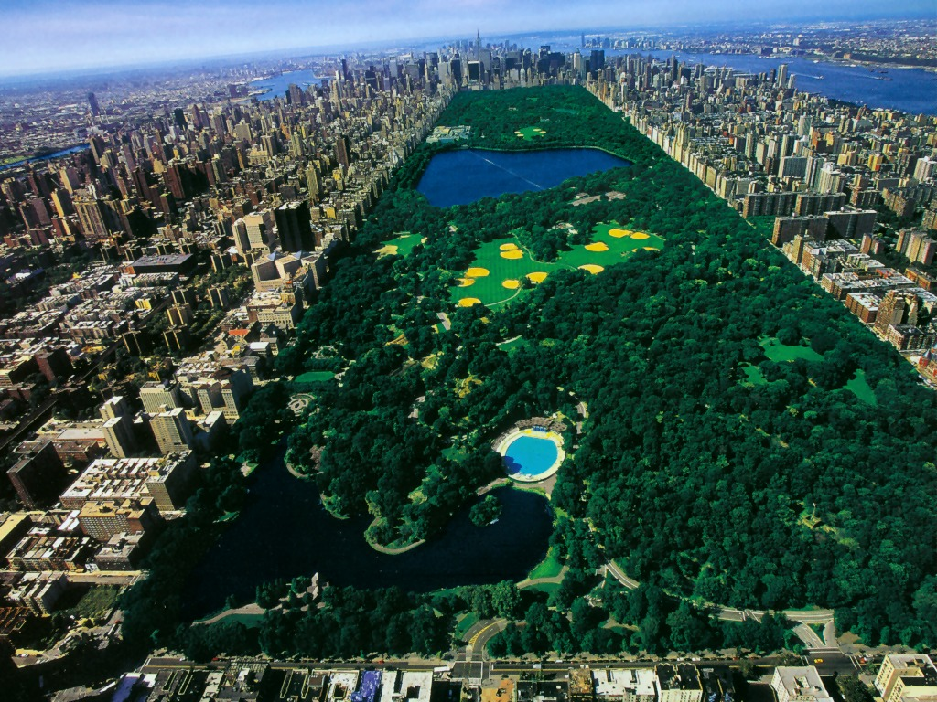
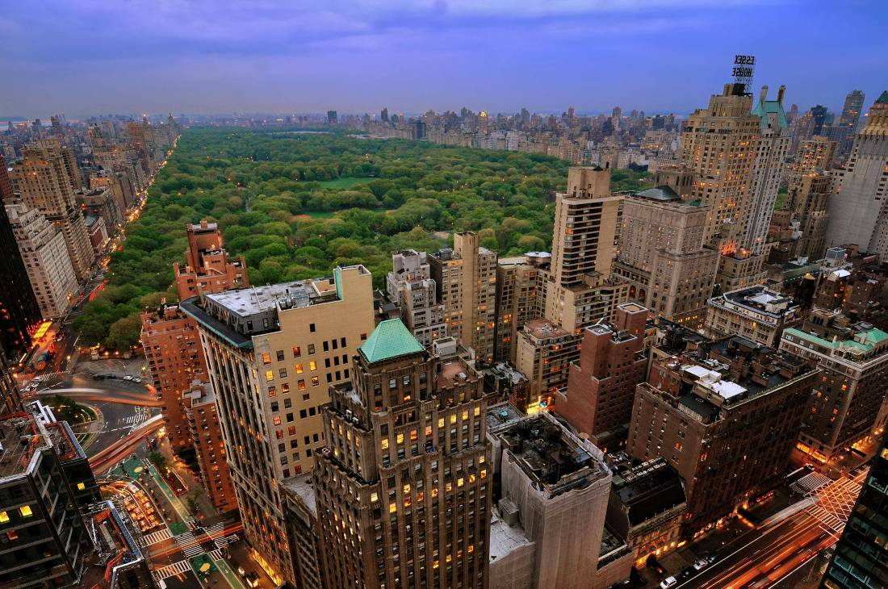
Central Park is an urban park in the central part of the borough of Manhattan, New York City . It was initially opened in 1857, on 778 acres (315 ha) of city-owned land (later expanding to its current size of 843 acres (341 ha)

Slide 50
DECLARING NEW PROPOSED OPEN SPACE AS
PLAY FIELD -VARIABLE
NEIGHBOURHOOD PARK – 1-2 ACRES/1000 POP
COMMUNITY FIELD - 5-8ACRES/1000 POP
SPECIAL USE PARK [RECREATIONAL PARK, AMUSEMENT PARK]
-3 ACRES/1000 POP
LINEAR PARK - 5ACRES/1000 POP
NATURE PARK - VARIABLE
WIDEN PEDESTRIAN

Slide 51
CONVERTION OF
EXISTING & NEW OPEN SPACES

Slide 52
Wider Pedestrain for emargency use
Open spaces :
leaving open spaces by providing proper utialization

Slide 53
RIVER BANK – A GREEN BELT along the city

Slide 54
INTEGRATED OPEN SPACE USE

Slide 55
EXISTING & PROPOSED CONCEPTUAL RIVER BANK

Slide 56
Temporary Shelter
BAMBOO
#. Local material
#. Affordability
#. Use
#.Local knowledge

Slide 57
Cocoon – A versatile refuge for disaster victims
. A 'Cocoon' is an exploration of mass-produced, easy-to-assemble and quick-to-mobilize disaster-relief shelters. A family of three objects, 'Case', Capsule' and 'Cuddle', represent new solutions for shelter and comfort as well as provide varying levels of protection for different climates and surroundings. The Cocoon objects can be mass-produced, are low-cost, and van be erected by one or two people. It is an 'industrial design paradigm' that can be manufactured on demand and in time.

Slide 58
The shelters are produced and delivered in four stackable sections, weighing no more than 60 pounds each, making them light enough for a single person to transport. The shelters are also user-friendly, with 30-minute set-up by a single individual with minimal tools and skills. In can also be adapted to the needs of each individual family or community it intends to serve, with a 85-square-foot basic footprint which can be enlarged or connected to other huts through the use of extender sections. Their flexibility makes them suitable for a number of different purposes in addition to housing, including medical care and first aid stations, equipment and food storage as well as overflow prison accommodations.

Slide 60
Existing open space
Shelter from rainwater & sun
Shaded space
Space fragmented
Actual situation

Slide 61
PROPOSED
BREATING HUB : GREEN
GREEN BELT

Slide 62
THANK YOU

