Slide 1
SPATIAL INTERPRETATION OF SOCIO-ECONOMIC INFORMATION
MSDP Project (2011-2031), CDMP-II & UDD
Planner Ripan Debnath
Decode-Bestway-Geomark JVC

Slide 2
Presentation Outline
Basic information
Findings of field verification
Method & outcome of spatial interpretation
Resultant maps/figures
  Overall scenario
  Scenario by family types
  Scenario by structure (settlement) types
Remarks

Slide 3
Basic Information
Location: Mymensingh Municipality
Area type: Urban
Total surveyed: 938 households (HH)
Sample checked: 208 HH (22%)
Spatially linked information: 629 HH (67% of total)
Variables considered for spatial interpretation: 21 Nos.
Parent classifier: 2 variables
  Family type (Single & Joint)
  Settlement type (Pucca & Others)

Slide 4
Findings of Field Verification
Variation between the results of total surveyed and checked HHs is ranging within ±5% which is generally acceptable and indicates great reliability of the total survey work.
Some high deviations have been observed for distance related figures which indicates that most of the field checking were performed within a close proximity to the city center.
Coincidently the checked sample HHs belong a rich community since the deviations in income and expenditure proportions have been observed among the upper ranges of the respective classifications.
Disaster and other problem related results sustained as were found in previous analysis.

Slide 5
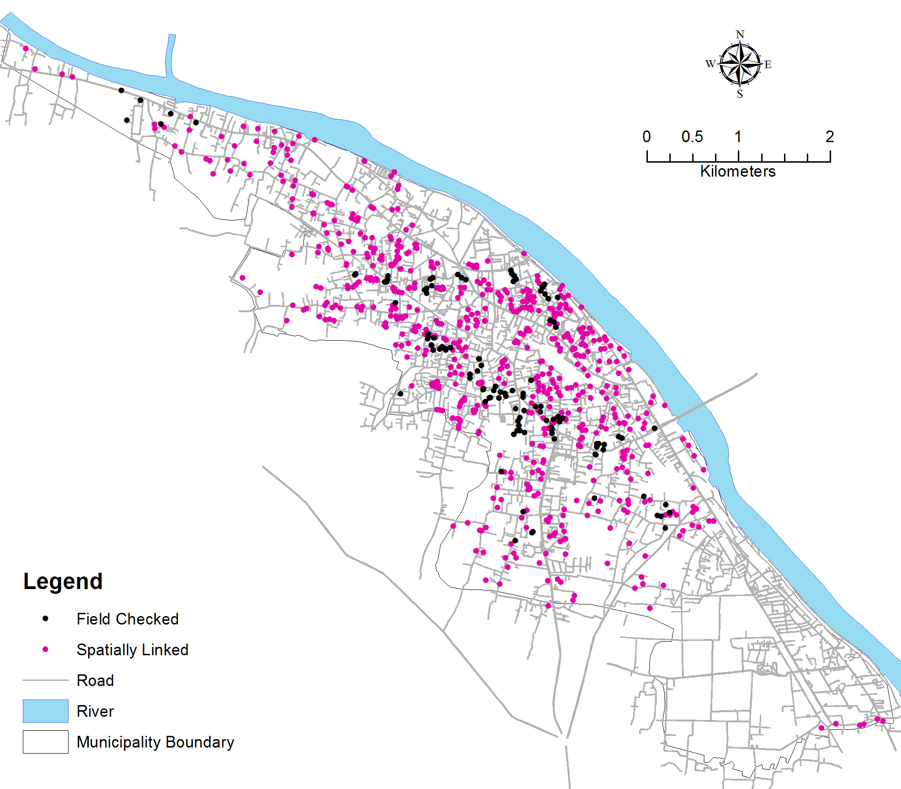
Map of Checked & Spatially Linked Data

Slide 6
Method & Output
Tools used: 3D Analyst Tools
Area of exclusion: Restricted & large institutions
Output format: Raster
Output categories:
  Overall scenario
  Parent classifiers’ oriented
Considered Variables
Raster Map
3D Analyst Tools in ArcMap

Slide 7
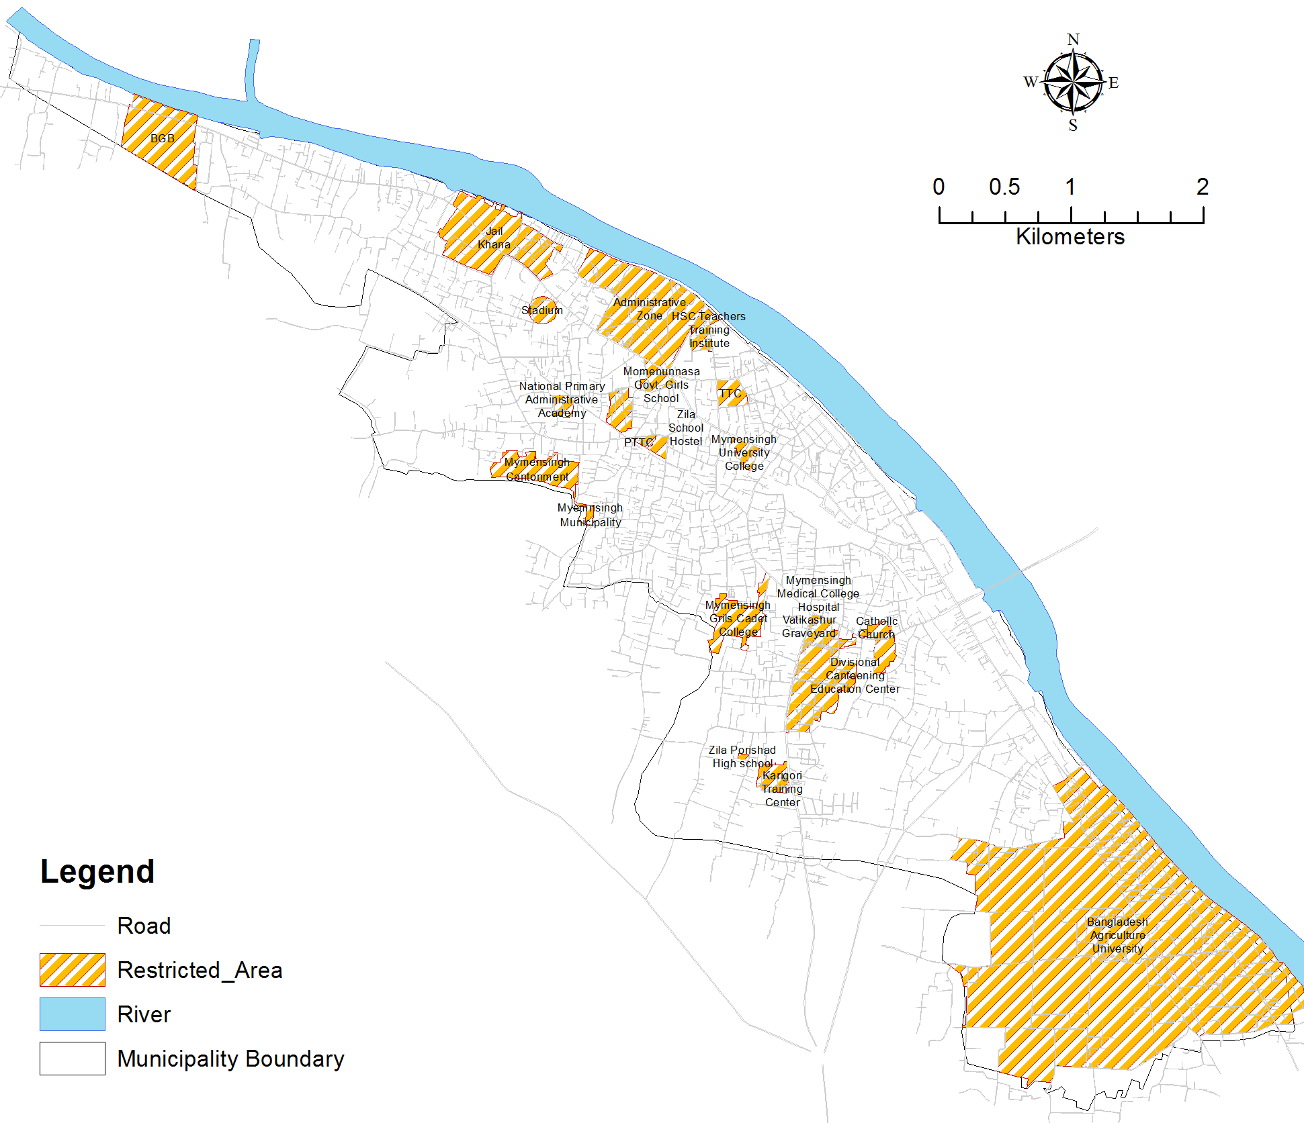
Restricted Areas within Municipality

Slide 8
Summary of Considered Variables
Variable | Status of Response
 | N | Percent
Total family member | 629 | 100.00%
Type of the Family | 619 | 98.40%
Monthly Income of the Family | 626 | 99.50%
Monthly Family Expense of the Family | 626 | 99.50%
Year of Immigration | 218 | 34.70%
Reason of Immigration | 189 | 30.00%
Is the H.H. Owner of the Land/Flat? | 609 | 96.80%
Type of Structure | 522 | 83.00%
Land area in katha | 227 | 36.10%
Value of Land | 308 | 49.00%
Area of House/Flat (in sq ft) | 81 | 12.90%
Value of House/Flat | 81 | 12.90%
Has Land been Filled to Build the House? | 416 | 66.10%
Which Type of Land Use is Demanded More in this Area? | 570 | 90.60%
Land value in 2002 | 445 | 70.70%
Land value in 2007 | 456 | 72.50%
Land value in 2012 | 582 | 92.50%
Had anyone been Sick in Last One year? | 587 | 93.30%
What change has taken place ? | 202 | 32.10%
Are you interested to change your current LU? | 629 | 100.00%
Are you interested to leave space for road widening? | 629 | 100.00%

Slide 9
Overall scenario
Spatial Interpretation

Slide 10
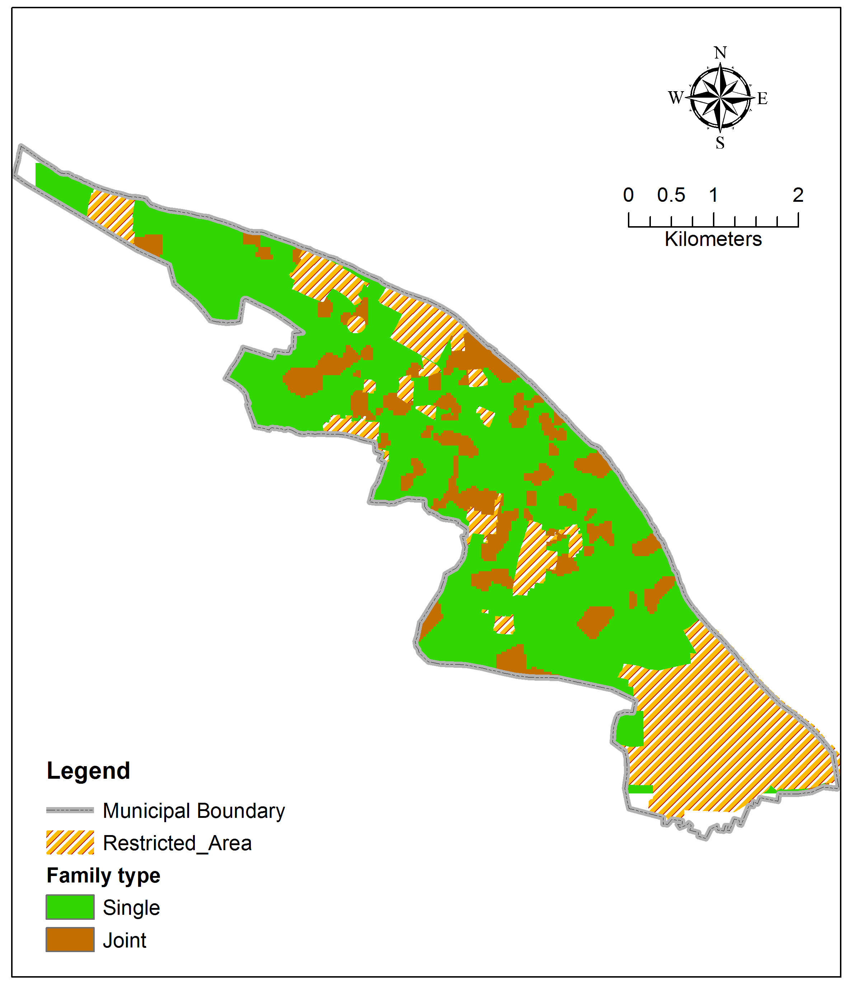
Family Type

Slide 11
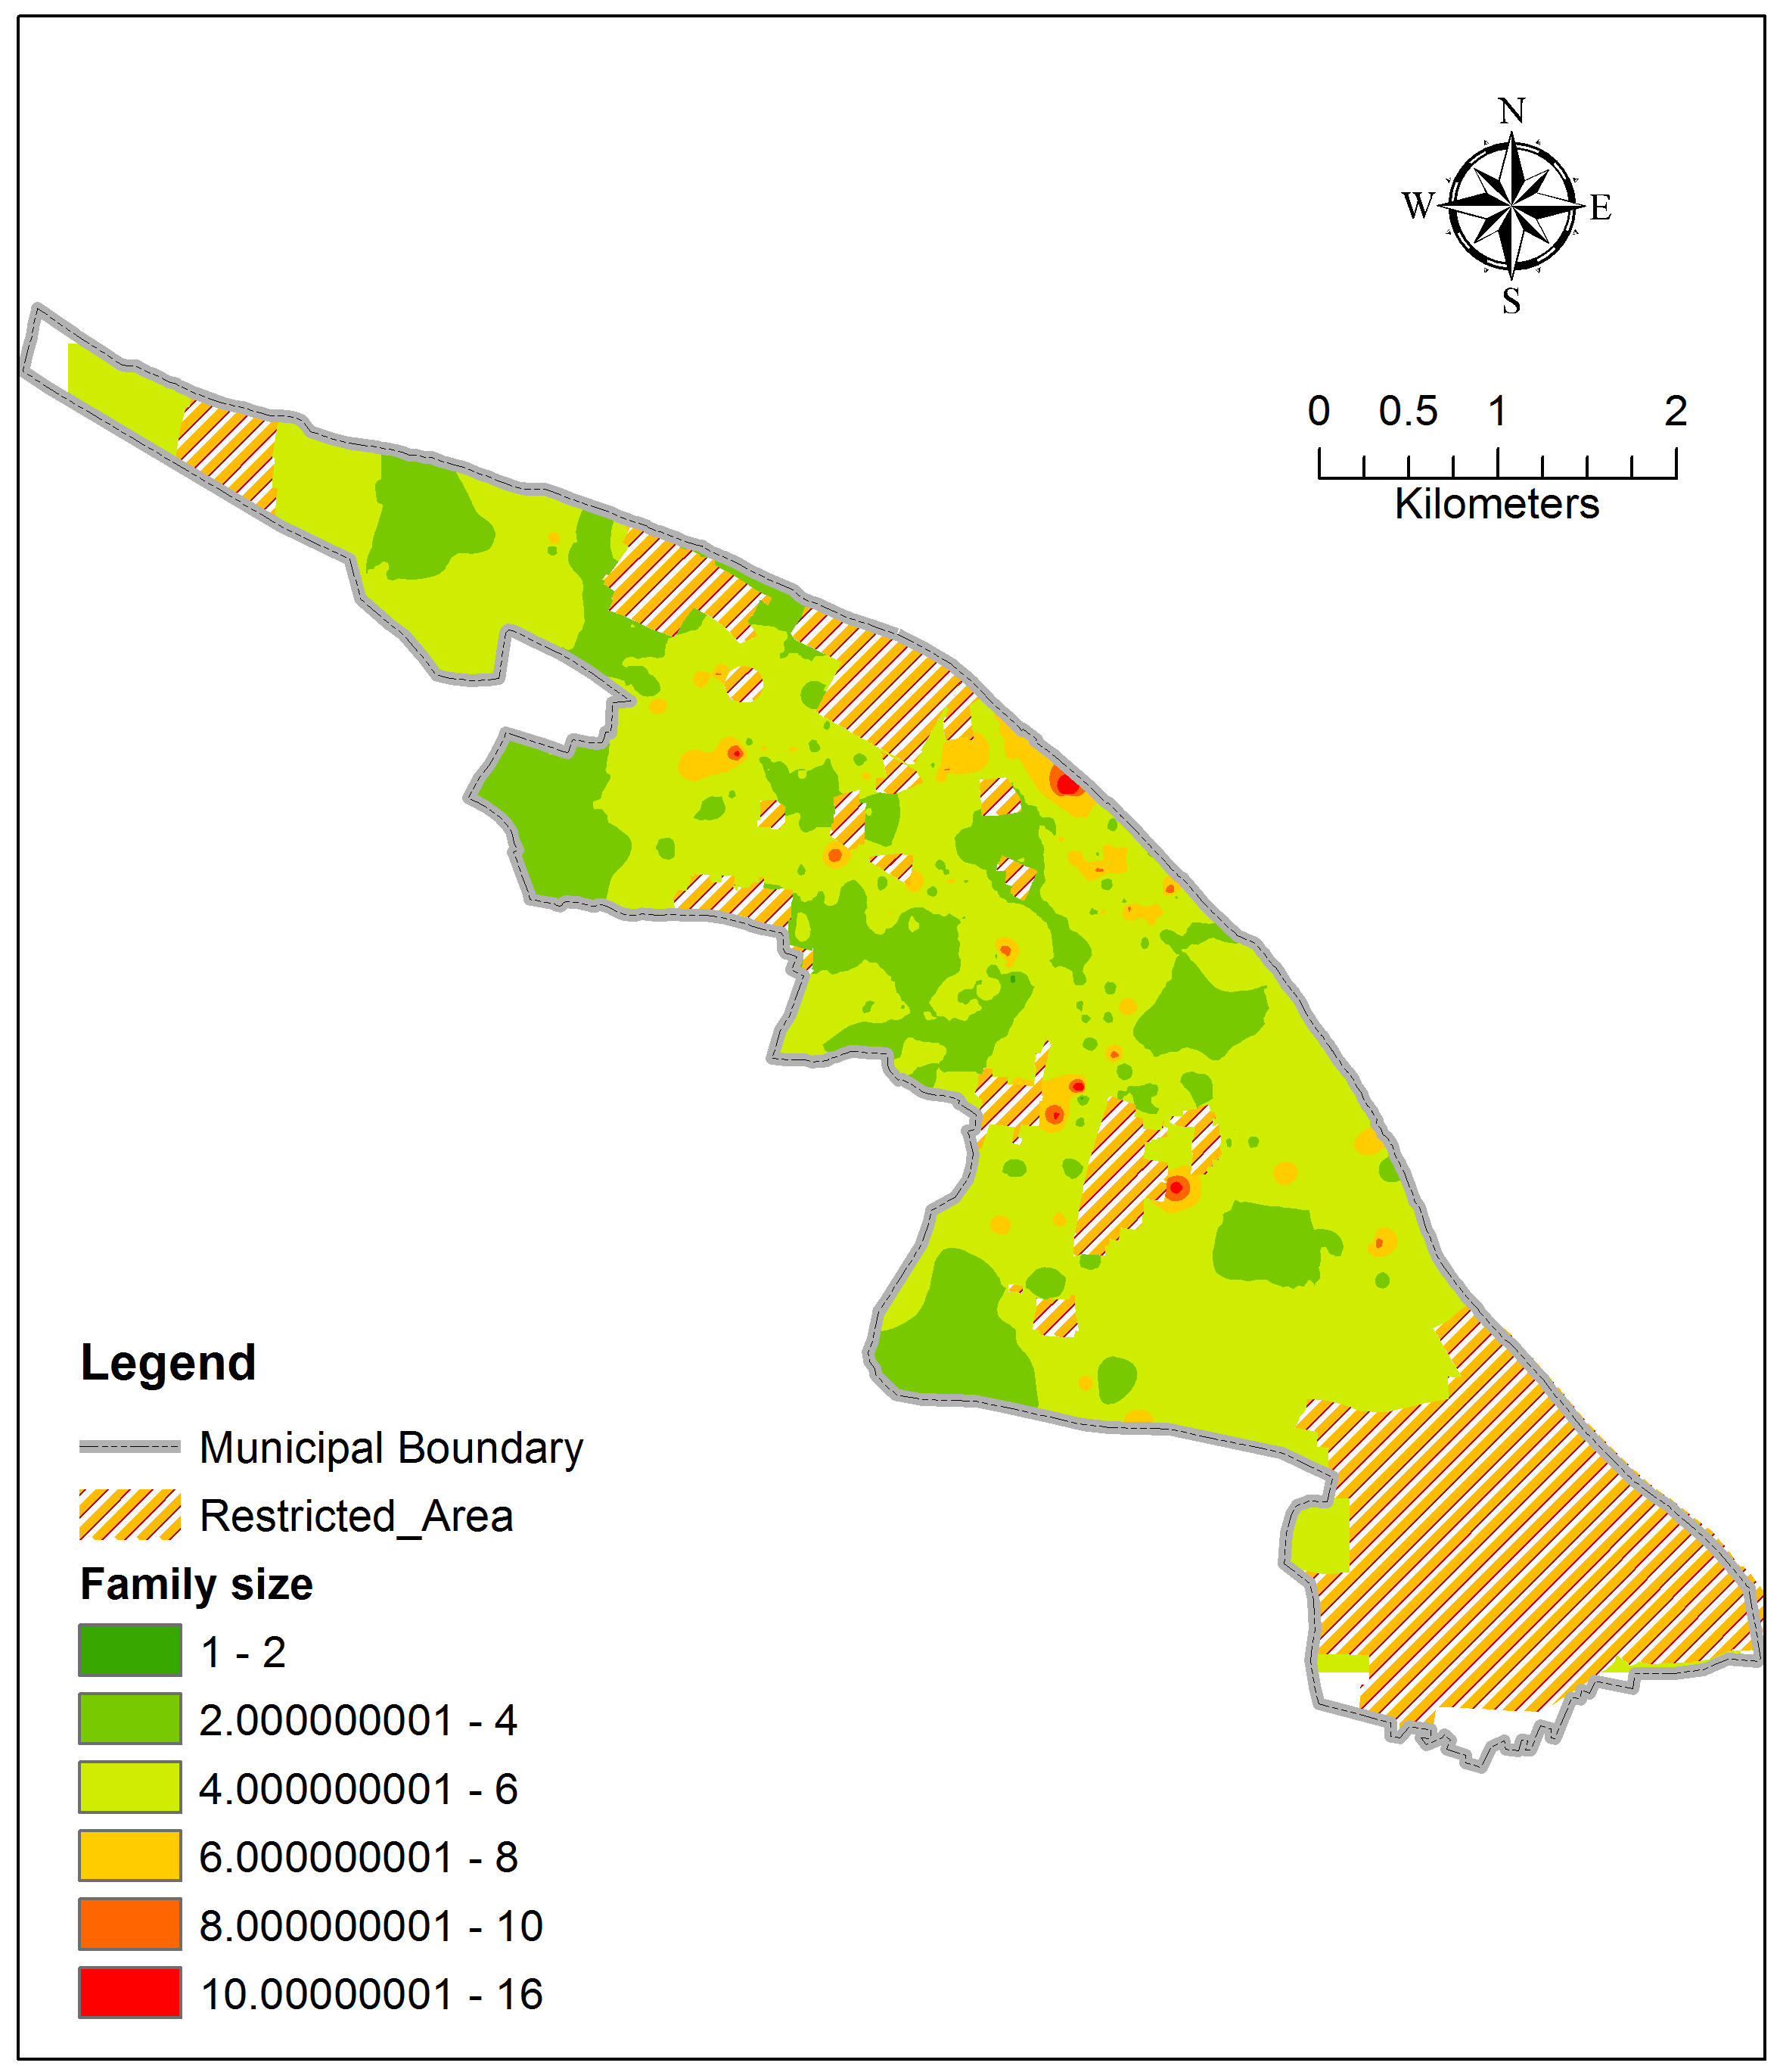
Family size

Slide 12
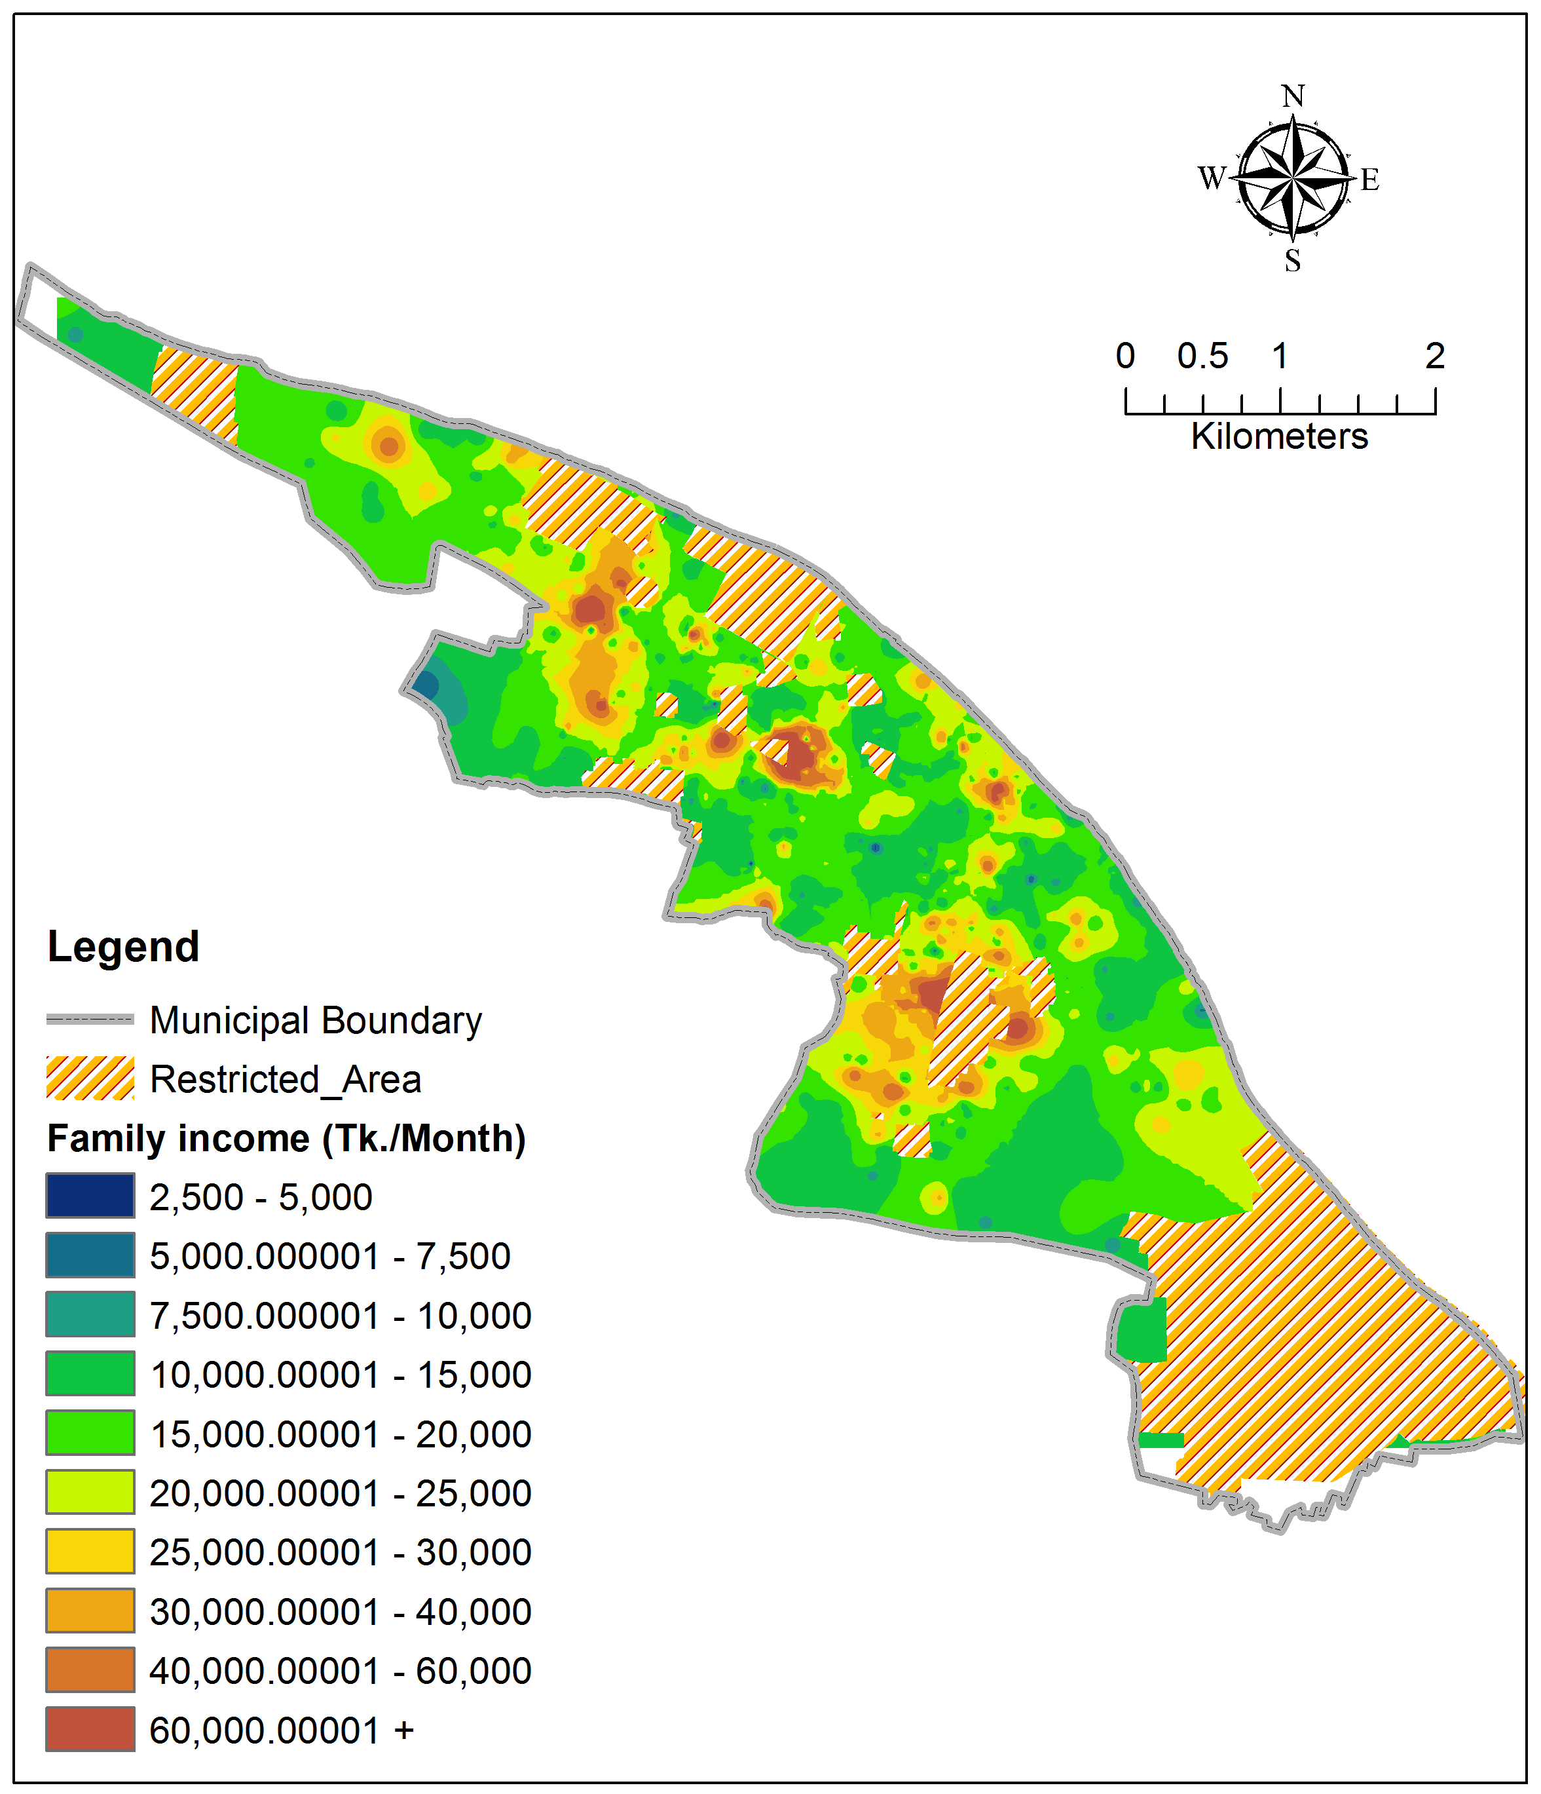
Total monthly income

Slide 13
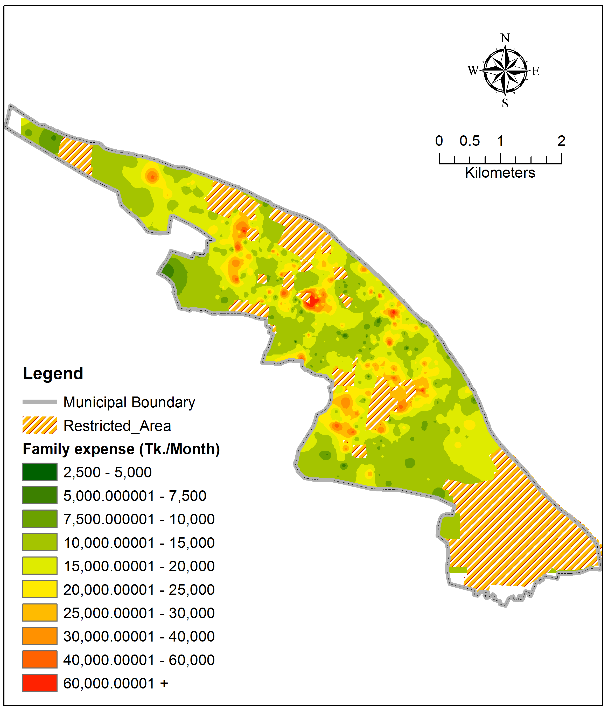
Total monthly expenditure

Slide 14
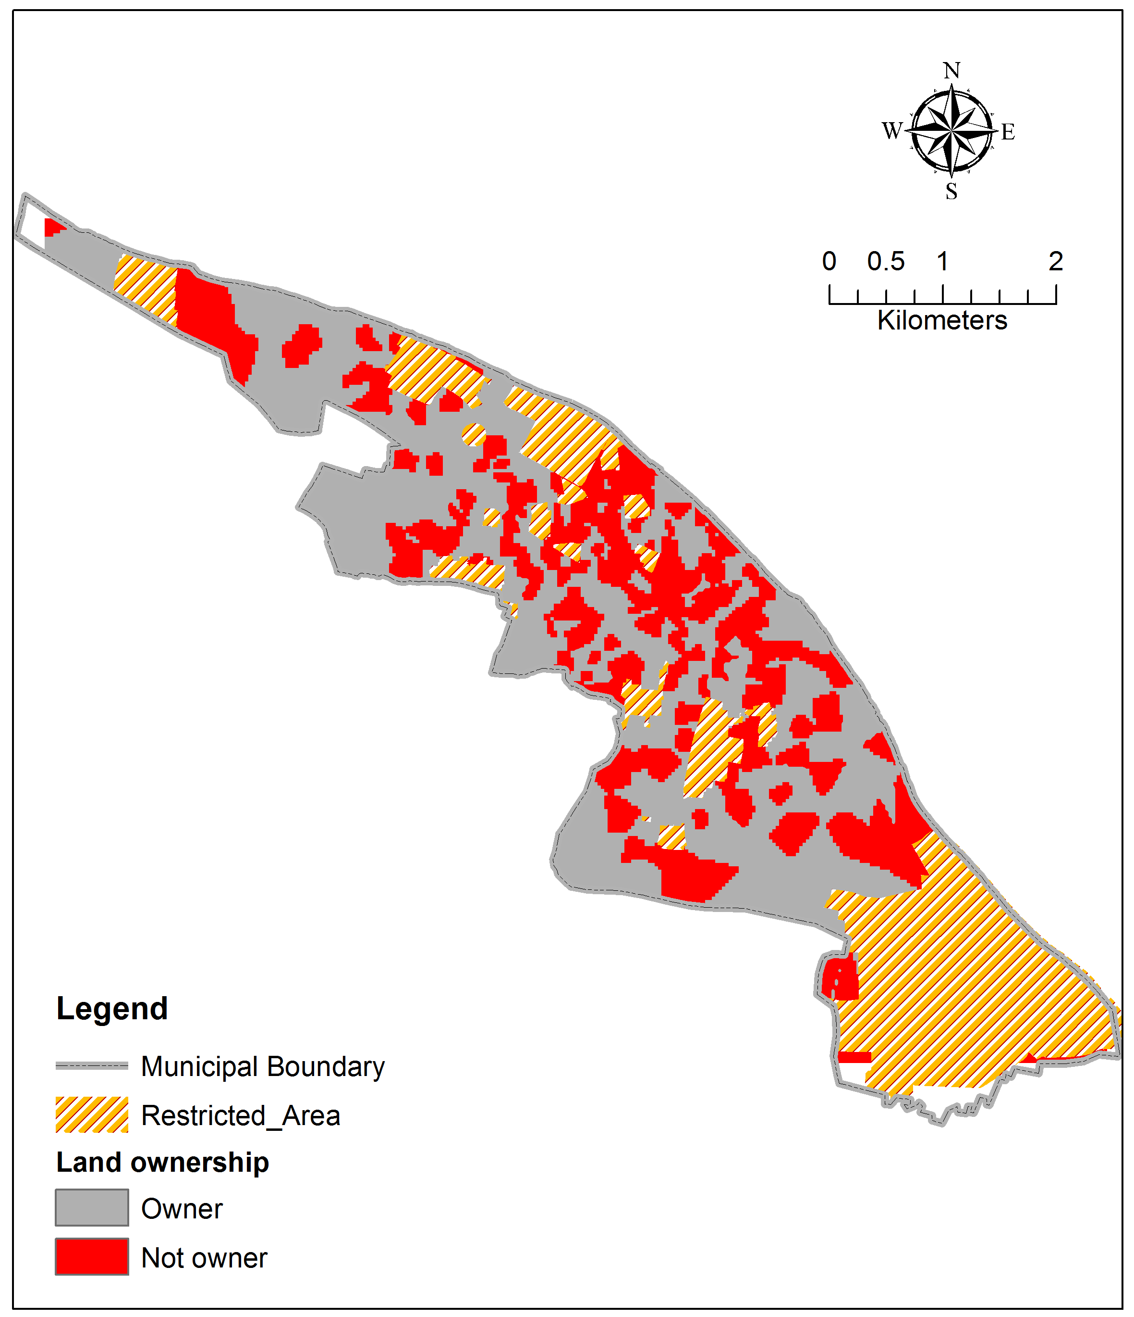
Land/Flat ownership

Slide 15
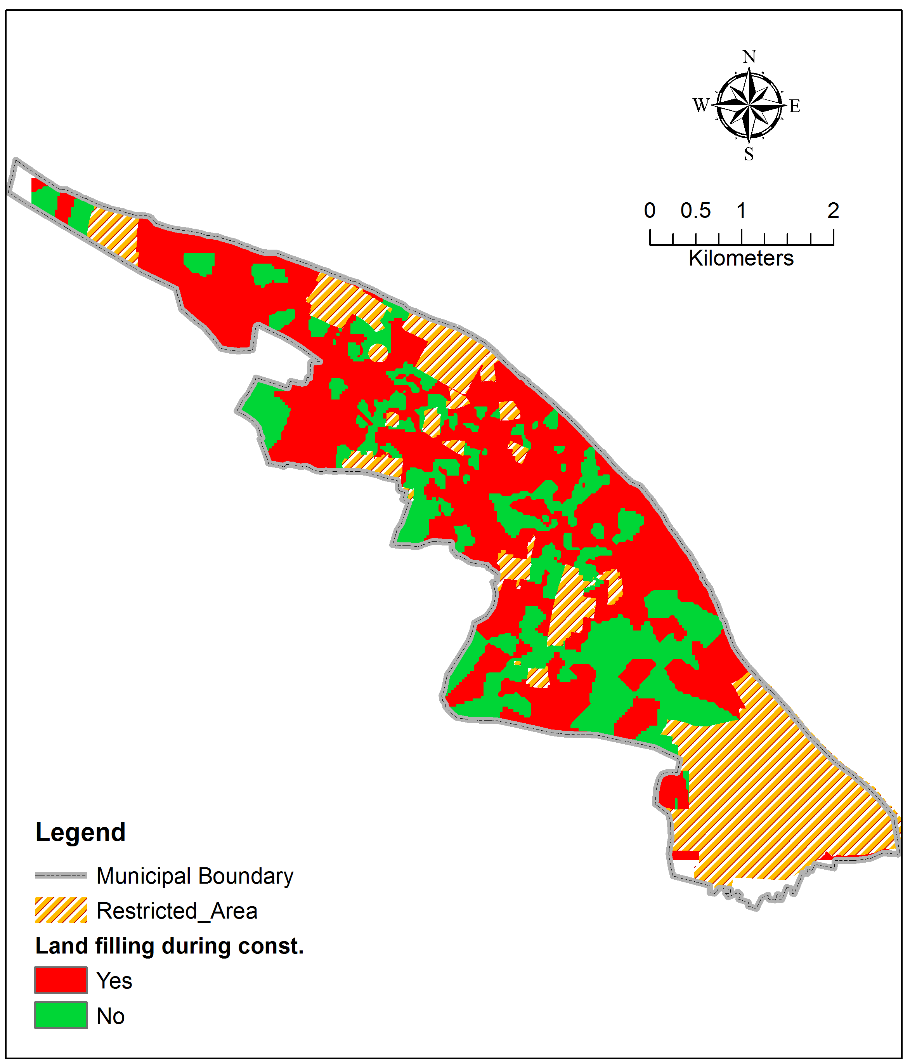
Land filling during construction

Slide 16
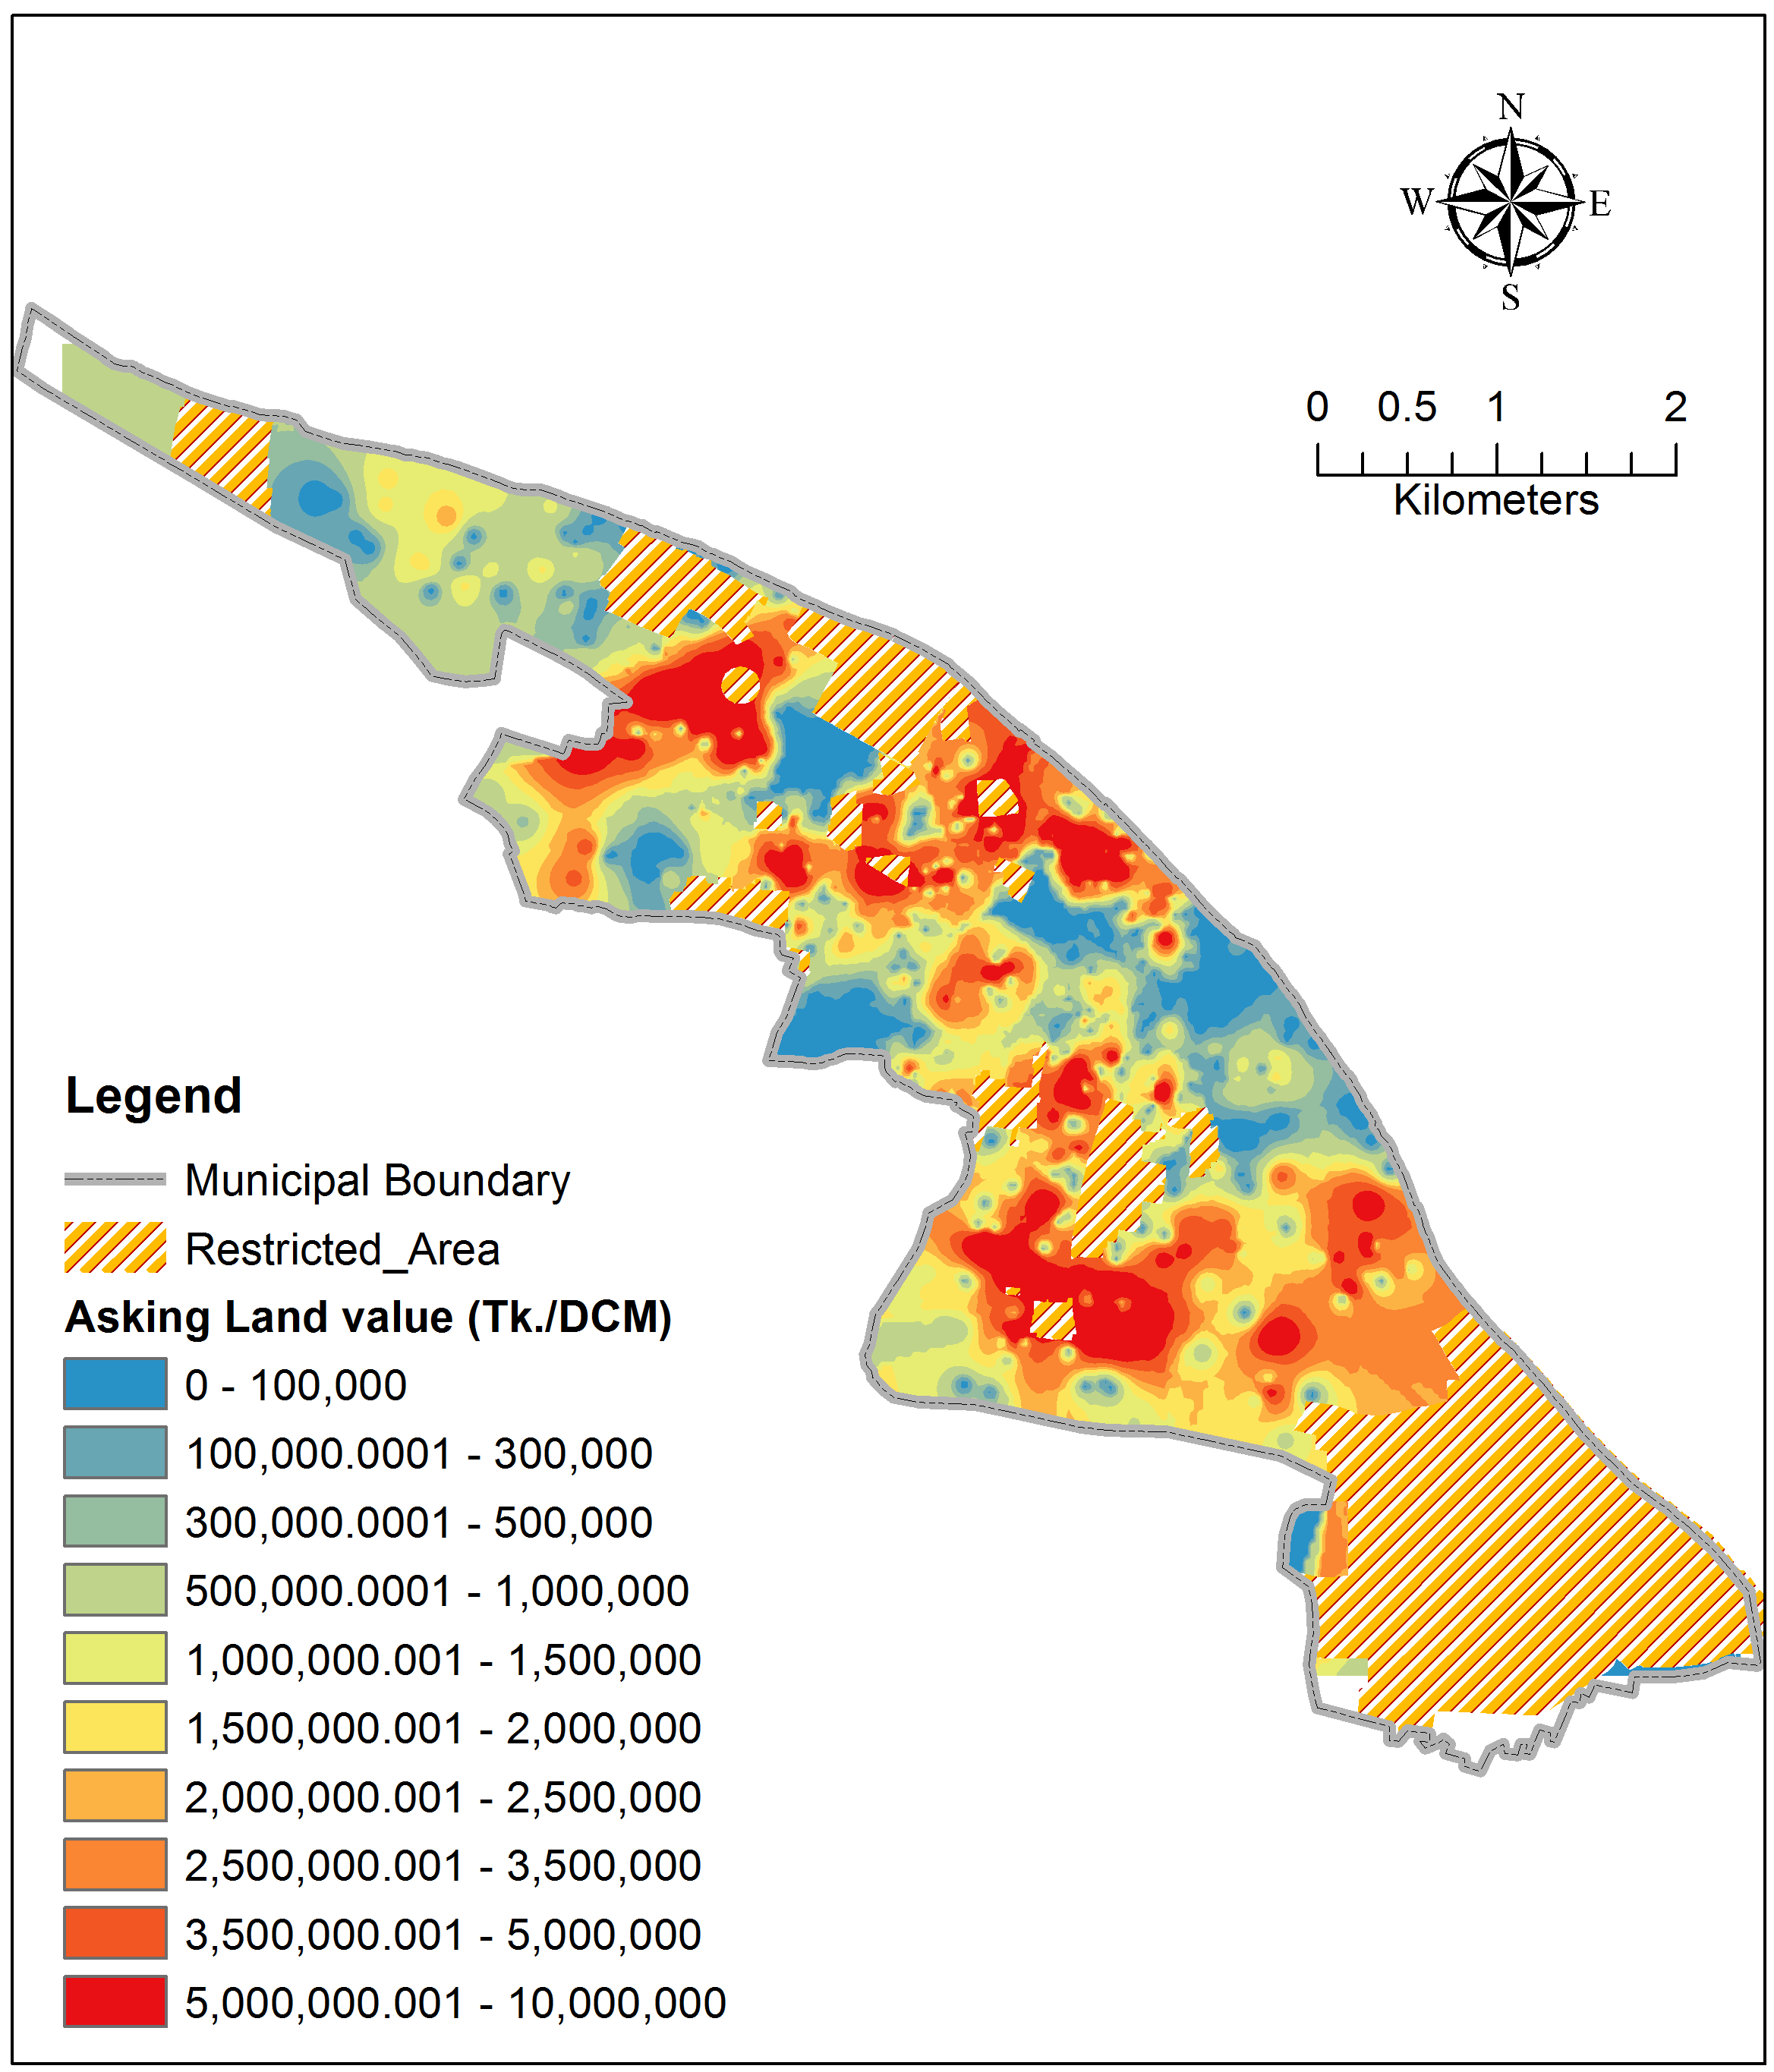
Current asset (land) value
Unexpected scenario at some locations due to less than 50% active responses

Slide 17
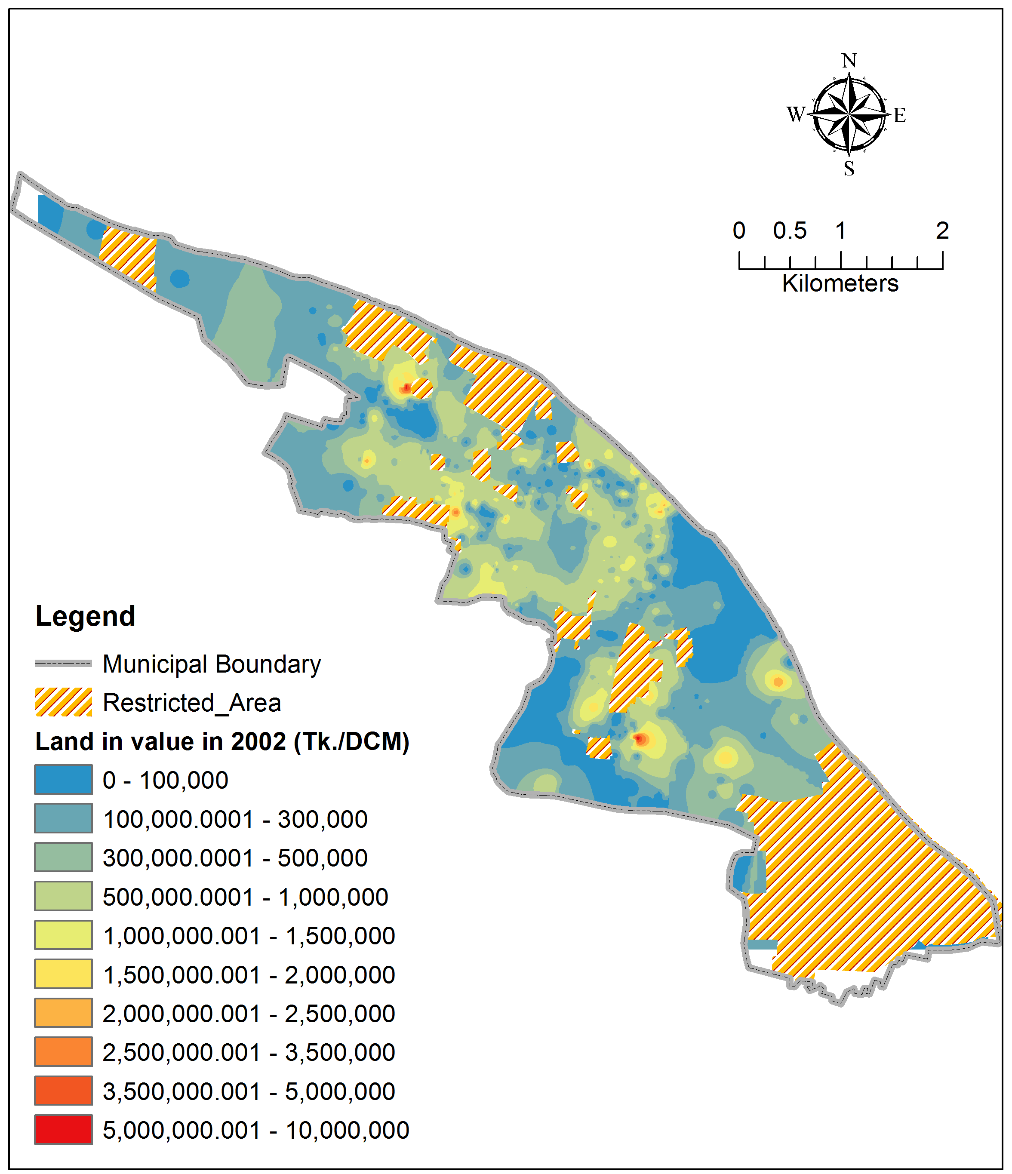
Land value in 2002

Slide 18
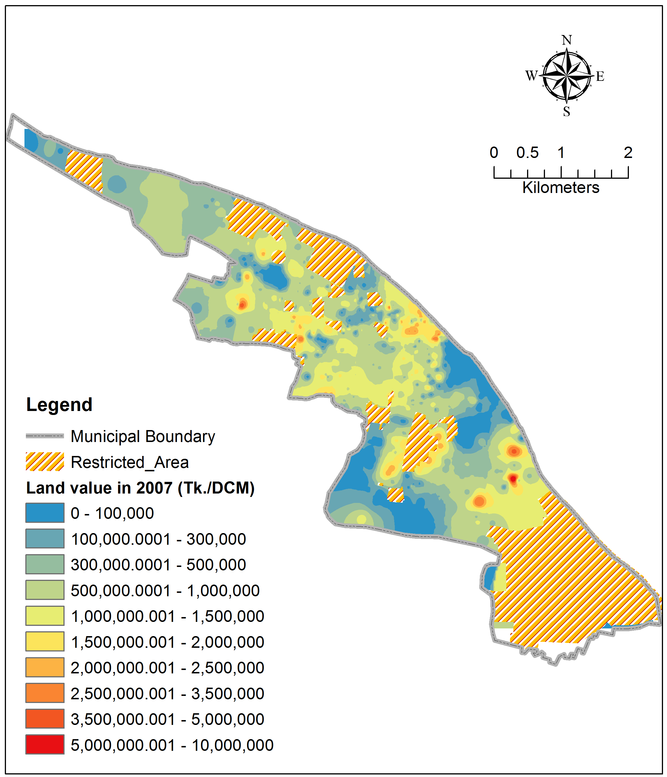
Land value in 2007

Slide 19
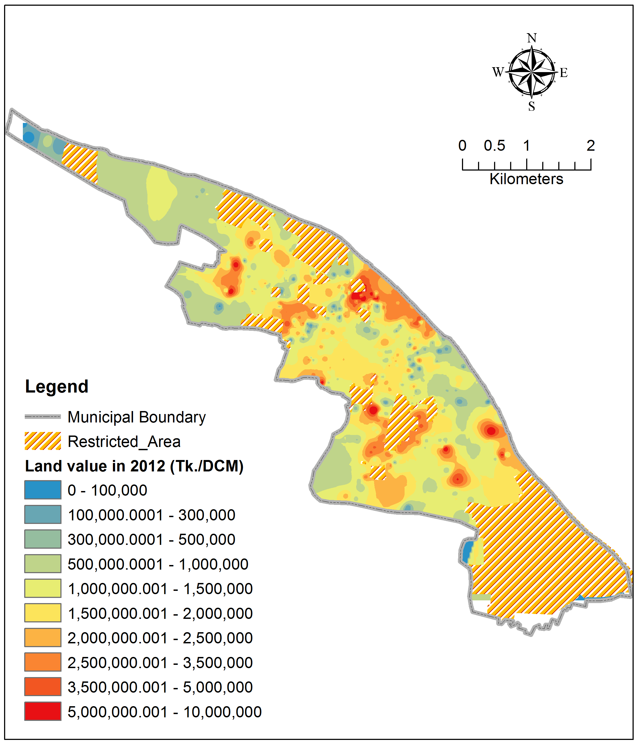
Land value in 2012

Slide 20
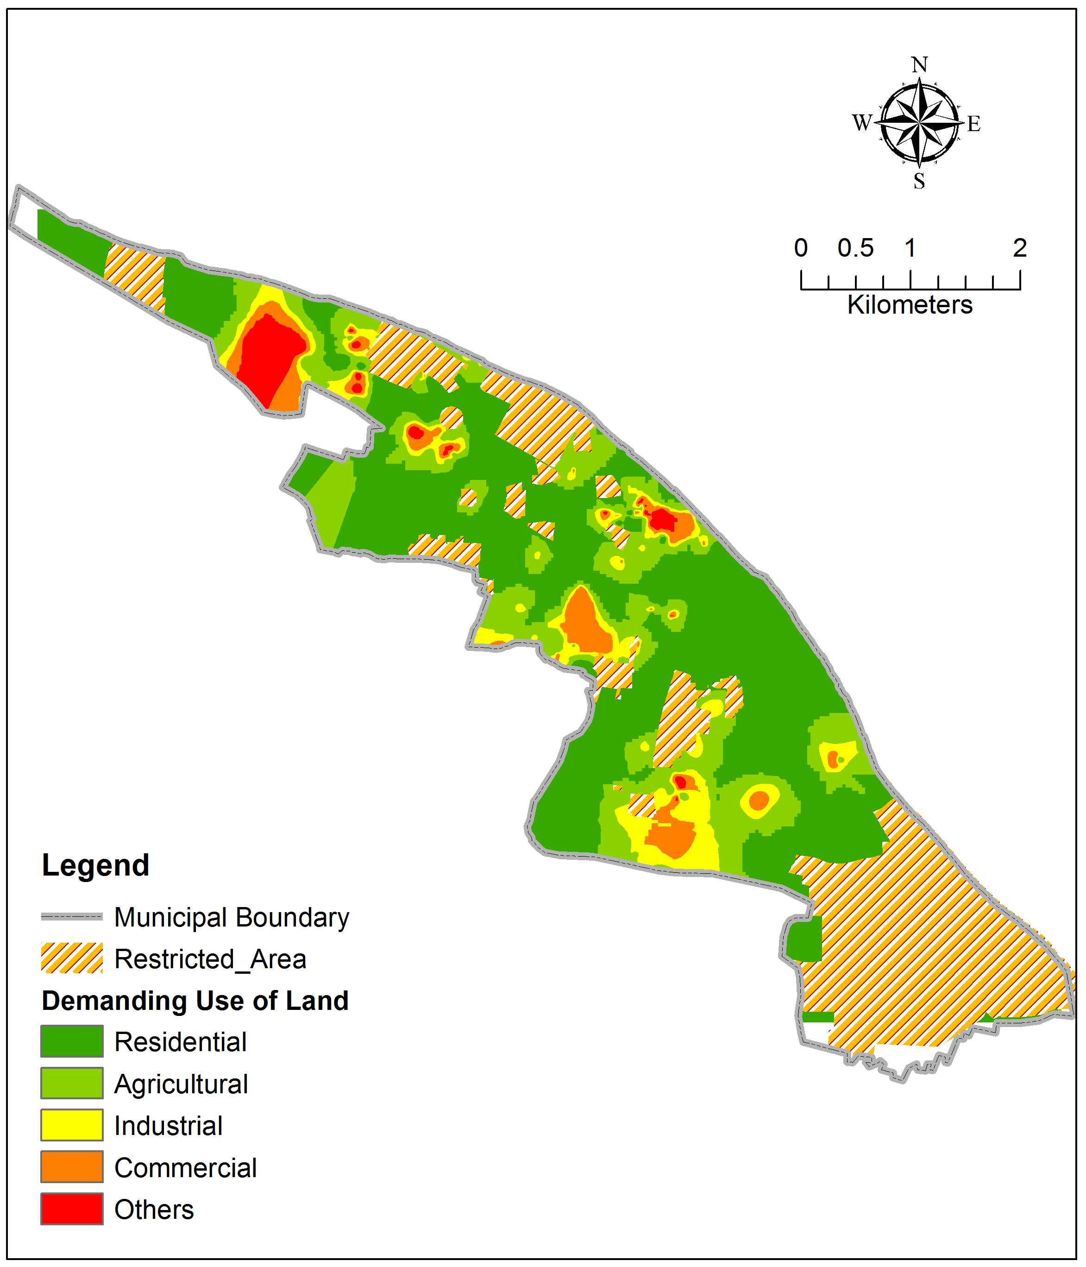
Demanding use of land

Slide 21
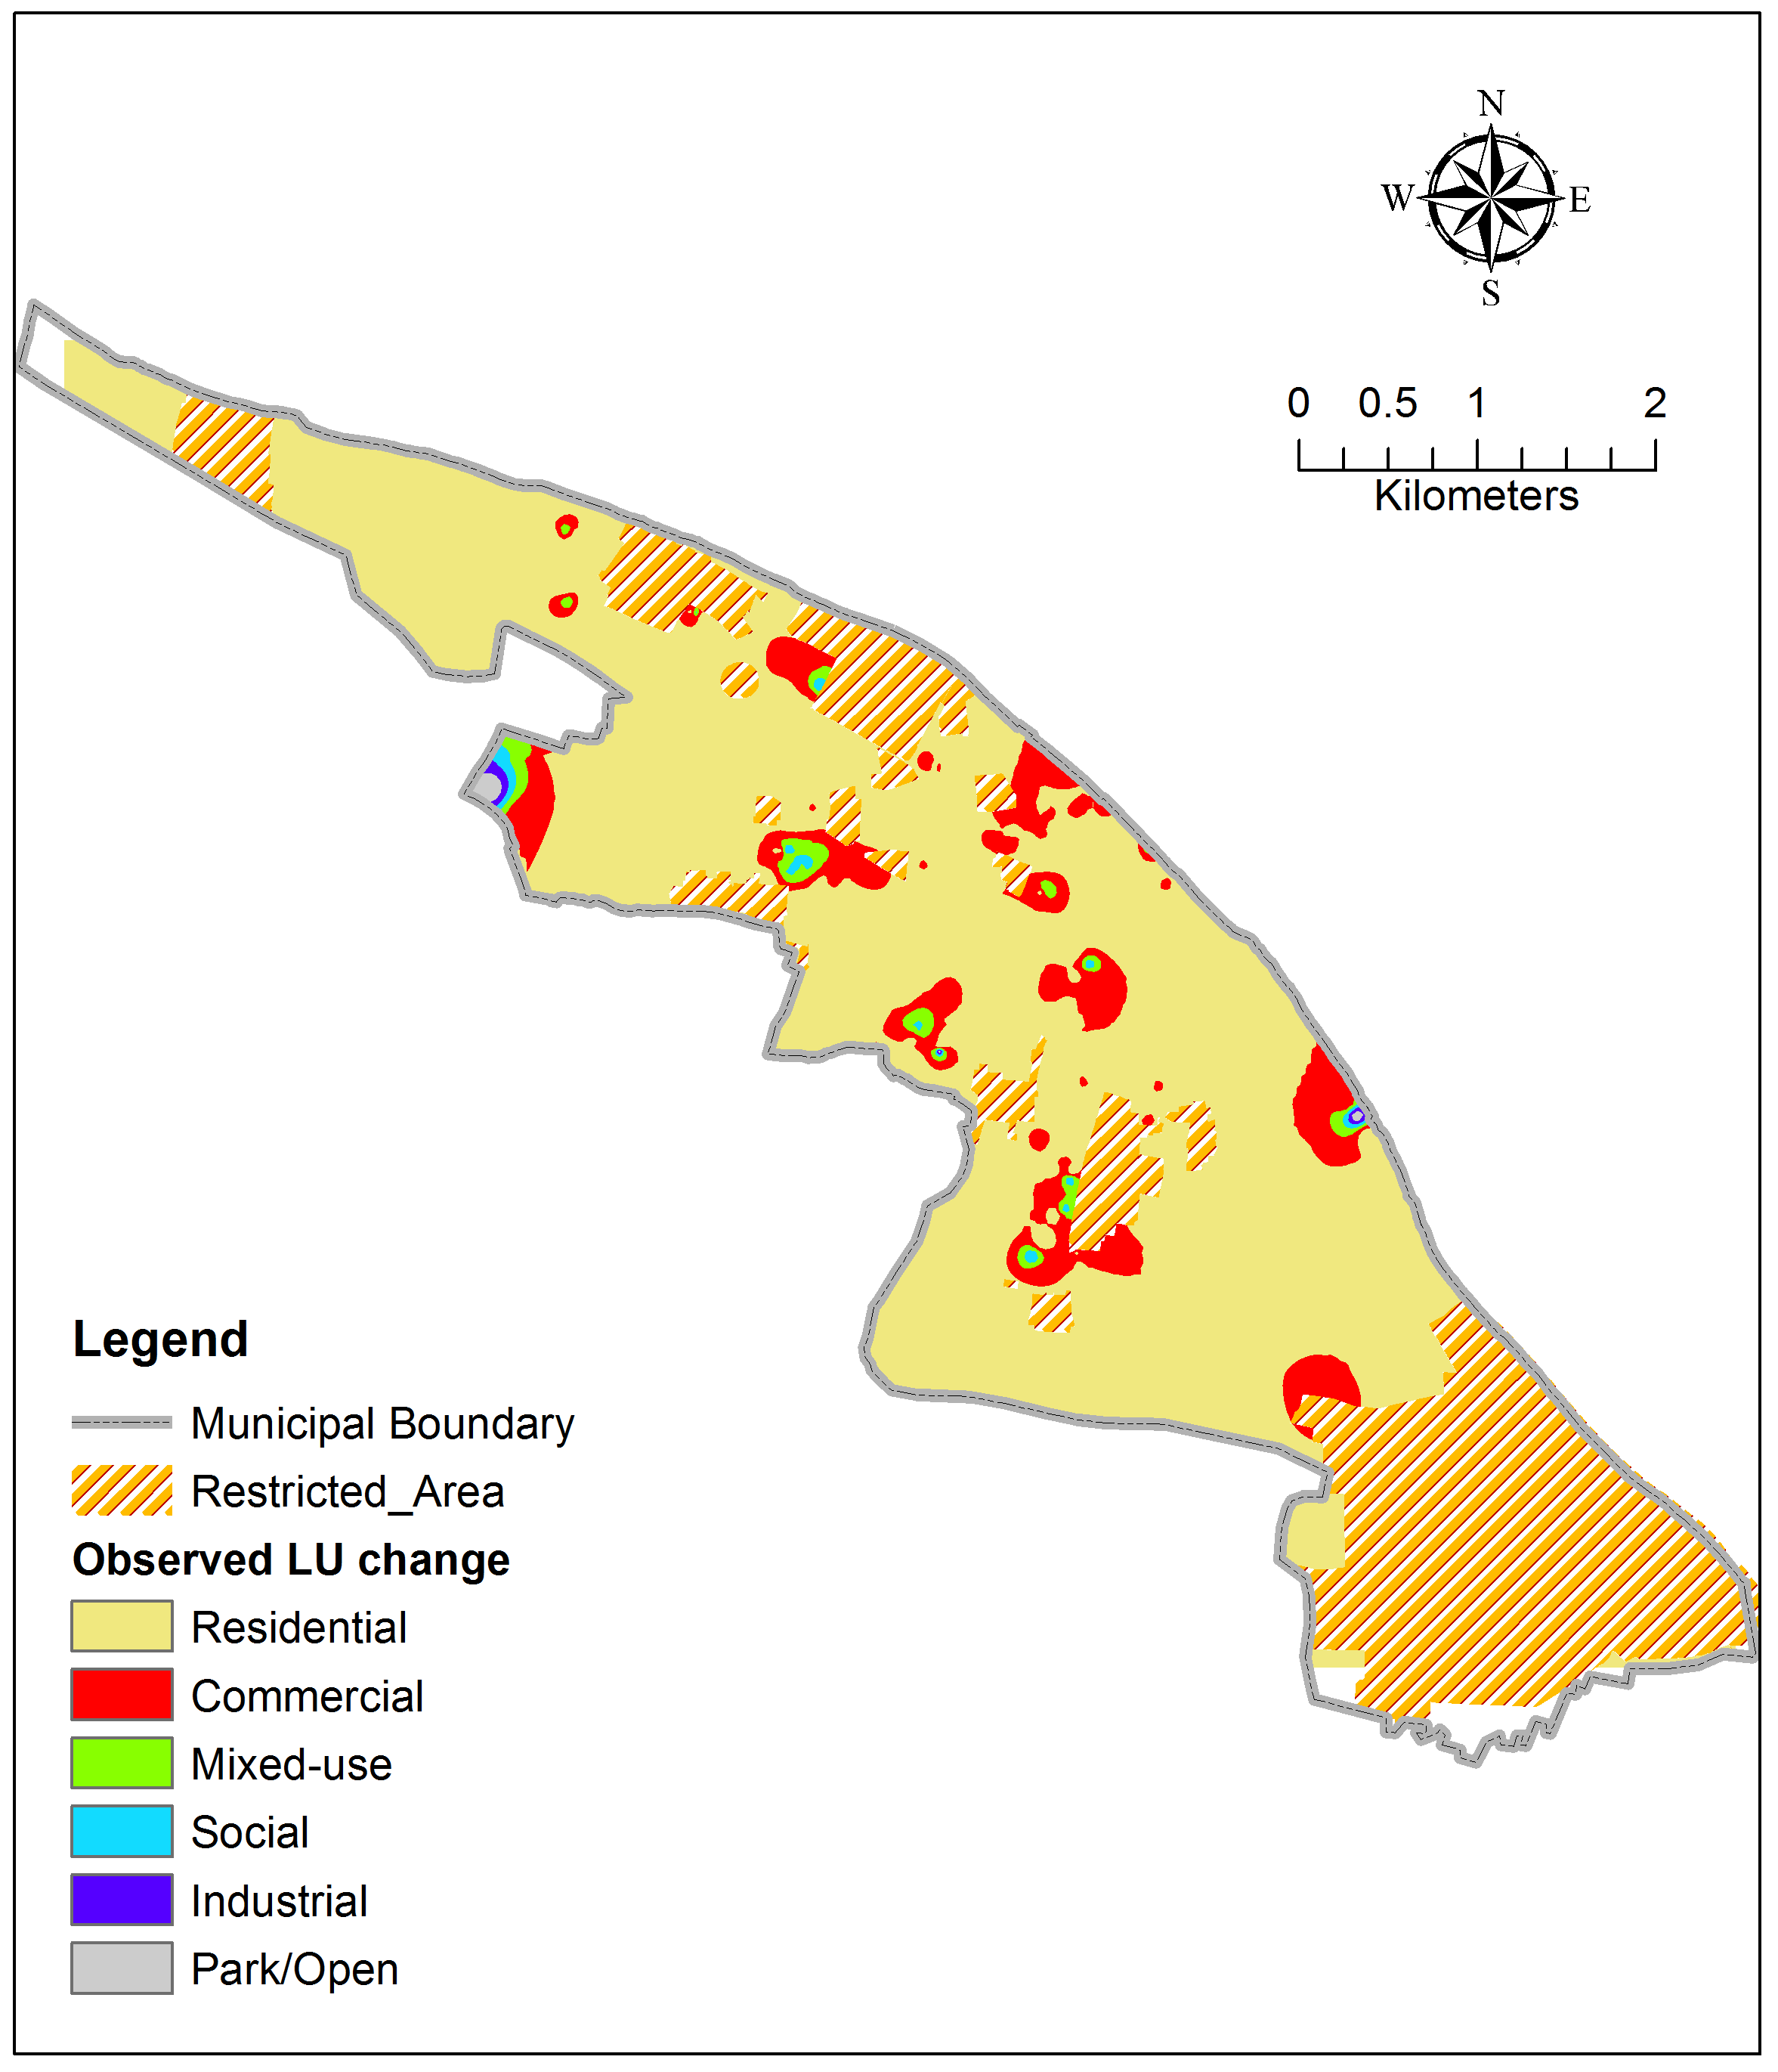
Land-use change in community

Slide 22
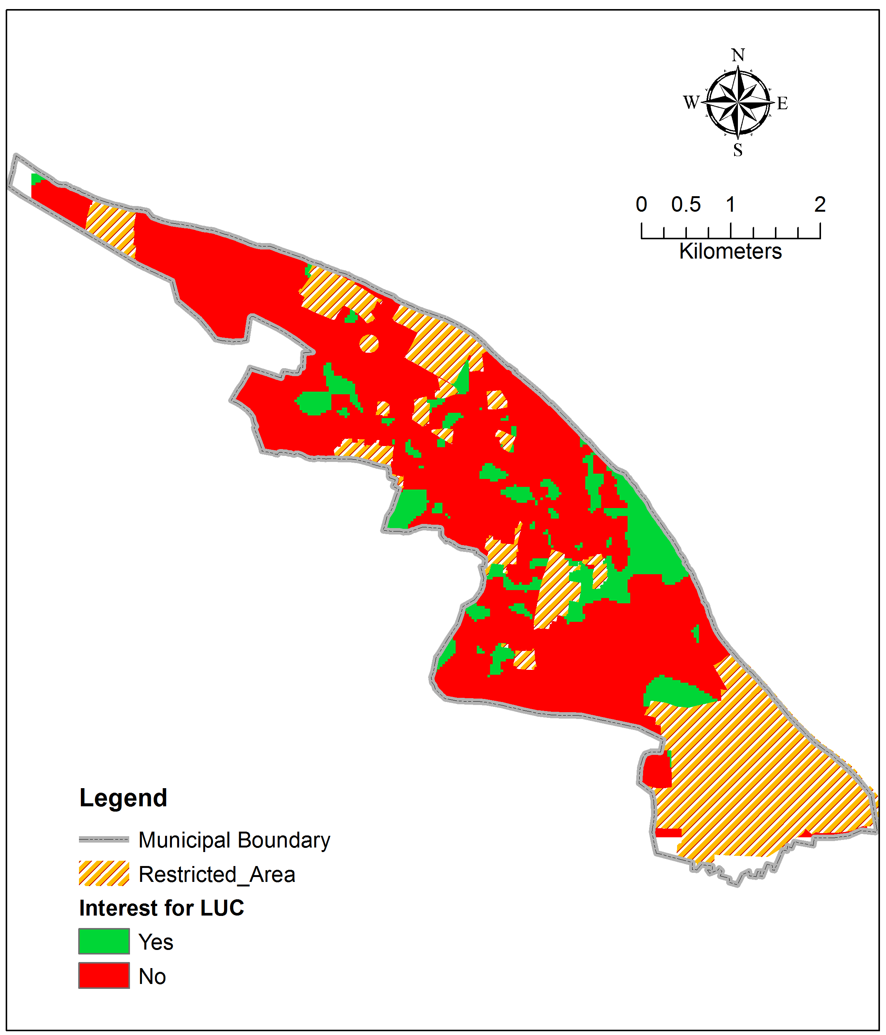
Interest to change current LU

Slide 23
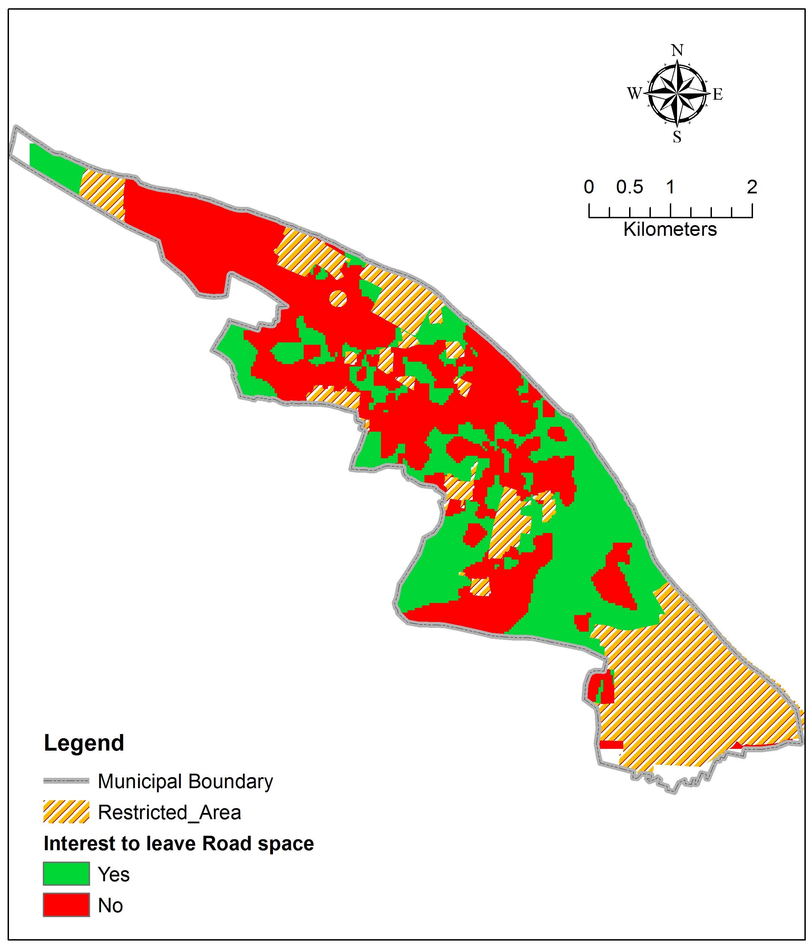
Willingness to offer land for roads

Slide 24

Sickness pattern

Slide 25
Scenario by family type
Spatial Interpretation

Slide 26
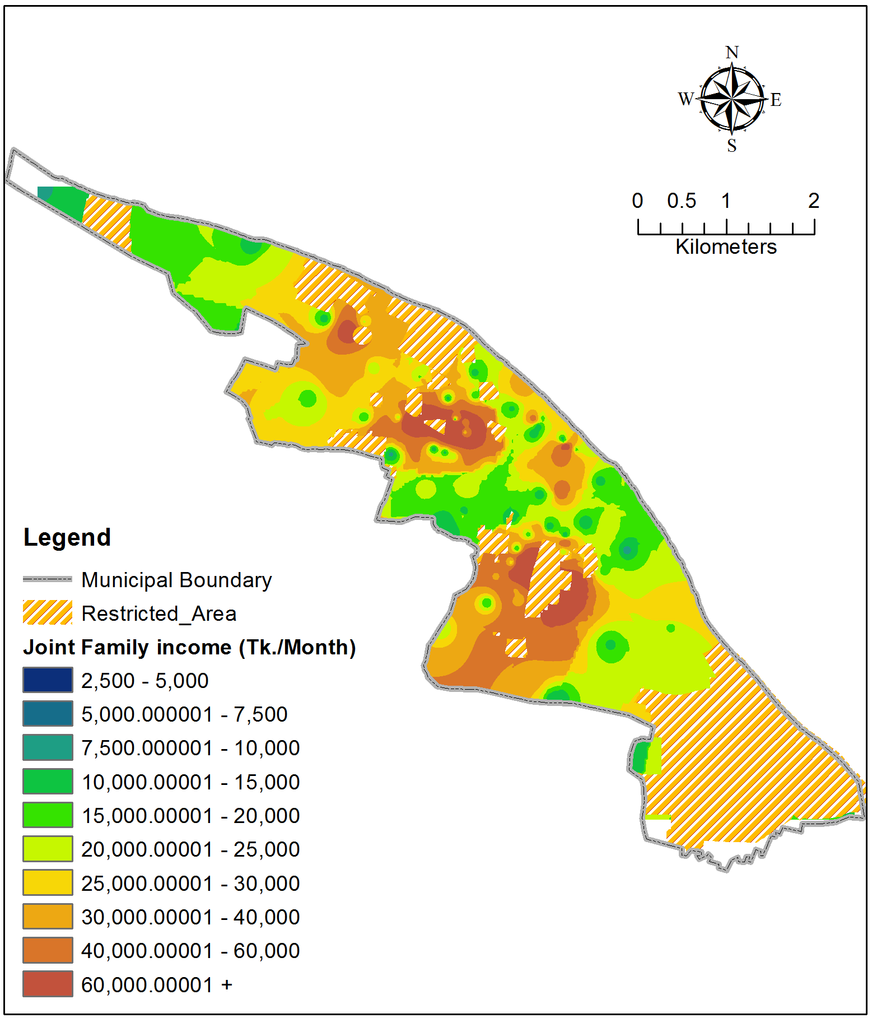
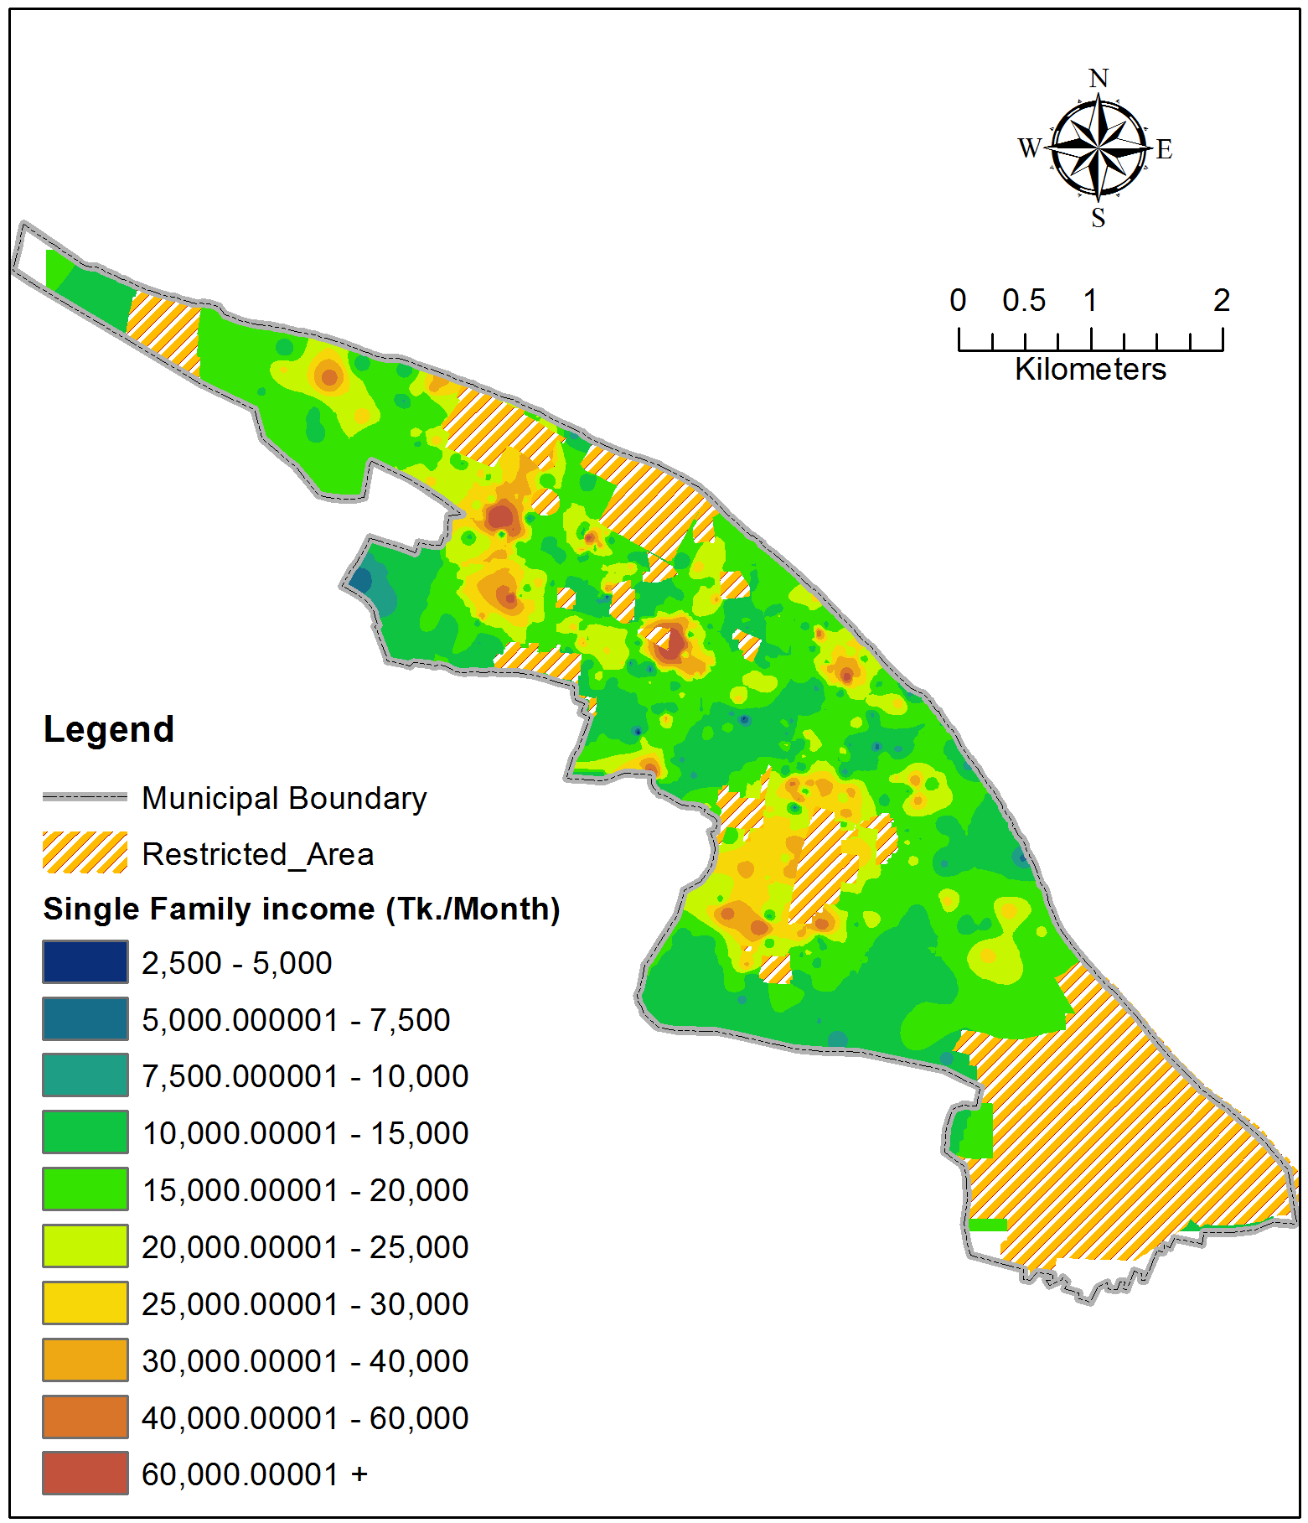
Monthly Income: Joint vs. Single family

Slide 27
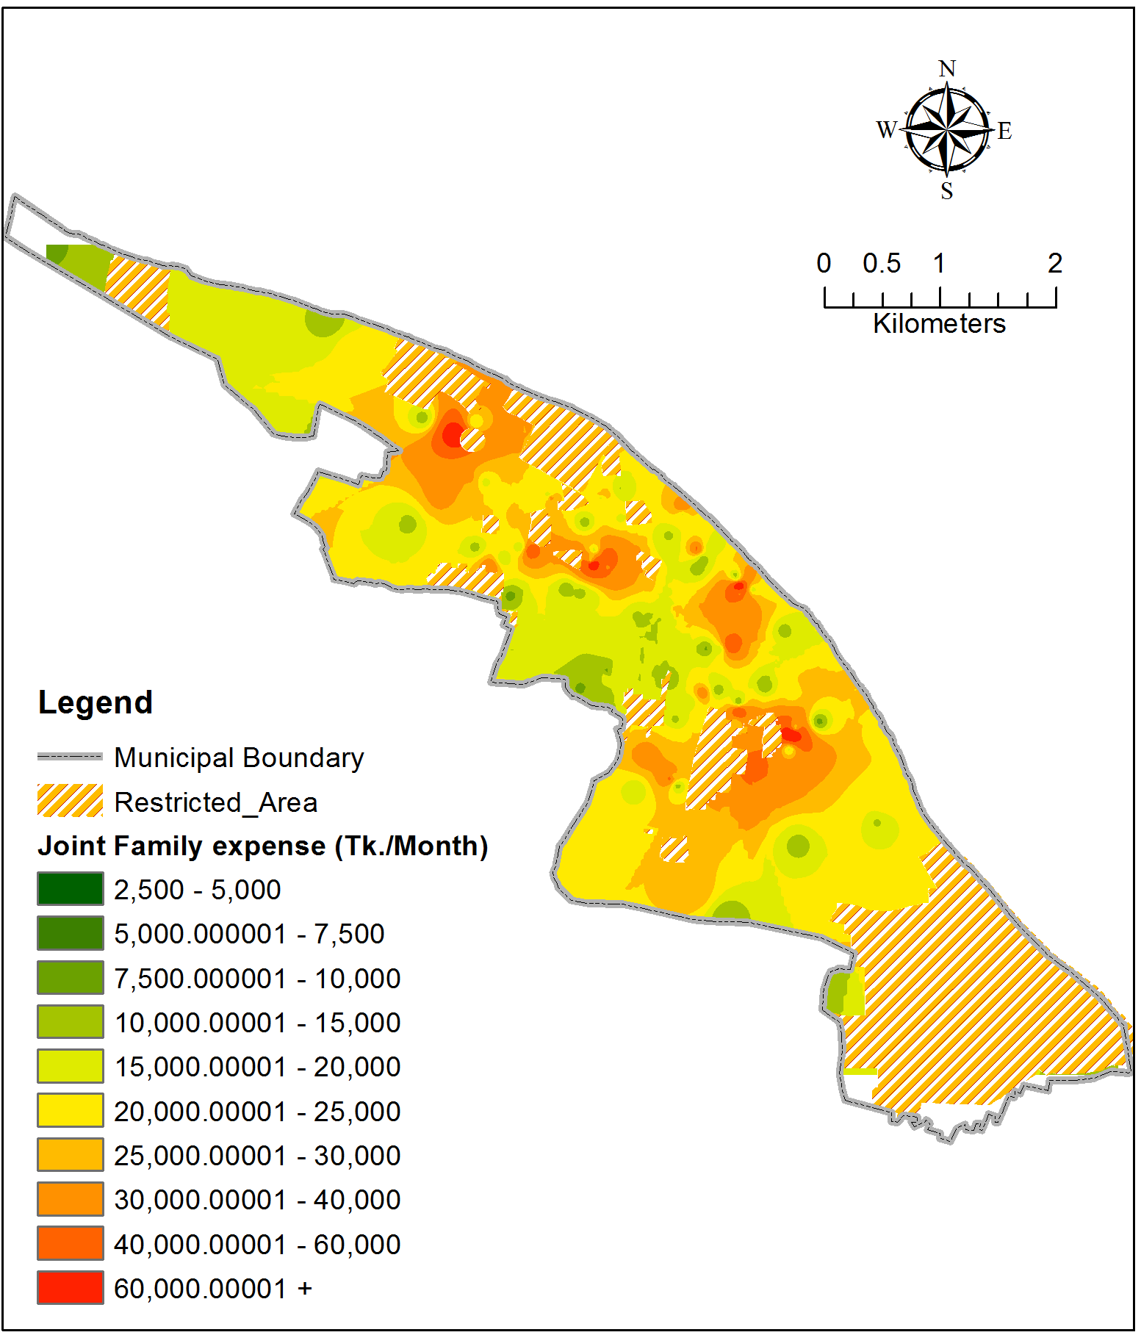
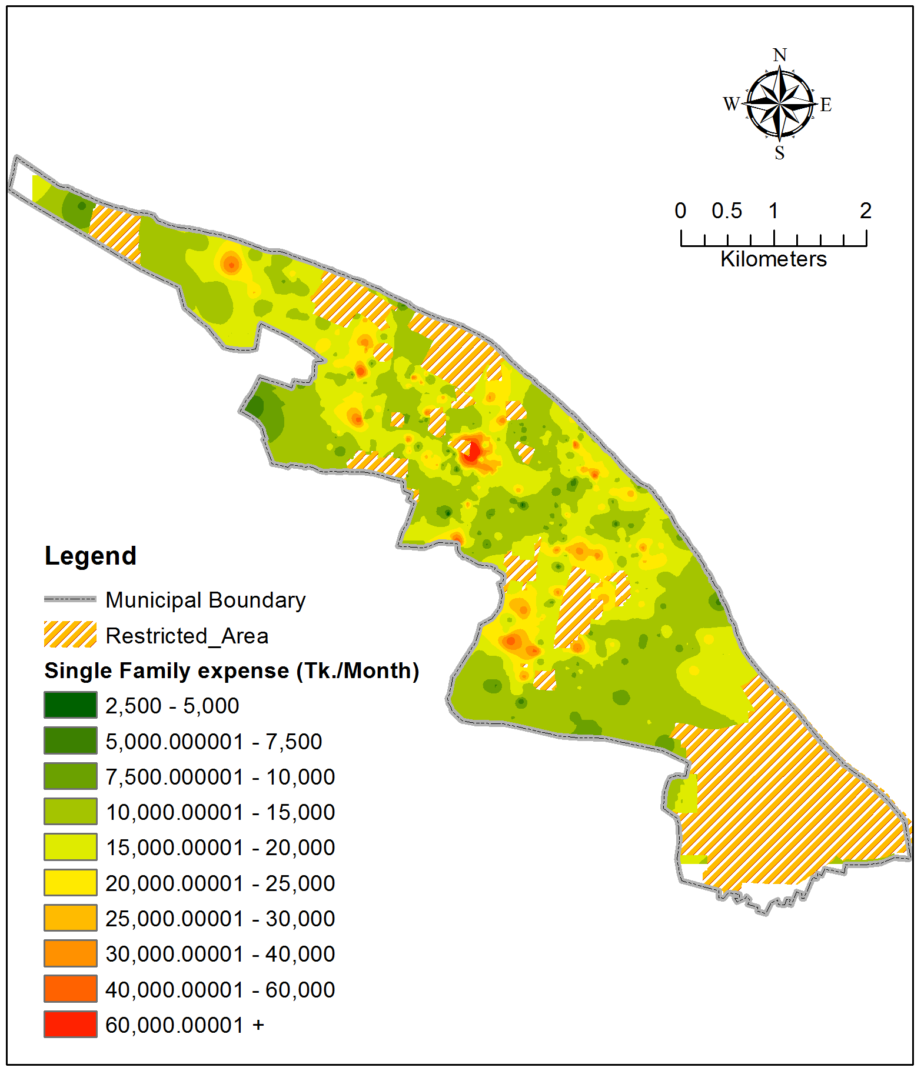
Expenditure: Joint vs. Single family

Slide 28
Scenario by settlement type
Spatial Interpretation

Slide 29
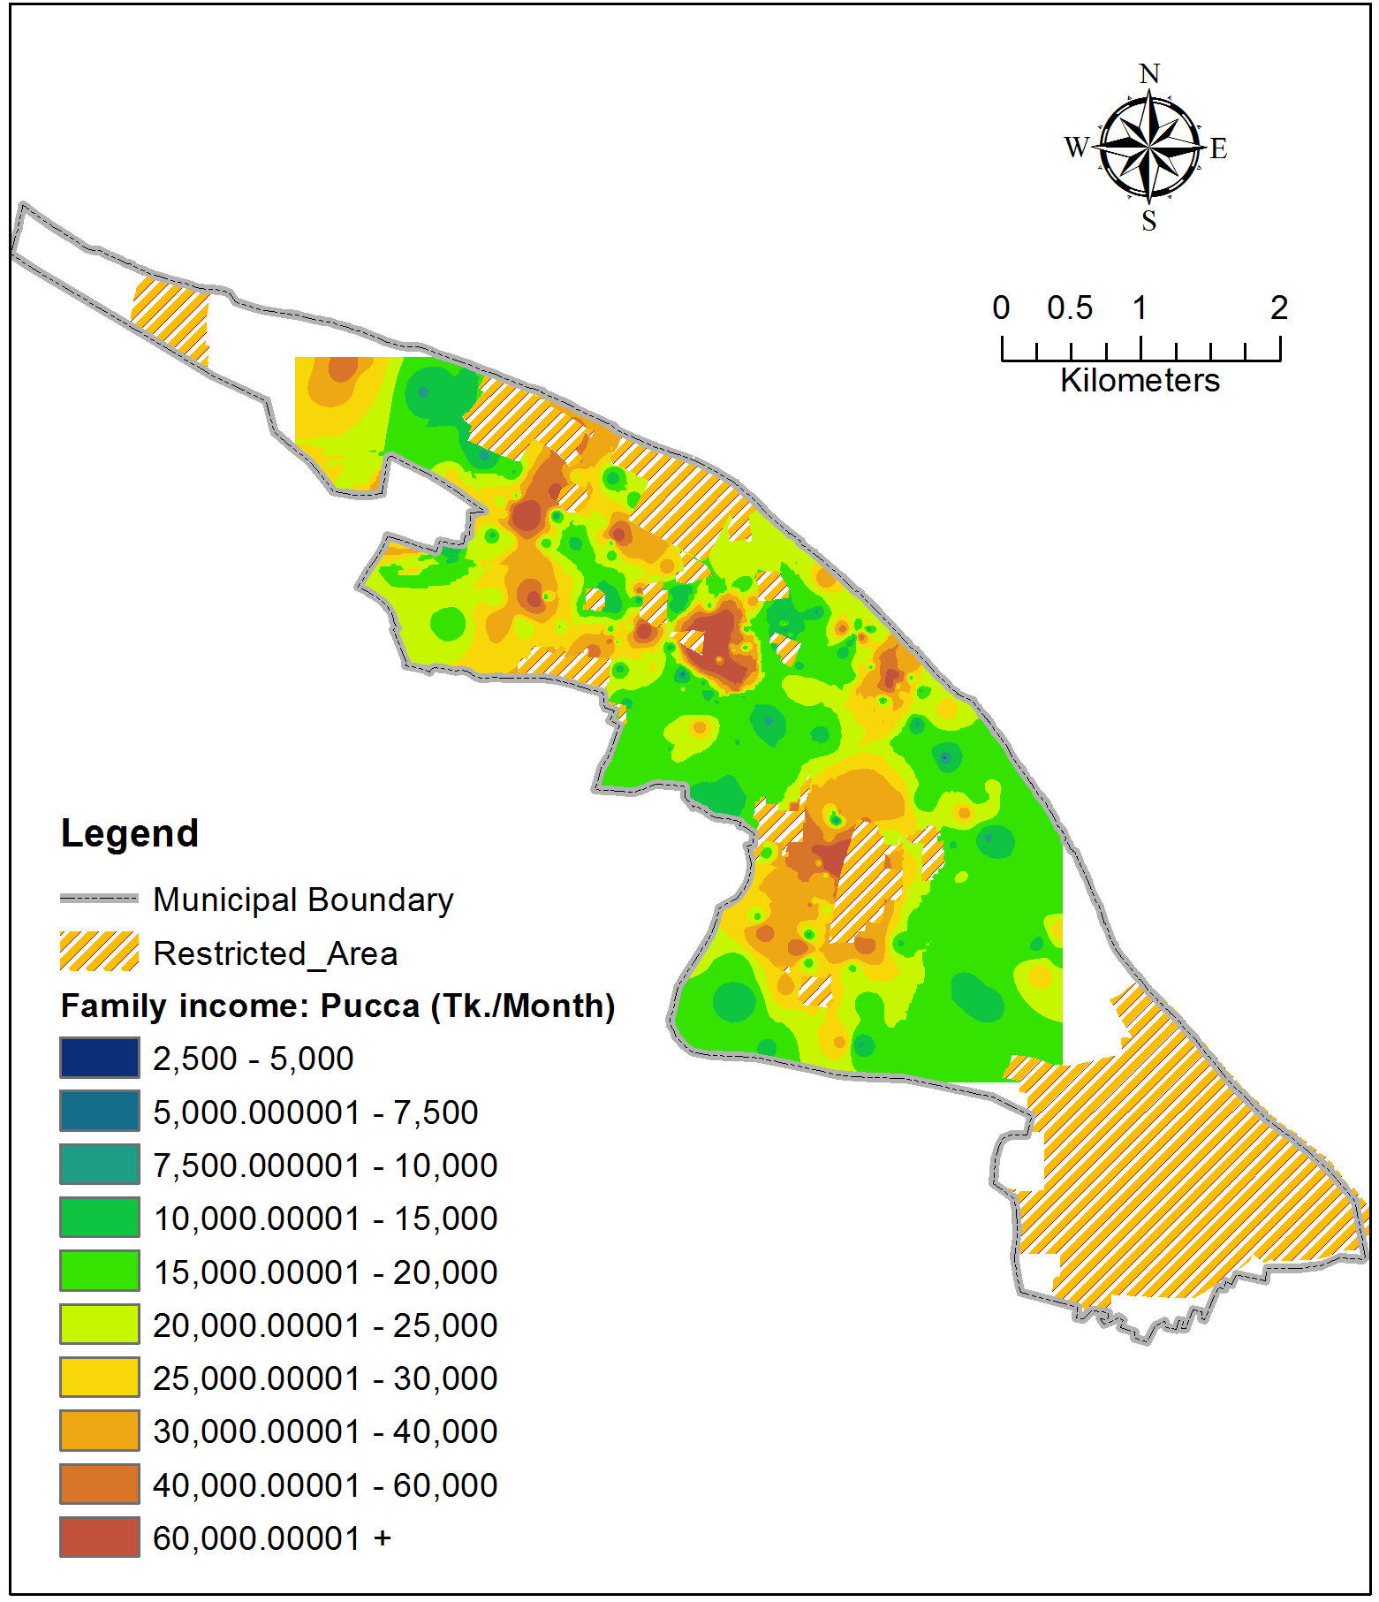
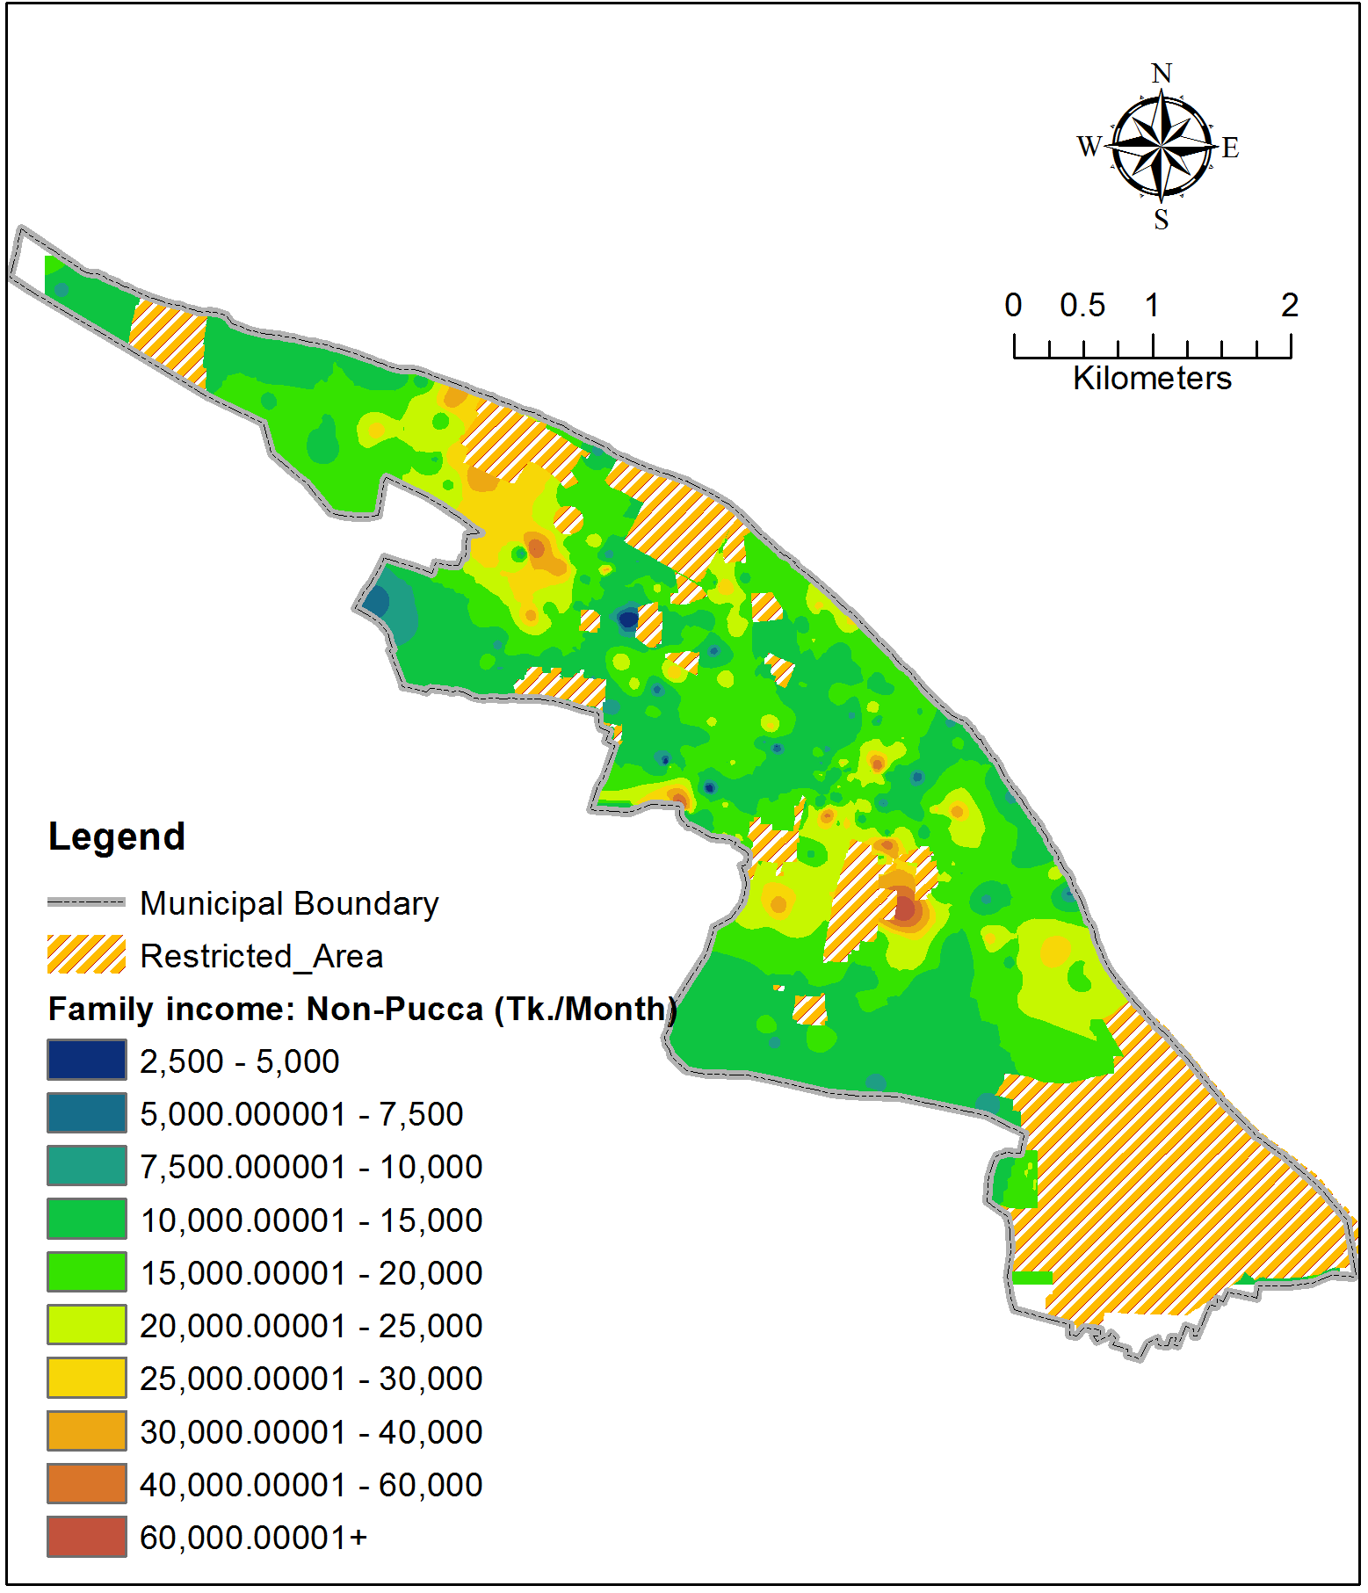
Family Income: Pucca vs. Other types

Slide 30
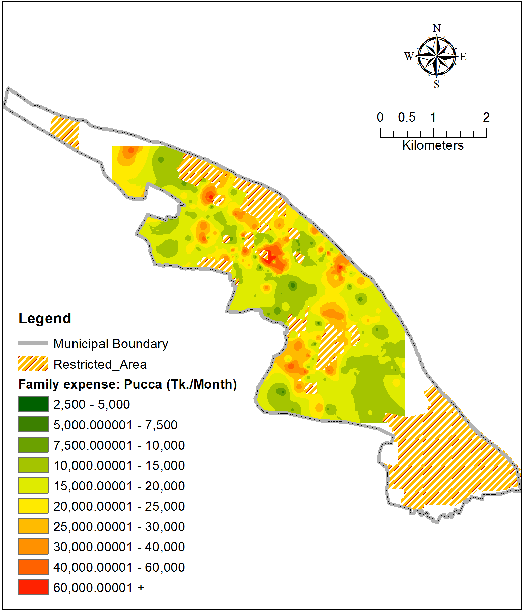
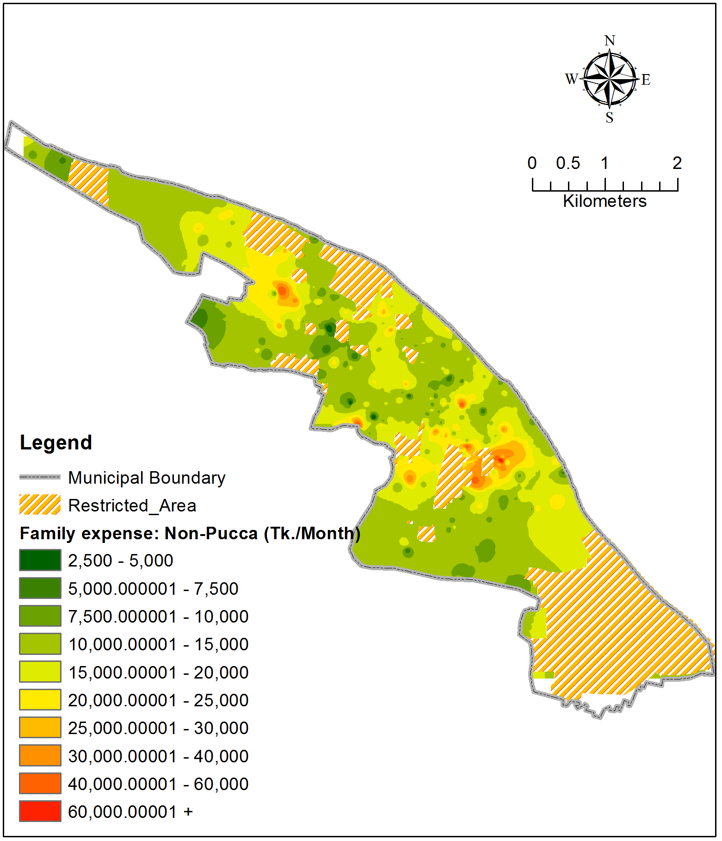
Family expense: Pucca vs. other types

Slide 31
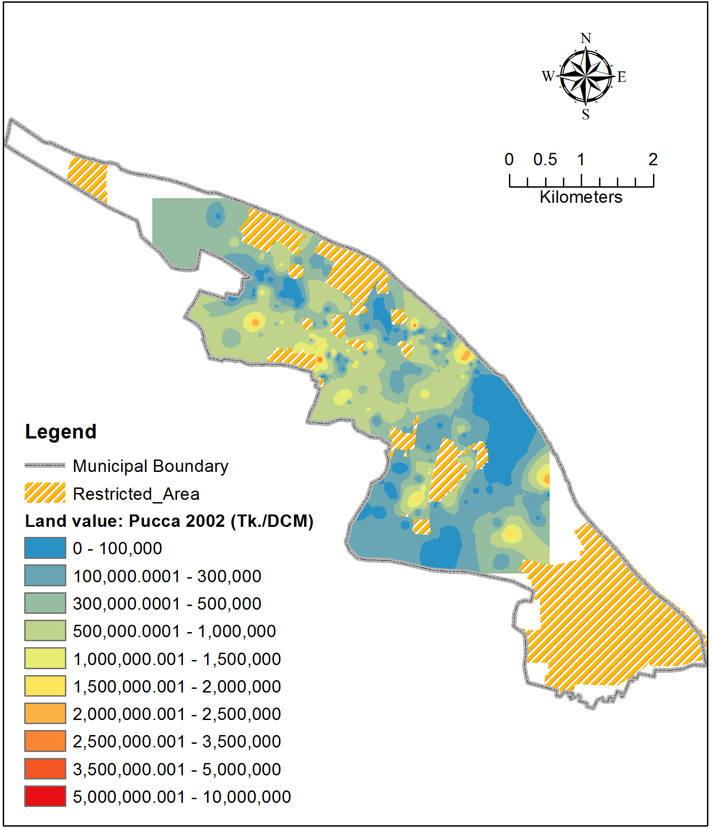
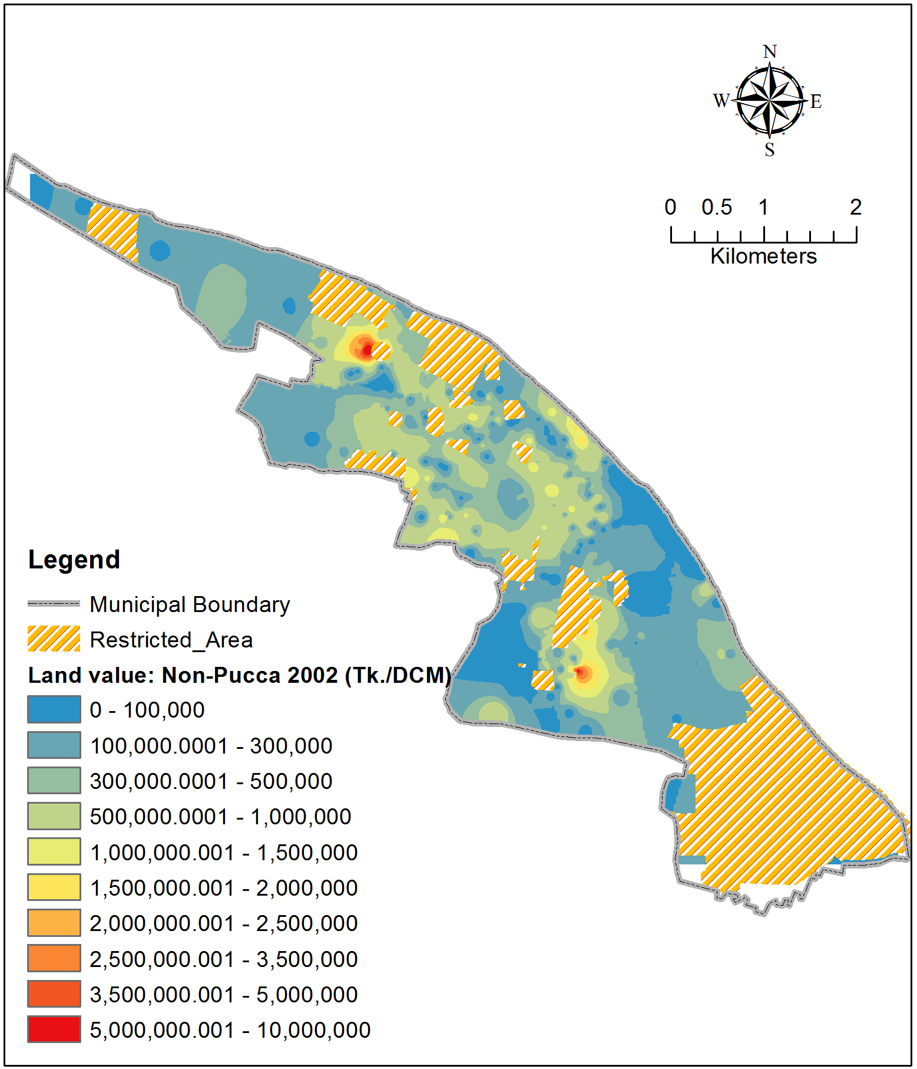
Land value in 2002: Pucca vs. other types

Slide 32
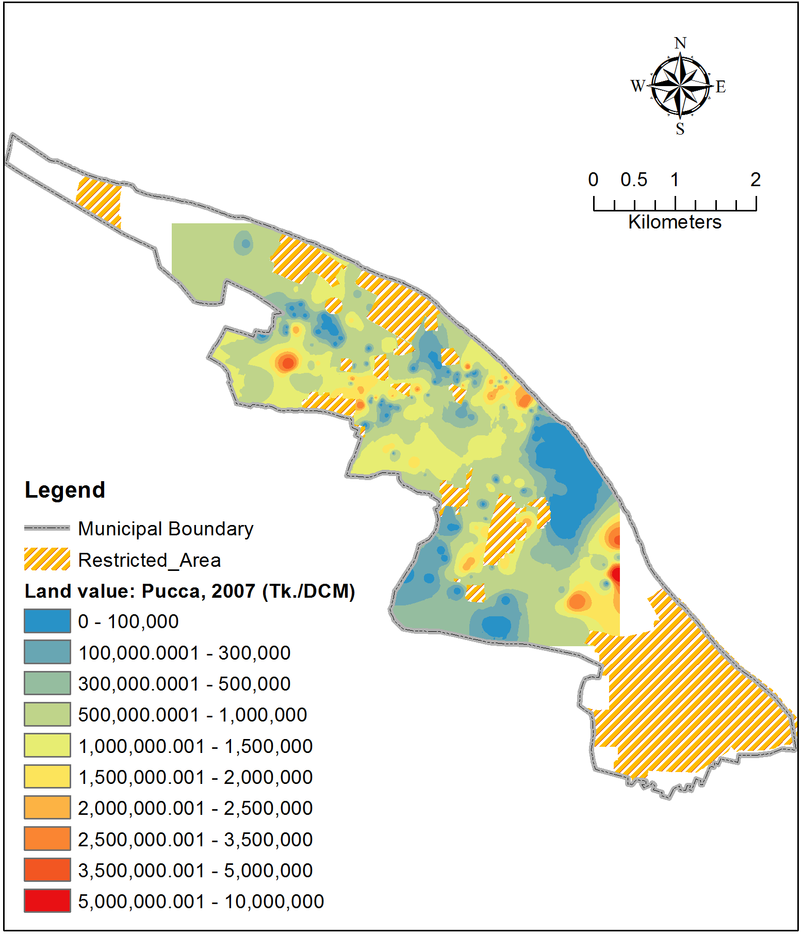
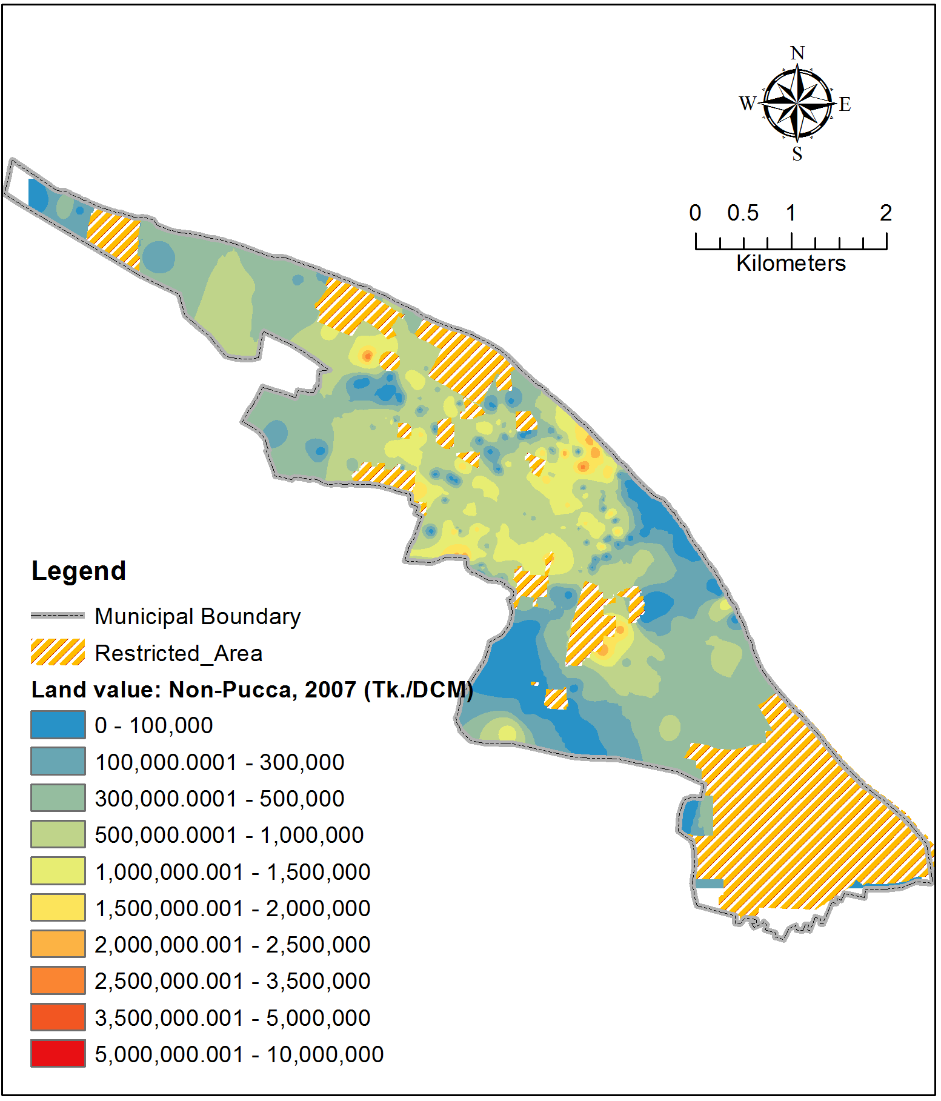
Land value in 2007: Pucca vs. other types

Slide 33
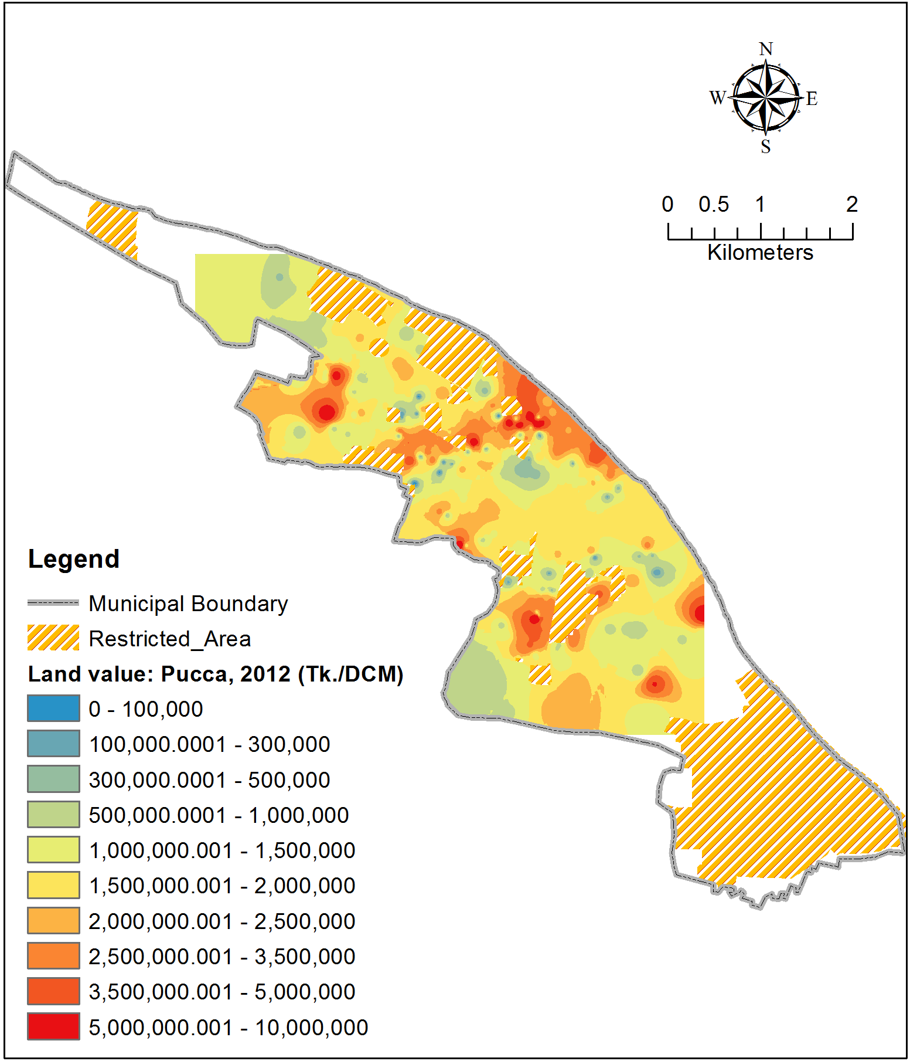
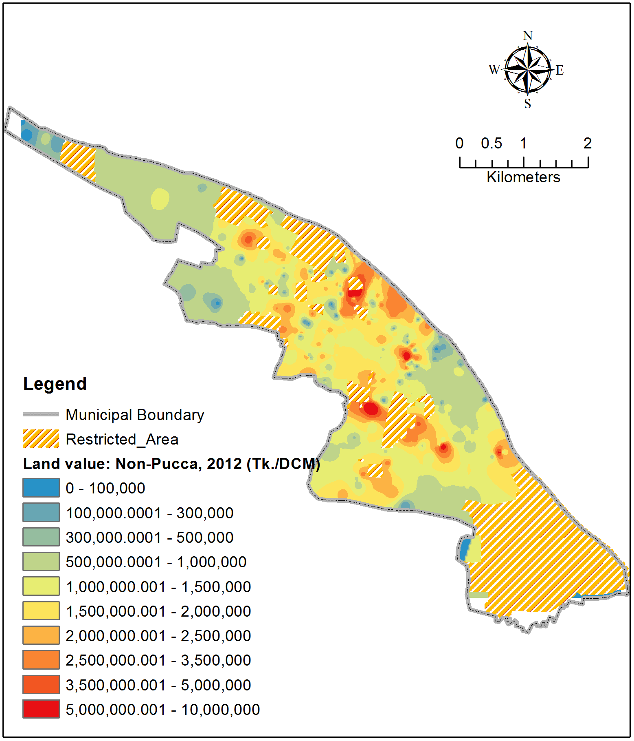
Land value in 2012: Pucca vs. other types

Slide 34
Remarks
Contribution of spatial interpretation in MSDP via knowing:
  Spatial pattern and extent of:
    Income
    Expenditure
    Land value
    Land-use change, etc.
  Comparative pattern between:
    Different family types
    HH living in Pucca & Other types of houses

Slide 35
THANK YOU ALL FOR YOUR KIND ATTENTION

