Slide 1
MSDP, 2011-2031 Project
SURVEY WORK steps:
Data Base.
Mapping.
Analyses.
On Table Discursion and
Other etc.

Slide 2
MSDP, 2011-2031 Project Survey work Mythology
Collation of Image.
Collation of Reference Point SOB, B M Pillar xyz value.
Recognize Survey.
RTK/DGPS Machine use TBM Point of the Project area.
Geo-Referancing.
Digitalization.
Checking & Editing.
Gerund Shutting Survey.
Checking & Editing.
Final layout and Printing.
Total Station Using for Road Networking.
Checking Data Up-gradating & Editing.
Final layout and Printing.

Slide 3
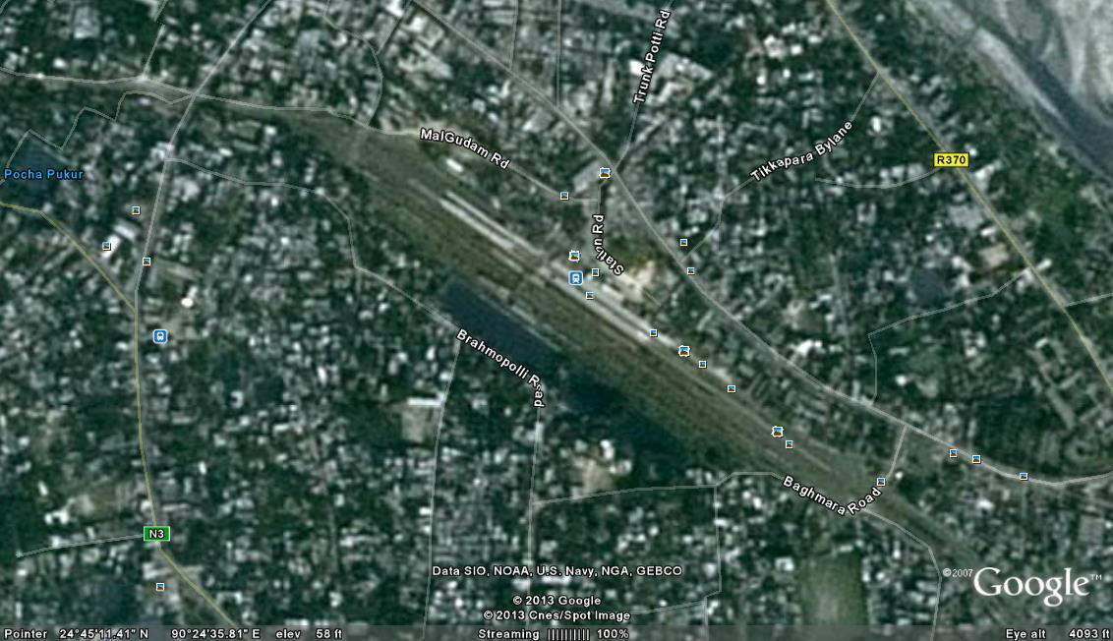
Collection of Image

Slide 4
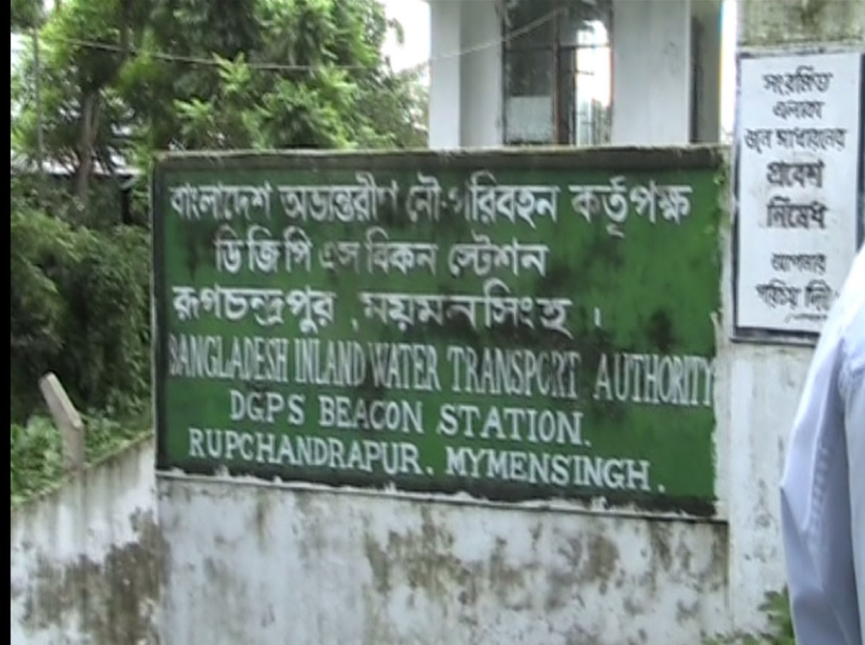
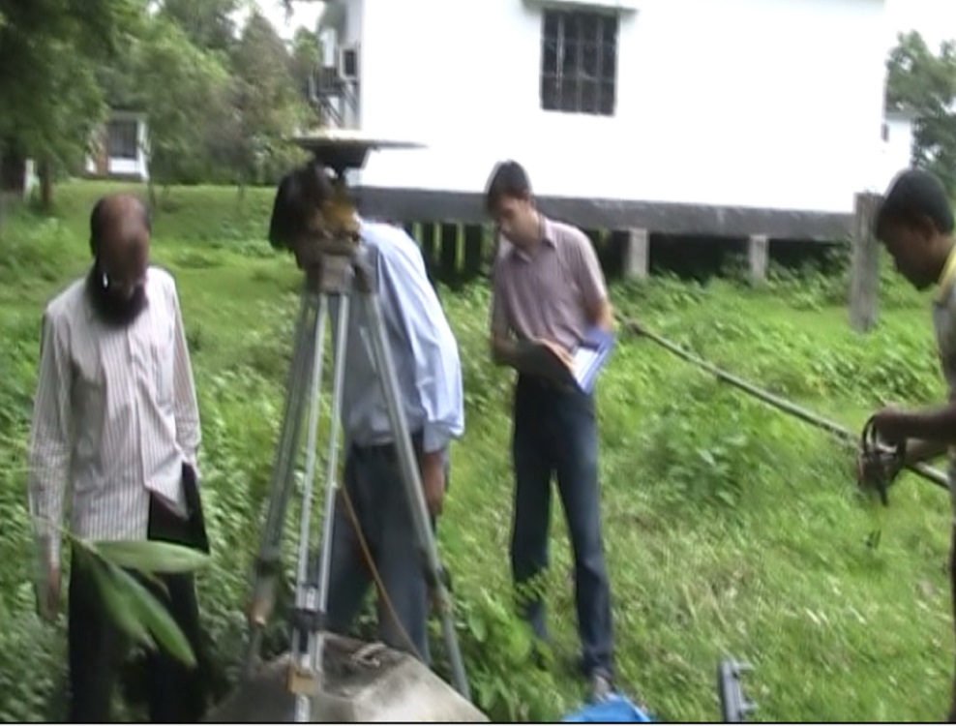
Geo-Referencing Point(xyz)
Rupchadpur DGPS Station
In Side of DGPS Station.

Slide 5

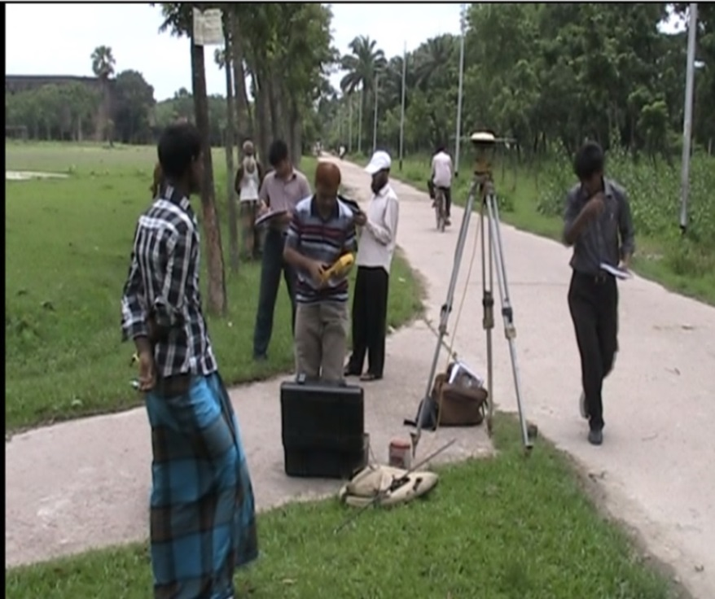
RTK Geo- Referencing Image

Slide 6

RTK Machine Setting & Point

Slide 7
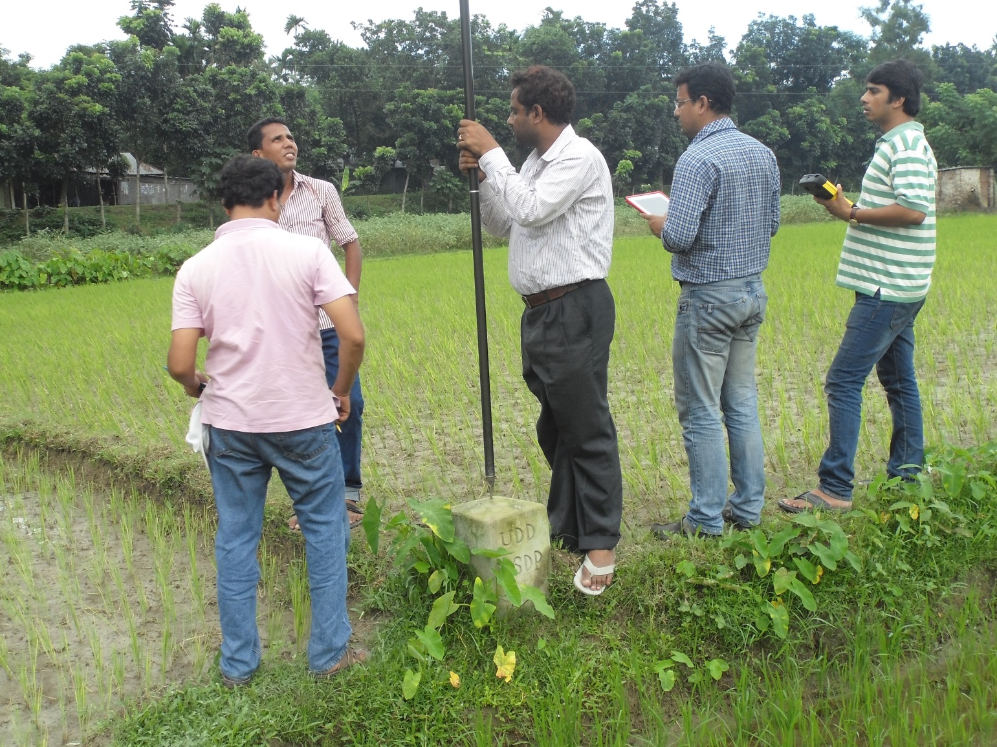
Filed Survey of BM Pillar & Mouza

Slide 8
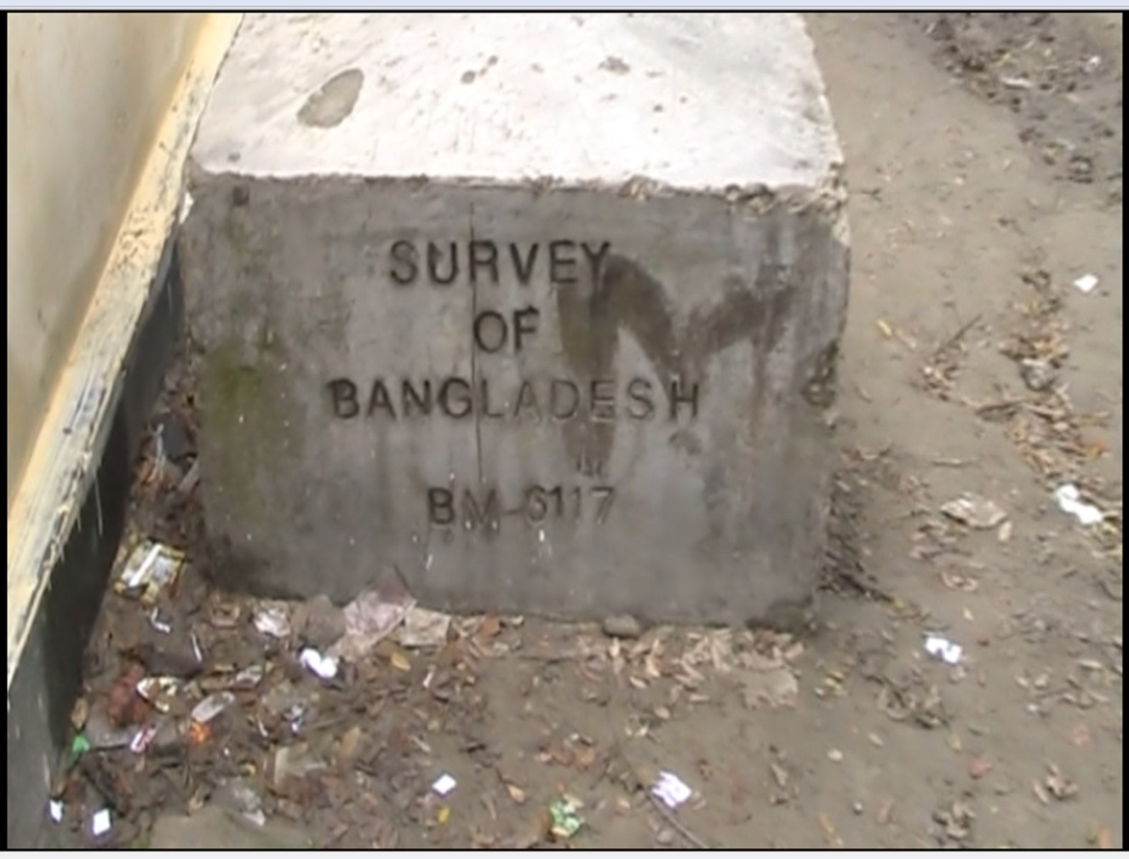
Geo-Referencing Point
Survey of Bangladesh
Z velue B M Pillar.
Pillar no- 6117
Location: Samvu gonj U C high School
Sadar upzila,
Mymanshing.

Slide 9
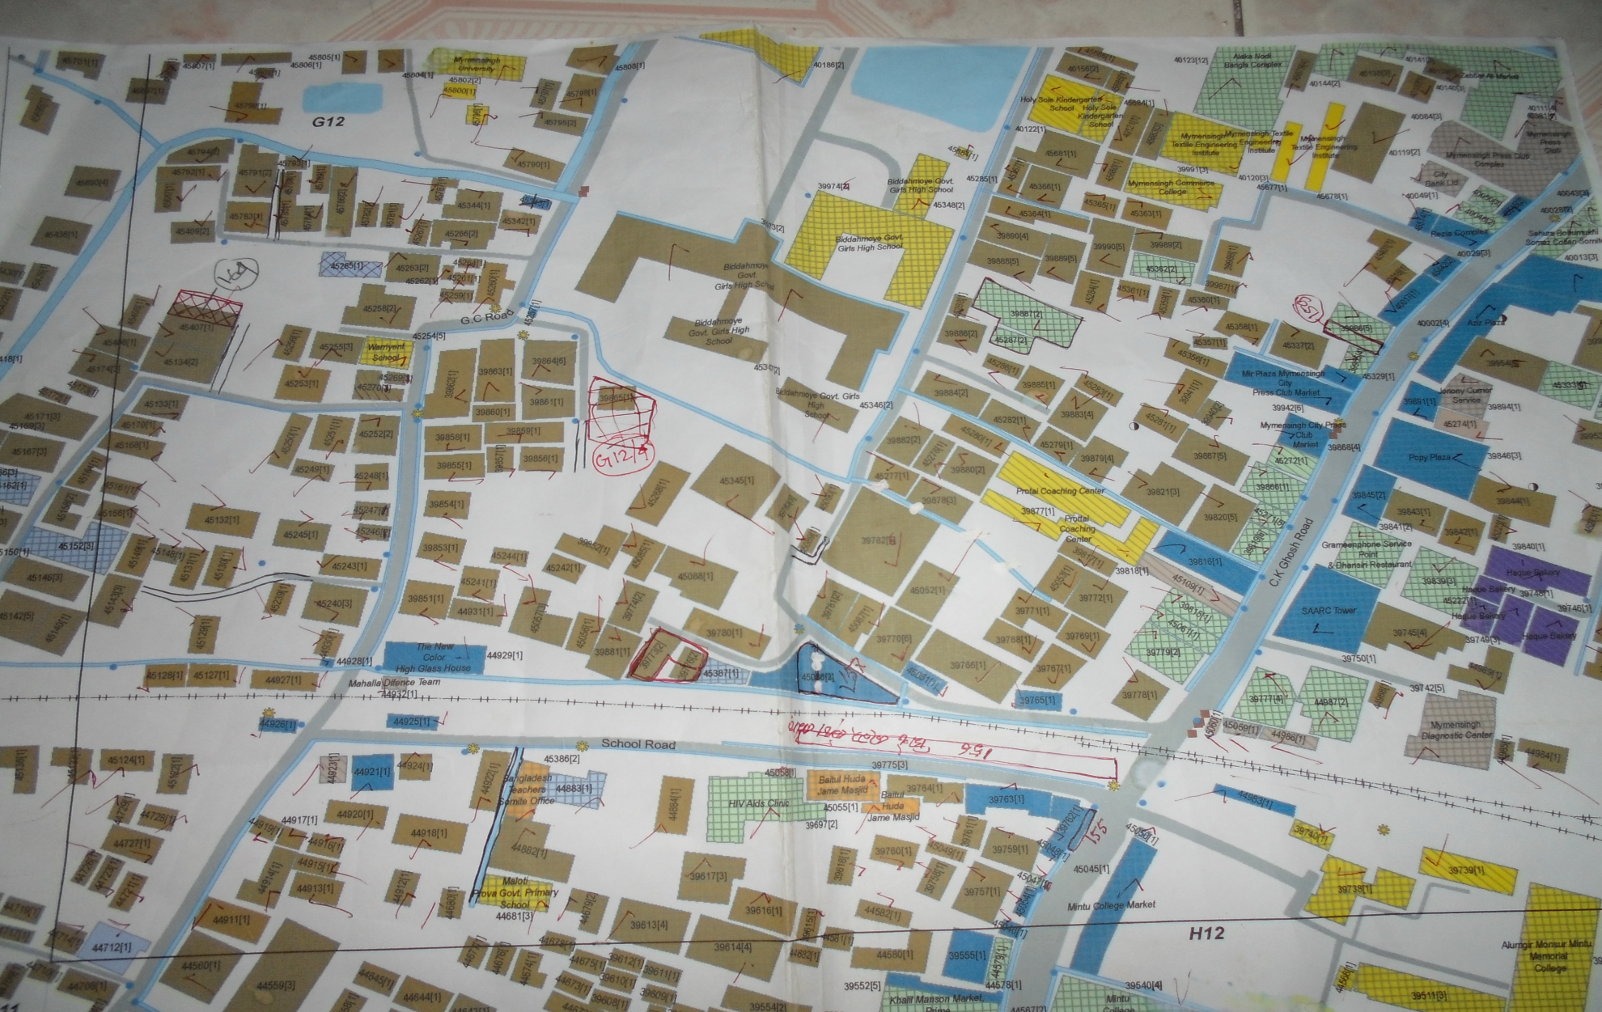
UDD Personal Staff Map caking

Slide 10
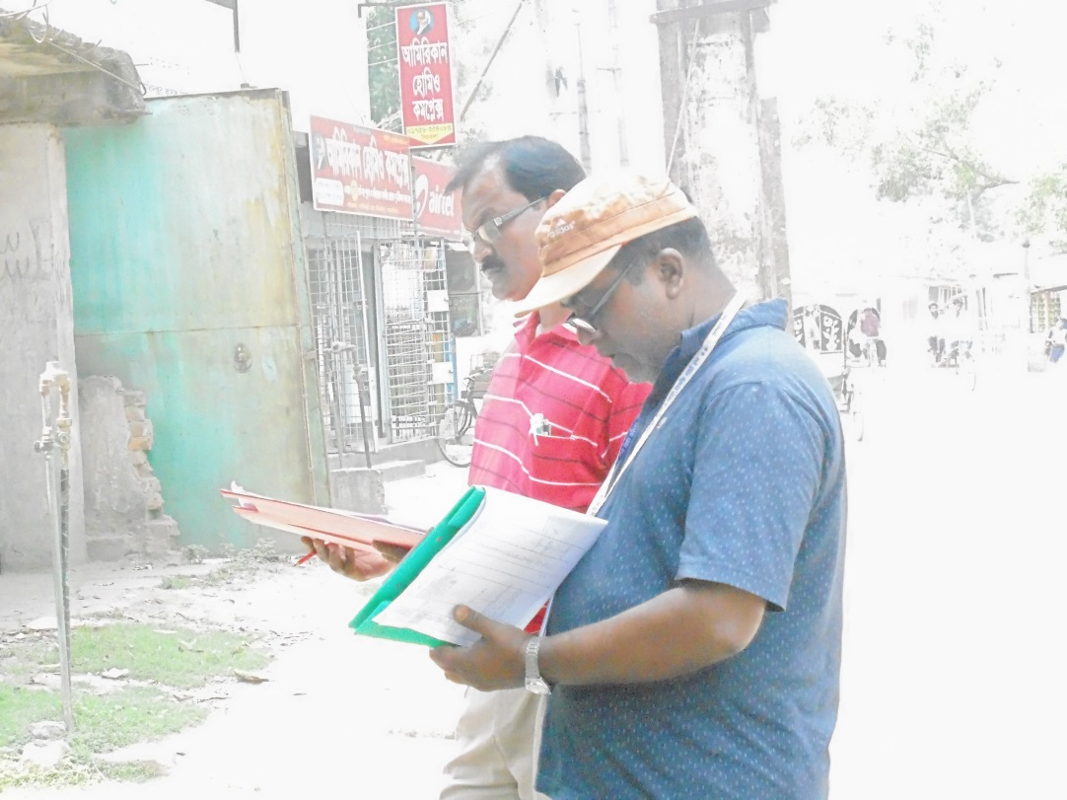
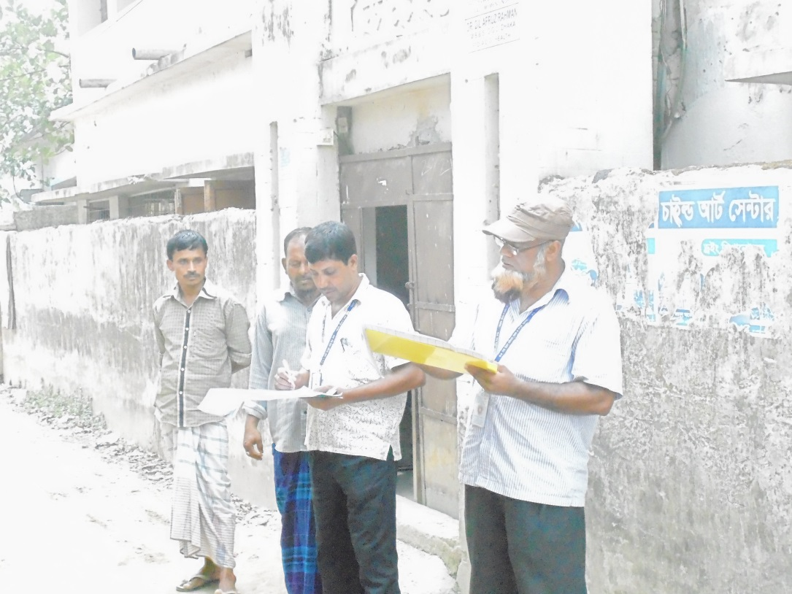
UDD Personal Staff Field Map Chacking
Group-A
Group-B

Slide 11
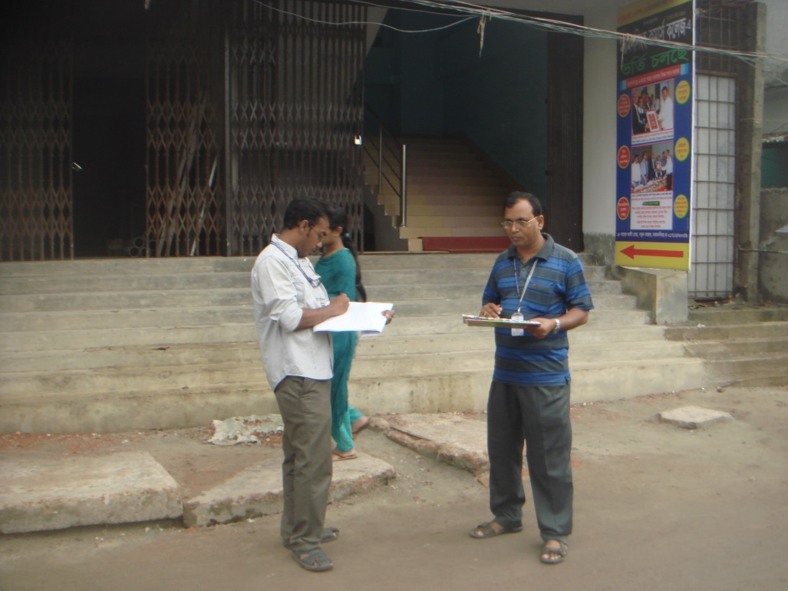
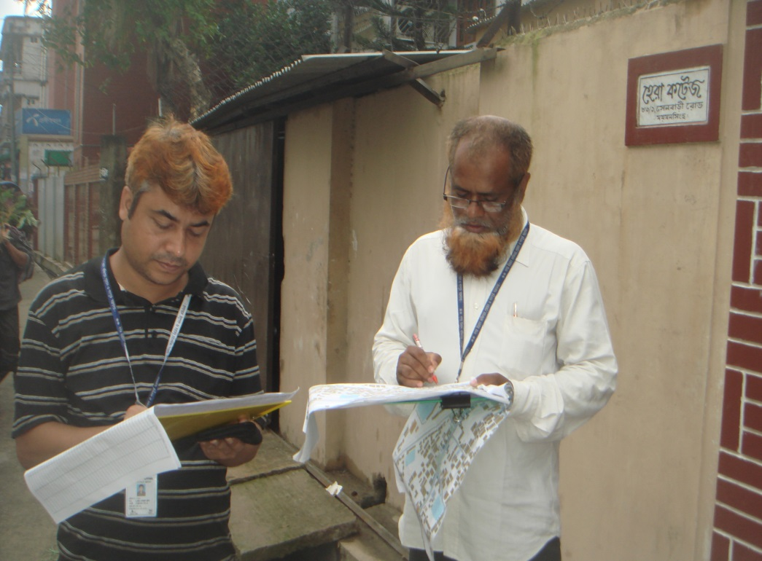
UDD Personal Staff Field Map Chacking
Group-C
Group-D

Slide 12
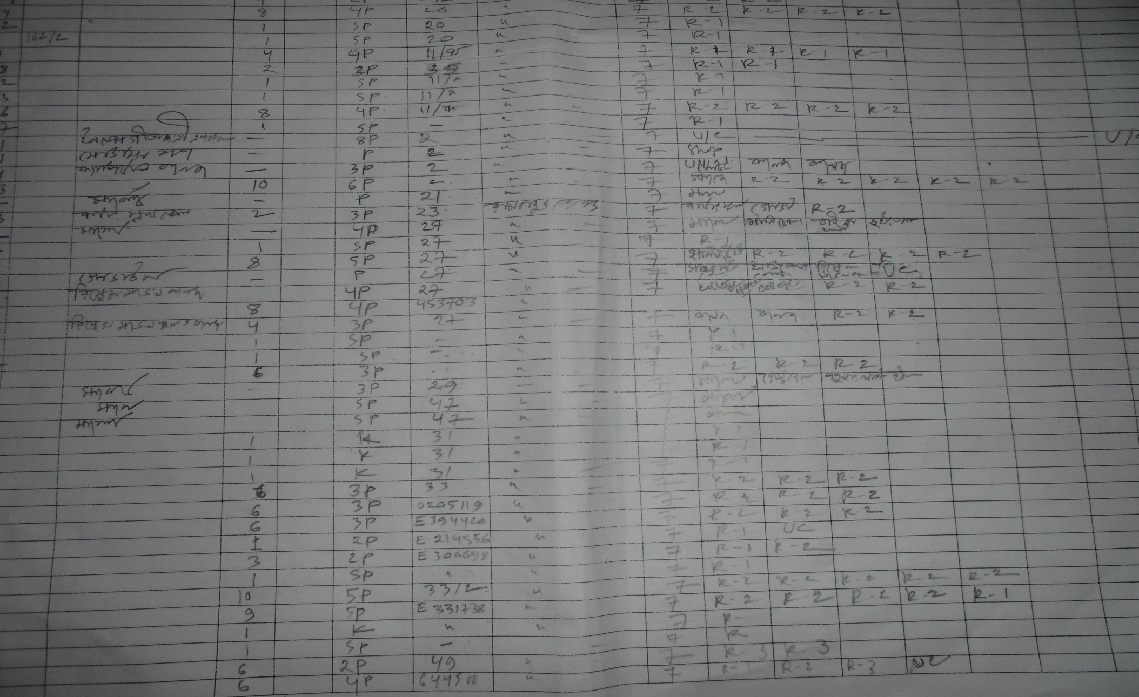
UDD Personal Staff Field Map caking & Data Entry

Slide 13
Filed Data entry
ADPC_ID | UDD_ID | NAME | Construction_Year | H.H | Floor_Hight | STRUCTYPE | Holding_No | Para__Moholla | Ward no | G_Floor | 1st_F_Use | 2nd_F_Use | 3rd_F_Use | 4th_F_Use | 5th_F_Use | 6_th_F_Use | 7th_F_Use | 8th_FtoUp_
30783 |  | Halim Loz |  | 1 | 1 | Semi Pucca | 116/ka Bagmara Road | Bagmara | 17 | Residence
30782 |  | Halim Loz |  | 1 | 1 | Pucca | 116/ka Bagmara Road | Bagmara | 17 | Residence
30777 |  | Sapil, Abdus Salam |  | 7 | 3 | Pucca | 44/8, Bagmara Road | Bagmara | 17 | Residence | Residence | Residence | Residence
30802 |  | MD. Moklesur Rahman |  |  | 1 | Semi Pucca | 116/B, Bagmara Road | Bagmara | 17 | Residence
30786 |  | Abdul Mazid |  |  | 1 | Semi Pucca | 116/B, Bagmara Road | Bagmara | 17 | Residence
30784 |  | Abdur Rajjak |  | 2 | 1 | Pucca | 116/B, Bagmara Road | Bagmara | 17 | Residence

Slide 14
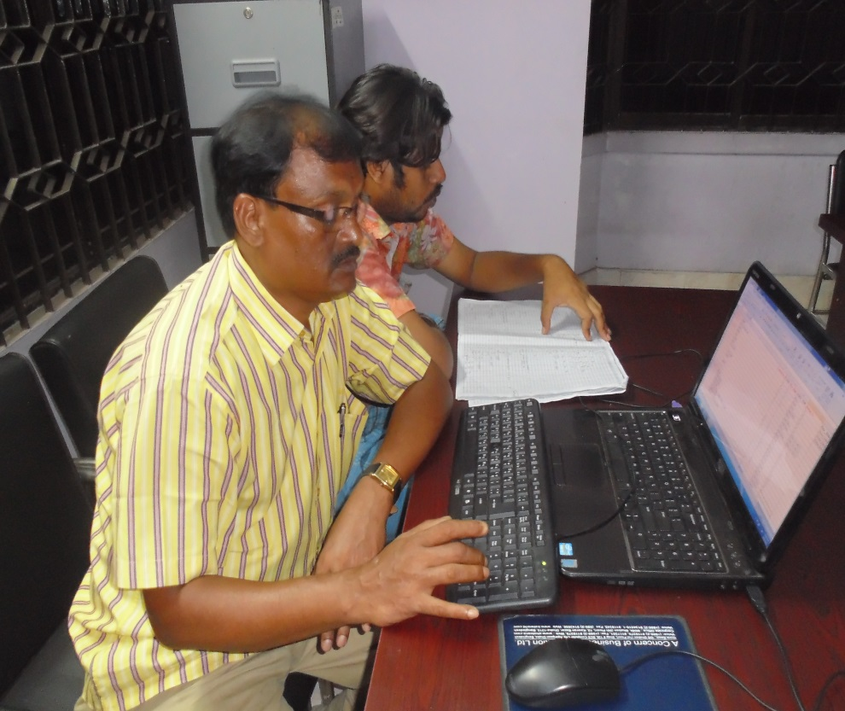
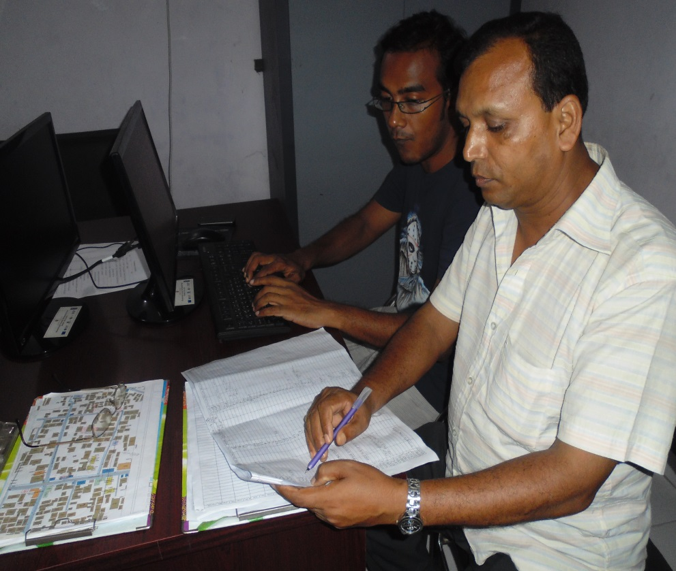
UDD Personal Staff Computer Data Entry
Computer Data entry
Computer Data entry

Slide 15
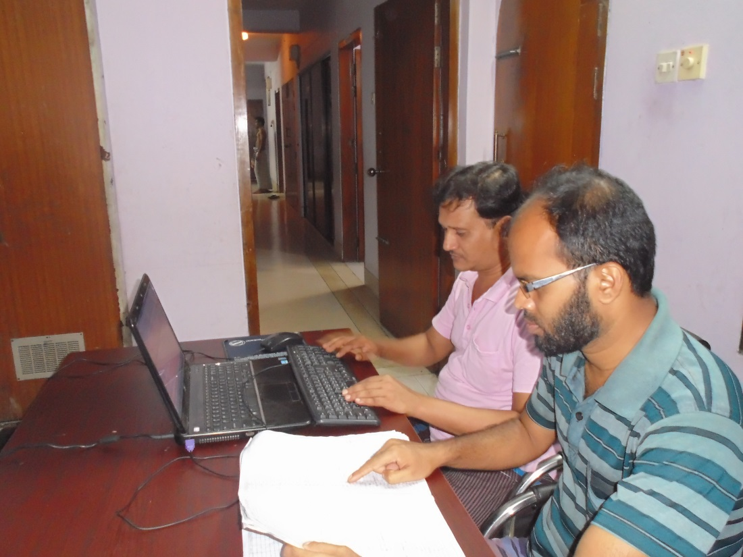
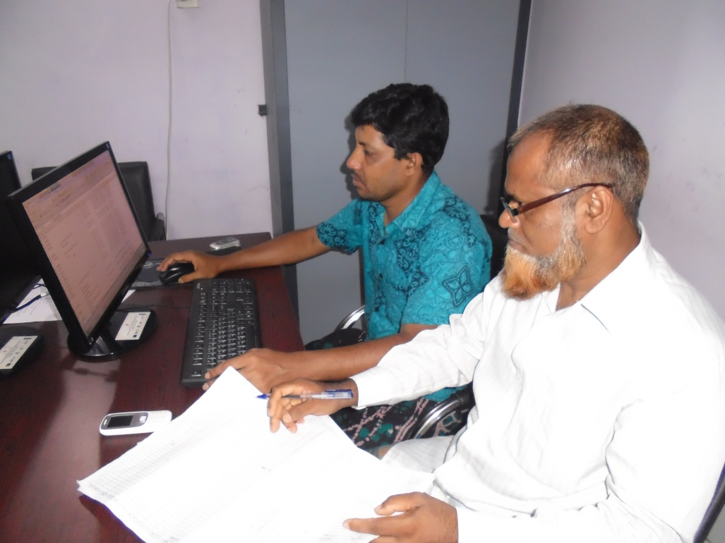
UDD Personal Staff Computer Data Entry

Slide 16
Steps of Work
Step – 1 : Mouza Map Collection & Scanning
Step – 2 : Mouza Map Georefferncing
Step – 3 : Mouza map Digitizing
Step – 4 : Base Map Preparation
Step -5 : Draft Print Received
Step -6 : Mouza Map Check (Light Table)
Step -7 : Georefferncing Check
Step -8 : Finalization of Mouza/ Base Map Preparation

Slide 17
Step – 2 : Mouza Map Georefferncing
Mouza Maps are geo-referenced by some Sequential Steps. These are :
Selection/Identification of GCP Location
Collection of Coordinates of GCP by GPS Survey
Updating Raster Image by GCP value to real world Coordinate

Slide 18
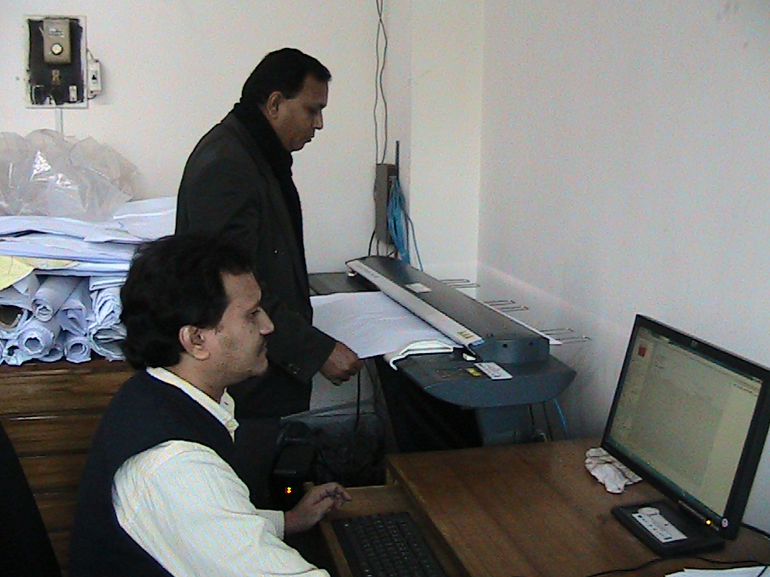
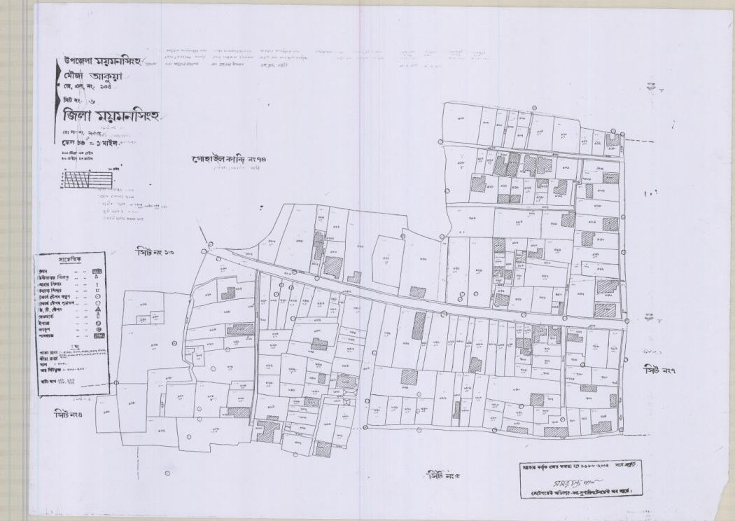
Step – 1 : Mouza Map Collection & Scanning
The mouza maps have been collected and Scanned with five Hundred pixel per inch
Map Scanning with Drum Scanner
Copy of Scanned Map

Slide 19
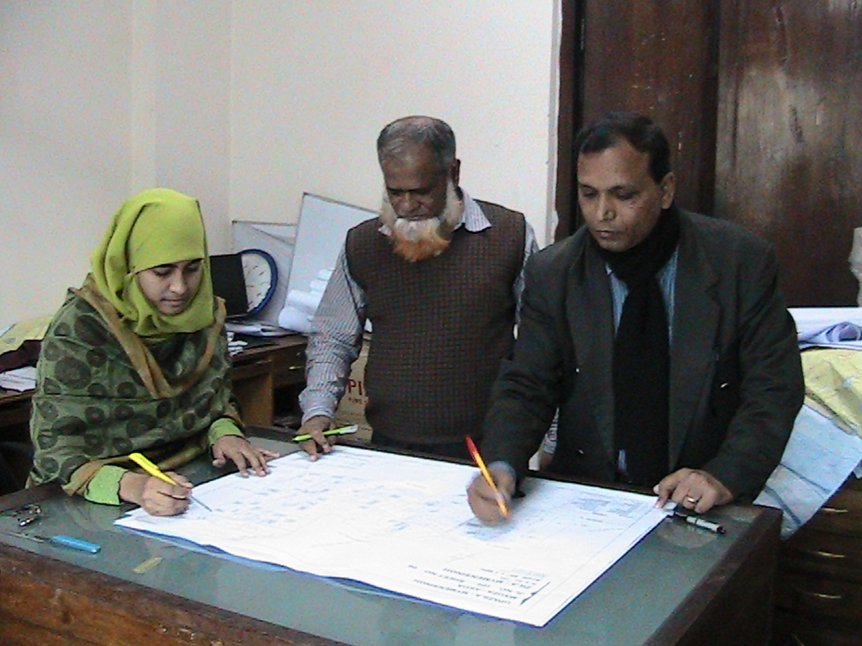
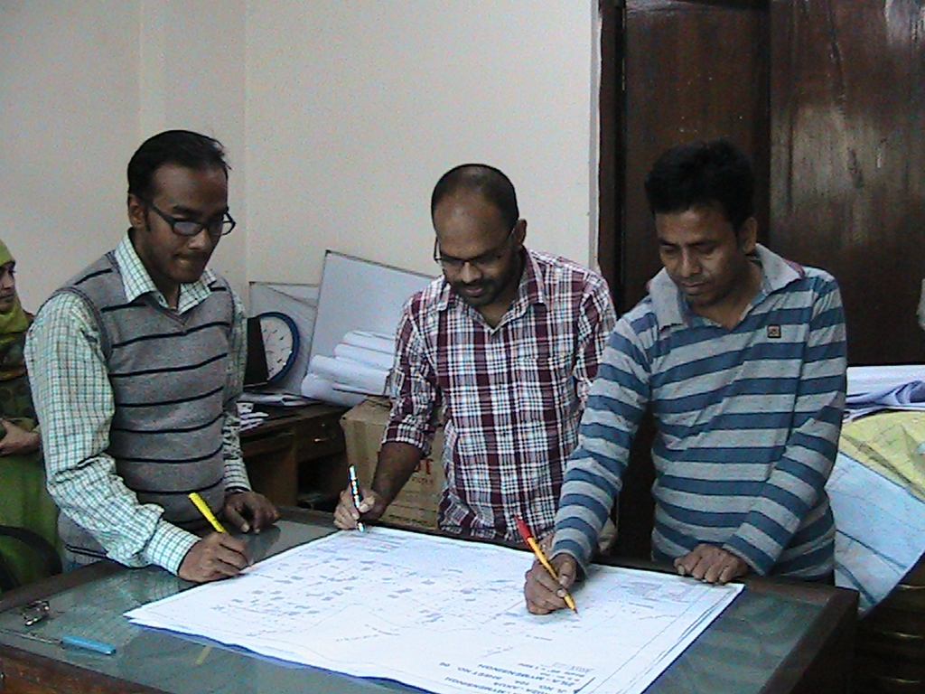
Step- 6 Mouza Map Check
Mouza Sheet Check on Light Table By MSDP Team UDD

Slide 20
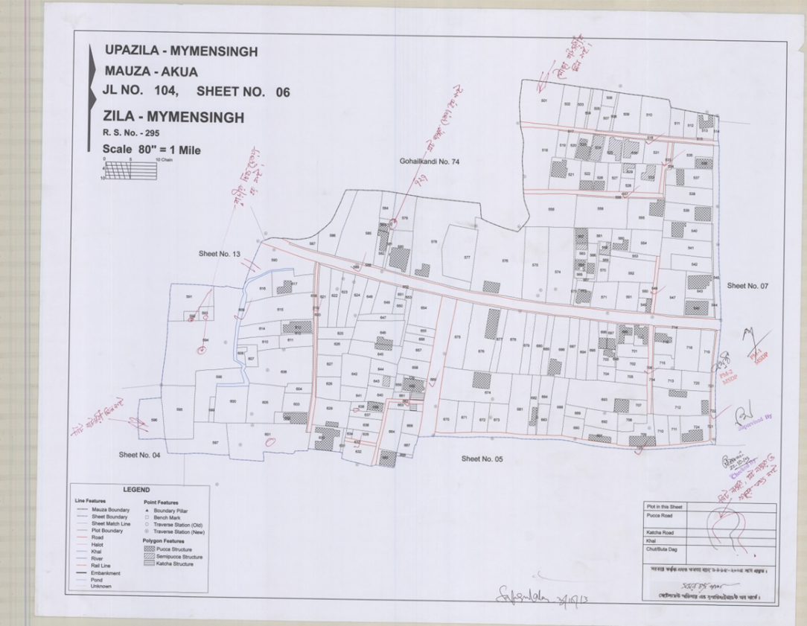
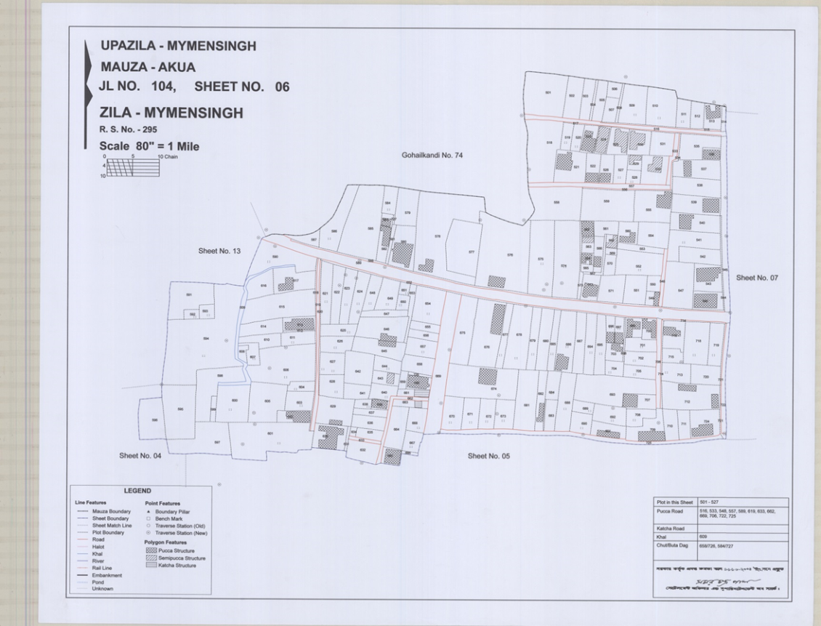
Image of Checked Mouza Sheet
Image of Corrected Mouza Sheet

Slide 21
Summery List of Referenced Mauza and Sheet for MSDP Area
Union/Municipality | Mauza | JL | Sheet
Mymensingh Municipality | 15 | 15 | 102
Akua | 2 | 2 | 30
Baera | 1 | 1 | 1
Bhabkhali | 4 | 4 | 6
Bhangnamari | 1 | 4 | 4
Char Ishwardia | 3 | 3 | 5
Char Nilakshmia | 4 | 4 | 7
Dapunia | 3 | 3 | 4
Ghagra | 1 | 1 | 1
Khagdahar | 2 | 2 | 4
Sirta | 2 | 2 | 3
Total | 38 | 41 | 167

Slide 22
Referenced Mauza of MSDP From GCP
Source : GIS Database

Slide 23
Referenced Mauza of MSDP From 3D Image
Source : GIS Database

Slide 24
Red Colour is Marked as Referenced Mauza From GCP
Blue Colour is Marked as Referenced Mauza From Image
Sirta Union
Khagdahar Union
Char Ishwardia Union
Char Nilakshmia Union
Akua Union
Mymensingh Paurashava
Dapunia Union
Baera Bhaluka
Ghaagra Union
Bhangnamari Union
Bhabkhali Union
Source : GIS Database

Slide 25
After Georeferencing Some Gap Between Mauza Sheets has been Identified
Black Marks Identifies the Gap/Blank Area in Mauzas
Source : GIS Database

Slide 26
Summary
District | 01. Mymensingh
Upzila | 02. Mymensingh Sadar(9 Union) & Gouripur (1 Union)
Union | 10 Nos.
Mouza -RS | 116 Nos.
Mouza Sheet (Supplied by UDD) | 417 Nos.
Out of Project Area | 58 Nos.
New Collected Mouza Sheet (GEOMARK ) | 131 Nos.
Total Mouza Sheet | 554 (548+6) Nos.

Slide 27
Thank you

